Slide 1
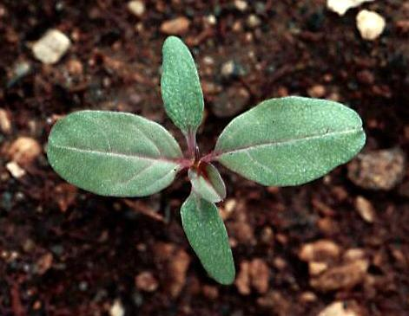
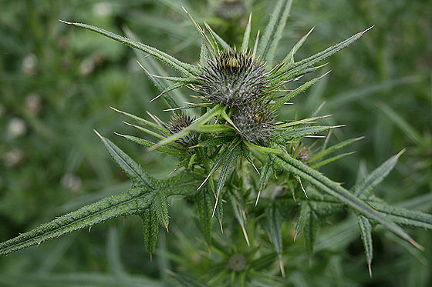
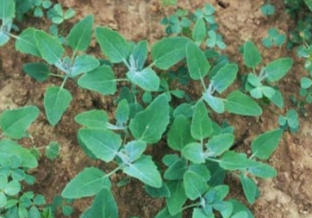
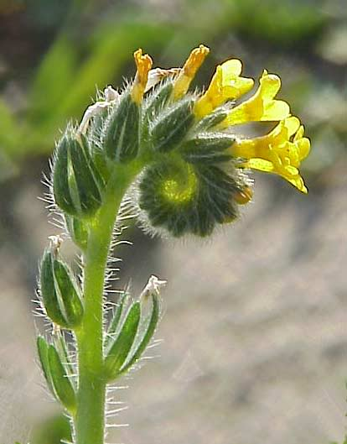
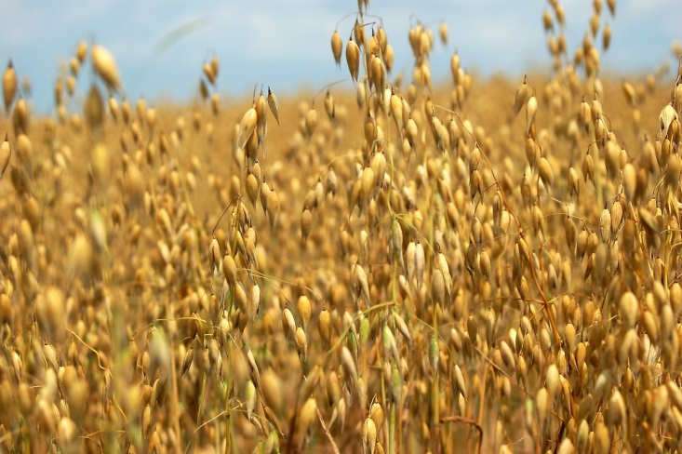
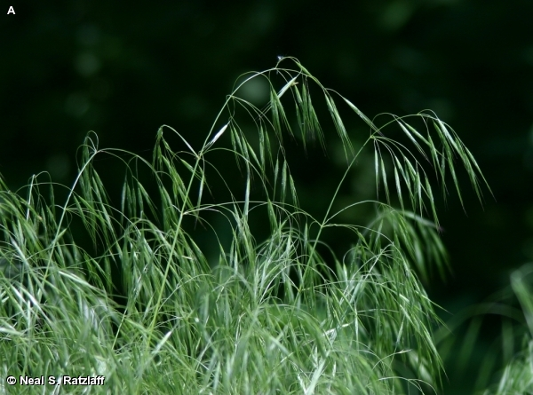
Working with Weeds: Identification and Preservation

Slide 2
Standards
Double click image to open MS Word DOC

Slide 3
Terms
Weed--Any plant that interferes with human affairs
Noxious weed--Any plant which is determined by a state agency to be injurious to public health, crops, livestock, land or other property
Shrub--A woody perennial plant smaller than a tree and usually with several basal stems
Herb--A plant with no persistent woody stem above ground
Vine--A plant that climbs on some support, the stem cannot stand upright by itself
Tree--A perennial woody plant of considerable stature at maturity with a main trunk
Rosette--A dense, basal cluster of leaves arranged in a circular fashion like the leaves of the common dandelion
Prostrate--Lying flat on the ground
Evergreen--Bearing green leaves throughout the year
Deciduous--Plants that shed their leaves annually
Alternate--Not opposite, one leaf at a node

Slide 4
Opposite--Leaves two at a node and situated across the stem from each other
Simple leaf--Of only one part; leaf not completely divided into separate segments
Compound leaf--A leaf completely separated into two or more leaflets
Midrib--The main or central rib of a leaf
Vein--Threads of vascular tissue in a leaf
Blade--The expanded, usually flat portion of a leaf or petal
Petiole--The stalk of a leaf blade or compound leaf
Pinnate--Compound leaf with the leaflets on opposite sides
Internode--The part of a stem between two nodes
Node--The place on a stem where one or more leaves are attached

Slide 5
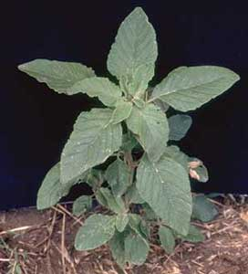
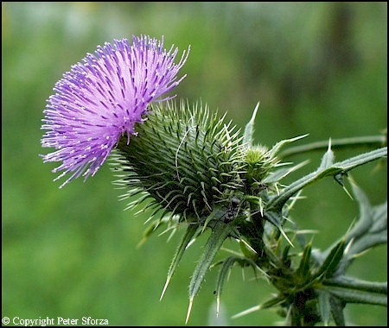
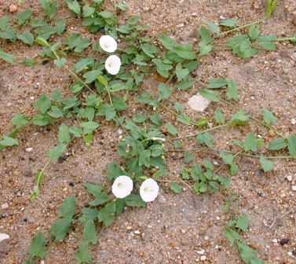
Growth Forms and Habits
Annual – completes its life cycle in one year or less
Biennial – takes 2 years to reach maturity, normally spending first year as a rosette
Perennial – lasts for multiple years, generally growing back from root stock

Slide 6
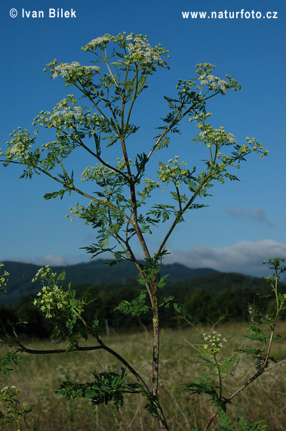
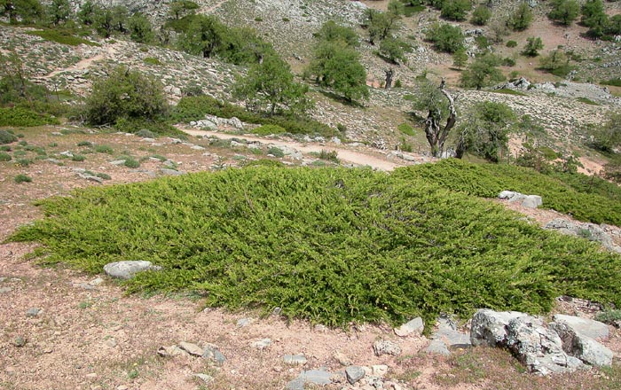
Growth Forms and Habits
Prostrate – growing low to the ground, often creeping
Erect – grows upright in form

Slide 7
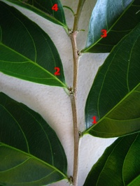
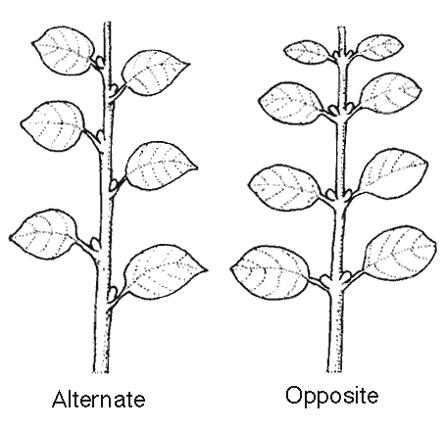
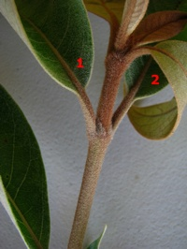
Leaf Arrangement
Alternate – leaves alternate position along the stem from one node to the next.
Opposite – leaf pairs are directly opposed to each other on the same node

Slide 8
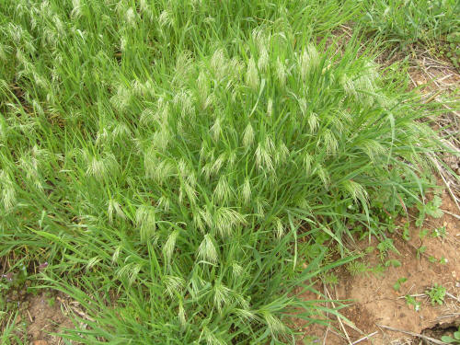
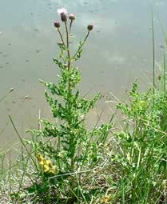
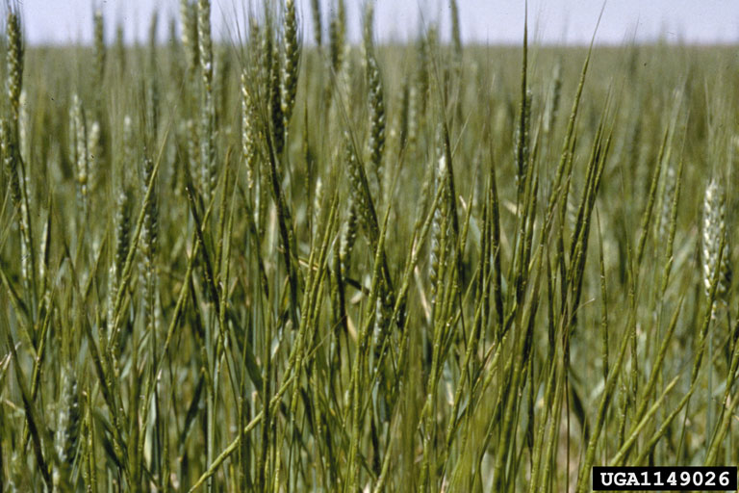
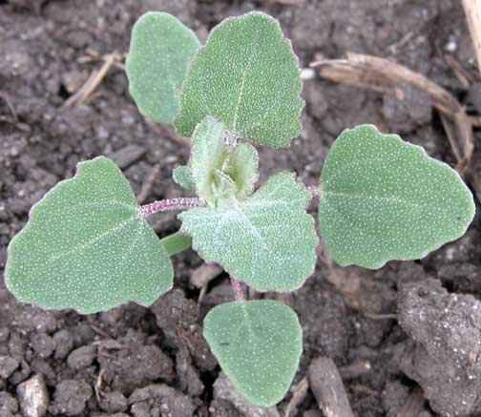
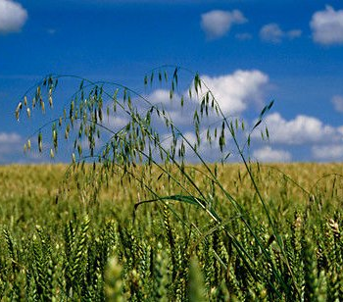
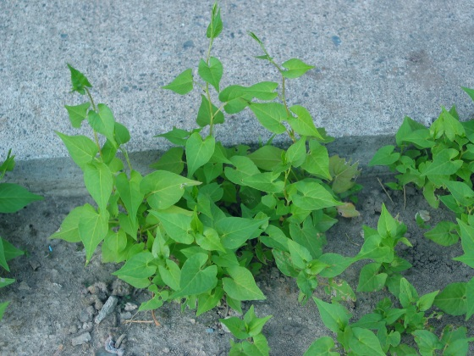
Grasses
Grass-selective
herbicides:
-- Axial
-- Huskie
-- Achieve
Broadleaves
Broadleaf-selective
herbicides:
-- 2,4-D
-- Aim
-- Stinger

Slide 9
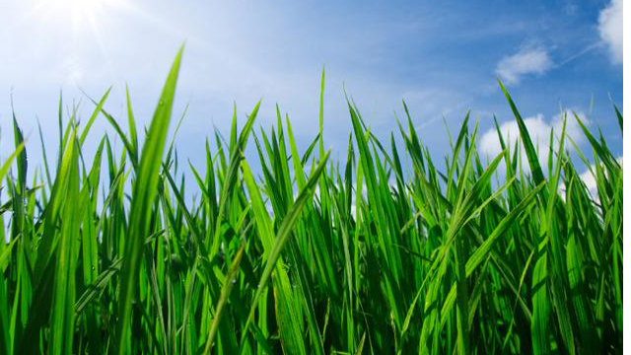
What is a ‘grass’?
The flowers lack petals
The leaves are flat, long, and slender and form a sheath around the stem
The stems are round and somewhat swollen at the nodes
The combination of these three characteristics make it a grass

Slide 10
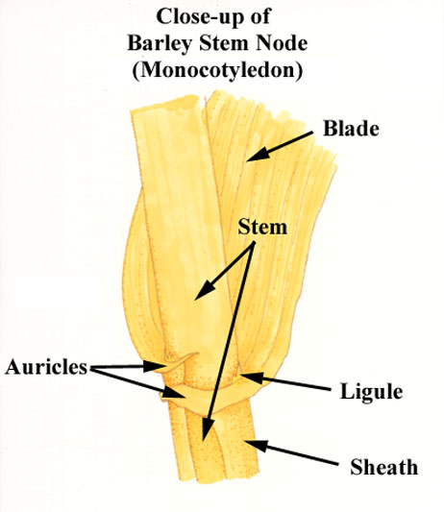
Grass Anatomy
Sheath - lower part of the leaf that encloses the internode
Ligule - outgrowth at the inner junction of the leaf sheath and blade, often membranous, sometimes a fringe of hairs
Auricle - claw appendages at the base of the blade of some grasses
Collar - a thin band of meristematic tissue at the junction of the leaf blade and the sheath
Blade - part of the leaf above the collar
Collar

Slide 11
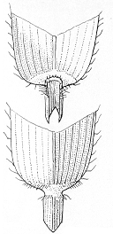



Grass Blade
The “leaves” of a grass
Boat-shaped tip
Rounded leaf tip
Pubescent
along edge
Pointed leaf tip

Slide 12
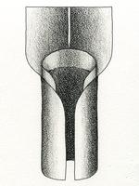
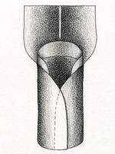
Sheath
The tubular portion of the leaf which wraps around or encloses the stem
split
overlap
compressed

Slide 13
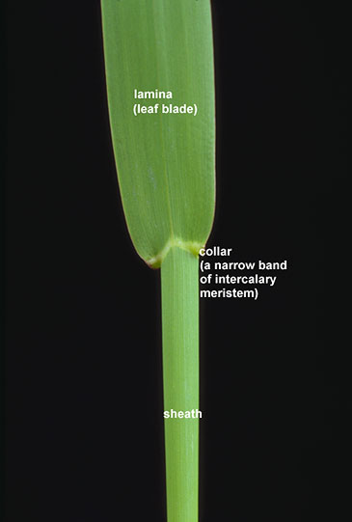
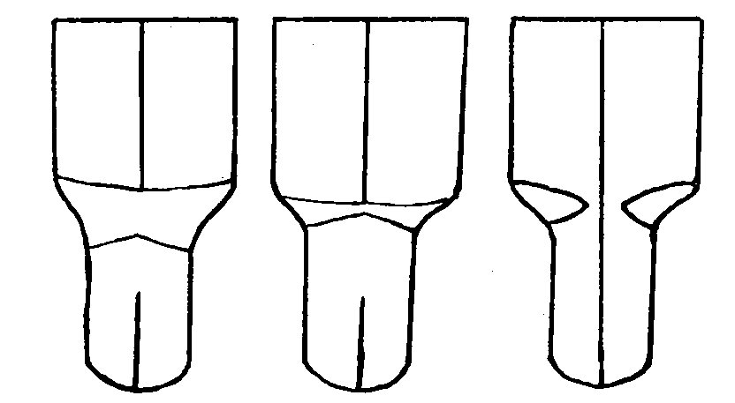
Collar
The area on the outer side of the leaf where the blade and sheath join
wide/broad
narrow
divided

Slide 14
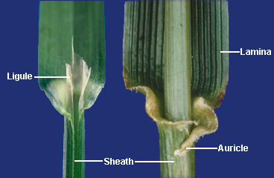
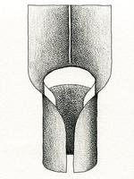
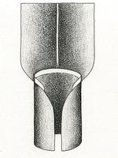
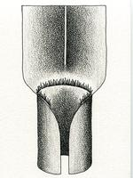
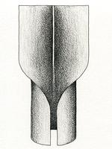
Ligule
Appendage at the junction of sheath & blade
membranous
long
membranous
short
fringe of hair
absent

Slide 15
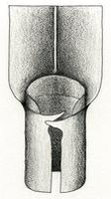
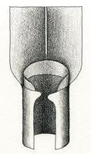
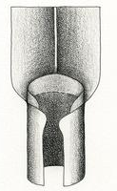
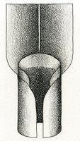
Auricles
Appendages that project from either side of the collar
Long (claw-like)
Rounded
Under-developed
absent

Slide 16
Leaf Parts
Petiole – connects the leaf blade to the stem node – leaf stem; when absent plant is referred to as sessile
Blade – or lamina, surface area of leaf
Mid-vein – central rib, generally continues from petiole to leaf tip
Stipules – paired, often leaf-like structures attached at the base of the petiole
Margin – edge of leaf – come in many textures
Notes:
Drawing by Anne Bebbington, used under Creative Commons. https://creativecommons.org/licenses/by-nc-sa/2.0/

Slide 17
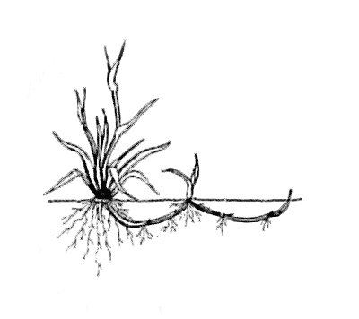
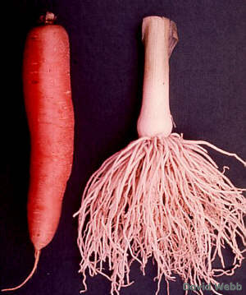
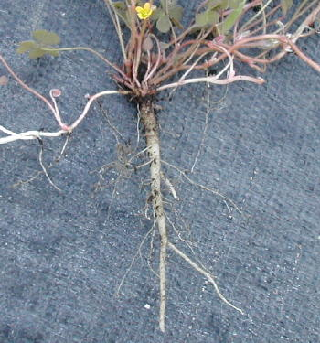
Root Structure
Creeping roots – large amounts of lateral growth, often for propagation; possibly through a rhizome.
Fibrous roots –primary root is not dominant; the whole root system branches in all directions
Tap root - primary root is prominent and has a single, dominant axis; there are fibrous secondary roots running outward. Usually allows for deeper roots capable of reaching low water tables
vs
Black medic taproot

Slide 18
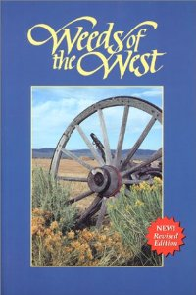

Steps for ID
Determine if grass or broadleaf
Identify characteristics—leaf pattern, shape, ligule and inflorescence if grass, etc.
Is it flowering? What color, how many petals?
Consult ID book, extension publication, or use an online key.
Notes:
Weeds of the West: https://pubs.wsu.edu/ItemDetail.aspx?ProductID=15133&ReturnTo=3
FREE & Low-cost Extension Publications about Weeds: https://pubs.wsu.edu/ListItems.aspx?CategoryID=142

Slide 19
Crop Pests—Weeds
Common Weeds to know in the PNW
Notes:
Original descriptions found in: WEED AND CROP PLANTS COMMON TO IDAHO
By Perry Robinson, Vocational Agriculture Instructor Rexburg, Idaho (1980’s)

Slide 20
Terms
Weed--Any plant that interferes with human affairs
Noxious weed--Any plant which is determined by a state agency to be injurious to public health, crops, livestock, land or other property
Shrub--A woody perennial plant smaller than a tree and usually with several basal stems
Herb--A plant with no persistent woody stem above ground
Vine--A plant that climbs on some support, the stem cannot stand upright by itself
Tree--A perennial woody plant of considerable stature at maturity with a main trunk
Rosette--A dense, basal cluster of leaves arranged in a circular fashion like the leaves of the common dandelion
Prostrate--Lying flat on the ground
Evergreen--Bearing green leaves throughout the year
Deciduous--Plants that shed their leaves annually
Notes:
Vocabulary and anatomy overheads taken from Idaho Ag 150-J Curriculum Guide: http://www.uidaho.edu/~/media/Files/orgs/CALS/Department/AEE/Curriculum/Curriculum%20guides/100%20level/Ag%20150%20Contents/Ag%20150-J.ashx

Slide 21
Terms
Alternate--Not opposite, one leaf at a node
Opposite--Leaves two at a node and situated across the stem from each other
Simple leaf--Of only one part; leaf not completely divided into separate segments
Compound leaf--A leaf completely separated into two or more leaflets
Midrib--The main or central rib of a leaf
Vein--Threads of vascular tissue in a leaf
Blade--The expanded, usually flat portion of a leaf or petal
Petiole--The stalk of a leaf blade or compound leaf
Pinnate--Compound leaf with the leaflets on opposite sides
Internode--The part of a stem between two nodes
Node--The place on a stem where one or more leaves are attached
Notes:
Vocabulary and anatomy overheads taken from Idaho Ag 150-J Curriculum Guide: http://www.uidaho.edu/~/media/Files/orgs/CALS/Department/AEE/Curriculum/Curriculum%20guides/100%20level/Ag%20150%20Contents/Ag%20150-J.ashx

Slide 22
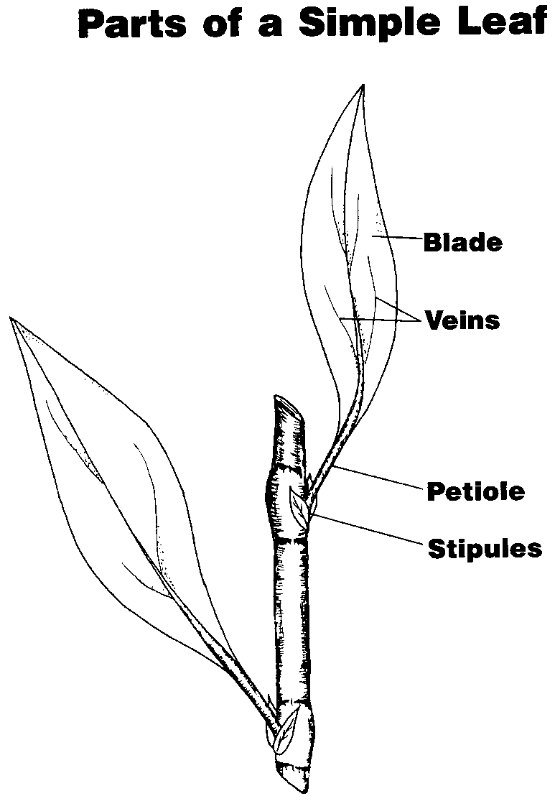
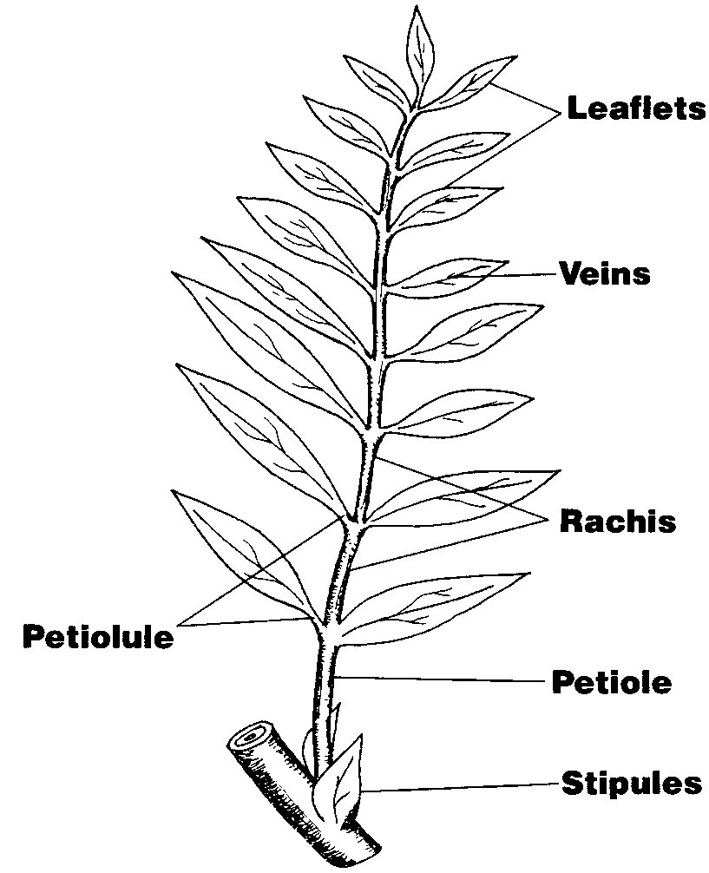
Plant Anatomy
Simple Leaves
Compound Leaves

Slide 23
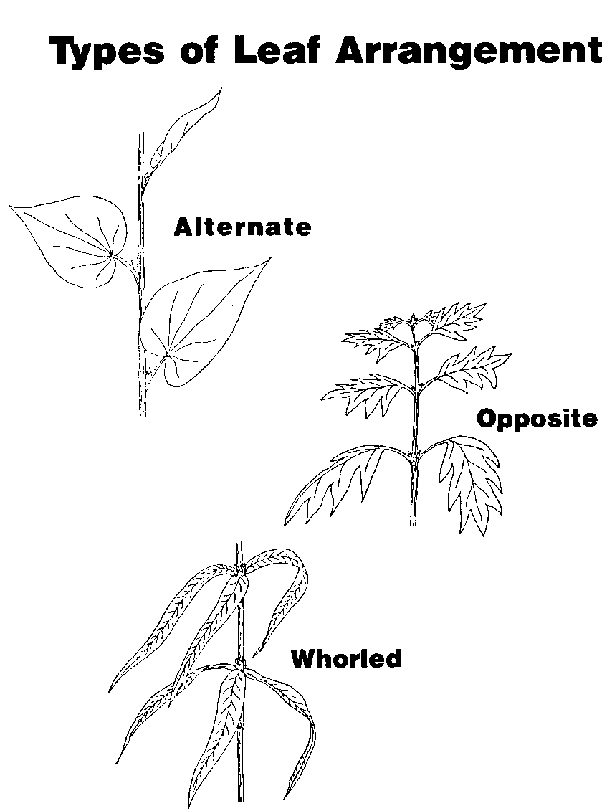
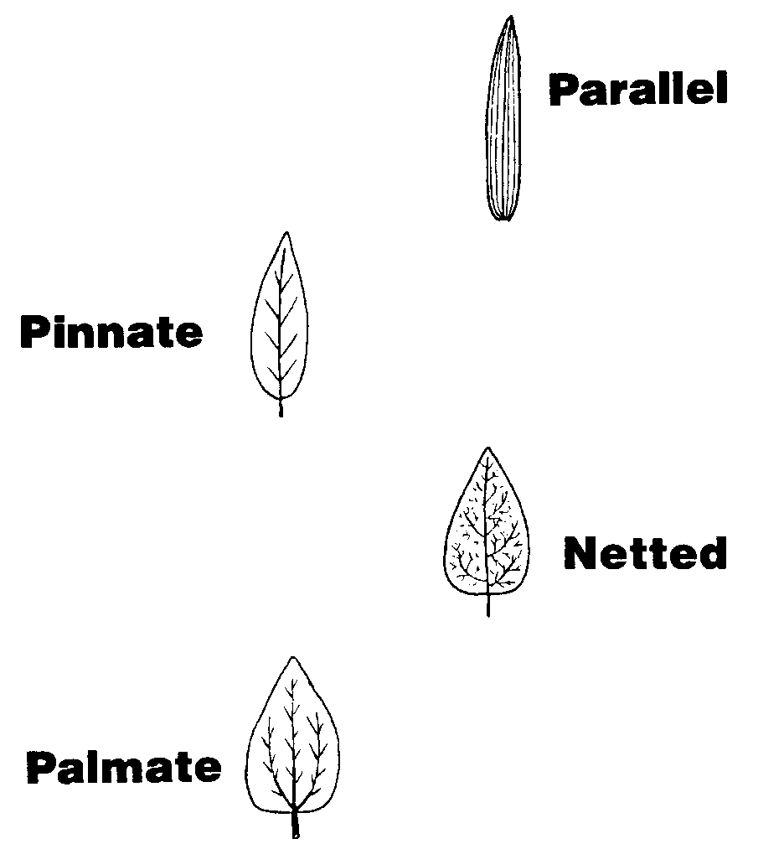
Plant Anatomy cont.
Leaf Arrangement
Leaf Veination

Slide 24
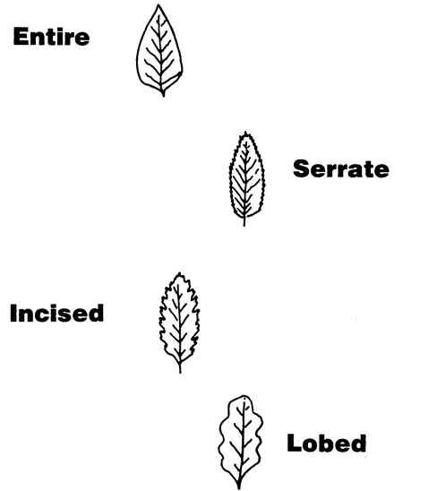
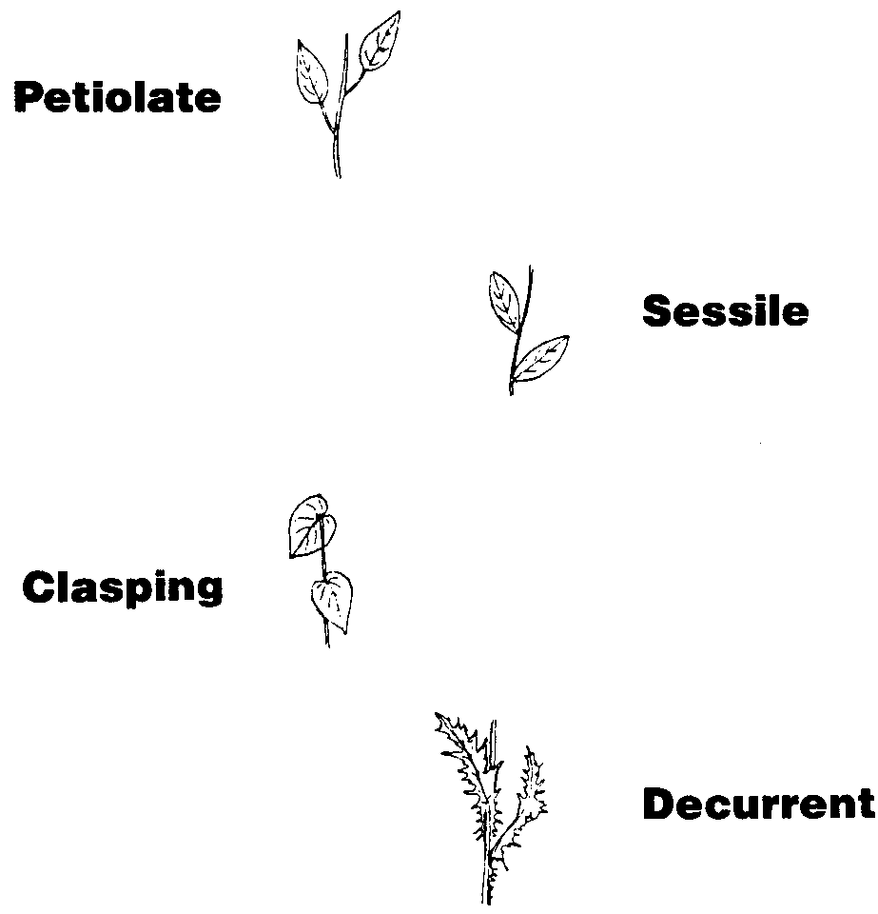
Plant Anatomy cont.
Leaf Margins
Leaf Attachment

Slide 25
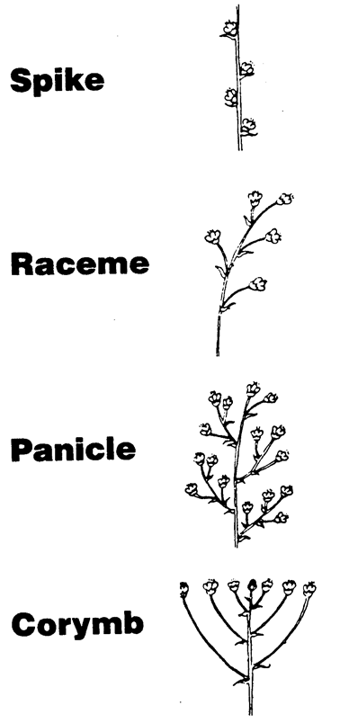
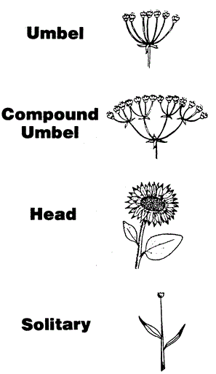
Types of Inflorescence

Slide 26
Tips for Collecting and Mounting Plants
Avoid wet plants, dry plants are ready sooner
Spread leaves and flowers to get better samples
Face all identifiable parts the same direction
  You only see one side once you mount them
Use more paper on wetter samples
Plants which drop leaves as they dry may keep them if they are microwaved to dry
  Don’t put metal in a microwave
  Don’t use printed newspaper in microwave (it may catch fire)

Slide 27
Activities
Plant collecting
  http://herbarium.usu.edu/k-12/collecting/default.htm
Creating a class identification key
Creating plant anatomy posters

Slide 28
Activities:
Double Click image to open MS Word Document

Slide 29
Identification Slides
The following slides are intended as a starter set for your region. The weeds included grow across the Pacific Northwest and students should have little problems locating and pressing the plants that follow.
Should you decide to expand your identification set, or wish to create a local ID reference text, High Quality versions of the images to follow are available through the Consortium of Pacific Northwest Herbaria website:
www.pnwherbaria.org
This site hosts thousands of images from herbaria across the region.

Slide 30
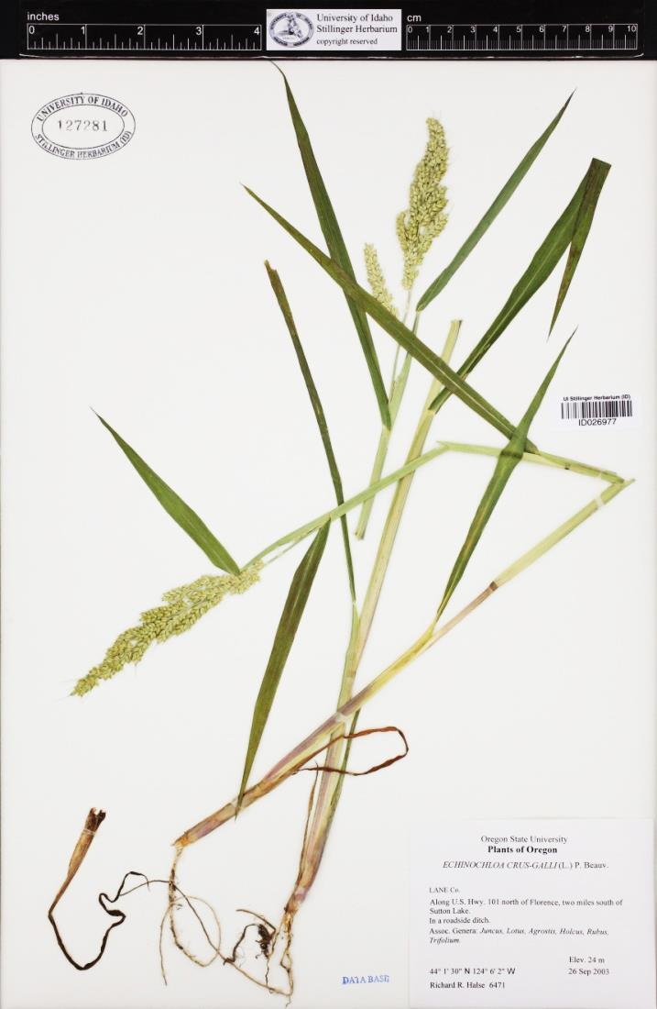
Weeds of the PNW—
Barnyardgrass
Echinochloa crus-galli
Taxonomic Identifiers
(Graminae Echinochloa crusgalli) -annual warm season grass reproducing by seed.
Root: fibrous.
Stems: coarse, simple or branching at the base and ascending above. Stem may lay flat on ground with seed heed ascending. One to two feet tall is the norm, but under ideal conditions, five to six feet.
Leaves: alternate, smooth on the sheath and blade, do not have auricles or legules, and are wide and soft.
Flower: is a panicle, dark green or violet tinged in color. The seed head bear slender bristles or awns coming out of each seed case.
Found: cultivated fields, pastures, gardens, and moist fertile locations.
Notes:
Herbarium specimen data provided by: Oregon State University Herbarium, University of Idaho Stillinger Herbarium, University of Washington Herbarium (Accessed through the Consortium of Pacific Northwest Herbaria web site, www.pnwherbaria.org, 2011-08-27)

Slide 31
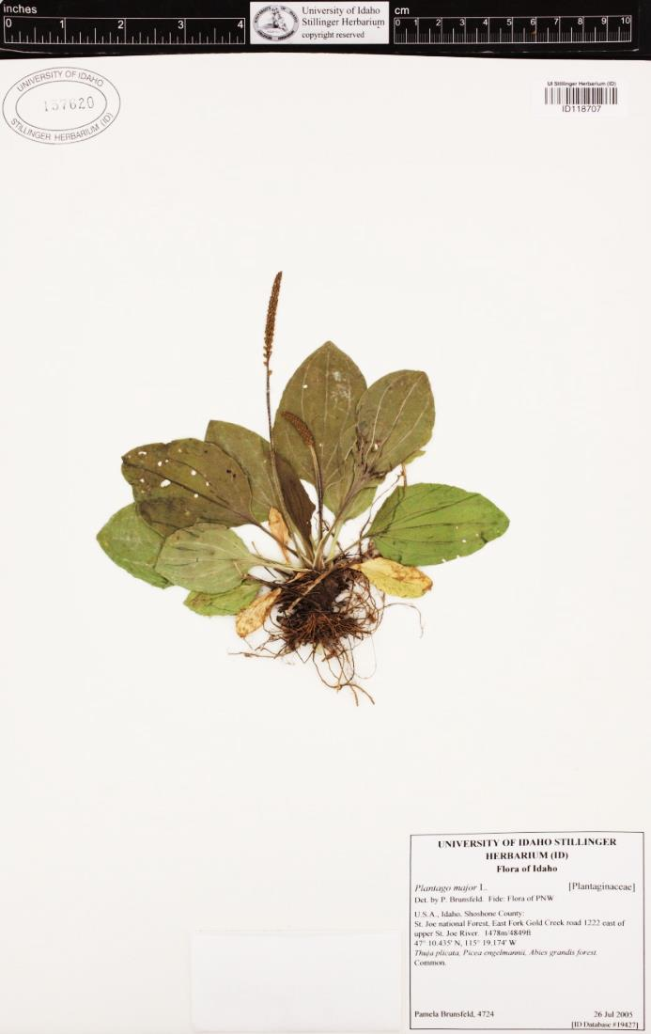
Weeds of the PNW—
Broadleaf Plantain
Plantago major
Taxonomic Identifiers
Perennial herb, sometimes annual, reproducing by seeds.
Root: fibrous, white, some-what fleshy, shallow and dense.
Leaves: form a basal rosette, ascending or occasionally nearly erect. Blades are egg shaped, long petioled, and strongly ribbed with 5 to 7 longitudinal veins. They are smooth, wavy edged, up to one foot long and four to five inches wide (most are smaller than this) and have a purplish color at the base of the petioles.
Flowers: spike, long slender flower stalk with dense alternate flowers, 7 to 16 inches in height. Seed pods form along stalk, which is nearly round. Each capsule contains four to ten seeds.
Found: lawns, gardens, and waste places.
Notes:
Herbarium specimen data provided by: Oregon State University Herbarium, University of Idaho Stillinger Herbarium, University of Washington Herbarium (Accessed through the Consortium of Pacific Northwest Herbaria web site, www.pnwherbaria.org, 2011-08-27)

Slide 32

Weeds of the PNW—
Buckhorn Plantain
Plantago lanceolata
Taxonomic Identifiers
Perennial or biennial, reproducing by seed and shoots from the roots.
Roots: are shallow, tough, slender rootlets.
Stem: are slender, erect, leafless, up to 16 inches tall, with a terminal flower spike.
Leaves: are basal, in a rosette, alternate and simple. They are narrow oblong-lanceolate, tapering to the petioles and have strong longitudinal veins.
Flowers: greenish-white in a short dense spike. The spike at blooming is egg shaped with the anthers forming outer whorl.
Found: in lawns, pastures, and waste lands.
Notes:
Herbarium specimen data provided by: Oregon State University Herbarium, University of Idaho Stillinger Herbarium, University of Washington Herbarium (Accessed through the Consortium of Pacific Northwest Herbaria web site, www.pnwherbaria.org, 2011-08-27)

Slide 33

Weeds of the PNW—
Bull Thistle
Cirsium vulgare
Taxonomic Identifiers
Biennial herb reproducing by seeds.
Root: large fleshy tap root. First year plant grows rosette-type-leaves. Second year: Stems: erect, 3 to 4 feet tall. Stout, often branched, more or less hairy, spiny-winged by the decurrent leaf bases.
Leaves: alternate are coarsely lobed, short and broad. Each triangular lance-shaped lobe has 3 to 4 points which end in a sharp, long stout yellow spine. Numerous short spines are between the point spines. The upper surface of the leaf has short, stiff hairs and spines, and the underneath is covered with woolly gray hairs.
Flowers: oval shaped buds produce small to medium sized purple flowers on ends of the branches. Flower bracts are slightly hairy and tipped v1ith a long sharp spine.
Found: pastures and waste places.
Notes:
Herbarium specimen data provided by: Oregon State University Herbarium, University of Idaho Stillinger Herbarium, University of Washington Herbarium (Accessed through the Consortium of Pacific Northwest Herbaria web site, www.pnwherbaria.org, 2011-08-27)

Slide 34

Weeds of the PNW—
Canada Thistle
Cirsium arvense
Taxonomic Identifiers
Perennial reproducing by seed and horizontal creeping roots. Roots: extensive roots are fleshy and send up frequent new shoots. Stems: erect, hollow, smooth or slightly hairy, up to 4 feet high and branched on top.
Leaves: alternate oblong or lanceolate, usually with crinkled edges and spiny margins, somewhat lobed, hairy beneath at maturity and leaves sessile.
Flowers: head dioecious (male and female flowers on separate plants) numerous, small, compact and vary from light lavender to rose purple (some may be white). Bracts on flower head not spiny.
Found: cultivated fields, meadows, pastures, and waste places.
Notes:
Herbarium specimen data provided by: Oregon State University Herbarium, University of Idaho Stillinger Herbarium, University of Washington Herbarium (Accessed through the Consortium of Pacific Northwest Herbaria web site, www.pnwherbaria.org, 2011-08-27)
http://www.pnwherbaria.org/images/jpeg.php?Image=WWB021331.jpg

Slide 35

Weeds of the PNW—
Cocklebur
Xanthium strumarium
Taxonomic Identifiers
Annual reproducing by seed.
Root: branched taproot. Stem: is erect, branched, ridged, spotted and very rough.
Leaves: are alternate, triangular or heart­ shaped, rough on both sides and long petioled. Leaves light green on underside of leaf and darker green op surface.
Flowers: are small in the axils of the upper leaves. Male and female flowers are separate. Seed pods are formed from 2 flowers. Seed pod is about 1 inch long, woody, have hooked prickles and 2 curved spines at the tip. Each pod contains two seeds.
Found: cultivated land, pastures, and waste areas.

Slide 36

Weeds of the PNW—
Crabgrass
Digitaria spp.
Taxonomic Identifiers
Annual reproducing by seed and stem rooting at the nodes.
Root: fibrous and dense. Stems: prostrate at the base and ascends to a seed head 1 to 3 feet tall. The sheath is hairy, loose, and stem is branched at the lower nodes. Leaves: are rolled in bud, slightly hairy, wide, taper to point.
Flowers: 3 to 9 branched fingers in a whorl near the top of the stem.
Found: in crops and lawns, waste areas, pastures and road­ sides.

Slide 37

Weeds of the PNW—
Curly Dock
Rumex crispus
Taxonomic Identifiers
Perennial reproducing by seed only.
Root: fleshy-tap brached yellowish-orange in color.
Stem: smooth with swollen nodes, erect, and two to four feet tall. One to many branching stems may arise from the crown.
Leaves: dark green, alternate, Smooth, simple, crimped along the edges and petioled. Large basal leaves found near base of stem.
Flowers: whorled clusters, without petals, green in color ind turn dark reddish-brown at maturity (sometimes called Indian tobacco).
Found: in waste areas, meadows, pastures, and lawns.

Slide 38

Weeds of the PNW—
Dodder
Cuscuta spp.
Taxonomic Identifiers
Annual parasitic herb, reproducing by seeds.
Roots: does not produce roots, but sends out suckers (haustria) which attach to the host plant and extract food from it.
Stems: string-like, twining, smooth, and branching to form dense masses. They are usually yellowish or reddish in color.
Leaves: small scales almost too small to see, appear as tiny bracts.
Flowers: small whitish or pale pink clusters borne on leaf axils.
Found: alfalfa or other legume crops.

Slide 39

Weeds of the PNW—
Field Bindweed
Convolvulus arvensis
Taxonomic Identifiers
Perennial, reproducing by seed and underground rhizomes.
Roots: extensive, wide spreading and deep penetrating. Stem: is branching prostrate stem, two to seven feet long, with the ability-to-climb short distances.
Leaves: are spade shaped, alternate, simple, petioled, and vary in size and shape according to environment. Flower: pink or white funnel shaped 2/3 to 1 inch long and ¾ to 1 inch across, borne on a single long flower stalk.
Found: lawns, gardens, pastures, field crops, and waste areas.

Slide 40

Weeds of the PNW— Green Foxtail
Setaria viridis
Taxonomic Identifiers
Annual reproducing by seed.
Roots: shallow fibrous.
Stem: erect or ascending, branched at the base and 6 to 30 inches tall.
Leaves: are flat, smooth, pointed and somewhat barbed on the margins. Leaf sheafs are hairy on margins. Flower: Spike dense head, cylindrical bristly panicle one to three inches long. Each spikelet has one to three green bristles. (Head looks like small bottle brush.) Found: in cultivated land, pastures, lawns, roadsides, and waste places.

Slide 41

Weeds of the PNW—
Jointed Goatgrass
Taxonomic Identifiers
Jointed goatgrass is a winter annual grass, vegetatively similar to wheat in the seed stage. Leaves are alternately arranged with auricles at their base and occasional hairs extending along the margins. The flower spike is cylindrical and distinct from wheat. Two to four flowers are arranged in each of the spikelets which form the elongate cylindrical spike. It is jointed in appearance and each joint contains one to three seeds. The glumes on the top spikelet have long awns. The seed of jointed goatgrass ripens before winter wheat and shatters easily. (Washington State Noxious Weed Control Board)

Slide 42

Weeds of the PNW—
Kochia
Kochia scoparia
Taxonomic Identifiers
Annual reproducing by seed.
Root: branching taproot.
Stem: erect, spreading, with ascending branches from a central stem; stem color will vary as plant matures from green to yellow to deep red; plant will grow 6 feet tall. Leaves: alternate, simple, sessile, with a lance or narrow linear shape leaf.
Flowers: found on axils of leaves. They are small greenish to reddish in color; at maturity will have cotton-like material around seeds.
Found: cultivated land, waste areas, roadsides, and gardens

Slide 43

Weeds of the PNW— Lambsquarters
Chenopodium album
Taxonomic Identifiers
Annual reproducing by seed.
Root: short branched taproot.
Stem: erect, smooth, scurfy, grooved and light green with some red coloration often occurring at maturity. Under favorable conditions may obtain height of 6 feet but generally 2 feet.
Leaves: alternate, simple, smooth surface and mealy on the underside. Leaf blade is broad triangular shape with wavy or toothed indentation along the margins. Older leaves are streaked with red.
Flower: green, small, and occur on the tip of the branches and upper leaf axils.
Found: cultivated fields, gardens, waste areas, roadsides, and farm yards. (Leaf has shape of lamb’s hind quarter.)

Slide 44

Weeds of the PNW—
Mallow
Malva neglecta
Taxonomic Identifiers
Annual or perennial, reproducing by seed.
Root: long taproot.
Stem: semi-prostrate radiated stem.
Leaves: alternate, nearly round mostly hairy with obscure lobes; leaves are on long petioles and have rounded teeth on the edges.
Flowers: are on short pedicels lilac or white in color. The pod is a circular, flattened disk. Pod looks like wagon wheel.
Found: in yards, lawns and waste areas.

Slide 45

Weeds of the PNW—
Nutsedge
Cyperus esculentus
Taxonomic Identifiers
Perennial reproducing by tuberons at the end of the roots, seed and stolons.
Roots: fibrous scaly roots.
Stem: triangular, simple, erect, and 1 to 2½ feet tall. Leaves: mostly basal, three-ranked, pale green, long and grass-like. Several leaves surround the flowering head.
Flower: umbel with several spikelets arranged along the rachis.
Found: cultivated fields, lawns, pastures, meadows, roadsides, waterways, and waste areas.

Slide 46

Weeds of the PNW—
Prickly Lettuce
Lactuca serriola
Taxonomic Identifiers
Annual and sometimes biennial reproducing by seed.
Root: large taproot.
Stem: erect, two to six feet tall, sparsely prickly at base, leafy and hollow.
Leaves: large, lobe toothed edges or wavy, clasping, oblong-lanceolate, and with spines on midrib on underside.
Flower: loose panicle, pyramidal shape with spreading branches. Flowers are small and yellow. Stem and leaves contain milky juice-like substance.
Found: waste places, idle cropland, gardens, and roadsides.

Slide 47

Weeds of the PNW—
Prostrate Knotweed
Polygonum aviculare
Taxonomic Identifiers
Annual reproducing by seed.
Root: thin, long taproot.
Stems: grow prostrate and radiate in a mat from the root. They are leafy, and have thin papery sheaths at the joints.
Leaves: dull bluish-green color, oblong, linear, or elliptic in shape.
Flowers: small yellow, white, green, or pink, inconspicuous and clustered in the axils of the leaves.
Found: lawns, paths, parks and playgrounds.

Slide 48

Weeds of the PNW—
Quackgrass
Elytrigia repens
Taxonomic Identifiers
Perennial reproducing by rhizomes and seed.
Roots: extensive creeping rootstock with fibrous roots at the nodes. Rhizomes vary between two and eight inches deep and extend six to eight feet in length.
Stems: erect, branched at the crown, and approximately two feet tall. Upper part of stem smooth and the lower sparsely hairy.
Leaves: deep green and sparsely hairy on the upper surface. They have clasping auricles and short membranaceous ligules.
Flower: spike two to five inches long has four to seven flowered spikelets. The seed head has alternately attached seed clusters.
Found: pastures, lawns, and crops of all kinds.

Slide 49

Weeds of the PNW—
Redroot Pigweed
Amaranthus retroflexus
Taxonomic Identifiers
Annual reproducing by seeds.
Root: red or pink taproot.
Stern: erect, rough, branched and can be 4 to 6 feet tall, with ascending branches.
Leaves: dull dark green, long petioled, prominently veined, and rough. They are lance shaped with smooth margins.
Flowers: small, green, with each flower surrounded by three spiny bracts. Terminal panicles are thick, heavy, dense, and divided into small lobes.
Found: cultivated land, gardens, yards, fence rows, and waste areas.

Slide 50

Weeds of the PNW—
Russian Thistle
Salsola tragus (formerly Salsola pestifer )
Taxonomic Identifiers
Annual, reproducing by seed.
Root: is taproot.
Stems: are branched from the base to the top to form a bushy purple-tinged globular plant three to four feet tall. Stem breaks from the root at maturity and easily tumbles in the wind.
Leaves: alternate, linear, and succulent when young. Later they are awl-shaped and end in a spine.
Flowers: small inconspicuous flowers are borne in the axils of the leaves and stems; often reddish in color. Found: waste areas, ditch banks, and roadsides.

Slide 51

Weeds of the PNW— Shepherdspurse
Capsella bursa-pastoris
Taxonomic Identifiers
Annual, reproducing by seed.
Root: taproot.
Stem: basal leaves in a rosette resembling dandelions growing to a width of up to 9”. Flowering stalks can grow up to 2 ½ feet tall. Leaves: basal leaves are elliptic, lanceolate, or oblanceolate, and are pinnately lobed.
Flowers: small white flowers found growing up the stem in bunches, replaced by seedpods, which hold up to 20 seeds. Pods are heart shaped.

Slide 52

Weeds of the PNW—
Common Sowthistle
Sonchus oleraceus
Taxonomic Identifiers
Perennial reproducing by seed and creeping rhizomes. Roots: deep penetrating, wide spreading horizontally. Stems: smooth or glandular, hairy, leafy, hollow and branched at the top. Stems and leaves are milky inside and covered with whitish bloom.
Leaves: are variable. Basal leaves narrow at the stem to short petioles, are deeply lobed and have soft spines on the irregular margins. The stem leaves are alternate, clasping with rounded lobes, deeply cut, irregular toothed and curving blade.
Flowers: large yellow dandelion-type flower. Numerous flower heads are on the ends of terminal branches. Found: cultivated fields, pastures, and waste land.

Slide 53

Weeds of the PNW—
Wild Oats
Avena fatua
Taxonomic Identifiers
Annual, reproducing by seeds.
Roots: extensive and fibrous.
Culms (stem): smooth, erect, stout, 2 to 4 feet tall in small tufts.
Leaf: blades long and wide, resembling tame oats. Flower: panicle loose and open, with slender branches ascending. Spikelets pendulous, glumes smooth, lemmas with long dark awns, the lower parts twisted, upper part bent sharply at right angles, with ring of hairs at the base, which is stiff and brownish in color.
Found: fields under cultivation to small grains.

