Slide 1
Insect and Arthropod Identification

Slide 2
Standards
Double click image to open MS Word DOC

Slide 3
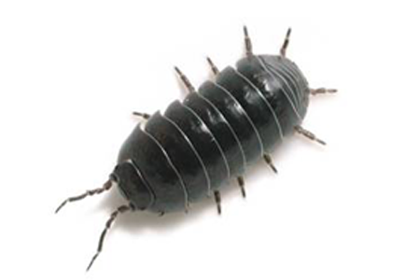
What isn’t an insect
Too many legs

Slide 4
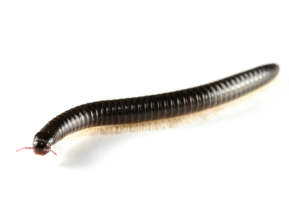
What isn’t an insect
Way too many legs

Slide 5
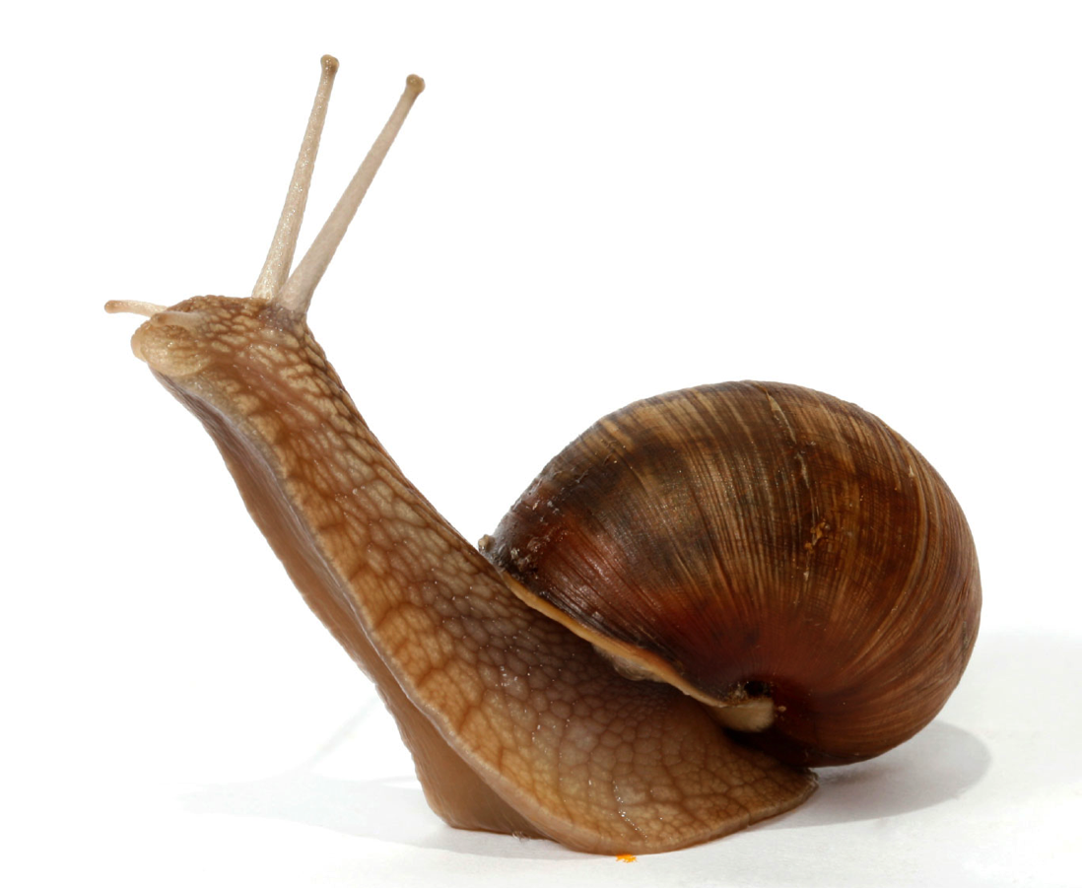
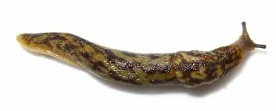
What isn’t an insect
Not enough legs

Slide 6
What is an insect?
6 legs
3 body parts
Head, thorax and abdomen
1 pair antenna
0, 1 or 2 pairs of wings

Slide 7
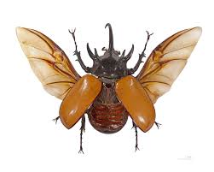
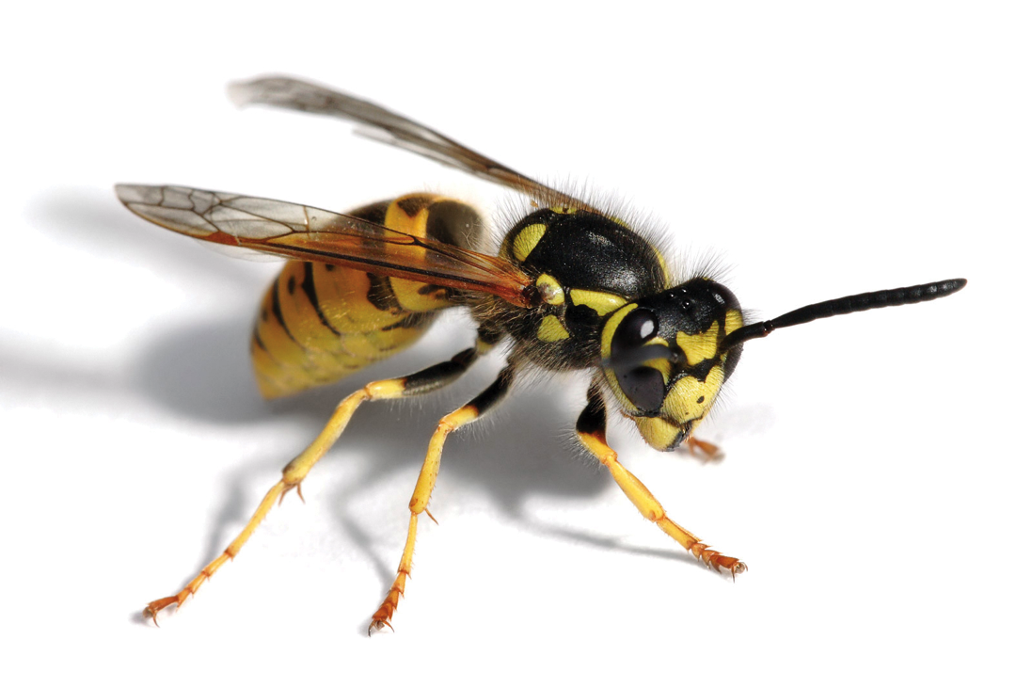
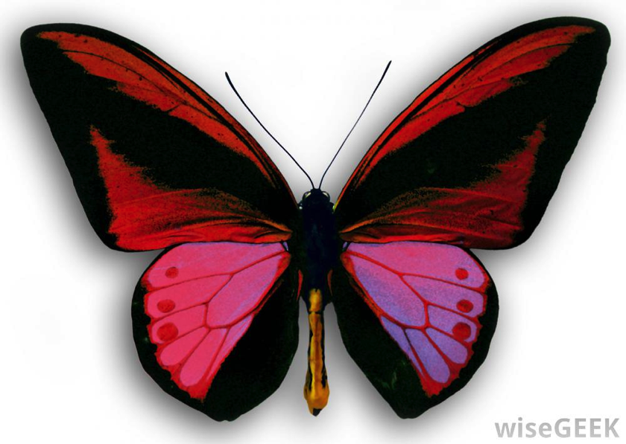
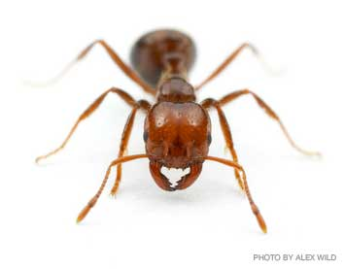
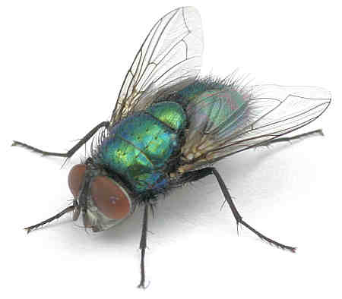
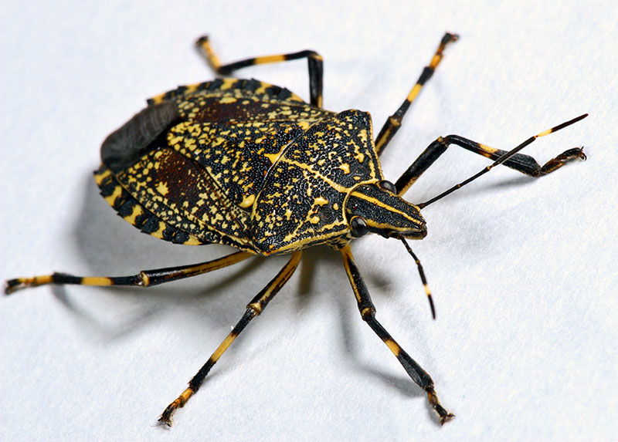
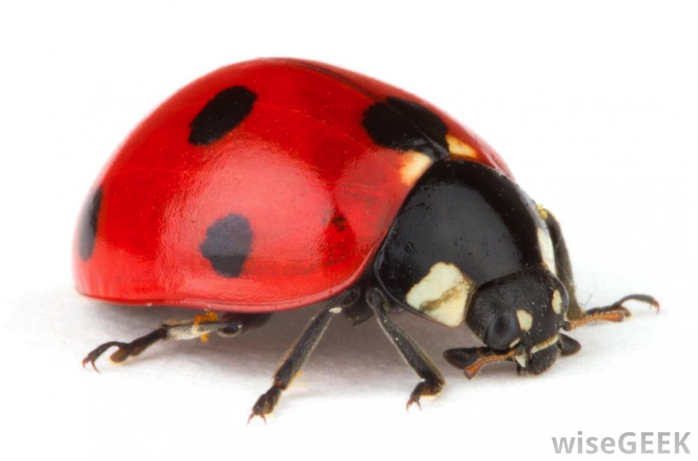
Insects

Slide 8
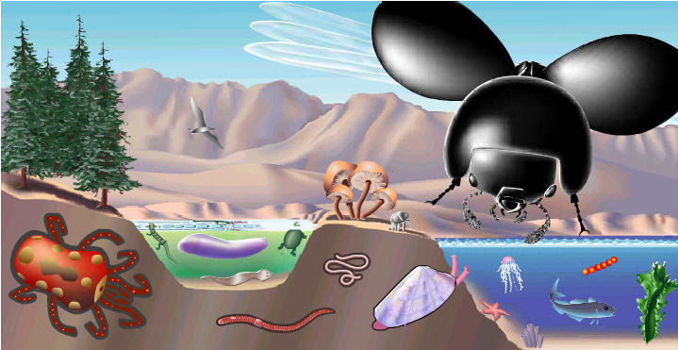
Classification of Insects
Insects are incredibly diverse
Scientists estimate there are 6-10 billion species
Insects weigh more than weight of all other land animals combined
We need more specific categories to classify so many species
Source of Image: Cornell Virtual University Species-Scape Illustration of Major Groups Scaled by Diversity
Notes:
Size of insect/trees/etc. is scaled to the relative amount of biomass on earth. Most is insects

Slide 9
Classification of insects
Kingdom
Phylum
Class
Order
Animalia
Arthropods
Insects
29 different orders
Notes:
These slides focus on how to identify insects at the order level

Slide 10
11 most common insect orders
Hymenoptera
Ants, wasps, and bees
Diptera
Flies, mosquitos
Coleoptera
Beetles
Hemiptera
aphids, “bugs”
Orthoptera
Crickets, grasshoppers
Lepidoptera
Moths, butterflies
Odonata
Dragonflies, damselflies
Mantodea
Mantises
Blattodea
Cockroaches, termites
Dermaptera
Earwigs
Neuroptera
Lacewings

Slide 11
Identifying most common insects
These slides will show you how to identify most of the common insects to Order
Be careful:
Some insects are look-a-likes, for example some flies mimic bees
These are only 11 of the 28 orders
Some insects are odd and difficult to identify
Online key: http://biokeys.berkeley.edu/inverts/insecta.html

Slide 12
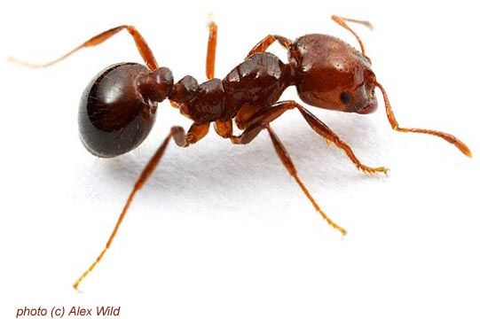
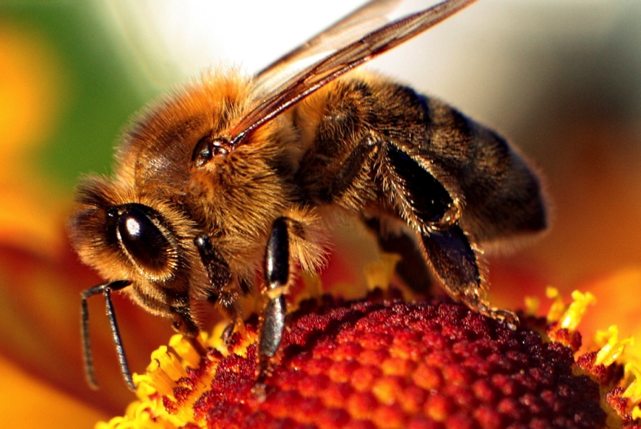
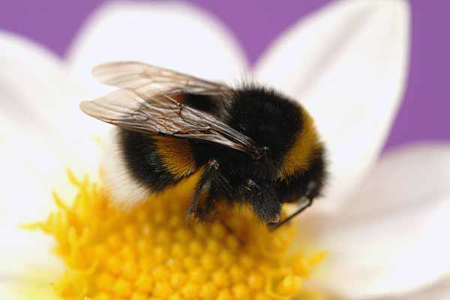
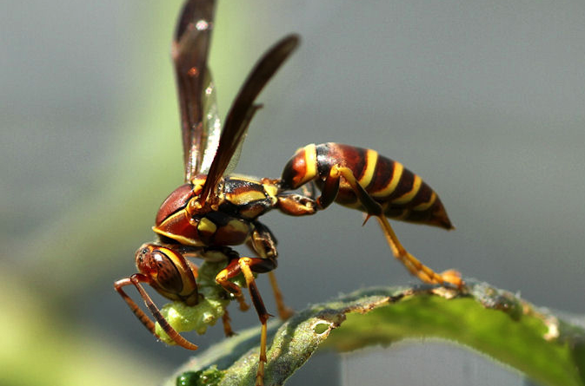
Hymenoptera

Slide 13
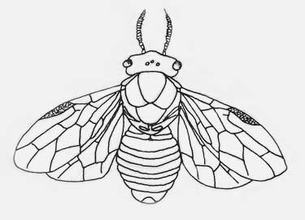
Hymenoptera
Ants, bees, wasps, hornets
2 pairs of wings
clear
Zero for non-reproductive ants
Abdomen narrowly joined to thorax
Sawflies more broadly joined

Slide 14
Diptera
Flies, mosquitos, midges, gnats
One pair of wings
clear
Second pair reduced to “clubs” or halteres
Notes:
http://www.bobs-bugs.info/2013/12/20/diptera-true-flies/
http://biokeys.berkeley.edu/inverts/diptera.html

Slide 15
Diptera
Hymenoptera
Notes:
http://www.microscopy-uk.org.uk/mag/artmay07/cd-hoverflies.html

Slide 16
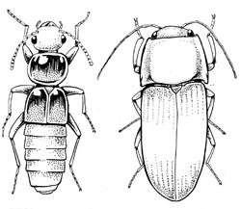
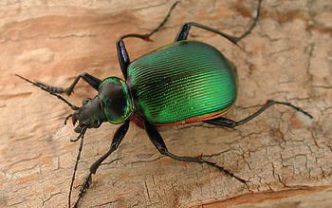
Coleoptera
Beetles
Largest order of insects
Very diverse
2 pairs of wings
Hard outer wings
Clear inner wings
Notes:
http://biokeys.berkeley.edu/inverts/coleoptera.html

Slide 17
Hemiptera
Bugs, aphids, leaf hoppers, stink bugs, water striders…
2 pairs of wings
Outer wings partially toughened
Inner clear wings
Triangular scutellum

Slide 18
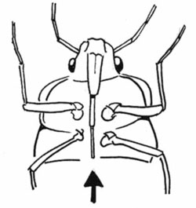
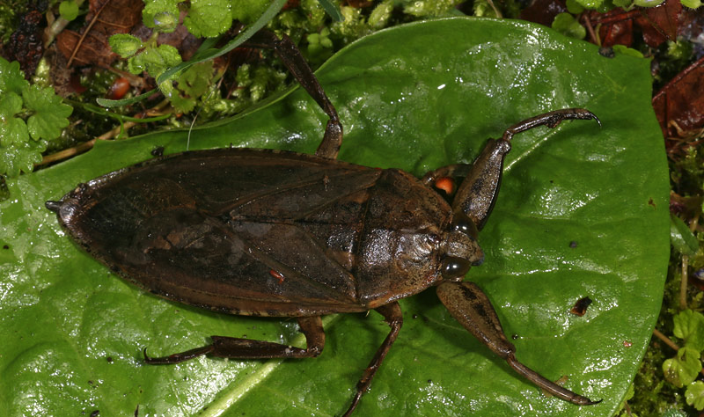
Hemiptera
Stink bugs, leaf hoppers, aphids many others
Many unusual forms
Have piercing sucking mouthparts

Slide 19
Hemiptera
Coleoptera

Slide 20
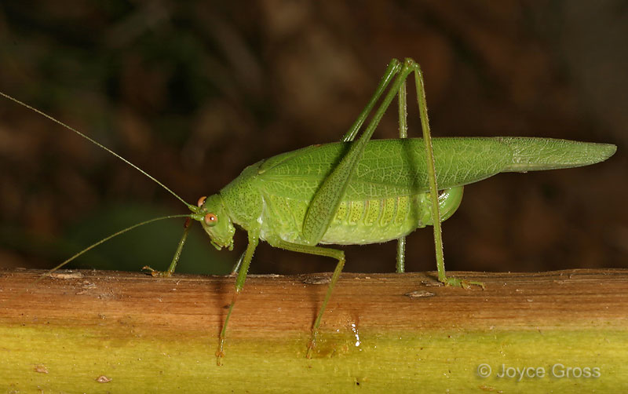
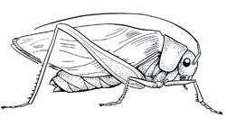
Orthoptera
Grasshoppers, crickets, katydids
Back legs adapted for jumping
No wings or 2 pairs
Outer wings usually tough and leathery
Notes:
http://biokeys.berkeley.edu/inverts/orthoptera.html

Slide 21
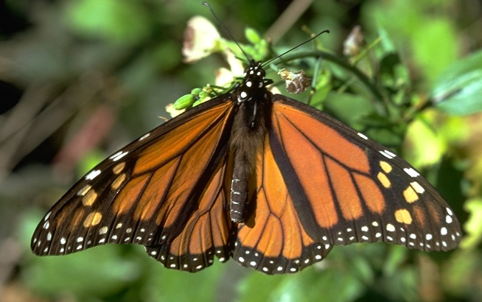
Lepidoptera
Butterflies and moths
2 pairs of wings
Broad wings
Covered in colorful scales
Few species with clear wings
Long coiled sucking mouth parts
Notes:
http://www.entomology.umn.edu/museum/projects/Interactive_Keys/Intro_tutorial/GLOSSARY/Glossary_images/siphoning.jpg
http://www.entomology.umn.edu/museum/projects/Interactive_Keys/Intro_tutorial/

Slide 22
Lepidoptera
Hymenoptera
Clearwing sphinx moth

Slide 23
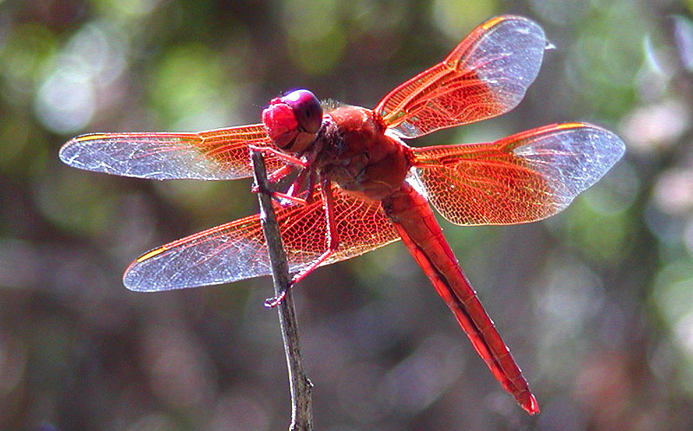
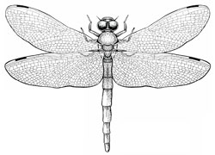
Odonata
Damselfly
Dragonflies, damselflies
Slender abdomen
Large eyes
2 pairs of similarly sized wings
Dragonfly
Notes:
http://biokeys.berkeley.edu/inverts/odonata.html

Slide 24
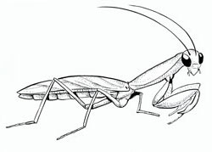
Mantodea
Mantises
2 pairs of wings
Outer pair tough and leathery
Triangular heads
Long forelegs for grabbing prey

Slide 25
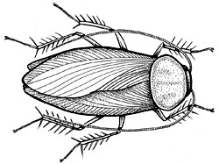
Blattodea
Woodroaches, cockroaches, termites
Flattened bodies
2 pairs of wings
Large pronotum covering head
Notes:
Note for teachers: Termites used to have their own order and were recently shifted to blattodea on the basis of new evidence.

Slide 26
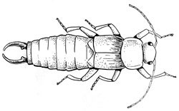
Dermaptera
Earwigs
2 pairs of wings
Short tough outer wings
Large clear wings fold under outer
Rear “pincers”
Notes:
http://biokeys.berkeley.edu/inverts/dermaptera.html

Slide 27
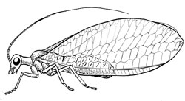
Neuroptera
Lacewings
Small green or brown
2 pairs of equal size clear wings

Slide 28
Creating an Insect Collection

Slide 29
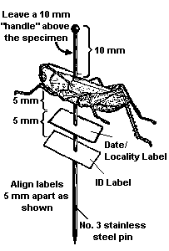
Insect labeling
Date
St., County
Location
Collector
Aug. 2, 2013
WA, Whitman
Kamiak Butte
Col. C. Walsh
It is very important to carefully label and preserve insect specimens. This makes identification easier. Also when new or rare species are found it is important to have good collection location information.

Slide 30
Creating an Insect Collection
http://extension.entm.purdue.edu/401Book/default.php?page=how_to_collect

Slide 31
Activities:
Double Click images to open MS Word Docs

Slide 32
Crop Insects of the PNW
Common Insects of the PNW

Slide 33
Insects Beneficial
to
PNW Agriculture

Slide 34
Honey Bee
Notes:
Honey Bee (Italian)
Order: Hymenoptera
Scientific Name: Apis mellifera Linnaeus
Agricultural Importance: Beneficial to Idaho Agriculture
Description: Adult worker color is variable, generally some shade of black, gray or brown, intermixed with yellow; thorax has a dense coat of fine short hairs, usually black; abdomen with thin coat of hairs and often banded with yellow; length is 15-20 mm. Queen is black, with scattered yellowish hairs, three to five yellow bands on abdomen; length is 25-30 mm. Drones are longer than workers and smaller than the queen; usually the same color as workers. Drone*s eyes come together at top of head.
Damage or Benefit: No significant damage done. Bees are very beneficial pollinators of agricultural crops.
Life History: The new queen emerges from the queen cell and within 5-10 days makes a mating flight where a drone or drones will mate with her. Drones die after mating while the queen turns to producing eggs. The sperm received from the drones is stored in the spermatheca of the queen. The queen produces workers by fertilizing eggs, unfertilized eggs will produce drones. As the queen matures, she depletes her supply of sperm and begins laying more drone eggs than worker eggs. At this time, workers develop queen cells to produce a new queen to replace the old queen. The total society of the hive has only one purpose-the survival of the species.
A colony of honey bees usually consists of a queen, a few hundred drones and several thousand female workers. Workers have several classes, each of which has a specific purpose in the hive.
Average number of days in the development of Honey bees
egg larva pupa total days
Queen 3 5½ 7½ 16 Worker 3 6 12 21
Drone 3 6½ 14½ 24

Slide 35
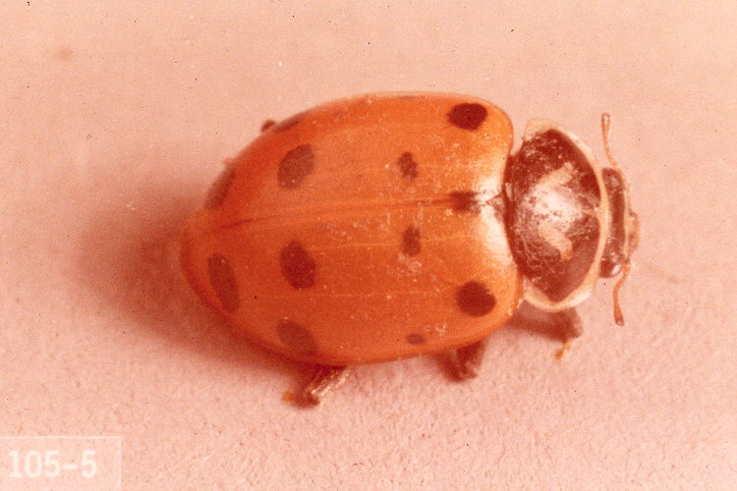
Lady Bug
Notes:
Ladybird Beetle, Lady Beetle, Ladybug
Order: Coleoptera
Scientific Name: Hippodamia convergens Guerin-Meneville
Agricultural Importance: Beneficial to Idaho Agriculture
Description: Adult beetle is 4 mm. in length, oval and convex in shape; reddish-orange with black spots on elytra. Adults have two converging white lines on their black thorax. Larvae are gray or bluish gray with numerous yellow, white or red spots. Mature larvae are approximately 9.5 mm. in length. Several overlapping generations occur each year.
Damage or Benefit: Beetles consume large numbers of aphids and other soft bodied insects, but their population does not increase rapidly enough to overcome heavy infestations on their own to control them.
Life History: The adults over winter in aggregations in protected areas of forests, mountainous areas or protected croplands. They migrate to the fields in March, April and May and feed upon aphids. After feeding for a short while the adults deposit their eggs on plants infested with aphids. Eggs hatch in 5-7 days and the larvae begin to feed upon aphids and other small prey. The mature larvae then pupate on the plant. Adults emerge about 7 days later. A complete life cycle takes 4-6 weeks.
Prey: Aphids, soft bodied insects

Slide 36
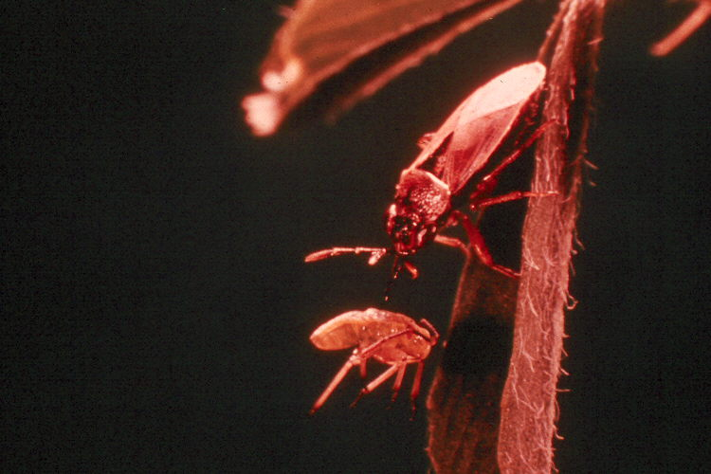
Bigeyed Bug
Notes:
Bigeyed Bug
Order: Heteroptera
Scientific Name: Geocoris bullatus (Say)
Agricultural Importance: Beneficial to Idaho Agriculture
Description: Adults are 3-6 mm. in length; mostly buff, gray or blackish in color. Their eyes are prominent; eyes separate them from other similar sized insects. The nymphs or immature are smaller than the adults, but are similar in shape and color.
Damage or Benefit: Adults and nymphs are effective predators of lygus bugs and other plant bugs, aphids, leafhoppers and may also feed on spider mites.
Life History: Overwinter as adults in trash, crop debris or other convenient hiding places. Adults appear in the field when other insects, such as the lygus bug, begin to increase in numbers. The eggs are laid soon after the adults emerge. The eggs are football shaped, ribbed and pink, grayishwhite in color. There are usually two complete generations per year. The bigeyed bug is often confused with the lygus bug, but the lygus bug is larger in size.
Prey: Aphids, mites, lygus bugs and plant bugs

Slide 37
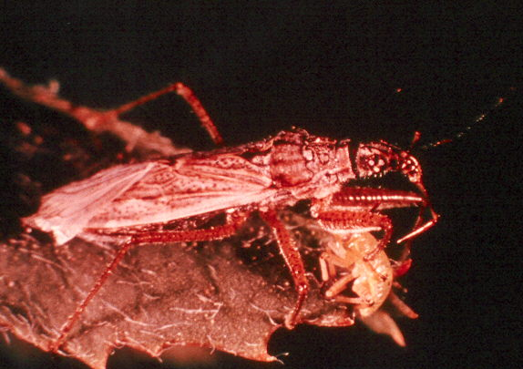
Western Damsel Bug
Notes:
Western Damsel Bug
Order: Heteroptera
Scientific Name: Nabis alternatus Parshley
Agricultural Importance: Beneficial to Idaho AgricultureDescription: Adults are slender, tan or grayish colored; about 9-13 mm. in length and 3 mm. in width. Head possesses a very long beak. The wing and leg attachment area tapers sharply towards the head. Nymphs resemble adults.
Damage or Benefit: Predacious on aphids, lygus bugs, leafhoppers and other small insects and mites. Both adults and nymphs can destroy a large number of insects of similar or smaller size.
Life History: Damsel bugs generally overwinter as adults and appear in the field in late spring or early summer. Eggs are laid soon after adults appear. The eggs are deposited in soft plant tissue. Eggs hatch into nymphs, which feed on small insects or eggs. There are numerous overlapping generations during the season.
Prey: Aphids, lygus bugs, leafhoppers, small soft insects and mites

Slide 38
Insects Harmful
to
Grain Crops

Slide 39
Granary Weevil
Notes:
Granary Weevil
Order: Coleoptera
Scientific Name: Sitophilus granarius (Linnaeus)
Agricultural Importance: Harmful to Stored Grain
Description: Adult is 3-5 mm. in length, blackish-brown; the head ends in a slightly curved proboscis; the thorax has depressed markings and is almost as long as the longitudinally grooved elytra.
Damage or Benefit: Adults cause some damage, but major damage is caused by larvae feeding on kernels, flour and meal. The larvae develop within the kernels and cannot be separated from uninfested grain.
Life History: The entire development takes place within the kernel of grain and is not discernable from the outside; the completely developed weevil then eats its way out of the kernel. The duration of the development phase depends on temperature, being on the average 113 days at 14-16 C. and about 42 days at 21 C. Two to three generations are produced each year.
Host: Wheat, rye, corn, barley, rice, flour and whole meal

Slide 40
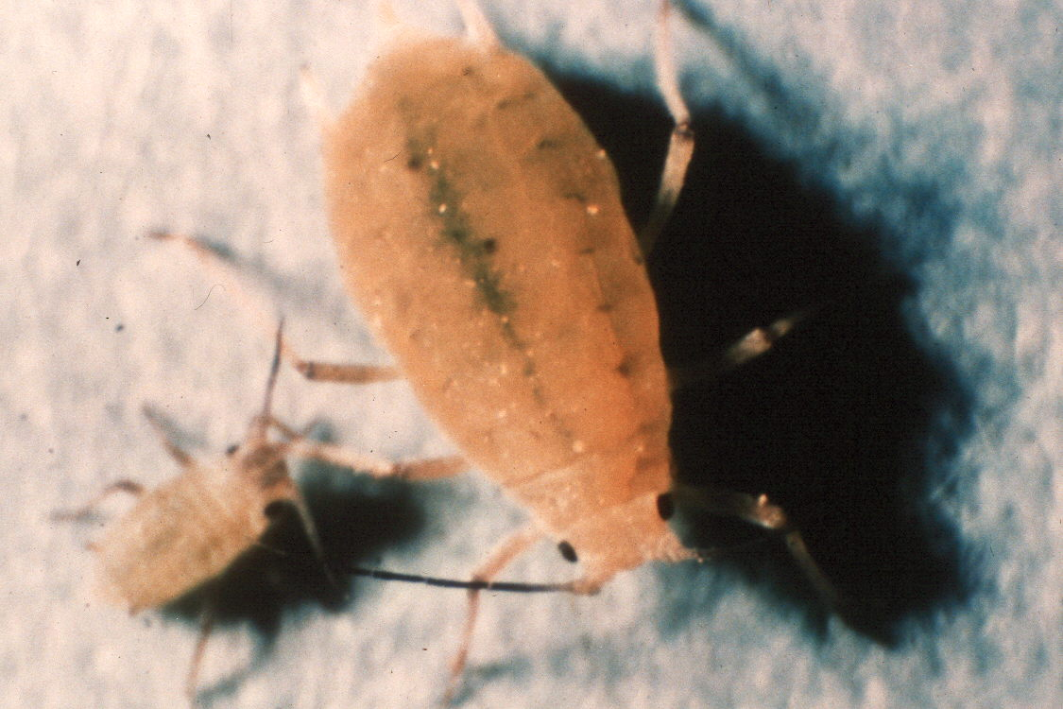
Greenbug
Notes:
Greenbug
Order: Homoptera
Scientific Name: Schizaphis graminum (Rondani)
Agricultural Importance: Harmful to Grain Crops
Description: Adult is usually a pale green, wingless form with darker green strip down the center of its back. In the winged form the stripe is less prominent and head is dark brownish yellow. Length of adult aphid is 1.25-2 mm. The immatures resemble wingless adults.
Damage or Benefit: Aphid feed on the plant’s fluids. While feeding on the plant the aphid injects saliva which contains a toxic substance, which kills the area of the plant where feeding occurred. Heavy infestations can kill plants. The greenbug is capable of transmitting barley wart virus and other disease causing organisms.
Life History: Eggs laid on plants in the fall hatch into females in the spring. Succeeding generations during the year are parthenogenetic females giving birth to living young. Males and oviporous females appear in the fall to produce overwintering eggs. There may be 4-14 generations per year.
Host: Wheat, corn, sorghum, and other small grains

Slide 41
Lesser Grain Borer
Notes:
Lesser Grain Borer
Order: Coleoptera
Scientific Name: Rhyzopertha dominica (Fabricius)
Agricultural Importance: Harmful to Grain Crops
Description: Adult is 2-3 mm. in length, red-brown, slim, cylindrical in body. The hood-shaped, rounded thorax shield extends beyond the head; the spots on the shield gradually become smaller towards the rear. Larva is white, similar to grubs and have brown head capsules; the white pupal stage is passed in the grain kernel.
Damage or Benefit: Infests wheat, rye, corn and rice. Larvae and beetles bore into kernels.
Life History: In sufficiently warm areas, the beetle can fly well. Female deposits 300-500 eggs in grain and similar crops. The larvae eat their way into grain kernels, complete their development and pupate there. Development is only possible above 750 F; the development period is approximately 4 weeks at 850 F.
Host: Wheat, rye, corn, rice or other high carbohydrate vegetable products

Slide 42
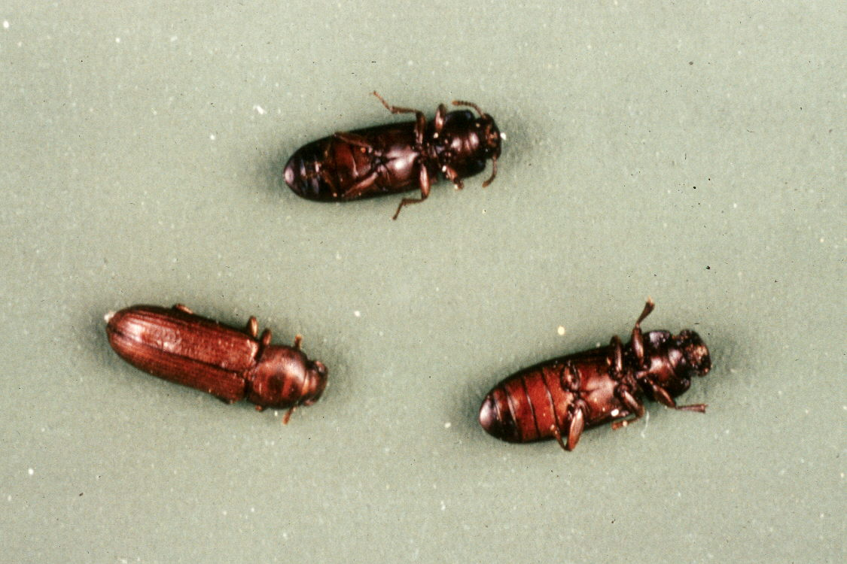
Red Flour Beetle
Notes:
Red Flour Beetle
Order: Coleoptera
Scientific Name: Tribolium castaneum (Herbst)
Agricultural Importance: Harmful to Grain Crops
Description: Adult is slim, 3-4 mm. in length, red-brown to black in color. Larva is slim, freely mobile, whitish to yellow-brown and grows to 5-6 mm. in length.
Damage or Benefit: Feeds on wide selection of dry vegetable substances causing the food to smell and have foreign materials in them.The eggs are laid loose on the stored product. The female can deposit eggs for a period which can exceed one year, 350-400 eggs on the average. The total development period is 4-12 weeks, depending on temperature. The larvae pupate loose in the infested goods. They do best under warm, humid conditions. An adult beetle seldom flies and can live more than 3 years.
Host: Cereal seeds and especially cracked, crushed seeds

Slide 43
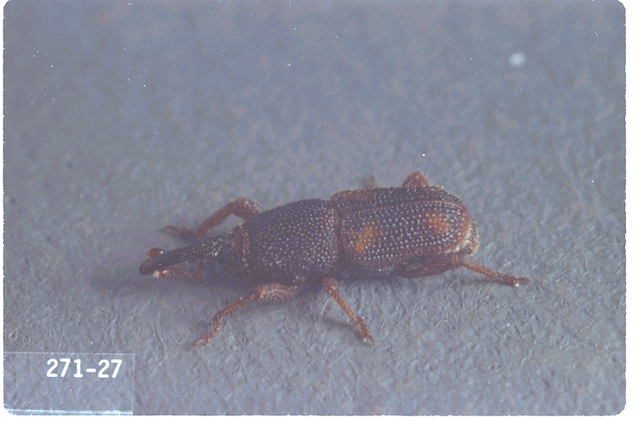
Rice Weevil
Notes:
Rice Weevil
Order: Coleoptera
Scientific Name: Sitophilus oryzae (Linnaeus)
Agricultural Importance: Harmful to Grain Crops
Description: Adult is 2.3-3.5 mm. in length; black-brown in color with four red spots on the elytra. The larva is short, whitish, fat and found inside the kernel.
Damage or Benefit: It infests all types of grain causing damage from boring out of kernel. Larva completes its development inside kernel causing the insect not to be detected or separated easily.
Life History: Develops in the kernel of grain when temperature approaches 600 F. and above. Development takes only 30 days.
Host: Cereal seeds, grains

Slide 44
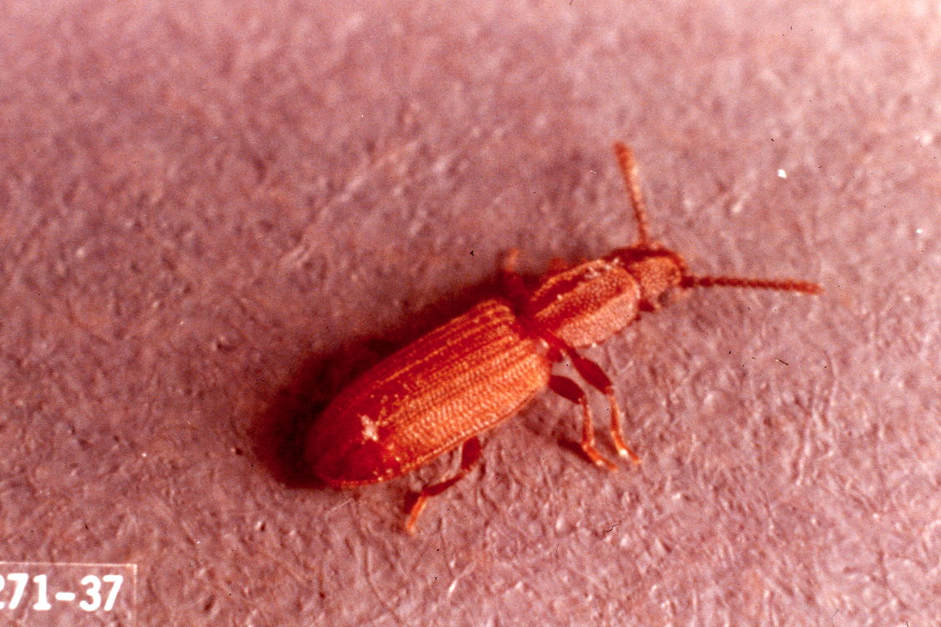
Sawtoothed Grain Beetle
Notes:
Sawtoothed Grain Beetle
Order: Coleoptera
Scientific Name: Oryzaephilus surinamensis (Linnaeus)
Agricultural Importance: Harmful to Grain Crops
Description: Adult beetle is 2.5-3.5 mm. long, dark brown in color, thorax has two deep longitudinal grooves and 6 sharply-pointed projections on each side. Larva is slim, whitish-yellow in color and grows to a length of 3.5-4 mm.
Damage or Benefit: Infests grain, grain products and dried fruit. Direct damage from feeding and contamination results.
Life History: The female deposits eggs loosely in the infested goods. The total development period is 3-10 weeks, depending on temperature, nutrition and moisture. The lower boundary is approximately 650 F. An adult insect may live 3 years under optimum conditions.
Host: Cereal seeds, especially cracked or damaged seeds and flour

Slide 45
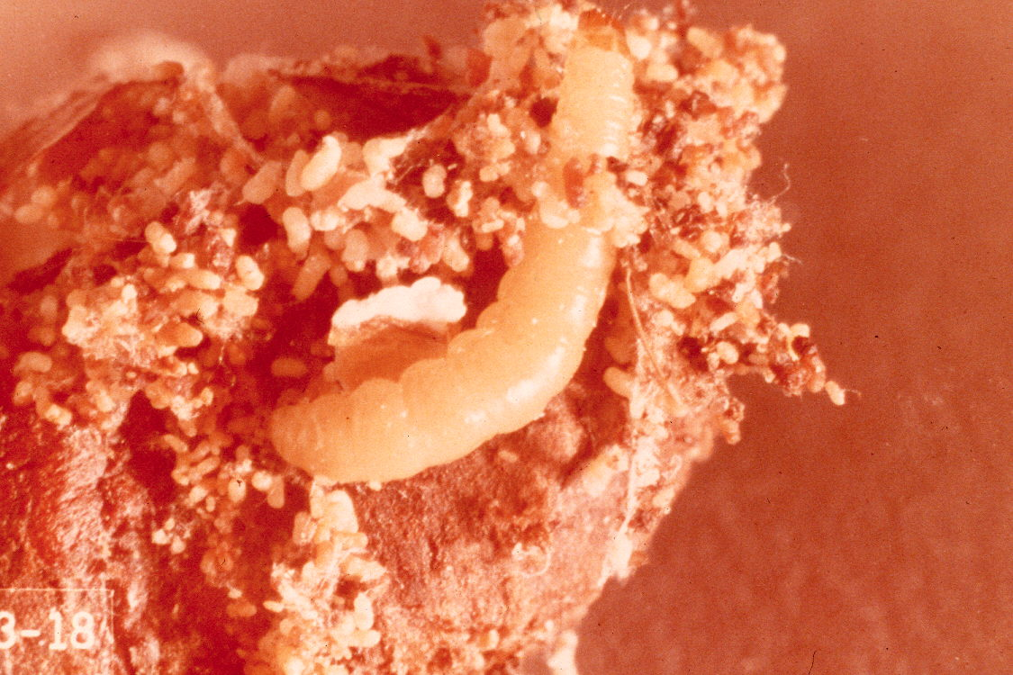
Indian Meal Moth
Notes:
Indian Meal Moth
Order: Lepidoptera
Scientific Name: Plodia interpunctella (Hubner)
Agricultural Importance: Harmful to Grain Crops
Description: Adult has a wing expanse of 14-20 mm., body length of 8-10 mm. The outer halves of the forewings are bronze; the inner halves are light-gray to ochre yellow. Larva is yellowish-white, sometimes reddish or greenish, with a brown head. They grow to a length of 11 mm.
Damage or Benefit: Feeds on grain and other dry vegetable material. Damages cereals and other foodstuffs by feeding, heavy webbing and fecal material present in food.
Life History: The females deposit between 60 and 300 eggs, singly or in groups on suitable nutrients. The grown larvae are active spinners; before pupation, they leave their food sources and climb up walls. Pupation occurs in a cocoon. The life cycle depends on temperature and is 6-8 weeks in length.
Host: Cereals, dry vegetable material and other foodstuffs

Slide 46
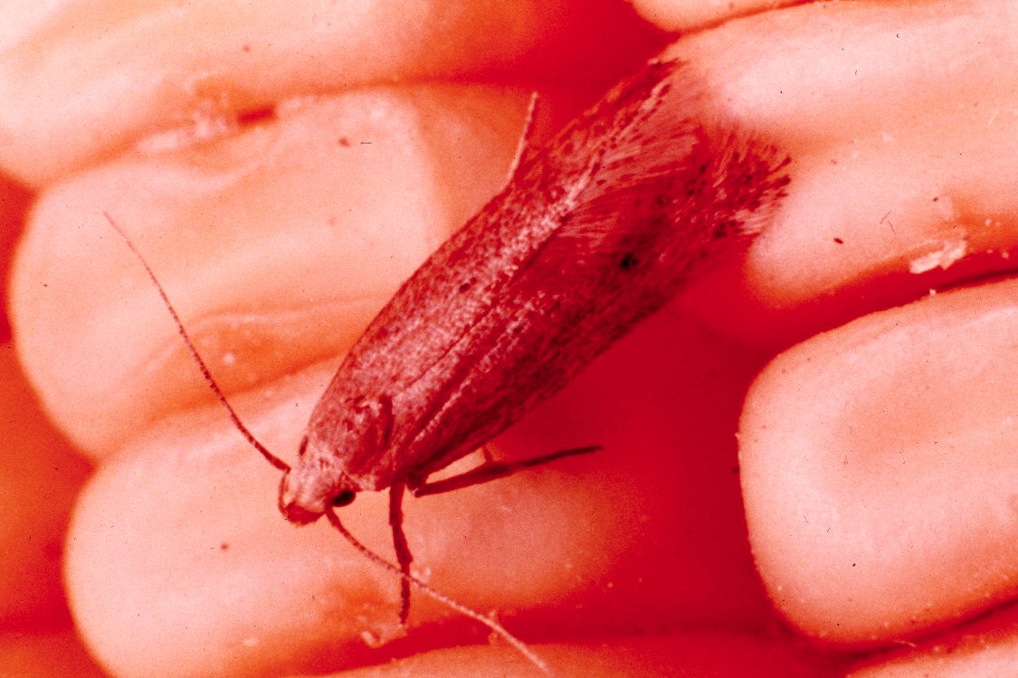
Angoumois Grain Moth
Notes:
Angoumois Grain Moth
Order: Lepi doptera
Scientific Name: Sitotroga cerealela (Olivier)
Agricultural Importance: Harmful to Grain Crops
Description: The moth has a wing expanse of 13-19 mm. and a body length of 6-9 mm. Forewing is buff or yellowish brown, silky, with fringe slightly darker. Larva is white with yellowish head, about 5 mm. in length.
Damage or Benefit: Destroys kernel of grain. Damaged grain also has webbing and fecal material present, which contaminates grain.
Life History: The female lays approximately 150 eggs. The eggs hatch and larvae bore into grain kernels, remaining there until fully developed. There are 5-6 generations per year in storage houses.
Host: Cereals

Slide 47
Insects Harmful
to
Vegetable Crops

Slide 48
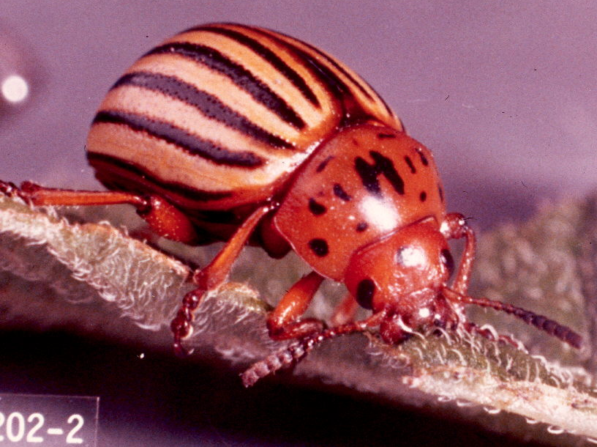
Colorado Potato Beetle
Notes:
Colorado Potato Beetle
Order: Coleoptera
Scientific Name: Leptinotarsa decemlineata (Say)
Agricultural Importance: Harmful to Vegetable Crops
Description: Adult beetles are convex, yellow with 5 black lines on each elytra. Eggs are yellow-orange and are laid on the underside of potato leaves. Larvae are hump-backed, red in color with black spots along the sides.
Damage or Benefit: Defoliates plants which causes yield reduction.
Life History: The adults overwinter in the soil. A short feeding period in the spring is needed before females deposit eggs on the underside of leaves. In 4-9 days the eggs hatch into brick red, humped-back larvae with black spots on their sides. They are voracious feeders and mature in 2-3 weeks. The larvae descends into the soil and makes an earthen cell. After emerging from the soil, these adults start a second generation. There are usually two complete generations a year and sometimes a partial third generation in Southwestern Idaho.
Host: Potatoes, tomatoes and other members of the nightshade family

Slide 49
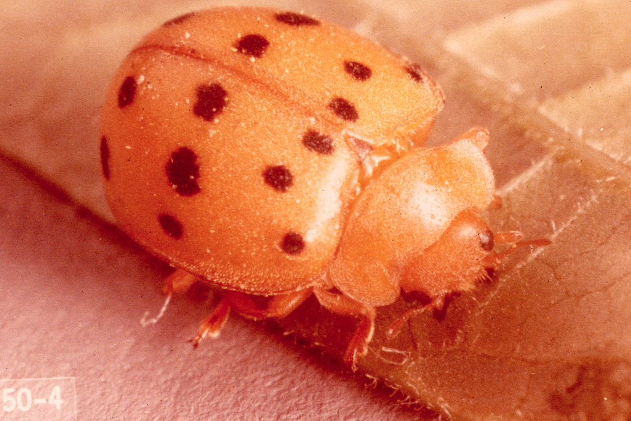
Mexican Bean Beetle
Notes:
Mexican Bean Beetle
Order: Coleoptera
Scientific Name: Epilachna varivestis Mulsant
Agricultural Importance: Harmful to Vegetable Crops
Description: Adults are yellowish brown to copper, with sixteen small black spots on elytra. They darken after overwintering and the spots become less distinct. Length is 6 mm. Larvae are orange, about 7.5 mm. long, covered with long branched spines.
Damage or Benefit: Feeds on leaves of host plant.
Life History: Adults appear in spring after overwintering in woods or debris. A female may lay up to 900-1000 eggs during season. The eggs hatch in 8-11 days and larvae begin to feed. The larvae feed for 20-25 days then undergo pupation. Adults then appear. Two to three generations per year. Currently this insect is found only within Ada County and mostly confined to the City of Boise.
Host: Beans (dry, snap, pinto and soybean)

Slide 50
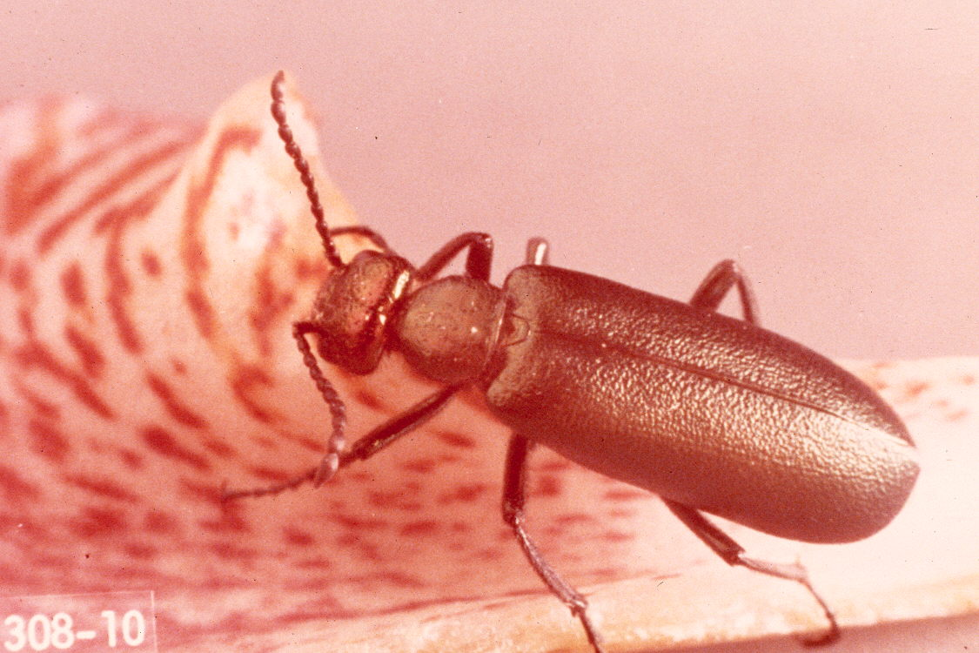
Nuttall Blister Beetle
Notes:
Nuttall Blister Beetle
Order: Coleoptera
Scientific Name: Lytta nuttalli Say
Agricultural Importance: Harmful to Vegetable Crops
Description: Adults are metallic green or purplish; margins are violet. Larvae undergo hypermetamorphosis and have several distinct forms. Larvae are white, yellow or orange at first but quickly turn black. Adults are 16.5-28 mm. in length.
Damage or Benefit: Adults feed on plant foliage and flowers; larvae are predacious on grasshopper eggs.
Life History:The life cycle of the blister beetle is correlated to the host*s cycle. Life cycle takes 35-50 days with one generation per year.
Host: Beets, alfalfa, swiss chard, cabbage, mustard, sugarbeet seed and ornamentals
Three other species in Idaho:
1. Western spotted blister beetle
2. Ash-gray blister
3. Black puncture blister beetle

Slide 51
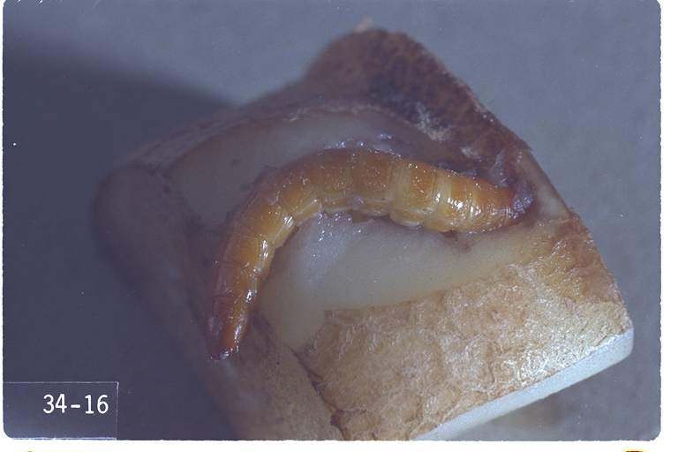
Notes:
Sugarbeet Wireworn
Order: Coleoptera
Scientific Name: Limonius californicus (Mannerheim)
Agricultural Importance: Harmful to Vegetable Crops
Description:The adult is an elongated black beetle with a reddish-brown elytra. The antennae and legs are dark brown. The larva is cylindrical, skiny, yellowish-brown and up to an inch long.
Damage or Benefit:Damage depends upon the age of crop. Wireworms destroy newly planted seeds, cut off young plants, tunnel and scar roots and tubers of mature plants.
Life History:Overwintering adults generally appear in the latter part of March or early April when soil temperature reaches 500 F. or above. Males emerge prior to females. Males can detect the sex pheromones of a female prior to her emergence and often form a group awaiting her arrival to the surface. After mating, the female re-enters the ground to lay her tiny, round eggs 75-105 mm. below the surface. Eggs hatch in approximately 20 days. Larvae usually require several years to develop. They cause little damage the first year but feed ravenously in the second and third. Pupation occurs in August of the third year of larval development. Adult stage is reached about 30 days after pupation. Adults remain in the soil until the following spring.
Host: All crop plants, but usually more serious to root crops

Slide 52
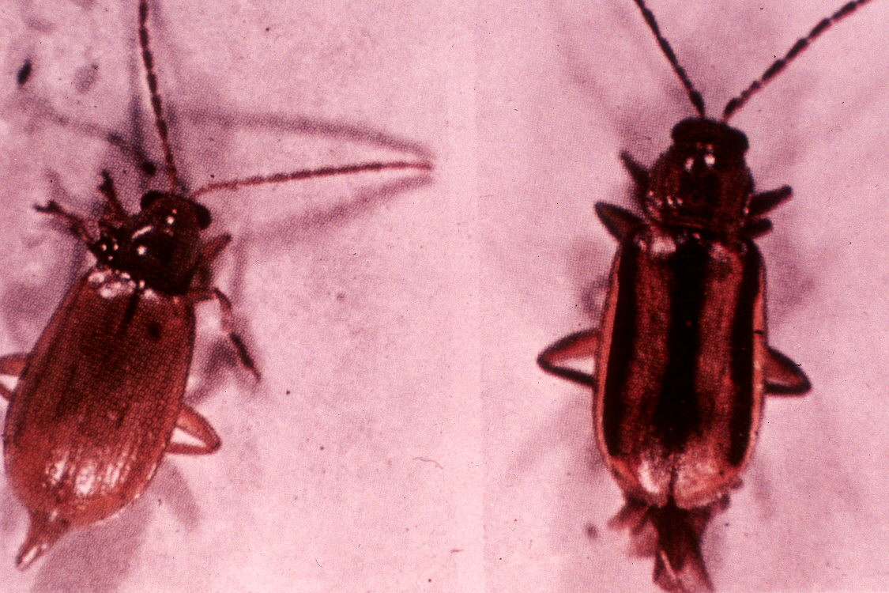
western corn rootworm
Notes:
Western Corn Rootworrn
Order: Coleoptera
Scientific Name: Diabrotica virgifera LeConte
Agricultural Importance: Harmful to Vegetable Crops
Description: Adults are greenish to yellowish green, head and pronotum are brown. Larvae are wrinkled, threadlike, white with yellowish brown heads.
Damage or Benefit: Adults feed on silks of corn ears causing poor fill from lack of pollination. larvae feed on roots of corn causing the corn to lodge and yield to be reduced.
Life History: Eggs overwinter and hatch in spring. Larvae feed on roots until July when they pupate. Adults emerge in late July and August. Adults feed on corn silk and flowers until September and October when they deposit eggs around roots of corn.
Host: Corn and certain annual grasses

Slide 53
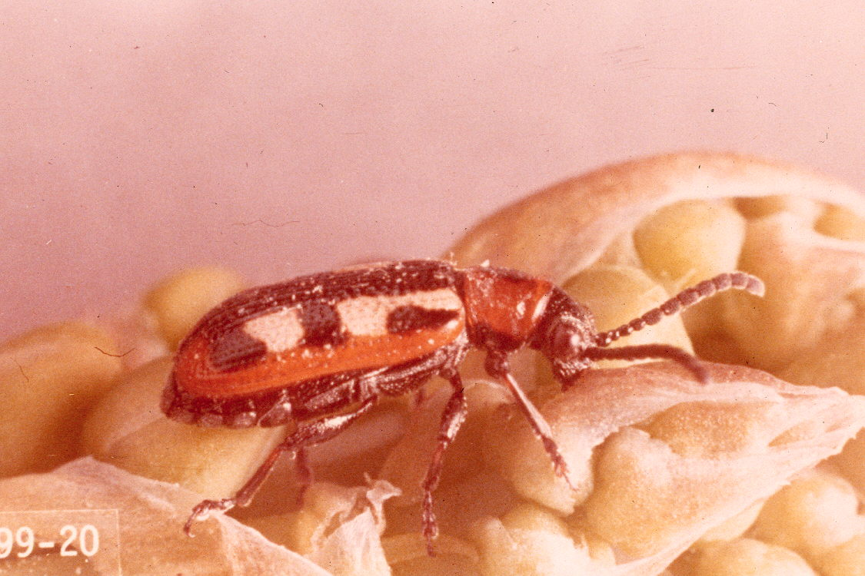
asparagus beetle
Notes:
Asparagus Beetle
Order: Coleoptera
Scientific Name: Crioceris asparagi (Linnaeus)
Agricultural Importance: Harmful to Vegetable Crops
Description: The adult is a slender beetle and 6 mm. in length; blue-black in general color with red on the thorax and dark blue wings marked with yellow and red borders. Larvae are dark, olive-gray with black heads.
Damage or Benefit: Larvae and adults feed on tender young shoots in the spring causing them to be scarred and browned. Eggs are also deposited all over the young spears making them unmarketable.
Life History: The adults spend the winter in sheltered places. As the spears appear the adults start feeding upon the tips and laying eggs on the spears. The eggs hatch and the larvae feed inside the berries on the ferns. The larvae complete their feeding in 10-14 days and pupate in the soil. The adults emerge and 1-2 more generations occur each year.
Host: Asparagus

Slide 54
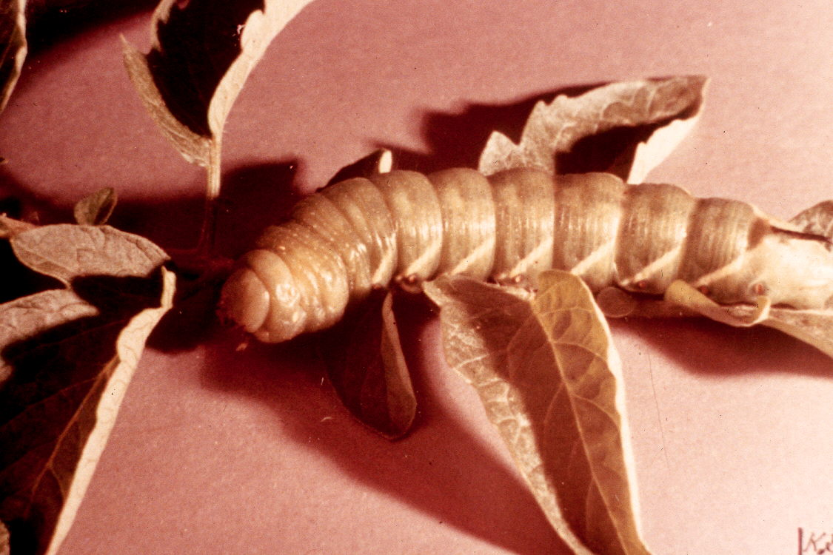
tomato hornworm
Notes:
Tomato Hornworm
Order: Lepidoptera
Scientific Name: Manduca quinquemaculata (Haworth)
Agricultural Importance: Harmful to Vegetable Crops
Description: Adult is known as a hawk moth and is grayish or brownish winged with white and dark streaks and mottling. Body has 5 pair of orange spots. Larva is light or dark green with black caudal horn and eight oblique white stripes hooked backward at the base, forming an L or V; 76-100 mm. in length when fully grown.
Damage or Benefit: Larvae feed on leaves, blossoms and fruit.
Life History: The adults appear in May or June and deposit eggs in small batches. The larvae hatch and feed for about 3 weeks growing to a length of 75-105 mm. The larvae bury themselves 75-105 mm. in the soil, pupate and some change into adults to produce a second generation; others wait until the following season to emerge as an adult.
Host: Tomatoes and other members of the nightshade family

Slide 55
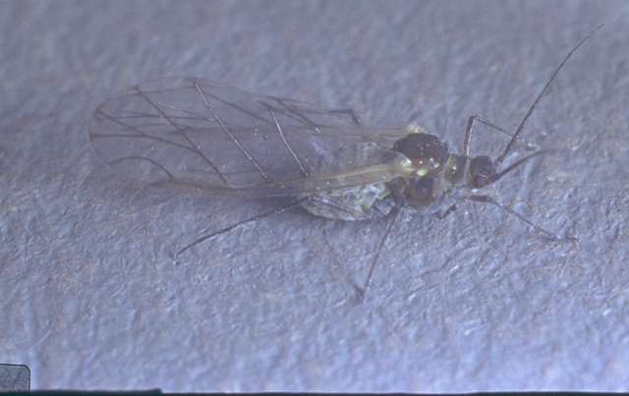
Cabbage Maggot
Notes:
Cabbage Maggot
Order: Diptera
Scientific Name: Hylemya brassicae (Weidemann)
Agricultural Importance: Harmful to Vegetable Crops
Description: Adult is gray with black stripes on thorax, black bristles over the body; resembles house fly but smaller; length is 6 mm. Larva is white; blunt at rear end, pointed at front end and 6 mm. in length.
Damage or Benefit: Larvae feed on roots and fleshy parts; destroys small roots causing plant to wilt.
Life History: Overwinter as pupae in the soil. Adults appear in spring, laying their eggs on plants at the soil line. Eggs hatch and larvae bore into plant and feed on roots and fleshy parts. It feeds for 3-4 weeks before pupating. Two to three generations occur a year.
Host: Broccoli, brussel sprouts, cabbage, cauliflower, kohlrabi, radishes, mustard seed

Slide 56
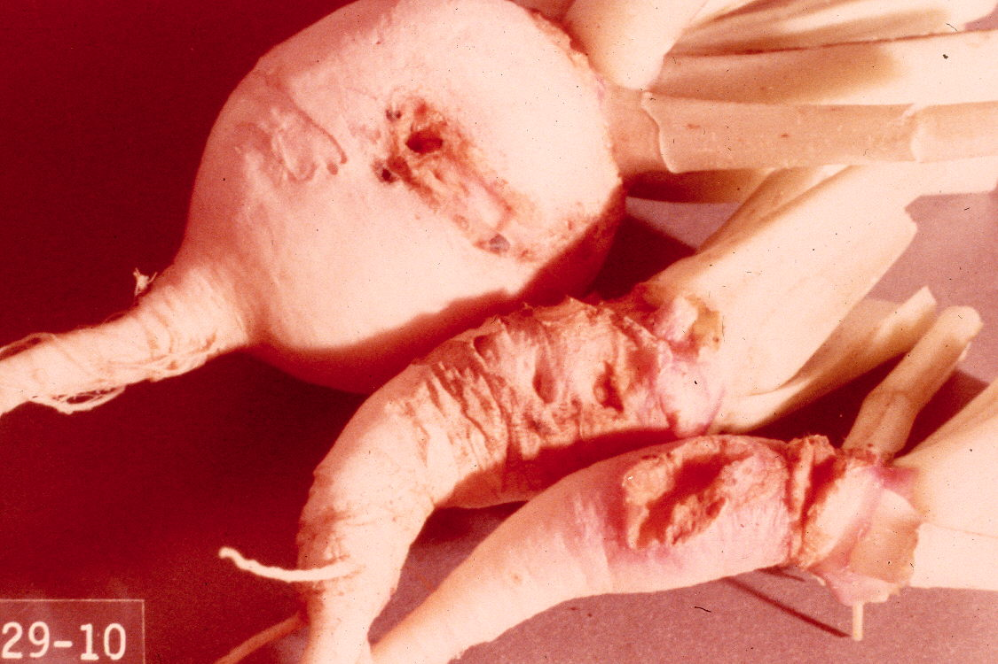
cabbage maggot damages
Notes:
Cabbage maggot damage

Slide 57
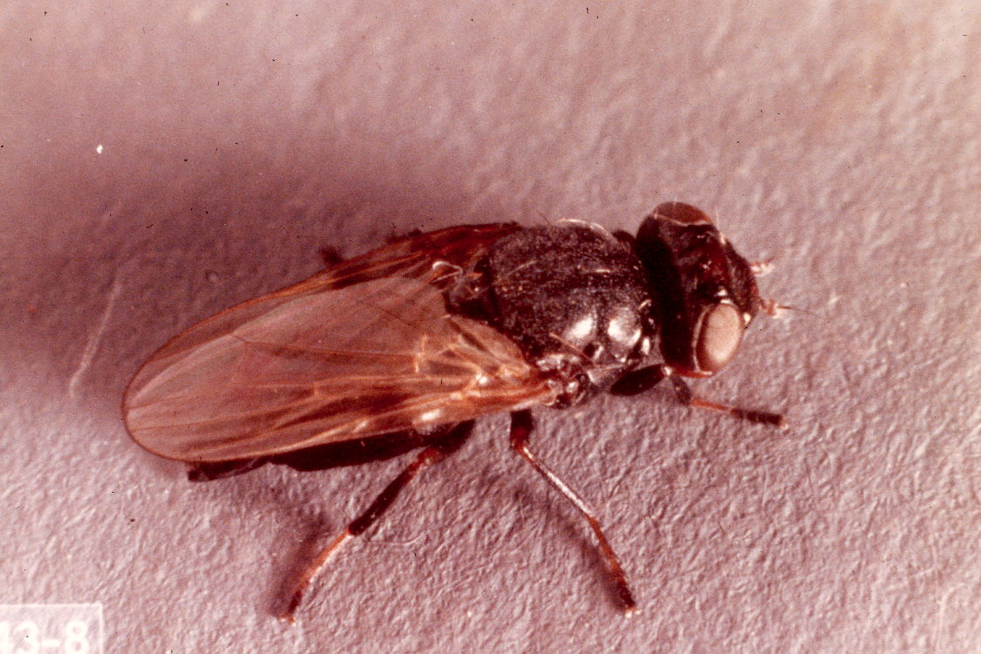
sugarbeet root maggot
Notes:
Sugarbeet Root Maggot
Order: Diptera
Scientific Name: Tentanops myopaeformis (Raider)
Agricultural Importance: Harmful to Vegetable Crops
Description: Adults are glossy black with smoky patch on costal margin of wing a third the way from the base to tip. Adults are 6 m. in length. Larva are white to pinkish white.
Damage or Benefit: Larva feed on tap root of sugarbeets causing the plant to die or have smaller, forked roots.
Life History: Overwinters as larvae, pupate near soil surface in late May or early June. Adults appear in about 2 weeks. The adults deposit eggs in June on the ground near the host plants. The eggs hatch and larvae begin to feed on sugarbeets. There are 2 generations per year.
Host: Sugarbeets and some weeds

Slide 58
says stink bug
Notes:
Says Stink Bug
Order: Heteroptera
Scientific Name: Chlorochroa sayi Stal
Agricultural Importance: Harmful to Vegetable Crops
Description: Adults are bright green with minute specks and three orange spots at base of scutellum; tip of scutellum is whitish or orange; length of 15 mm. Nymphs resemble adults except in size.
Damage or Benefit: Feeds on pods, fruit and vegetables causing blemishes and deformities.
Life History: Overwinters as adults under foliage. Emerging in the spring, the adults feed for several weeks before commensing egg laying on host plants. There are 3 generations per year.
Host: Many plants are infested including fruits, vegetables, small grains and seed crops.

Slide 59
squash bug
Notes:
Squash Bug
Order: Heteroptera
Scientific Name: Anasa tristis (De Geer)
Agricultural Importance: Harmful to Vegetable Crops
Description: Adult is brownish yellow; appears black because of dense covering of black hairs. Protruding margins of abdomen are orange and brown striped; margins of pronotum are yellow. Nymph is pale green, changing to blackish thorax and brown abdomen, often covered with white powder.
Damage or Benefit: Feed on leaves of squash family plants causing leaves to turn black, droop, turn crisp and die.
Life History: Adults begin feeding on plants in spring and lay their eggs. The eggs hatch and nymphs begin to feed. There is only one generation per year.
Host: Pumpkins, melons and squash

Slide 60
cabbage aphid
Notes:
Cabbage Aphid
Order: Homoptera
Scientific Name: Brevicoryne brassicae (Li nnaeus)
Agricultural Importance: Harmful to Vegetable Crops
Description: Adults are grayish-green, distinguished from other aphids by the powdery, waxy covering. Length of 2 mm.
Damage or Benefit: Causes leaves to droop, plants to be unhealthy and the edible parts to contain sticky insects.
Life History: Overwinters as eggs in residue of host crop. There are up to 30 generations per year as females are parthenogenic. In the fall both males and oviporous females appear to produce eggs for overwintering.
Host: Broccoli, brussel sprouts, kale, cabbage, cauliflower and other members of the cabbage family

Slide 61
corn leaf aphid
Notes:
Corn Leaf Aphid
Order: Homoptera
Scientific Name: Rhopalosiphum maidis (Fitch)
Agricultural Importance: Harmful to Vegetable Crops
Description: Aphids are green with dark green heads and resemble cabbage aphids but without the covering of waxy substance. Adults are 1.5 mm. in length.
Damage or Benefit: Feed on heart leaves, young tassels and heads of corn. Spreads disease causing organisms from diseased to healthy plants.
Life History: Overwinters as eggs on host crop residue. Adults appear in spring and begin feeding. Females are parthenogenic during the year. Males and oviporus females appear in fall to produce eggs to overwinter.
Host: Corn and cereal crops

Slide 62
green peach aphid
Notes:
Green Peach Aphid
Order: Homoptera
Scientific Name: Myzus persicae (Sulzer)
Agricultural Importance: Harmful to Vegetable Crops
Description: Wingless form varies from light green with yellow tint during summer to pink to red in the fall. Winged forms are usually dark brown with a yellowish abdomen. Length varies from 1.5-2.25 mm.
Damage or Benefit: Injures new growth and curls terminal foliage of host. Spreads disease organisms from diseased to healthy plants. This insect is responsible for transmitting the potato leafroll virus which is responsible for net necrosis condition of the potato tubers.
Life History: In most regions females are parthenogenic and reproduction is continuous throughout the summer.
Host: Most vegetables, fruits and field crops

Slide 63
cabbage loopers
Notes:
Cabbage Looper
Order: Lepidoptera
Scientific Name: Trichoplusia ni (Hubner)
Agricultural Importance: Harmful to Vegetable Crops
Description: Larva color varies from a light translucent green to an intense dark green or nearly black; has faint to intense white stripes on the back and sides and has a maximum length of 27-32 mm. The adult has a distinct head with the body diameter increasing towards the rear with three pair of begs behind the head and three pair of prolegs on the abdomen. Adults are sandy brown on forewings having whitish figure 8-shaped mark. The inner loop of this mark is open, “hollow” and appears to be bowl-shaped.
Damage or Benefit: Larvae destroy leaves, blossoms and fruit.
Life History: Loopers overwinter as pupae in soil or in plant debris in or near the base of the host plants. Moths emerge when temperatures reach 55~60 degrees F., fly to weed/crop host, then lay eggs to begin the first of two to three generations. Most abundant in August. Larvae of the second generation attack summer and fall truck crops.
Host: Cabbage family and other vegetable crops

Slide 64
imported cabbage worm
Notes:
Imported Cabbage Worm
Order: Lepidoptera
Scientific Name: Pieris rapae (Linnaeus)
Agricultural Importance: Harmful to Vegetable Crops
Description: Adult wings are white with apex of forewing tipped with black, black spot on forewing of male, two on that of female; black spot on costal margin on hindwing. Larva are pale green with numerous spots, body covered with fine hair, dark stripe down the back, row of yellow spots along each side; length is 32-35 mm.
Damage or Benefit: Feeds on leaves, buds and flower stalk of host plant.
Life History: Adults emerge in May and deposit eggs on foliage of host plants. Eggs hatch and larvae begin feeding on host plant. Mature larvae pupate and overwinter as pupae. In summer months, a generation takes 31-35 days.
Host: Cabbage family (for other pests, hosts are listed)

Slide 65
corn earworm
Notes:
Corn Earworm
Order: Lepi doptera
Scientific Name: Heliothis zea (Boddie)
Agricultural Importance: Harmful to Vegetable Crops
Description: The adults are olive green to grayish-brown; forewings with obscure black spots near middle of front margin; scattered, indistinct black markings; dark submarginal band interrupted by light patch near middle. Larvae vary in color from pinkish-green, green, cream to yellow. Length is 38 mm. when full grown.
Damage or Benefit: Early damage is on leaves and tassels. Later the larvae feec upon the silk and ears causing the yields to be reduced and the cost of processing to increase.
Life History: The corn earworm has three generations per year. Earworms overwinter as pupae and mature by late spring. The adults lay first generation eggs on a host of plants. This first generation larvae do little serious damage. First generation moths appear in late June to early July. They lay eggs in the corn ear silk. Eggs hatch in 3-5 days and larvae feed on ears of corn. In late August the second generation adults appear and deposit eggs in processing corn ears and early seed fields which can cause damage.
Host:Corn and many other vegetable, forage crops and weeds

Slide 66
spotted cutworm
Notes:
Spotted Cutworm
Order: Lepidoptera
Scientific Name: Amathes c-nigrun (Linnaeus)
Agricultural Importance: Harmful to Vegetable Crops
Description: Mature larvae are about 30-40 mm. in length. The general body color is dull brown with brown and black flecks. A double row of slanting, triangular, black marks on the backs increase in size and prominence towards the posterior of the body. Forewings are purplish to reddish brown with kidney-shaped spots along the front margins. Hindwings are smoky colored with dark outer margins.
Damage or Benefit: Larvae eat foliage of host plants and cut off seedlings.
Life History: Partially grown larvae pass the winter in the soil. Moths emerge during late May and early June and deposit eggs on undersides of leaves. Larvae feed on foliage for 4-6 weeks, from late June through July, then pupate in the soil. Moths emerge in late August and deposit eggs, which hatch into larvae and overwinter. There are two overlapping generations per year.
Host: Most vegetable, field and fruit crops

Slide 67
western bean cutworm
Notes:
Western Bean Cutworm
Order: Lepidoptera
Scientific Name: Loxagrotis albicosta (Smith)
Agricultural Importance: Harmful to Vegetable Crops
Description: The adult moth*s forewings are righ brown with a very light narrow band along front margin. The hindwings are light tan shading to darker brown on outer margin. Larva is up to 40 mm. in length, 6 mm. in diameter and pinkish brown.
Damage or Benefit: The most obvious damage to beans is holes in the pods and seeds. On corn the damage is caused by tunneling into ears and feeding on kernels.
Life History: Adults emerge from early July to mid-August and live from 1-9 days. Egg laying begins about 3 days after emergence. Eggs hatch in about 6 days. Larvae are present from late July to late September. As cool weather approaches, mature worms enter the soil to a depth of 75-275 mm. and construct earthen cells in which they spend the winter. Late the following spring they change to pupae and soon emerge as adult moths.
Host: Mainly beans and corn

Slide 68
migratory grasshopper
Notes:
Migratory Grasshopper
Order: Orthoptera
Scientific Name: Melanoplus sanguinipes (Fabricius)
Agricultural Importance: Harmful to Vegetable Crops
Description: Adults are light brown and yellow and the hind tibiae are red. The male has a small, broad projection on either side of the tip of the abdomen and a distinct swelling between the middle legs. Length of the male is 25 mm.; female is 32 mm.
Damage or Benefit: Severely defoliate vegetation.
Life History: Overwinters as eggs, nymphs appear in ilay, June and early July.
Nymphs feed for 40-60 days before completing growth to adults. Adults mate
in late summer and deposit eggs in hard cases to overwinter.
Host: Pasture, field, forage and vegetable crops

Slide 69
onion thrips
Notes:
Onion Thrips
Order: Thysanoptera
Scientific Name: Thrips tabaci (Lindeman)
Agricultural Importance: Harmful to Vegetable Crops
Description: Adult is pale yellow to dark brown; antenna are seven segmented; posterior margin of abdomen bears comb of fine hairs; forewings are gray. Nymph is milky white at first, later turns to green or lemon yellow, with red eyes. Adult is 1 mm. in length.
Damage or Benefit: Thrips destroy the cells on the underside of leaves lowering the quality of the host and allowing entry points for disease causing organisms.
Life History: Overwinters as adults and nymphs. Adults appear in spring and begin feeding. The females deposit eggs in tender plant tissue. Eggs hatch and nymphs begin feeding for about 6 days and molt twice, then drop to the ground, where they undergo two more molts then pupate. It takes 28-30 days for one generation. There are 6-8 generations per year with many overlapping.
Host: Onions and garlic most severely, but attacks most plants.

Slide 70
garden symphylan
Notes:
Garden Symphylan (G199-34, 52-13)
Non insect
Scientific Name: Scutigrella immaculata (Newport)
Agricultural Importance: Harmful to Vegetable Crops
Description: This is not a true insect since the adult has 12 pair of legs. Newly hatched nymphs have 6 pair of legs, but adds one pair each time it molts until adult stage is reached. Symphylons are 3-4 mm. in length, white, soft bodied, “centipede-like” animals with prominent antenna.
Damage or Benefit: Feed on root systems of plants causing stunting of plant growth. Damage to seedling plants causes poor stands.
Life History: Eggs, nymphs and adults can be found anytime of the year, but the majority of the eggs are found in the early spring and fall months. Nymphs and adults become active in the spring and can be found in increasing numbers in the upper 150-200 mm. of the soil from April through August. Eggs are deposited in clusters of 4-25 at various depths, depending upon soil temperature, moisture and structure. Eggs hatch in 30-40 days and nymphs begin feeding on small roots. The total development time from egg to adult is approximately 5 months at 100 C. There are 1-2 generations per year.
Host: Most severe on root crops, but damage most crops

Slide 71
Insects Harmful
to
Fruit Crops

Slide 72
two-spotted spider mite
Notes:
Two-Spotted Spider Mite
Order: Acarina
Scientific Name: Tetranychus urticae Koch
Agricultural Importance: Harmful to Plants
Description: Two-spotted spider mites are not insects but, rather, are closely related to spiders. mite is pale on the back. Adults and nymphs have eight legs, but larvae have six. The mite is yellow, translucent reddish or greenish with two dark spots on the back. These spots are not distinct on nymphs. Size ranges from 0.25-0.5 mm in length.
Damage or Benefit: Feeding on the surface layer of cells causes mottling of leaves which turn brown or bronze. Fruit does not color and other crops mature early causing reduced yields.
Life History: Female spider mites overwinter in cracks and crevices in the soil and under debris in and around margins of host plant fields. They emerge in the spring and begin depositing eggs on the undersides of host plant leaves. Eggs hatch into larvae in 4-5 days. The life cycle from egg to adult takes 1-3 weeks depending on temperature.
Host: Most fruit, vegetables forage and seed crops

Slide 73
blackvine weevil
Notes:
Blackvine Weevil
Order: Coleoptera
Scientific Name: Otiorhynchus sulcatus (Fabricius)
Agricultural Importance: Harmful to Plants
Description: Adult is black with patches of yellow scales; elytra has minute grooves and punctures. The length is 6-10 mm. The larva is white or pinkish with a brown head; length of 10 mm. when full grown.
Damage or Benefit: Adults feed at night on plant leaves. Larvae feed on roots causing the plants to die or be severely stunted.
Life History: Immature larvae overwinter in earthen cells. They begin feeding again in the spring. Mature larvae pupate in early summer and adults appear in mid-summer. One generation per year.
Host: Berries, mint, hops, ornamentals and other crops

Slide 74
strawberry root weevil
Notes:
Strawberry Root Weevil
Order: Coleoptera
Scientific Name: Otiorh nchus ovatus (Linnaeus)
Agricultural Importance: Harmful to Fruit
Description: Adult is oblong oval in shape and averages about 4 mm. in length. Color varies from light to dark brown or nearly black. The legs and antennae are reddish brown. Adults cannot fly. Newly hatched larvae are white with conspicuous orange-brown head capsules and are about 0.5 mm. long. As larvae grow long they become more grub-like in appearance. Mature larvae are 6-7 mm in length, legless, creamy white in color and “C” shaped.
Damage or Benefit: Larvae feed on roots which severely stunts or skills plants. Adults feed on leaves.
Life History: Eggs hatch in July and new larvae begin feeding on roots of their host plant. They feed during late summer and early fall, then overwinter. Larvae resume feeding in the spring during April and early May and then form a cell in the soil where they pupate. Adults begin emerging during mid-May and are present in the fields until late July. Adults begin depositing eggs around the base of plants about 3 weeks after emergence. Most of the eggs are deposited during late June and July and most adults are gone by early August. One generation per year.
Host: Berries, mint, hops and other crops

Slide 75
European earwig
Notes:
European Earwig
Order: Dermaptera
Scientific Name: Forficuh auricularid Linnaeus
Agricultural Importance: Harmful to Fruit
Description: Adult is reddish brown. Cerci of the male are curved, those of female are nearly straight. It is capable of flight. Adult is approximately 18-20 mm. in length. Nymphs are similar to adults.
Damage or Benefit: Feed on various garden flowers, vegetables, ripe fruit and a variety of insects.
Life History: For the first few days after eggs hatch, the nest is kept closed to prevent escape. The period from hatching to maturity lasts about 68 days and requires 4 molts. Overwinters in the egg stage and as adults under boards, stones and cells in the ground. There are 1-2 generations per year.
Host: Fruit, vegetables and ornamental crops

Slide 76
cherry fruit fly
Notes:
Cherry Fruit Fly
Order: Diptera
Scientific Name: Rhagoletis cingulata (Loew)
Agricultural Importance: Harmful to Fruit
Description: Adults are mostly shiny black; abdomen with four white cross-bands; tibia and tarsi are yellow, wings are clear with black bands. Adults are 3.5-5 mm. in length. Larvae are white and about 6 mm. in length when full grown.
Damage or Benefit: Larvae feed on the cherries causing them to be unmarketable.
Life History: Adults appear in June and July and after a few days begin to lay eggs in the immature fruit. The eggs hatch and larvae begin to feed on the fruit. When the larvae are mature, they fall to the ground and pupate in the larval skin which turns brown. Overwinter as a pupa in the soil.
Host: Primarily cherries

Slide 77
black cherry aphid
Notes:
Black Cherry Aphid
Order: Homoptera
Scientific Name: Myzus cerasi (Fabricius)
Agricultural Importance: Harmful to Fruit
Description: Adult is shiny black, 3 mm. in length. Nymphs are similar to adults except they are smaller without wings.
Damage or Benefit: Feeding causes discoloration and curling of leaves and new growth is stunted.
Life History: Overwinter as eggs tucked in among buds. Hatching occurs when the buds open. The young develop on the new growth, curling leaves and then living within the curl. Winged adults appear in mid-summer and migrate to crucifers. Later generations return to cherry trees in fall and produce wingless males and oviporous females which lay eggs to overwinter. Females during the year are generally parthenogenic. There are 3-4 generations per year.
Host: Cherries

Slide 78
San Jose scale
Notes:
San Jose Scale
Order: Homoptera
Scientific Name: Quadraspidiotus perniciousus (Comstock)
Agricultural Importance: Harmful to Fruit
Description: Adult females have armor which is grayish with a dark nipple-like projection in the center. Males are smaller, darker, elongated with the nipple-like projection near the larger end. The delicate sac-like bodies underneath the armor are bright yellow. Length of the scale is 2mm. First instar nymphs are yellow in color without scale armor, later instar nymphs have armor.
Damage or Benefit: The San Jose scale attacks all parts of fruit trees and some ornamental trees, causing damage which includes discoloration of the bark or skin of the fruit. Clusters of scales often occur around the stem and blossom end of the fruit rendering it unsalable. Heavy populations can cause girdling causing the limbs and twigs to die.
Life History: The young emerge alive. They are minute, motile and very active prior to the first molt. After the first molt the females lose their legs, antennae and anal filaments. After the first molt males can be differentiated. When the males emerge from under the scale armor they are minute, fragile, two-winged insects with well-developed antenna, eyes and an ana1 appendage called a stylus. The females remain stationary throughout their life. The eggs mature internally and active nymphs emerge. Overwinters as second instar nymphs, one-third grown in what is called the sooty black stage. It matures in the spring when trees are in bloom. There are 2-6 generations per year.
Host: Fruit and ornamental broadleaf trees

Slide 79
oyster shell scale
Notes:
Oyster Shell Scale
Order: Homoptera
Scientific Name: Lepidosaphes ulmi (Linnaeus)
Agricultural Importance Harmful to Fruit
Description: Adult armor is light to dark brown, shaped like a tiny oyster shell. Length of female is 3 mm. and width is 1 mm. First instar nymphs, known as crawlers are whitish. Later instars resemble adults.
Damage or Benefit: Causes leaves to turn yellow and fruit to discolor. Heavy populations cause limbs and trees to die from girdling resulting from feeding damage.
Life History: The eggs hatch from mid-May to mid-June. The whitish nymphs (crawlers) go to uninfested new wood and settle down in the bark and insert their long thread like mouthparts through the bark. They then secrete a covering of cottony fiber over their body. The females never move from this spot and lay eggs under their covering which hatch the next spring After the first molt males can be differentiated. When the males emerge from under the scale armor they are minute, fragile, two-winged insects with well developed antenna, eyes and an anal appendage called a stylus.
Host: Fruit and ornamental broadleaf trees

Slide 80
pear psylla
Notes:
Pear Psylla
Order: Homoptera
Scientific Name: Psylla pyricola Foerster
Agricultural Importance: Harmful to Fruit
Description: Adult is reddish brown to dark brown, with reddish or green markings. Transparent wings which fold rooflike when at rest. Length is 2.5-3 mm. Nymph is flat and broad, yellowish green to reddish brown with bright
red eyes.
Damage or Benefit: Saliva injected during feeding has a toxic affect causing leaves to turn yellow. Fruit is covered with sooty black fungus. It may also be a carrier of “pear decline” mycoplasm.
Life History: Overwinter as adults in bark and liter. The eggs are deposited on fruit spurs, leaf buds or twigs. After hatching the nymph goes through five instars. There are 3-6 generations per year.
Host: Pears

Slide 81
rosy apple aphid
Notes:
Rosy Apple Aphid
Order: Homptera
Scientific Name: Dysaphis plantaginea (Passerini)
Agricultural Importance: Harmful to Fruit
Description: Adults may be distinguished by the long cornicles which are flanged at the tips and by the long antenna; in spring, color is purplish or rosy-brown, winged for migration; non-winged forms during the year are brownish-green; length of the adult is 2.5 mm.
Damage or Benefit: In early spring aphids cause apple leaves to roll and fruit to dwarf or be misshapen. Honeydew excreted by the aphids is a medium to which grows a sooty black mold upon the fruit. It does not clean off during packing.
Life History: Overwinter as eggs on twigs, in bud axils and in dark trees. Eggs hatch when buds begin to swell. Several fruit spurs and young fruit causing damage. In early migrate to their summer host, plantain, then return trees. During the year parthenogenic females exist males and oviporous females exist, mate and produce crevices of apple broods feed on the sunimer the aphids in the fall to apple but in the fall both eggs which overwinter.
Host: Apple

Slide 82
pear slug
Notes:
Pear Slug
Order: Hymenoptera
Scientific Name: Caliroa cerasi (Linnaeus)
Agricultural Importance: Harmful to Fruit
Description: Adult is shiny black with smoky wings; length of 8 mm. Larva is sluglike, front end wide, tapered posteriorly; olive green to yellow in color, about 13 mm. on length and covered with slimy secretion.
Damage or Benefit: Skeletonizes leaves of pear and cherry trees.
Life History: The adults appear in spring and deposit eggs under the epidermal layer of the leaves. Eggs hatch, producing the sluglike larvae. The first generation females are parthenogenic, producing a large second generation. The fall larvae pupate and overwinter in the soil.
Host: Pears, cherries and some plums

Slide 83
codling moth
Notes:
Codling Moth
Order: Lepidoptera
Scientific Name: Laspejresia pomonella (Linnaeus)
Agricultural Importance: Harmful to Fruit
Description: Adult is brownish-gray; wings have chocolate-colored patch at tip and coppery or golden, wavy transverse markings. Larva is white with a pinkish tinge; dark-brown head; about 18-19 mm. in length when fully grown.
Damage or Benefit: This moth is most damaging to apples. Larva feed in the fruit causing it to be unmarketable.
Life History: The adults appear in the spring and lay their eggs on leaves, twigs or fruit spurs. The young larva feed on the leaves and shoots; it then enters the young apple at the calyx cup on the blossom end, works the way to the core, often eating the seeds. It tunnels out of the fruit when full grown, pupates in a cocoon under loos& bark or on the ground. Overwinters as full grown larva in the cocoon. There are 1-2 complete generations per year, a partial second or third in some years depending upon elevation within Idaho.
Host: Apples, pears and sometimes walnuts

Slide 84
peach tree borer
Notes:
Peach Tree Borer
Order: Lepidoptera
Scientific Name: Synanthedon exitiosa (Say)
Agricultural Importance: Harmful to Fruit
Description: This moth resembles a wasp in appearance. The males are light blue, with yellow stripes around abdomen, both wings clear with dark and yellowish borders. Females are darker steel blue, with wide orange band around abdomen, forewings are opaque steel blue, white or cream colored with dark brown head, about 25 mm. long when full grown.
Damage or Benefit: Larvae feed on the cambium and inner bark of trees, usually at or just below ground level, often girdling the trees.
Life History: Adults emerge from July until September and lay eggs on the trunks of trees or in the soil inches from the trunk of the tree. Eggs hatch and the larvae begin to feed on the outer layers of bark. As the larvae mature they burrow deeper into the tree. They overwinter as larvae. Pupation occurs in silk cocoons near the entrances to the burrows.
Host: Peaches, apricots, cherries and plums

Slide 85
strawberry leafroller (damage)
Notes:
Strawberry Leafroller
Order: Lepi doptera
Scientific Name: Ancylis comptana (Walsh & Riley)
Agricultural Importance: Harmful to Fruit
Description: Adult is grayish or brownish with darker and lighter bands. Larva is greenish or bronze in color; 12-14 mm. in length when full grown.
Damage: Defoliates strawberry plants causing loss late in the season to crop and reduction to next year*s crop.
Life History: Adults appear in spring and deposit eggs singly on the undersides of leaves. The eggs hatch and the larvae begin feeding. The larvae feed first on the underside of leaves under a silken webbing, later on the upper surface, folding the leaves over themselves with silken threads. They pupate in cocoons in the folded leaves. There are two generations per year with a partial third. Overwinter as pupae or as larvae in the cocoon in the folded leaf on the ground.
Host: Strawberries

Slide 86
Insects Harmful
to
Legume Crops

Slide 87
alfalfa weevil
Notes:
Alfalfa Weevil
Order: Coleoptera
Scientific Name: Hypera postica (Gyllenhal)
Agricultural Importance: Harmful to Legume Crops
Description: Adult weevils are 4-5 mm. in length; gray in color with a wide brownish stripe down the back. As the weevils mature they turn brown and darken in color. Larvae, on hatching, are dingy yellow but soon become green with a shiny black head and a prominent white stripe along the middle of the back. When full grown the larva is 9.5-10 mm. in length.
Damage or Benefit: Adults feed on alfalfa but do not seriously injure it. Feeding of the larvae causes leaves to be ragged or skeletonized. Severe infestation gives the field a grayish or whitish cast as if frosted and causes yields to be severely reduced.
Life History: Adults spend the winter under organic debris, in alfalfa stubble, along ditch banks and in field borders. They become active with the first warm weather in the spring. The female deposits her eggs inside the stems of some early weeds, old stubble or new growth. Each female is capable of laying at least 600 eggs. Hatching occurs throughout May and into June. The tiny larvae crawl up the stem and feed within the leaf buds of the terminal growth. Heavy infestations skeltonize leaves. Feeding may continue until early July. Larvae feed for approximately three weeks before dropping to the ground and pupating. In 10-12 days the adult weevils emerge and are active in the field until cold weather.
Host: Alfalfa

Slide 88
clover leaf weevil
Notes:
Clover Leaf Weevil
Order: Coleoptera
Scientific Name: Hypera punctata (Fabricius)
Agricultural Importance: Harmful to Legume Crops
Description: The adult is a large (5-8 mm.) dark brown weevil. The larva is fat-bodied, legless and pale green with a yellowish-white stripe edged in red down the center of its back.
Damage or Benefit: Feeds on leaves and flowers reducing yield of clovers severely.
Life History: Adults emerge in May to July and begin feeding on leaves and blossoms. Eggs are laid in September and October. Most hatch quickly except for a few that overwinter. Larvae feed on leaves at night. Larvae overwinter in cocoons in the soil or litter and pupate in the spring and early summer.
Host: Clovers and sometimes alfalfa

Slide 89
pea leaf weevil
Notes:
Pea Leaf Weevil
Order: Coleoptera
Scientific Name: Sitona lineata (Linnaeus)
Agricultural Importance: Harmful to Legume Crops
Description: Adult is grayish brown, slender and about 5 mm. in length. Three light, inconspicuous rows of small scales, one central and two lateral, run lengthwise on the thorax and tend to extend onto the wing covers. Wing covers are marked lengthwise by parallel striations. These weevils have large inner wings and are very strong fliers. Larvae are small, milky-white, curved and legless, about 3-5 mm. in length.
Damage or Benefit: Adults feed on pea leaves by cutting out circular notches in leaf margin, killing seedlings or badly deforming plants causing the yield to be severely reduced. Larvae feed on root nodules.
Life History: Adults overwinter under debris and start to emerge by mid-March. When numerous, they kill seedling peas, particularly those just breaking the surface in early May. New brood adults appear in July and can do serious damage to late peas and alfalfa. A single female may lay 1,000 small, smooth, glassy-surfaced, subspherically shaped eggs in the soil. At first they are white, but turn black in 24-48 hours. The larvae hatch in 16-18 days and scatter through the soil until contact is made with the root nodules. They emerge from the modules before pupation occurs.
Host: Peas, alfalfa, clover and some other legumes

Slide 90
lygus bug
Notes:
Lygus Bug
Order: Heteroptera
Scientific Name: Lygus hesperus Knight
Agricultural Importance: Harmful to Legume Crops
Description: The color of adults varies from a pale yellowish-green to a dark reddish-brown. They have an easily distinguished, yellowish, triangular-shaped area at the base of their wings, in the middle of their back. Females lay eggs singly in tender plant tissue. The young nymphs are shiny green.
Damage or Benefit: Lygus bugs pierce leaves, stems, buds, petioles and developing seeds with their beaks, then inject a toxic saliva as they feed. This causes stunting of plants, shrivelling of seeds, blasting of buds, shedding of bloom and seed curls.
Life History: The adults pass the winter in alfalfa fields and in grassy and weedy areas. They are active on warm days in late winter. The slightly curved or cucumber-shaped eggs are generally laid in the midrib veins of leaves and other similar places. The nymphs are quick moving when disturbed in contrast to small pale-green aphids. There are several generations per year; each requires about six weeks to complete.
Host: Seed crops, seedling plants and developing fruit

Slide 91
meadow spittlebug
Notes:
Meadow Spittlebug
Order: Homoptera
Scientific Name: Philaenus spumarius (Linnaeus)
Agricultural Importance: Harmful to Legume Crops
Description: Adults are gray or brown and spotted; length of 9 mm. Nymphs are similar to adults in color. The nymphs are surrounded with spittle material exuded by the nymphs for protection while feeding.
Damage or Benefit: Feeding causes stunting of growth, shortening of internodes, dwarfing, rosetting, general loss of vitality and low yield.
Life History: Overwinter as eggs; hatching begins in early spring. The nymphs reach the adult stage in 45 days. Adults are present all summer. Only one generation per year.
Host: Berries, vegetables crops and some forage crops

Slide 92
pea aphid
Notes:
Pea Aphid
Order: Homoptera
Scientific Name: Acyrthosiphon pisum (Harris)
Agricultural Importance: Harmful to Legume Crops
Description: Pea aphid is pale green or pinkish in color; 3-4 mm. in length.
Damage or Benefit: Pea aphid discolors foliage from feeding, stunts growth, curls leaves and damages buds. Saliva is toxic to the host plant. Severely injured plants turn yellow and dry up.
Life History: Overwinter as eggs or wingless adults. In March, or when temperatures reach 2-5 degrees C., eggs hatch and the adults begin to reproduce. Aphids hatched from eggs give birth to only a few young. However, overwintering adults may produce 150 young at the rate of 5-7 per day. Colonies from overwintering adults may be winged in the first generation, but young from eggs may take 2-3 generations before winged forms appear. Twelve to fifteen generations per year are produced. During the year females reproduce parthenogenically. In October, males and oviporous females appear and mate. Females deposit about 25 eggs in late October and early November which overwinter. Overwintering as adults occurs in the southern states.
Host: Alfalfa, peas, lentils and other legume crops

Slide 93
alfalfa looper
Notes:
Alfalfa Looper
Order: Lepidopterd
Scientific Name: Autographa californica (Speyer)
Agricultural Importance: Harmful to Legume Crops
Description: Adult moths have silver gray wings, with a darkening toward the wing tips. The forewings have an ivory-colored, funnel-shaped mark near the center of the wings. Moths have a wing span of 30-40 mm. and are most active at night. Larvae vary in color from a light, translucent green to an intense, dark green, to nearly black. Larvae have a dark stripe in the middle of the back, edged with distinct white lines, bordered by more obscure white lateral lines and a white stripe on either side. The larvae have 3 pair of legs on the thorax directly behind the head, but only 3 pair of prolegs on the abdomen as compared with 5 pairs on the cutworm larva. They are 20-30 mm. in length when fully grown.
Damage or Benefit: Small larvae feed on the scar leaf surface. Larger larvae feed on leaf edges, leaving ragged edges. Mature larva defoliate plants.
Life History: Moths emerge when temperatures reach 40 degrees C., usually in late March or April. Moths fly to blooming weed host (wild crucifers) where the first of three generations develop. A given female may lay up to 1600 eggs. The average is 650 under optimum conditions. Eggs hatch in 3-5 days. Each of the five larval stages lasts about three days; then pupa stage lasts from seven to nine days. After moth emergence, the females are active for 2-3 days prior to mating and egg laying.
Host: Vegetables and forage legumes

Slide 94
western yellowstriped armyworm
Notes:
Western Yellowstriped Armyworm
Order: Lepi doptera
Scientific Name: Spodoptera praefica (Grote)
Agricultural Importance: Harmful to Legume Crops
Description: Caterpillars are 31.5-50 mm. in length with yellow stripes along the body. They have an inverted white Y on their brown heads. Adults moths* front wings are gray or brown and mottled with buff colored markings. Hind-wings are silvery and gray.
Damage or Benefit: Feeding is usually done in daylight hours, resting at night. In feeding, the caterpillars devour tender leaves and blossoms.
Life History: The adult moths emerge in March and April and deposit eggs in masses on foliage. Larvae hatch and begin feeding on foliage for 6-8 weeks during May, June and early July, then pupate in the soil. The second generation adults emerge in late August and early September and deposit their eggs in the foliage. The larvae hatch and feed upon foliage until early October at which time they enter the pupal stage to overwinter. The two generations overlap during the year.
Host: Legumes and sugarbeets

Slide 95
Insects Harmful
to
Ornamentals & Structures

Slide 96
western subterranean termite
Notes:
Western Subterranean Termite
Order: Isoptera
Scientific Name: Reticulitermes hesperus Banks
Agricultural Importance: Harmful to Structures
Description: Adults- four forms or castes (1) reproductives -fertile males and females. They are sometimes called “imagos” or “alates”. Reproductives have black bodies with light gray wings. (2) Secondary reproductives -pale in color, have wing buds. The females augment egg production of the queen if necessary; are unable to produce winged progeny. (3) Sterile workers-are grayish white, eyeless, wingless. (4) Sterile soldiers -are like workers except for large, pale yellow heads and long mandibles. Length of reproductives with wings is 10 mm., body is 5 mm. The queen*s abdomen may reach 16 mm. in length when in maximum egg production.
Damage or Benefit: Devours wood products, fence posts, grape vines and wood requiring very expensive repairs to buildings.
Life History: Reproductive adults take a nuptial flight after which they pair off and shed their wings. They establish a nest to start a new colony. After establishing a nest the female begins egg laying. Eggs hatch in 30-90 days. The nymphs are cared for by the adults until the worker numbers are sufficient to care for them. The termites maintain a soil connection between their food source and their nest in the soil so they can maintain high humidity and be protected from predators.
Host: Wood, wood products, wood buildings and grape vines

Slide 97
powderpost beetle
Notes:
Powder Post Beetle
Order: Coleoptera
Scientific Name: Lyctus spp
Agricultural Importance : Harmful to Structures
Description: Adults are black with sparse yellowish white pubescence; pronotum with dense coarse punctures; elytra striated with double rows of punctures in between; length of 5-6 mm. The immatures are C-shaped, creamy white colored and found at the end of the tunnels in the wood.
Damage or Benefit: Burrows mainly in untreated or unpainted wood causing furniture, studding and tool handles to turn to dawdust.
Life History: Overwinter as early summer. larvae burrow
larvae in wood, pupates in spring; the adults appear in The adults deposit eggs in wood pores. Eggs hatch and into wood and reduce fiber to flour-like powder.
Host: Hardwoods

Slide 98
powderpost beetle
Notes:
Southern powder post

Slide 99
Notes:
Carpenter Worm
Order: Lepidoptera
Scientific Name: Prionoxystus robiniae (Peck)
Agricultural Importance: Harmful to Trees
Description: Adult has forewings which are grayish, with darker mottling; hindwing of male has wide orange band along outer margin; that of the female is tinged lightly with yellow. Larva is white with a pinkish cast and dark brown head; body is covered with dark brown tuberoles; length is up to 52 mm. Adult wing span is 75-80 mm.
Damage or Benefit: Larvae bore into trunk weakening structure.
Life History: Eggs are laid in bark crevices of host tree. Eggs hatch and larvae bore into the tree trunk. Burrows are approximately 12.5 mm. in diameter. Overwinter as larvae which continue to feed the following spring. The larvae feed through the second year and then pupate. It takes three years to complete one generation from egg to adult.
Host: Willow, popular, elm and most other broadleaf trees

Slide 100
Notes:
Western Pine Beetle
Order: Coleoptera
Scientific Name: Dendroctonus brevicomis LeConte
Agricultural Importance: Harmful to Ornamentals
Description: Adult is light brown to brown or nearly black; pronotum with narrow transverse elevation near the front margin in the female and a transverse depression similarly located in the male, faint elytral striae with very small punctures; length of 3-5 mm. Larva is white, legless, with prominent heads.
Damage or Benefit: Larvae feed on inner bark causing the trees to be girdled in the cambium layer and they also transfer a blue stain fungus which can kill the trees.
Life History: Eggs are laid in galleries. Eggs hatch and the larvae feed on the inner bark. There are 1-4 generations per year. Adults overwinter in the galleries or tunnels between bark and surface sapwood.
Host: Pine trees over 6 inches in diameter that are overmature, stressed by disease or drought or trees near a heavy infestation

Slide 101
douglas fur tussock moth
Notes:
Douglas Fir Tussock Moth
Order: Lepidoptera
Scientific Name: Orgyia pseudotsugata (McDunnough)
Agricultural Importance: Harmful to Ornamentals
Description: Adult is dull brownish gray; females are wingless and the males are winged. Adult males have a wing span of 25-30 mm.; wings are grayish brown and mottled; legs and thorax are covered with hair. Larva is grayish to light brown, with numerous red spots and a shiny black head; broken narrow orange stripes along the sides; length of 18-25 mm. when mature. The larva has two pencil-like tufts of black hairs behind the head and a longer one at the posterior end; four cream colored tufts on the first four segments of the abdomen; body is generally covered by hair.
Damage of Benefit: Defoliates the Douglas fir and the true fir family of trees causing the trees to put on little growth. In severe infestations trees are often killed by repeated attacks.
Life History: Overwinter as eggs. Eggs hatch in spring and larvae begin to feed. Mature larvae pupate in cocoons. Adults appear in late summer and early fall. Females lay eggs on their abandoned cocoon and cover them with froth and hair. One generation per year.
Host: Douglas fir, true firs and spruce

Slide 102
This slide show was taken almost entirely from Insects Affecting Idaho Agriculture (1982). It was transferred from slides and had additional pictures added to fill in missing insects. Pictures were taken from several sites on the internet. This is intended for classroom instruction only and is not for commercial sale. The majority of these pictures can be found in the Ken Grey Collection, Oregon State University on-line at: http://www.ipmnet.org/kgphoto/

Slide 103
Your Assignment
Collect and display 20 different insects found in our area.
At least one needs to be beneficial.
Insects do not to be in the previous slides to count.

