Slide 1
Pest and Beneficial organisms
Weeds, insects, and plant pathogens

Slide 2
Standards
Double click image to open MS Word DOC

Slide 3
Effects of pests and diseases
Reduce useable yield
  All diseases and pests
Reduce end-use quality and storability
  Most crops, especially fruits and vegetables
Destroy leaf tissue = reduce photosynthesis
  Insects, airborne fungi
Notes:
This is only a partial list of effects. Students should be encouraged to identify additional effects pests may have.

Slide 4
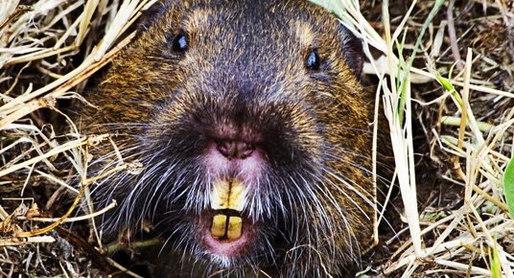
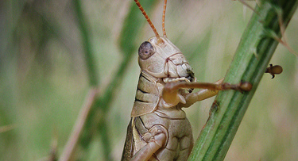
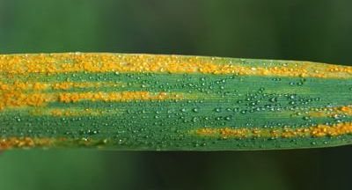
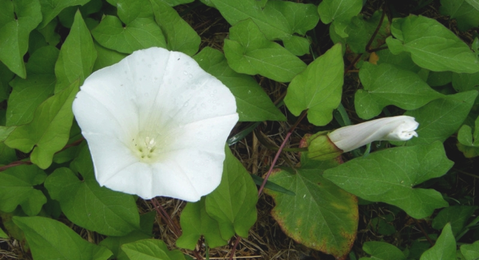
Types of pests
Vertebrates
Insects
Zoologists
Entomology
Pathogens
Weeds
Plant Pathologist
Weed science
Notes:
Four major categories of pests.

Slide 5
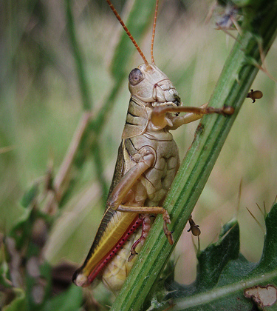
Insects: Types of Damage
Mechanical
  Damage to plant transport
  Eat seeds
  Reduce photosynthesis
Vectors of disease
Feed on phloem/xylem
  Take nutrients
Notes:
Picture by C Walsh
Discussion may need to focus on the term vector. This is also a good time to review xylem and phloem and why pests may focus on these structures.

Slide 6
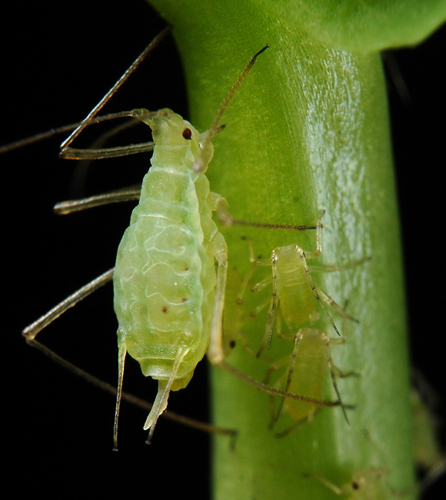
Common Pests in Small Grains
Aphids
  Many species
Wireworms
Hessian Fly
Cereal leaf beetle
Notes:
http://pnwhandbooks.org/insect/
http://en.wikipedia.org/wiki/Aphid
While not the only pests, these represent some of the more common insect pests. For a writing activity, students could create short descriptions and life cycle diagrams of these and each of the subsequent slides pests.

Slide 7
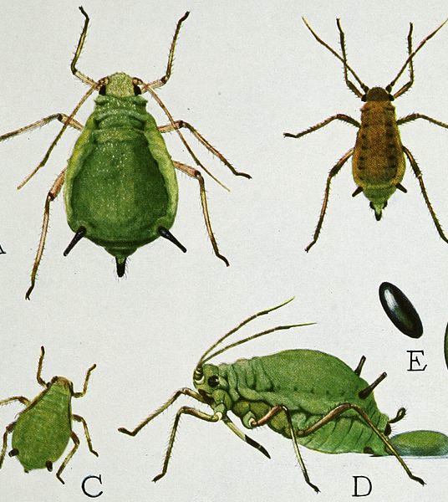
Example: Aphids
Soft bodied
Piercing-sucking mouth parts
Feed on phloem
Can transmit viruses
0.06-0.14 inches long
Most adults are wingless females
Notes:
http://en.wikipedia.org/wiki/File:Snodgrass_Aphis_pomi.jpg

Slide 8
Example: Aphids
Most of aphid impact is from virus spread
  Mosaic virus (bean, turnip, carrot, cucumber…)
  Potato virus y
  Potato leaf roll virus
  Barley yellow dwarf
Notes:
http://en.wikipedia.org/wiki/File:Snodgrass_Aphis_pomi.jpg
Similar to the insect summary pages suggested a few slides back, creation of disease summaries would also be a good way for students to locate and synthesize technical information.

Slide 9
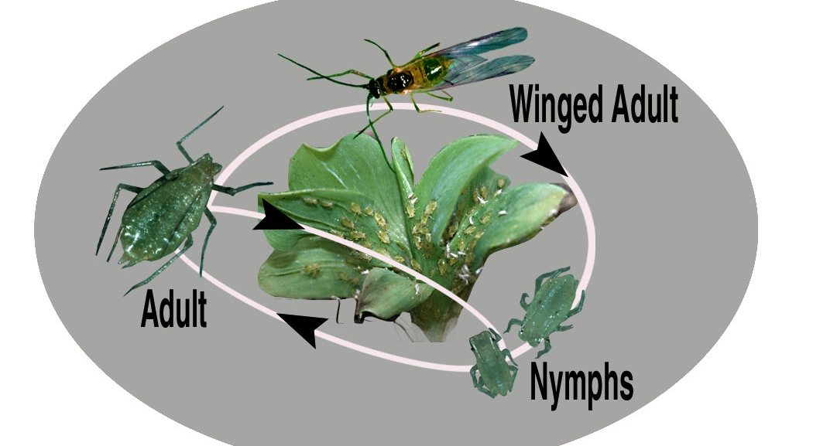
Aphids: Life cycle
Nymph to Adult:
7-10 days (73°-75°F)

Slide 10
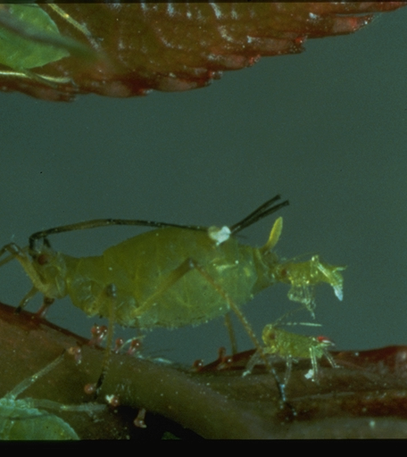
Aphids: Asexual reproduction
Females give birth to identical clones
Each daughter can begin reproducing in 4-10 days
In many species daughters are born already pregnant
  “telescoping generations”

Slide 11
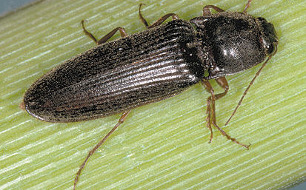
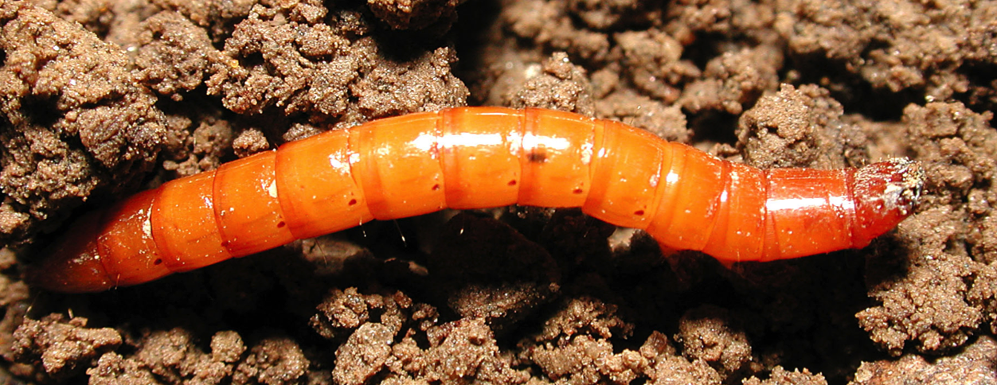
Wireworms
Beetles
Larvae are root feeding pests
  Spend several years as larvae
Notes:
http://extension.umass.edu/vegetable/insects/wireworm
http://www.ent.iastate.edu/imagegal/coleoptera/click/3936.12clickbeetle.html
Aaron Esser: http://lincoln-adams.wsu.edu/agriculture/Wireworm.html
http://lincoln-adams.wsu.edu/agriculture/Wireworm-Scouting-FS059E.pdf

Slide 12
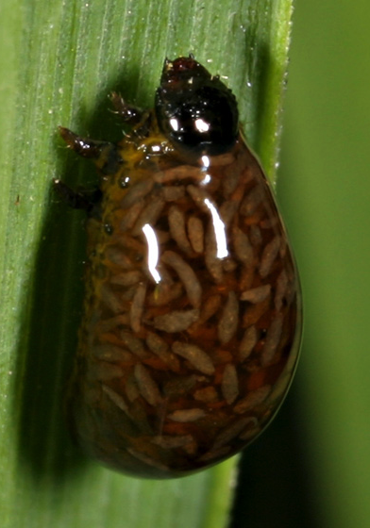
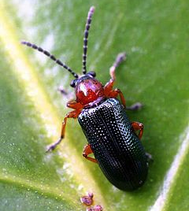
Cereal Leaf Beetle
Pests as adults and larvae
Preferred hosts are barley, oats, wheat, rye and corn
Feed on mesophyll
  Portion of leaf responsible for photosynthesis
Notes:
http://www.cals.uidaho.edu/edComm/pdf/CIS/CIS0994.pdf
http://en.wikipedia.org/wiki/Cereal_leaf_beetle
http://bugguide.net/node/view/85057/bgimage

Slide 13
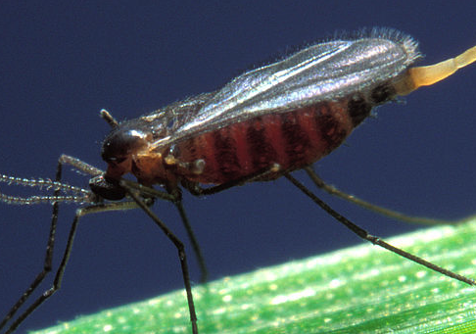
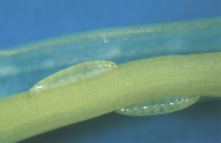
Hessian Fly
Significant crop pest of wheat, barley and rye
Feed on phloem
Transmit viruses
Native to Asia
Primarily a pest as larvae
Notes:
http://extension.entm.purdue.edu/fieldcropsipm/insects/hessianfly.php

Slide 14
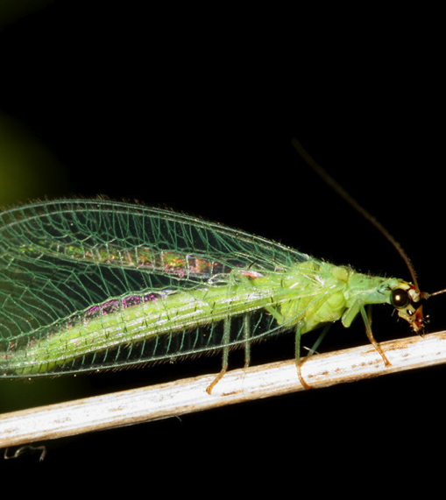
Beneficial Organisms
Natural Predators
  Insects that eat or parasitize pests
Detritivores
  Organisms involved in nutrient cycling
Pollinators
~98% of insect species are beneficial
Notes:
Picture of lacewing a natural predator
Students should be encouraged to identify other beneficial insects. If lady beetles are used in the school greenhouse as a biological control mechanism, this would be a good time to talk about them.

Slide 15
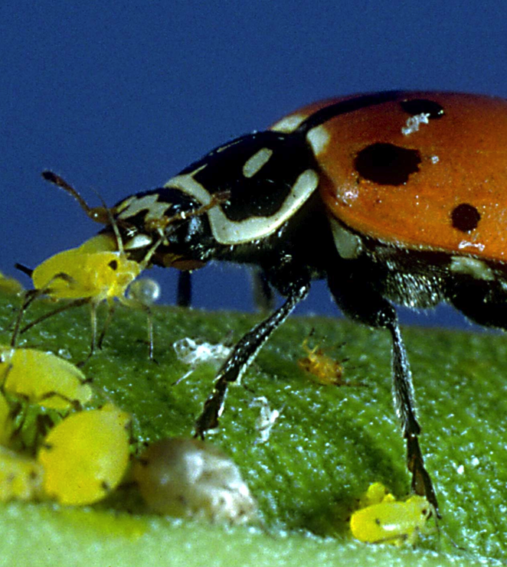
Natural Enemies
Parasitic Wasps
Spiders
Parasitic flies
Fungivorous and bactivorous nematodes
Predatory beetles
Predatory hemipterans
Preying mantises
Many more

Slide 16
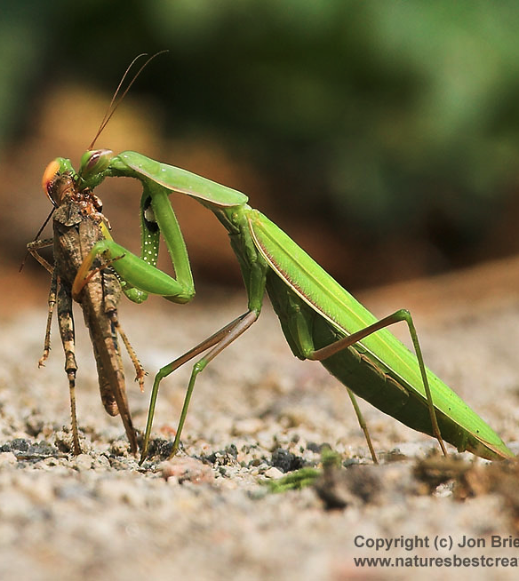
Increasing natural enemy populations
Reduce pesticide use
Increase crop diversity
Plant field margins with insectary plants
Intercrops
Cover crops
Mulches

Slide 17
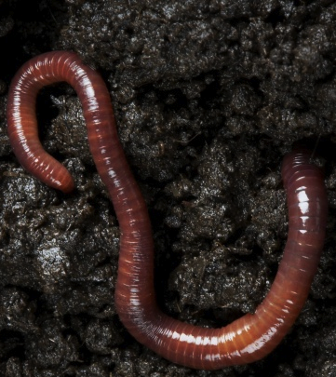
Detritivores
Important in nutrient cycling
Help to convert organic matter into plant available nutrients
Earthworms, arthropods primarily
Notes:
If the school has a composting site this could be an ideal time to visit and discuss why and what the school composts.

Slide 18
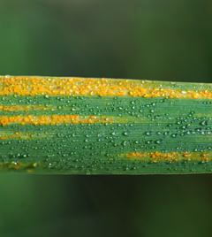
Pathogens
Block transport in plants
Reduce photosynthesis
Use plant nutrients
Reduce end use quality
  Toxins
  Effect aesthetics

Slide 19
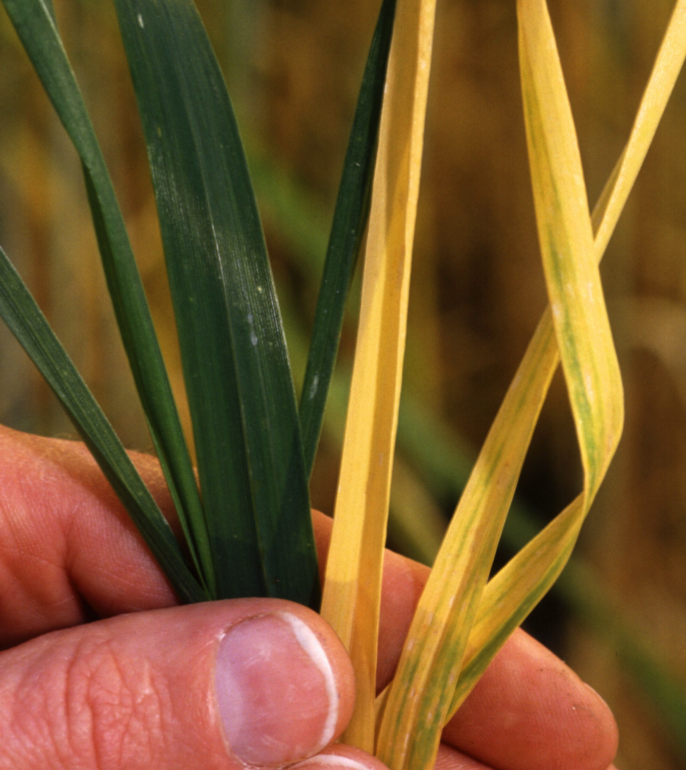
Viruses
Require vectors to be spread
Barley Yellow Dwarf
Wheat Streak Mosiac
Potato Virus Y
Notes:
If teachers are using this unit in conjunction with the FFA Agronomy CDE, additional slides may need to be created to include all of your states included pathogens.

Slide 20
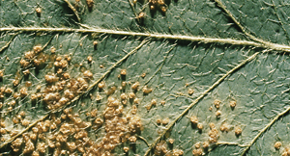
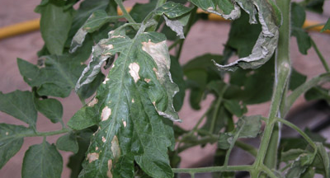
Bacteria
Favored by high humidity and high plant density
Bacterial leaf blight
Common genera:
  Erwinia
  Xanthomonas
  Pseudomonas

Slide 21
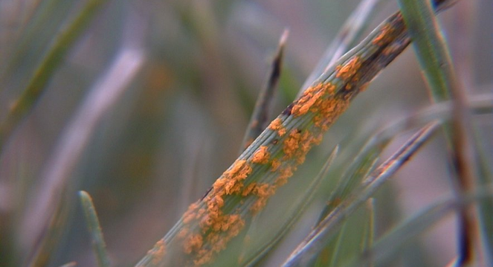
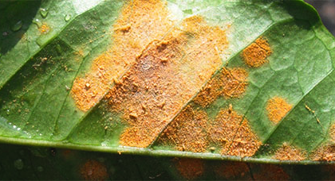
Fungi
Eukaryotes
Often have complex life cycles
Many survive long periods in the soil
Rusts, mildews, blights, cankers, rots, molds and wilts
Usually favored by humid conditions

Slide 22
Fungi
Eukaryotes
Often have complex life cycles
Many survive long periods in the soil
Rusts, mildews, blights, cankers, rots, molds and wilts
Requires humid climates/weather

Slide 23
Disease Triangle
Depends on local climates
Important pests vary by climate

Slide 24
Disease Triangle: Stripe Rust
Susceptible Wheat
Cool Humid
Weather
Puccinia striiformis
Stripe rust

Slide 25
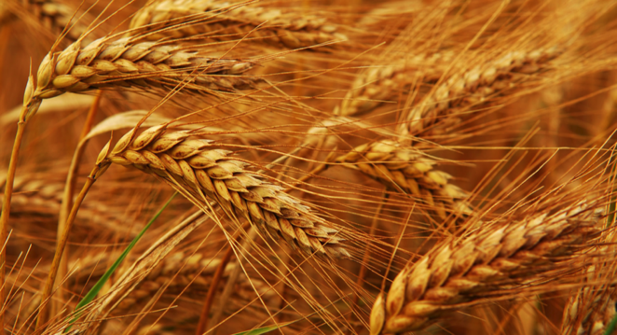
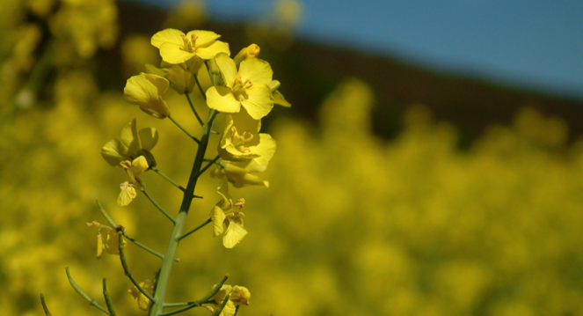
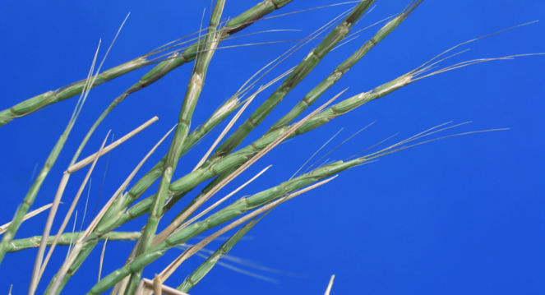
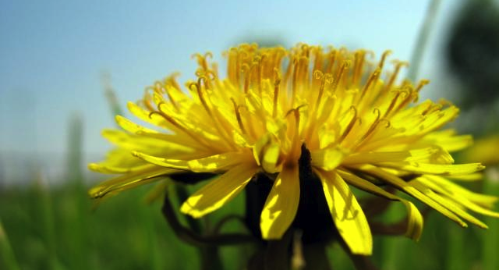
What is a weed?

Slide 26
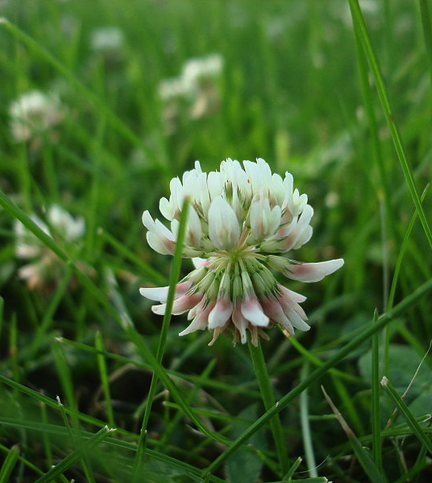
What is a weed?
A plant growing where it is not wanted and in competition with cultivated plants.

Slide 27
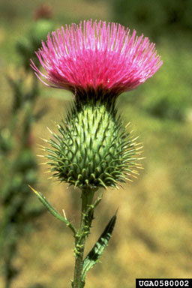
Common Weed Species
Depends on:
  Climate
  Crop
  Management
Some species are found in many systems
Others in just a few
Some weeds are more easily controlled

Slide 28
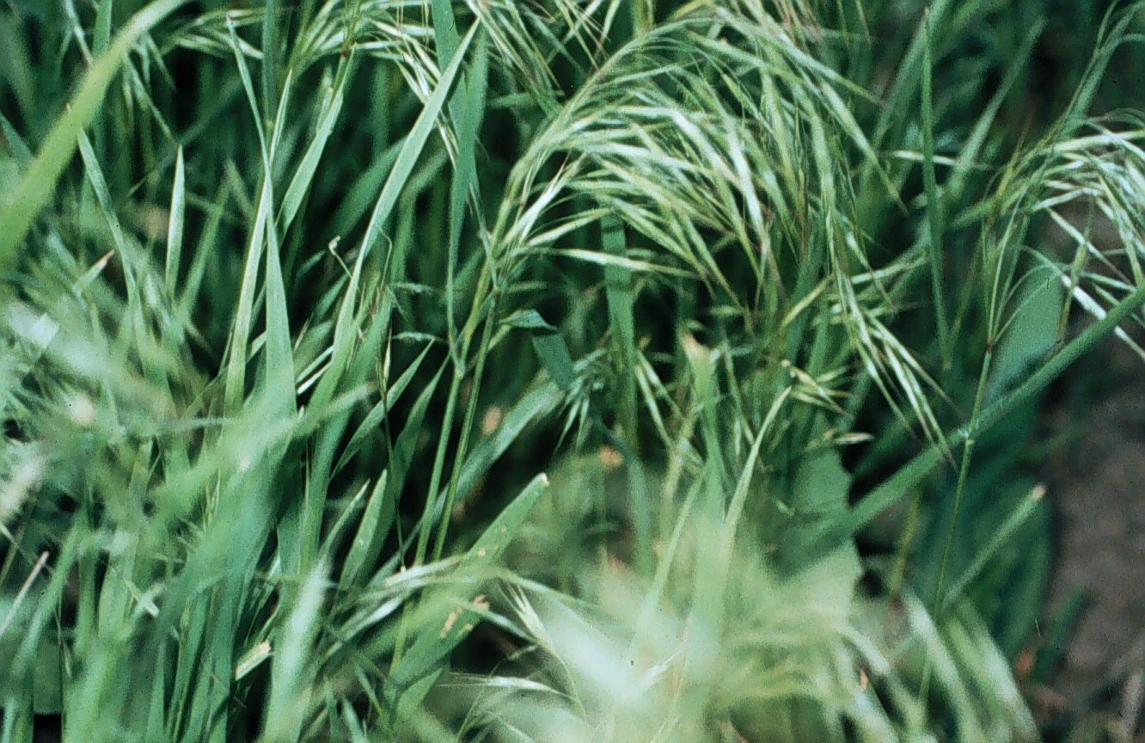
Common Weed Species
Most troublesome weeds are usually the most similar to the crop and therefore harder to control
Some weeds have become herbicide resistant
Notes:
http://news.cahnrs.wsu.edu/2009/04/16/regional-scientists-receive-500000-grant-to-test-weed-fighting-bacteria/

Slide 29
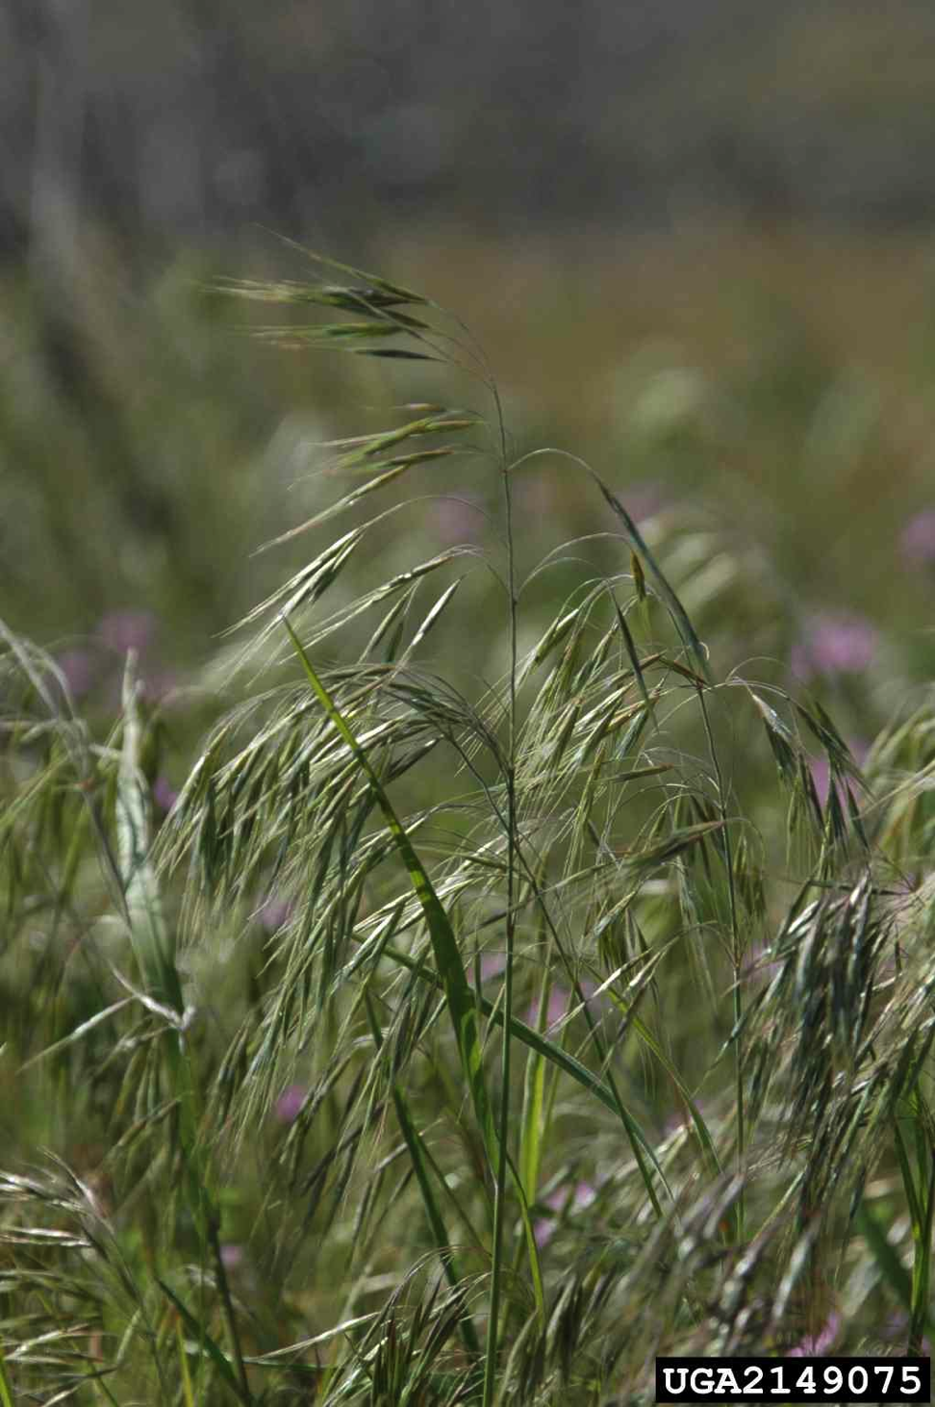
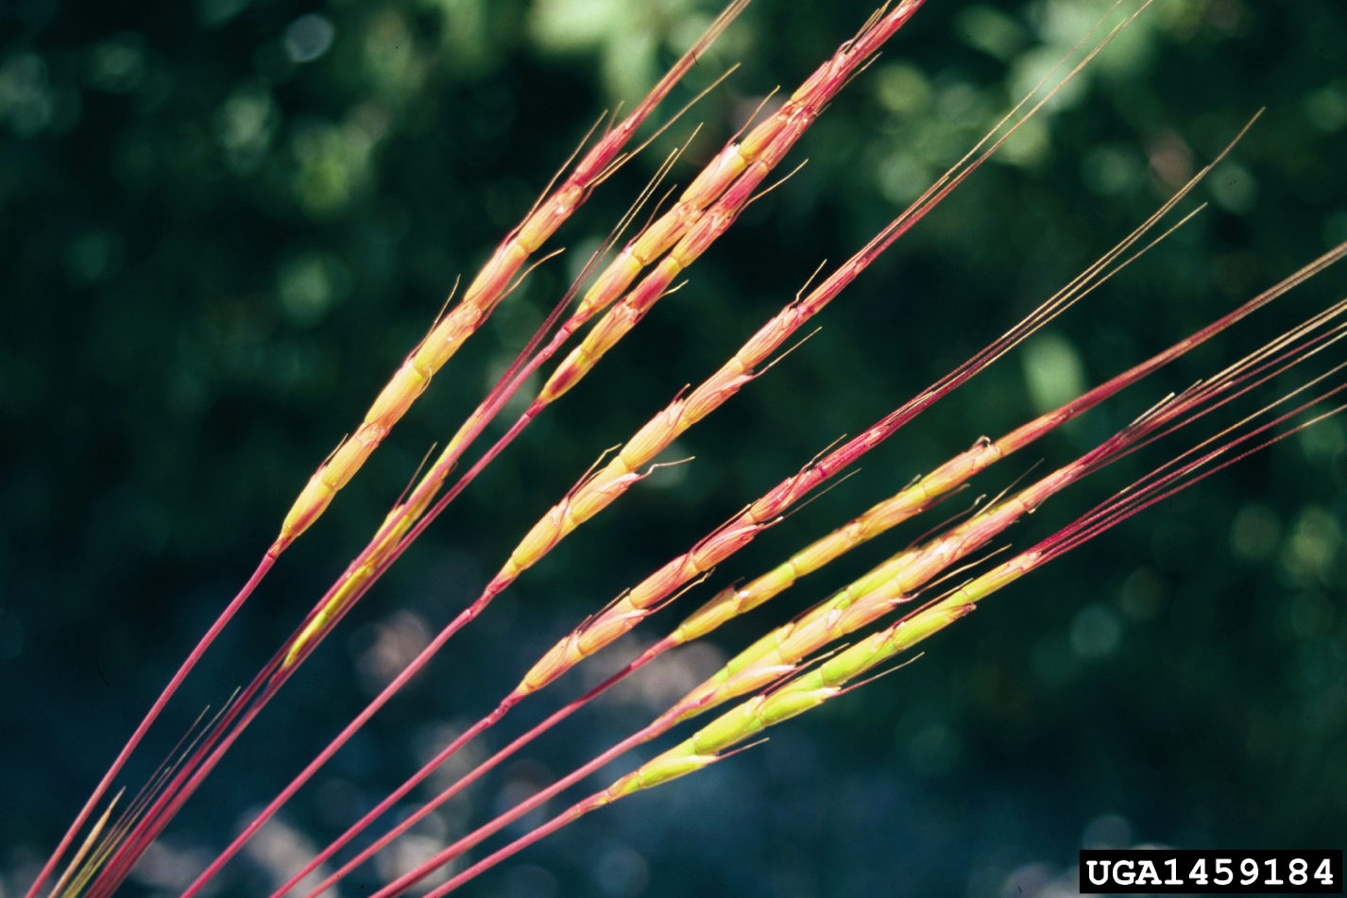
Common weed examples
Downy Brome
Jointed Goatgrass
Notes:
This is a good place to talk about weed classification and have students conduct quick searches to locate lists of your states restricted and prohibited noxious weeds.

Slide 30
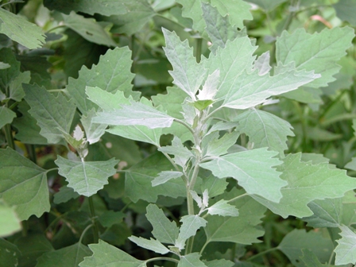
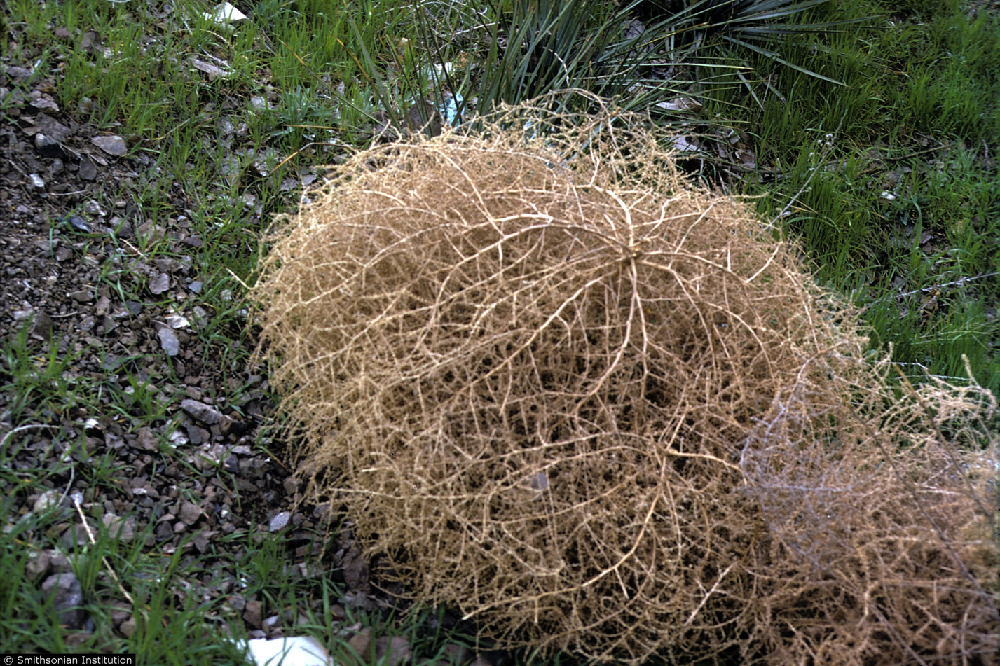
Common weed examples
Lambsquarter
Russian Thistle

Slide 31
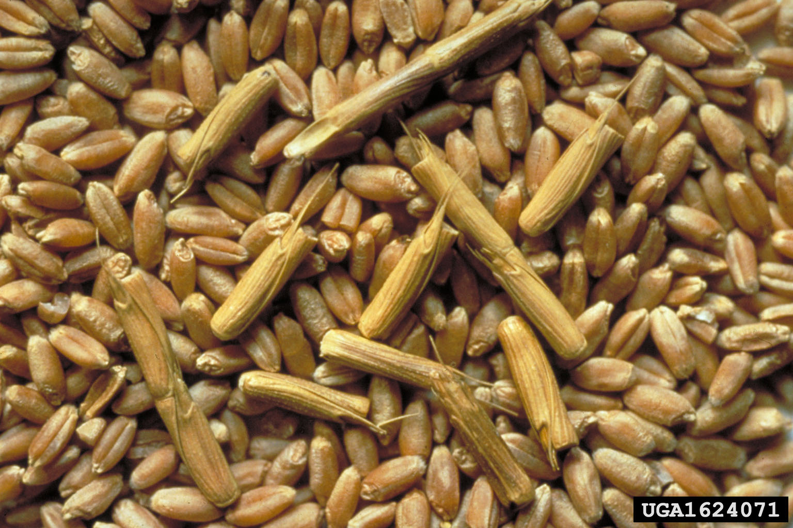
Effects of weeds
Compete with crop:
  Space
  Light
  Nutrients
  Water
Reduce crop quality
  Contamination
  Reduce yield
Notes:
http://www.invasive.org/weedcd/species/5038.htm when wheat contains weed seeds it has lower quality and receives a lower price. Prohibited weed seed presence may make a crop unsellable.

Slide 32
Effects of pests and diseases
Kill whole plants
  Vascular wilts, boring insects
Stunting plants
  Many viruses, insects, nematodes
Reduce end use quality

Slide 33
Thresholds
Economic Injury Level: cost of treatment = cost of damage
Action Threshold: before EIL, accounts for delay between detection/treatment and effect

Slide 34
Economic Injury Level (EIL)
EIL = C ÷ (V x L x K)
V = value of crop ($/acre)
L = loss per acre/insect (yield/acre /insect)
C = Pest Management Costs ($/acre)
K = proportionate reduction in injury

Slide 35
One of the principal advantages of EILs is their objectivity and scientific basis
L is determined empirically through field & laboratory experimentation.
C is, for the most part, easily determined.
For most agricultural crops, V is commonly available.

Slide 36
EIL = C ÷ (V x L x K)
What happens to the EIL when:
  Crop values are high?
  Crop values are low?
  A variety is resistant to the pest?
  The control rate is low?
  The control rate is high?
⬇
⬆
⬆
⬆
⬇

Slide 37
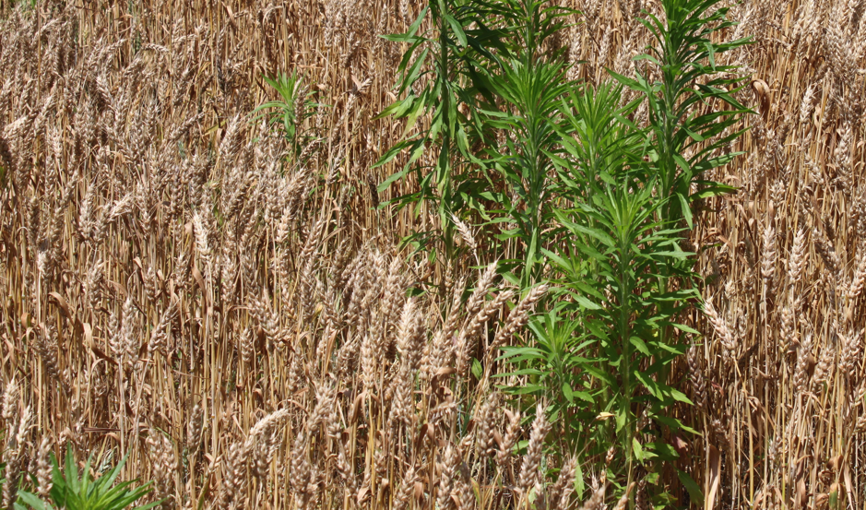
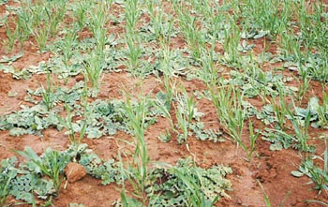
EIL/Thresholds
Thresholds can vary for different plant developmental stages
  Germination vs dry down
  When the crop is small fewer weeds can have a larger effect
  When a crop is close to harvest, weeds are less important unless it effects quality
Notes:
http://blogs.ext.vt.edu/soybean-update/2012/06/01/marestail-management-in-wheat-chris-drake-southampton-county-agent/
http://www.fao.org/docrep/006/x8234e/x8234e14.jpg

Slide 38
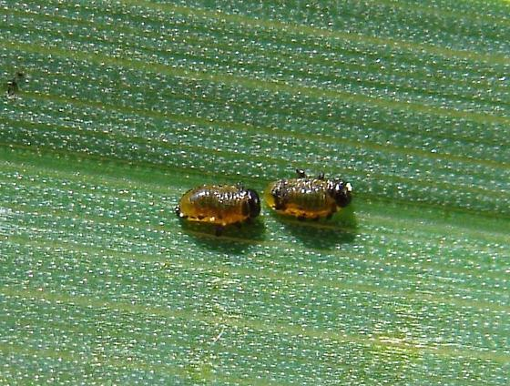
Cereal Leaf Beetle
Economic threshold is 3 larvae per plant or three eggs per plant
After boot threshold is 1 larvae per flag leaf
Notes:
http://bugguide.net/node/view/518615

Slide 39

Integrated Pest Management
Move from prevention to intervention
Cultural
Mechanical/physical
Biological
Chemical
Notes:
If YouTube is not blocked in your school, consider showing this video: https://youtu.be/UZPeanRqW5s for a homeowner approach to IPM, and this one: https://youtu.be/87VtpvnHSJ4 for agricultural applications.

Slide 40
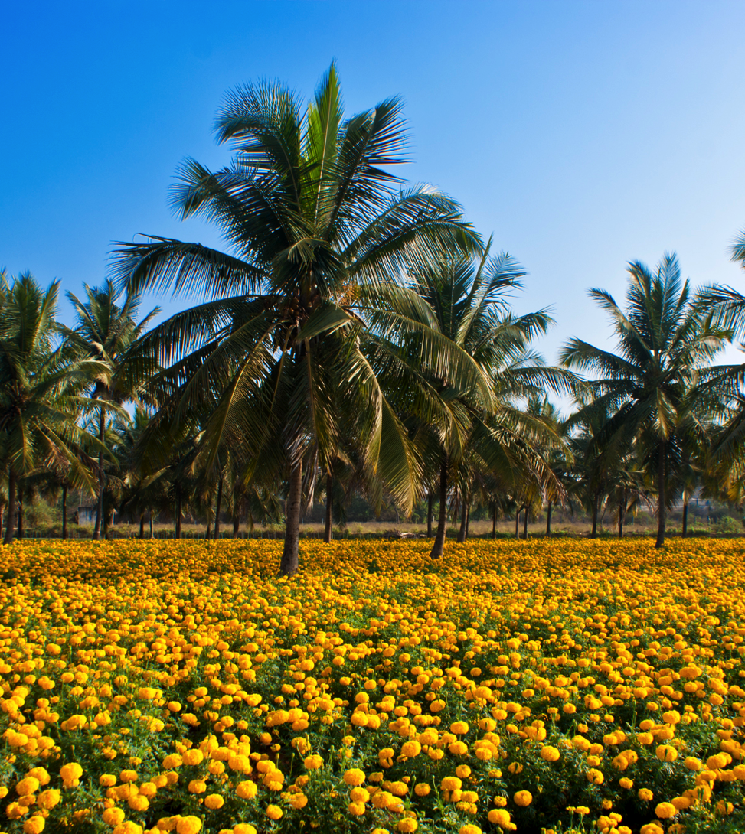
Cultural
Resistant cultivars
Certified seed
Trap crops
Intercropping
Crop rotation: 4+ years
Cultivation and tillage
Timing of planting
Timing of irrigation

Slide 41
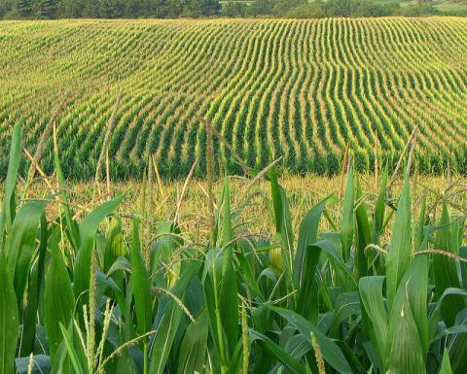
Importance of Diversity
Current agricultural systems have little diversity
High demand for cash crops such as wheat, corn, soybeans and potatoes
Incentive to grow most profitable crop
Notes:
Using Google Earth, students can look for regional examples of strip cropping, or can look for examples from across the world.

Slide 42
Spatial Diversity
Large areas planted with a single species
Often made up of genetically identical individuals

Slide 43
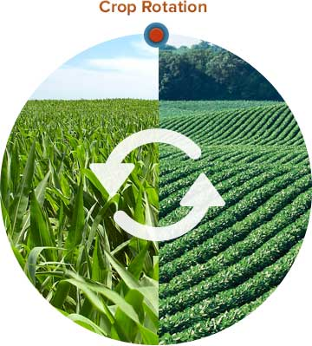
Temporal Diversity
Many fields have limited crop rotation
It is important to change the crops grown in each field to break pest and disease cycles
Best to plant very dissimilar crops
  Wheat and peas
  Not wheat and barley
Notes:
http://followgreenliving.com/profitable-practice-crop-rotation/

Slide 44
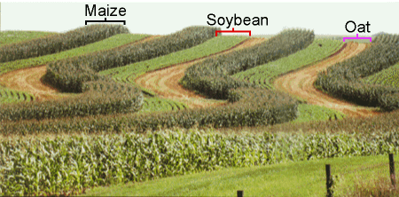
Increasing diversity
Reduces pests
Breaks disease cycles
  Diseases from previous years are not able to infect the next year’s crops
Reduces economic risk
  Like a diverse stock portfolio
Notes:
http://masters.agron.iastate.edu/Content/Students/sample/classes/Sample/lesson09/detail/strip.html

Slide 45
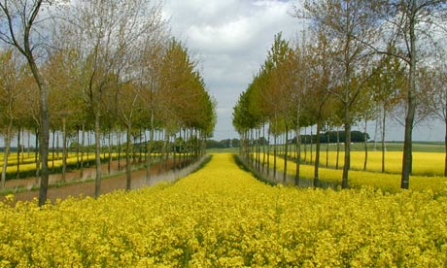
Increasing diversity
Increase the number of different crops in rotation
Intercrop (plant 2+ crops together)
Strip crop (plant 2+ crops in alternating rows)
Agroforestry (mix timber and crops)
Notes:
http://www.theguardian.com/environment/2012/aug/21/agroforestry-france-farming-revival

Slide 46
Mechanical/Physical
Tillage
  Inter-row cultivation
  Hand weeding
Mowing
Screens/traps

Slide 47
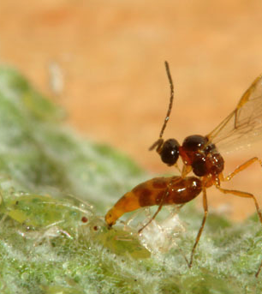
Biological
Natural predators and parasites
Biopesticides
  Mustard meal
  Fungi
  Bacteria

Slide 48
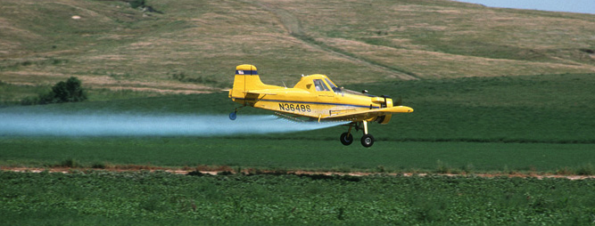
Chemical control
Appropriate pesticide use
Hormones

Slide 49
Implementing IPM
Principle 1: No Silver Bullet
  A mixture of strategies is needed
Principle 2: Treat the cause not the symptoms
  Learn about pest biology, especially environmental controls of pest invasion and survival
Principle 3: Presence does not equal problem
  Use economic thresholds

Slide 50
Implementing IPM
Principle 4: If you kill natural enemies you inherit their work
  Use naturally occurring bio-control agents
Principle 5: Just-in-time not Just-in-case
  Use pest sampling and forecasting methods
  Scout and monitor regularly

Slide 51
Chemicals & Youth in Agriculture
Handout from NSTMOP (HOSTA Task Sheet 3.5)
All youth under 18 are considered children.
Anywhere on a label that references children means anyone under 18.
Family exemptions: A farm where the parents are owners or part of a family owned coop or corporation.
Notes:
Download HOSTA Task Sheet 3.5 here: http://articles.extension.org/sites/default/files/NSTMOP%20Task%20Sheets%20Section%203%202013.pdf, or use the one included in the zipped readings file. Depending on your states level of enforcement, you may need additional time on this topic.

