Slide 1

Geographical Information Systems (GIS) & Precision Agriculture
What information could I utilize to maximize my on farm income?

Slide 2
Standards
Double click image to open MS Word DOC
This presentation contains three sections. One is an overview of GIS, one an overview of the GPS system, and the third applications of GIS.

Slide 3

Objectives
Define GIS related terms
Interpret GIS maps for specific data
List data sets freely available to agriculturalists through government sources.
Create a custom GIS map of your production area
Design a presentation, incorporating GIS components, to relay information
Subdivide your county using production related data sets
Provide field corners in geo-spatial terms of Longitude and latitude
Identify common applications for GIS technology in modern agriculture
Explain the advantages of GIS and precision agriculture to local agriculturalists
Explain how GIS can save farmers money when buying crop insurance
Describe how GPS has revolutionized agriculture

Slide 4
Terms
AOI—Defined area of interest from which data is taken
GIS—Geographical information systems
GPS—Global Positioning Sattelites

Slide 5
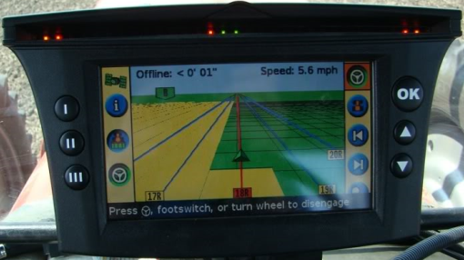
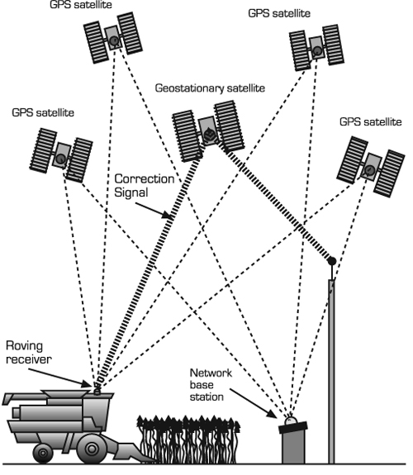
Global Positioning Satellite System
Pentagon began funding in 1973
  Launched first satellite (Block I) in 1978
  Second-generation satellites launched 1998
  System operational in 1995
  Original system was solely for government use
Open to public May 2000
  Government removed signal degradation
Notes:
http://pubs.ext.vt.edu/442/442-503/442-503.html

Slide 6
How do I view GIS data?
Web Applications
  US Geospatial One-Stop Data Portal - http://geo.data.gov/geoportal/catalog/main/home.page
  USGS Soil Survey - http://websoilsurvey.nrcs.usda.gov/app/HomePage.htm
  REACCH GIS Portal
  Others???
Free Downloadable Viewers
  ESRI ArcGIS Explorer - http://www.esri.com/software/arcgis/explorer
For Fee GIS Software
  ESRI ARCGIS 10

Slide 7
Where do we find data?
Free Data sources
  REACCH Program GIS Page
  USDA Geospatial data gateway @ http://datagateway.nrcs.usda.gov/
For Fee data
  Many GIS companies can create specialized data sets for you for a fee, many simply combine free resources to custom meet your needs

Slide 8
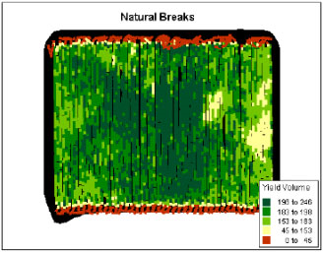
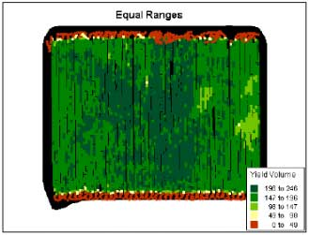
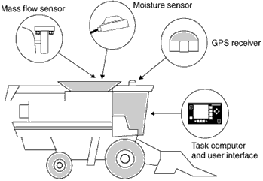
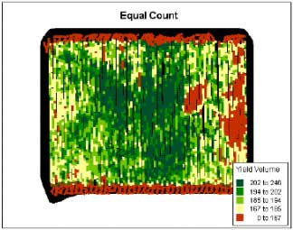
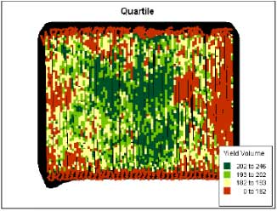
Common Applications for GIS Technology in Modern Agriculture
Yield Monitors
  Different yield maps showing same data
Basic Components
Notes:
Photos & Resources:
Yield Monitor https://www.pioneer.com/home/site/us/template.CONTENT/guid.8CC87FE3-DA4B-4157-9929-9578C88055C1/

Slide 9
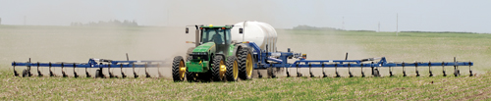
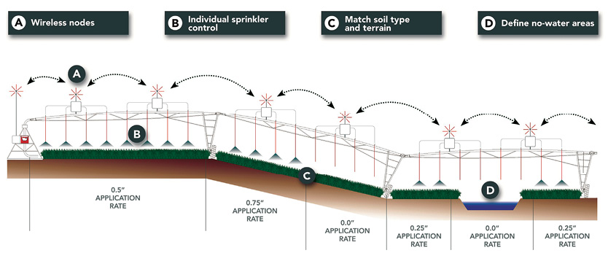
Variable Rate Application
Varies rates of water and fertilizer based on need of the crop and its stage of growth
Notes:
http://pubs.ext.vt.edu/442/442-505/442-505_PDF.pdf
http://www.farm-equipment.com/pages/Feature-Articles---Solving-the-Riddle-of-Variable-Rate-Application.php
http://www.farm-equipment.com/pages/In-this-Issue-AprilMay-2014-Ahead-of-the-Curve.php

Slide 10
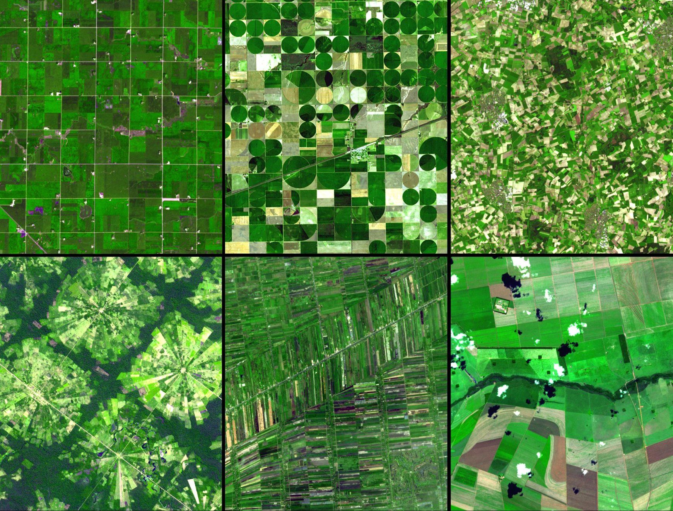

Remote Sensing
Notes:
In this montage of six ASTER sub-images, the differences are graphically illustrated by the variation in field geometry and size. In Minnesota (upper left) the very regular grid pattern reflects early 19th century surveying; the size of the fields is a function of mechanization and that dictates a certain efficiency. In Kansas (upper middle), center pivot irrigation is responsible for the field pattern. In northwest Germany (upper right), the small size and random pattern of fields is a leftover from the Middle Ages. Near Santa Cruz, Bolivia (lower left), the pie or radial patterned fields are part of a settlement scheme; at the center of each unit is a small community. Outside of Bangkok, Thailand (lower middle), rice paddies fed by an extensive network of canals that is hundreds of years old, appear as small skinny rectangular fields. And in the Cerrado in southern Brazil (lower right), cheap cost of land and its flatness have resulted in enormous farms and large field sizes. SOURCE: http://auracle.ca/news/?p=80

Slide 11
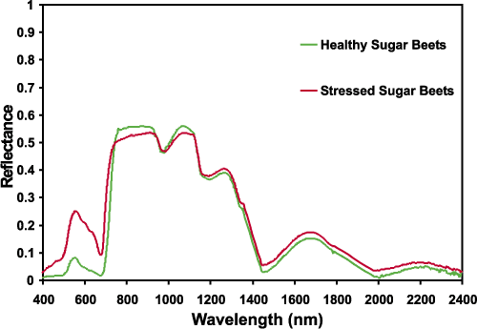
Spectral Resolution
Health and stressed plants reflect light differently

Slide 12
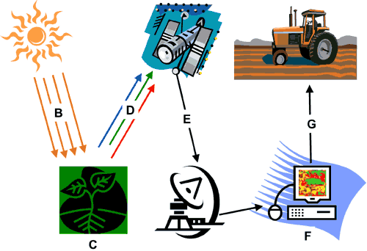
Remote Sensing cont.
Notes:
Photo: http://auracle.ca/news/?p=80

Slide 13
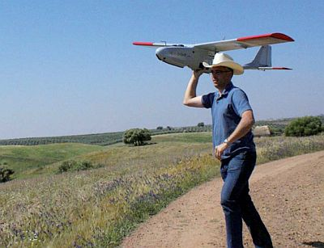

Unmanned aerial vehicles
Mapping
Crop scouting
Population counting
Prospect of crop dusting,
aerial applications
Notes:
http://www.precisionfarmingdealer.com/content/agriculture-gives-unmanned-aerial-vehicles-new-purpose
http://www.huffingtonpost.com/2013/05/20/drones-agriculture-unmanned-aircraft-farming_n_3308164.html
http://www.vision-systems.com/content/dam/VSD/online-articles/2012/01/vsdnewsheadwall011312.jpg

Slide 14
Labs & Activities Ideas
Create a custom GIS map of your production area
Design a presentation, incorporating GIS components, to relay information
Subdivide your county using production related data sets
Provide field corners in geo-spatial terms of Longitude and latitude (using a GPS)
Create a Google Earth maps of the locations and photographs of 10 weeds specified by the teacher.

Slide 15
Sections 1 & 2 Worksheets & Activities
Double Click on image to open MS Word Doc

Slide 16
Introduction
to GPS
Condensed from National Parks Service Training:
http://www.nps.gov/gis/gps/nps_gps_training.html

Slide 17
The History of GPS
Feasibility studies begun in 1960’s.
Pentagon appropriates funding in 1973.
First satellite launched in 1978.
System declared fully operational in April, 1995.
Intentional degradation of signal set to zero May 2000

Slide 18


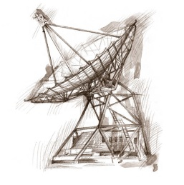
How GPS Works
Notes:
Signals from a minimum of three satellites converge at only one point. This is your location. The more evenly spaced the satellites, the more accurate the decoded signals are and the more accurate your position.
Complete GPS intro unit from Natl. Parks Service: http://www.nps.gov/gis/gps/gps4ics/2_prework/prework.ppt or http://www.nps.gov/gis/gps/downloadable_ppt.html

Slide 19
Three Segments of the GPS System
Space Segment
User Segment
Control Segment
Ground
Antennas
Master Station
Monitor Stations

Slide 20
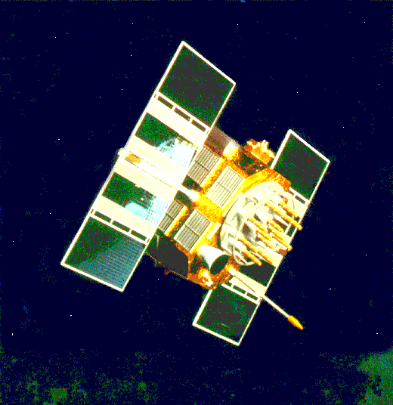
Components of the System
Space segment
24 satellite vehicles
Six orbital planes
  Inclined 55º with respect to equator
  Orbits separated by 60º
20,200 km elevation above Earth
Orbital period of 11 hr 55 min
Five to eight satellites visible from any point on Earth
Block I Satellite Vehicle

Slide 21
Signal From One Satellite
The receiver is somewhere on this sphere.

Slide 22
Signals From Two Satellites

Slide 23
Triangulating Correct Position

Slide 24
Three Satellites (2D Positioning)

Slide 25
Three Dimensional (3D) Positioning

Slide 26
GPS Satellite Geometry
Satellite geometry can affect the quality of GPS signals and accuracy of receiver trilateration.
Dilution of Precision (DOP) reflects each satellite’s position relative to the other satellites being accessed by a receiver.
There are five distinct kinds of DOP.
Position Dilution of Precision (PDOP) is the DOP value used most commonly in GPS to determine the quality of a receiver’s position.
It’s usually up to the GPS receiver to pick satellites which provide the best position triangulation.
Some GPS receivers allow DOP to be manipulated by the user.

Slide 27
Ideal Satellite Geometry
N
W
E
S

Slide 28
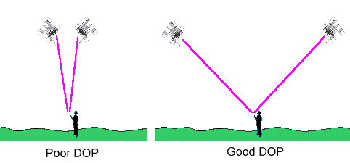
Good Satellite Geometry
Notes:
Image source: http://www.pdhcenter.com/courses/l116/l116content.htm

Slide 29
Poor Satellite Geometry
N
W
E
S

Slide 30
Poor Satellite Geometry

Slide 31
Poor Satellite Geometry

Slide 32
Sources of Signal Interference
Earth’s Atmosphere
Solid Structures
Metal
Electro-magnetic Fields

Slide 33
Sources of GPS Error
Standard Positioning Service (SPS ): Civilian Users
Source Amount of Error
  Satellite clocks: 1.5 to 3.6 meters
  Orbital errors: < 1 meter
  Ionosphere: 5.0 to 7.0 meters
  Troposphere: 0.5 to 0.7 meters
  Receiver noise: 0.3 to 1.5 meters
  Multipath: 0.6 to 1.2 meters
  User error: Up to a kilometer or more
Errors are cumulative and increased by PDOP.

Slide 34
Receiver Errors are Cumulative!
System and other flaws = < 9 meters
User error = +- 1 km

Slide 35
Position Fix
A position is based on real-time satellite tracking.
It’s defined by a set of coordinates.
It has no name.
A position represents only an approximation of the receiver’s true location.
A position is not static. It changes constantly as the GPS receiver moves (or wanders due to random errors).
A receiver must be in 2D or 3D mode (at least 3 or 4 satellites acquired) in order to provide a position fix.
3D mode dramatically improves position accuracy.

Slide 36
Waypoint
A waypoint is based on coordinates entered into a GPS receiver’s memory.
It can be either a saved position fix, or user entered coordinates.
It can be created for any remote point on earth.
It must have a receiver designated code or number, or a user supplied name.
Once entered and saved, a waypoint remains unchanged in the receiver’s memory until edited or deleted.

Slide 37
Planning a Navigation Route
= Waypoint
Start

Slide 38
How A Receiver Sees Your Route

Slide 39

GPS Satellite Vehicle
Four atomic clocks
Three nickel-cadmium batteries
Two solar panels
  Battery charging
  Power generation
  1136 watts

Slide 40
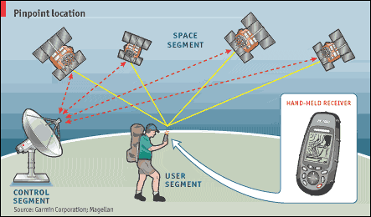
GPS Communication and Control

Slide 41

Geocaching
Cache of goodies established by individuals
Coordinates published on Web
Find cache
  Leave a message
  Leave some treasure
  Take some treasure
http://www.geocaching.com/

Slide 42
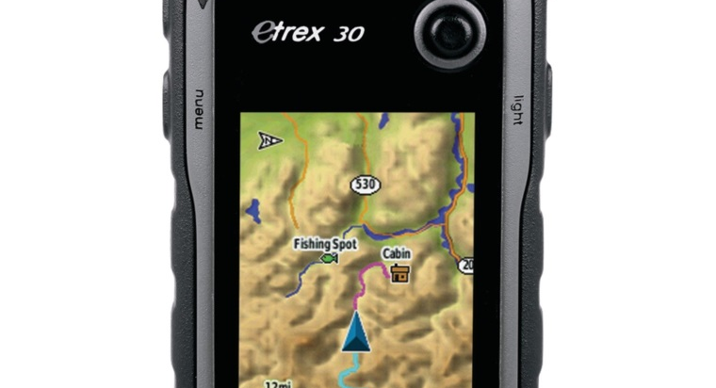
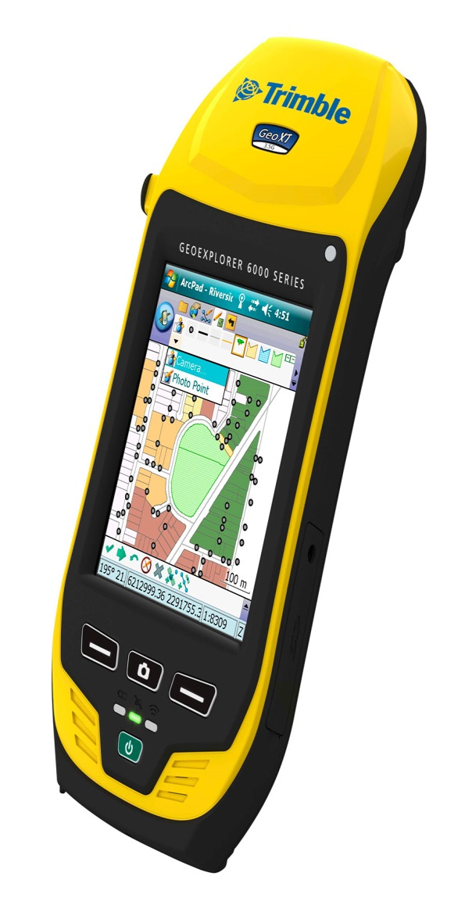
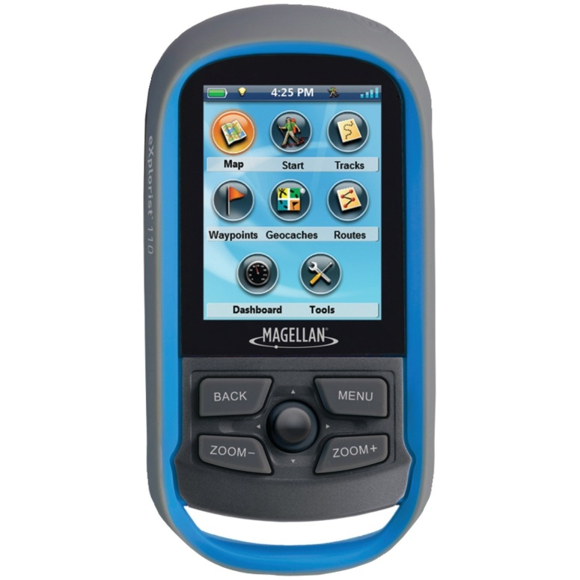
Handheld GPS Receivers
Three popular manufacturers
  Garmin
  Magellan
  Trimble
Price Range:
$50 to over $3,000

Slide 43
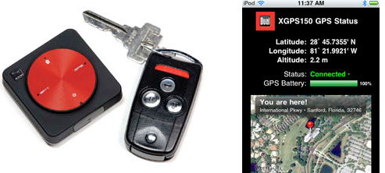
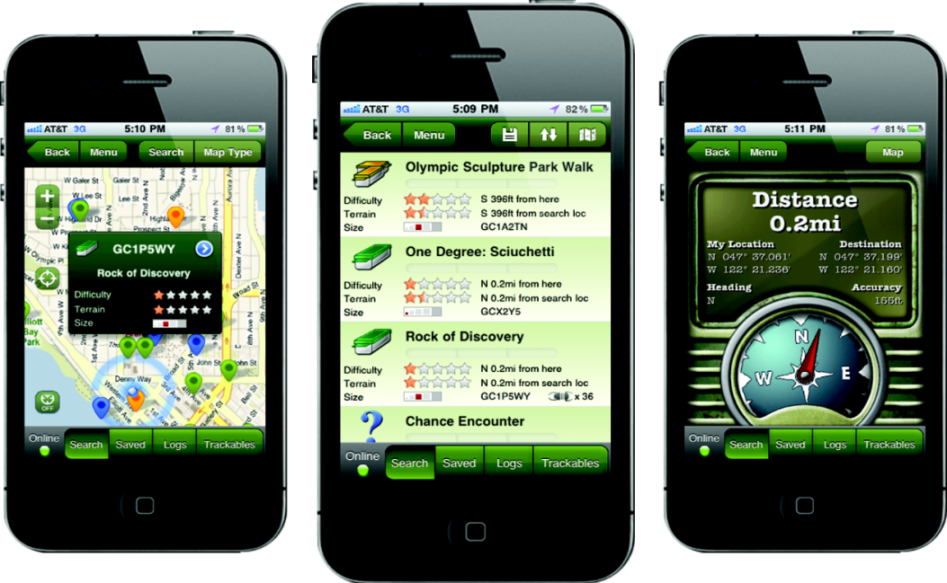
Smart phones and tablets
Many smart phones have native GPS
Tablets with cellular data plans usually have GPS
External GPS receivers are an inexpensive alternative
Accuracy can rival high end GPS units.
Notes:
Image sources: http://www.chipchick.com/2011/06/dual-electronics-xgps150-review.html, http://www.cachingbox.com/top-android-or-iphone-apps-for-geocaching/

Slide 44
Introduction to
Geographic Information Systems (GIS)
Edward Flathers
College of Natural Resources
Notes:
Each slide will have some descriptive information to help explain the concept that the slide is illustrating.

Slide 45
Multimedia:
This American Life episode that talks about maps—the prologue is about 4 minutes long and introduces some of the concepts of the lessons: http://www.thisamericanlife.org/radio-archives/episode/110/mapping
The book that is referred to in the episode is interesting to look at, too: http://sigliopress.com/book/everything-sings/
Notes:
The episode is more related to urban GIS, but it’s an entertaining listen. The whole thing is about an hour long, but the first four minutes are Ira Glass interviewing a man who works mapping problems with the streets and sidewalks of New York City. Important about this is Glass’ description of maps as “ignoring everything in the world but one thing.” This idea can be tied directly to the ‘layers’ concept that follows in the slides.

Slide 46
What is GIS?
Different kinds of spatial data
Organized into layers
To help solve a problem
And show the results
Notes:
This is a simple definition of GIS. Check the Wikipedia page (http://en.wikipedia.org/wiki/Geographic_information_system) for a more elaborate definition, but these are the basics. GIS is a tool for solving spatial problems. The problem might be ‘How do I get from Seattle to Chicago?’ and the answer is a road map, which is a product of GIS. The problem might be ‘How many water wells are there in Latah county?’ and the answer is a map of well locations, maybe including information about the person responsible for each well so that they can be contacted to arrange water quality testing. The problem might be ‘Where do I open my new coffee shop?’ and the solution is as simple as a street address that was chosen by the GIS using criteria that you entered (things like distance from other coffee shops, amount of traffic on the street, proximity to downtown business areas, etc.). These days, almost all maps are made using GIS, from simple ones like weather maps to complex ones like mineralogical survey results.

Slide 47
Several Kinds of Spatial Data
Vector Data
  Points
  Lines
  Polygons
Raster Data
  Grid of pixels
And more…
Notes:
This slide is meant as an overview for the next four slides, which have examples of each of these kinds of spatial data. The important concept here is that vector data can be thought of as mathematically-defined sets of coordinates on the surface of the Earth (like an x,y coordinate for a point, or a series of x,y coordinates for a line, or a series of x,y coordinates where the last pair is the same as the first for a polygon) that can have a set of attributes associated with them, and raster data is a grid of squares where each square is the same size and represents a single value for that area of the ground.

Slide 48
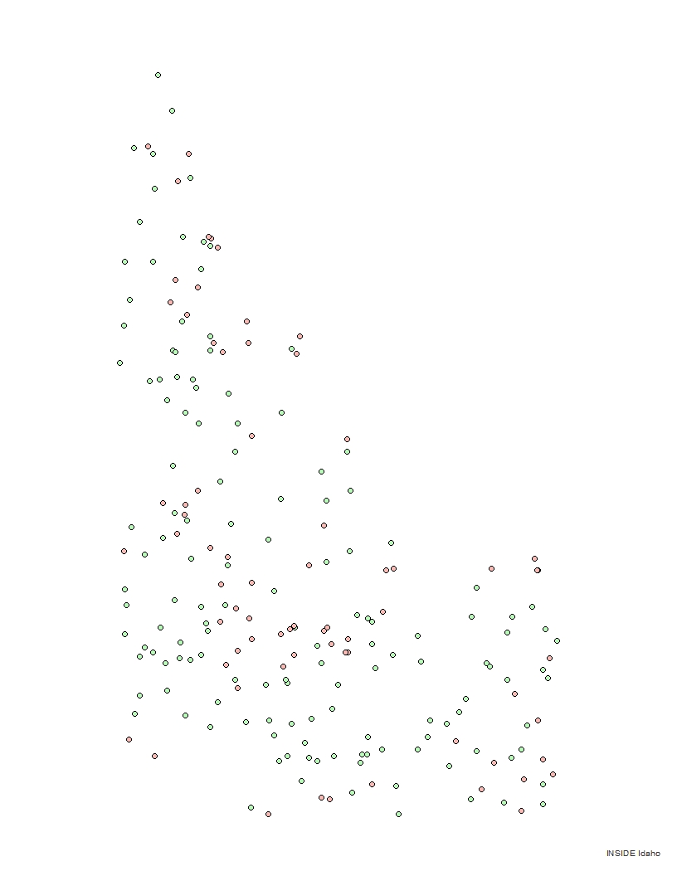
Points: Weather Stations of Idaho
Notes:
This is a point layer that shows weather stations in Idaho. The green points are National Weather Service stations and the red points are Natural Resources Conservation Service stations. Each point has an attribute that tells what agency runs it, and we choose the symbol for the point using that attribute. This will be a common theme in vector data.
Each point is stored in the GIS as an x,y coordinate pair and an associated list of attributes, like the operating agency, the street address, etc.
Point layers are usually used to show localized, discrete things like buildings, wells, cities (on a small-scale map), etc.

Slide 49
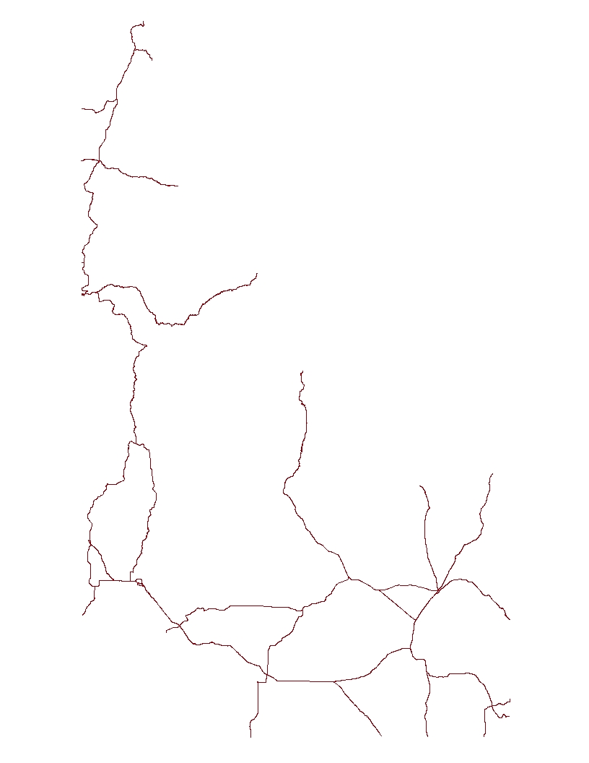
Lines: National Highways of Idaho
Notes:
This is a line layer that shows national highways/freeways in Idaho. There are no different symbols for the different kinds of roads shown here, but you could use different symbols for the Interstate Highway System vs. the US Highway System, or for different speed limits, or number of lanes, or any other attribute that is stored for the lines.
Each line is stored in the GIS as a series of x,y coordinate pairs and an associated list of attributes, like the type of highway, the route number, length, etc.
Line layers are usually used to show linear features like roads, railroads, rivers, etc.

Slide 50
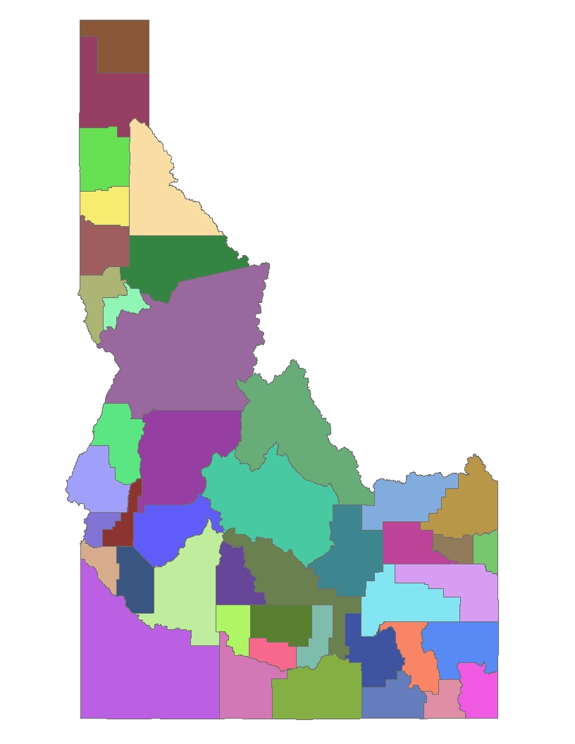
Polygons: Counties of Idaho
Notes:
This is a polygon layer that shows the counties of Idaho. The symbols (colors) of the polygons are chosen to be unique for each county name, so no two counties should be quite alike, though some are close enough to appear very similar—there are 44 counties in Idaho, and it can be difficult to come up with 44 different colors that the human eye can immediately distinguish. Other ways to symbolize this layer might be by population density, political party majority, etc.
Each polygon is stored in the GIS as a closed series of x,y coordinate pairs (so the last pair is the same as the first) and an associated list of attributes, like the county name, county seat, area, etc.
Polygon layers are usually used to show areal features like boundaries (county, state, legislative district, school district, property lines, etc.), lakes, building footprints in large-scale maps, etc.

Slide 51
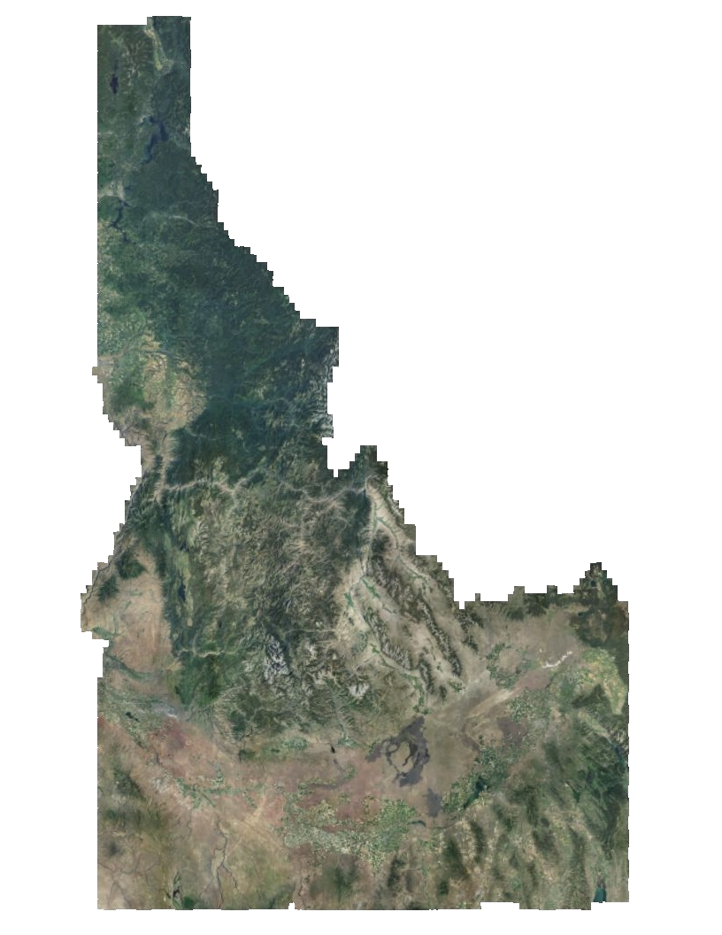
Raster: Air Photo of Idaho
Notes:
A good way to demonstrate raster data is to show something like Google Maps or ArcGIS online. Pick a spot in your town and zoom in on it and notice how you can make out more and more detail as you go. These kinds of raster images are taken by aircraft that fly relatively low and use digital cameras to take photos in which each pixel represents a small area—maybe 1 square meter, or 1 square foot, for example. The zoomed out view, like we see on this slide, is created by collecting all of the photos taken from the aircraft and stitching them together into a ‘photomosaic’.
This raster shows Idaho in natural color, or what we’d see with the naked eye. Each pixel in a raster has a value, and in this case, the value is the color of light we see when we look at that area of the ground, so when we show it on the screen, we can begin to make out some basic land cover (forest vs. rangelands, for example).

Slide 52
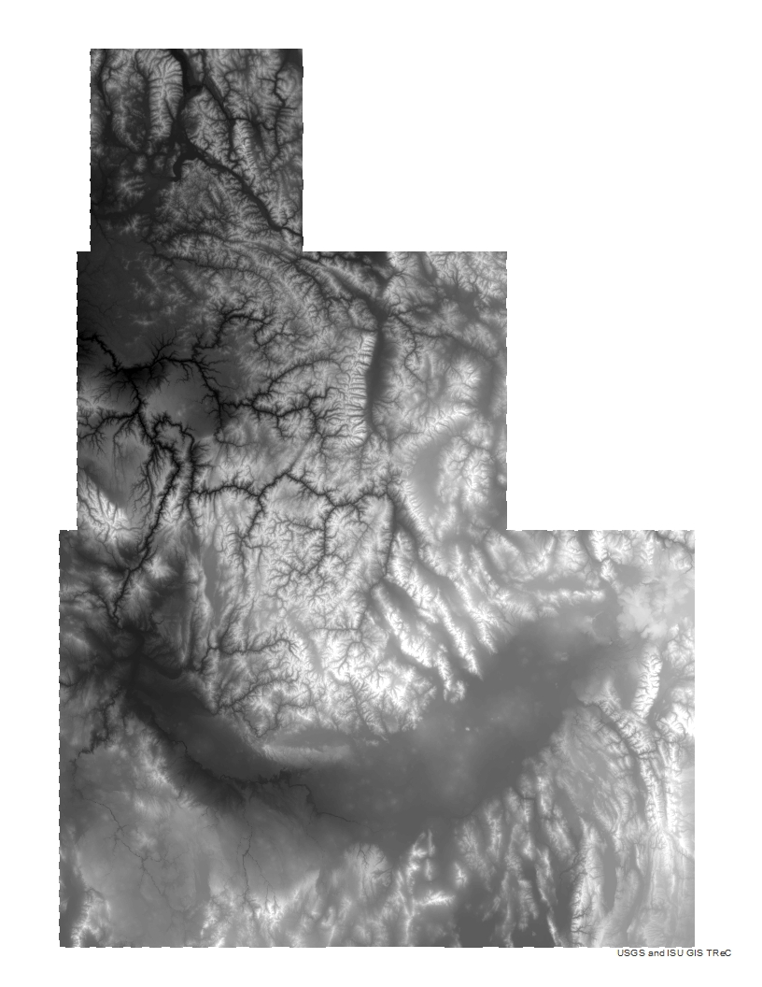
Raster: Elevation of Idaho
Notes:
Rasters don’t always show photos. They are good for showing continuous features of the Earth. In this raster, we see the elevation of Idaho. The white pixels are high elevation and the black pixels are low. The network of branching black on the left side is several rivers, including the Snake and the Salmon. The lighter colored area that stretches down much of eastern Idaho is the Bitterroot Range of the Rocky Mountains. The value of each pixel is the elevation above sea level, and as symbols we’ve chosen to shade each pixel in grayscale by its elevation value.

Slide 53
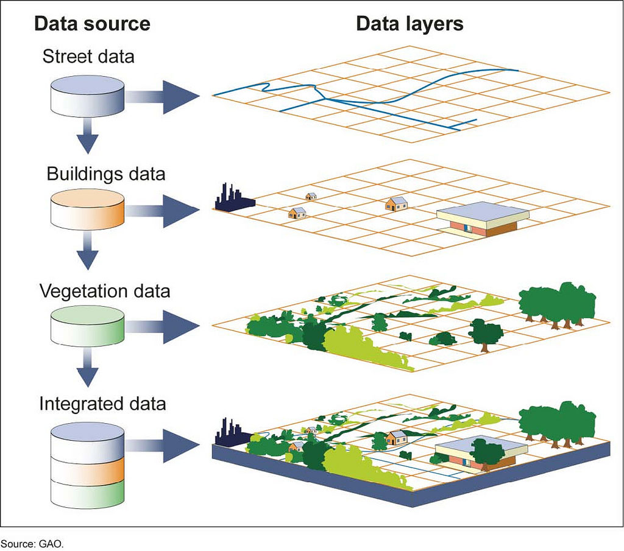
Layers
http://education.nationalgeographic.com/education/encyclopedia/geographic-information-system-gis/?ar_a=1
Notes:
The process of making a map is to take a collection of layers and combine them. This example shows a line layer of streets combining with what might be a polygon layer of buildings and a polygon layer of vegetation to create a map. When we look at a highway map, we see a map with a highway layer, a city layer, a state boundaries layer, a rivers layer, and so on, all combined into one map. The importance of combining several layers is usually that they provide context that help the user: a map of the US with cities shown but no roads (or vice versa) would not be very useful for navigation, for example.

Slide 54
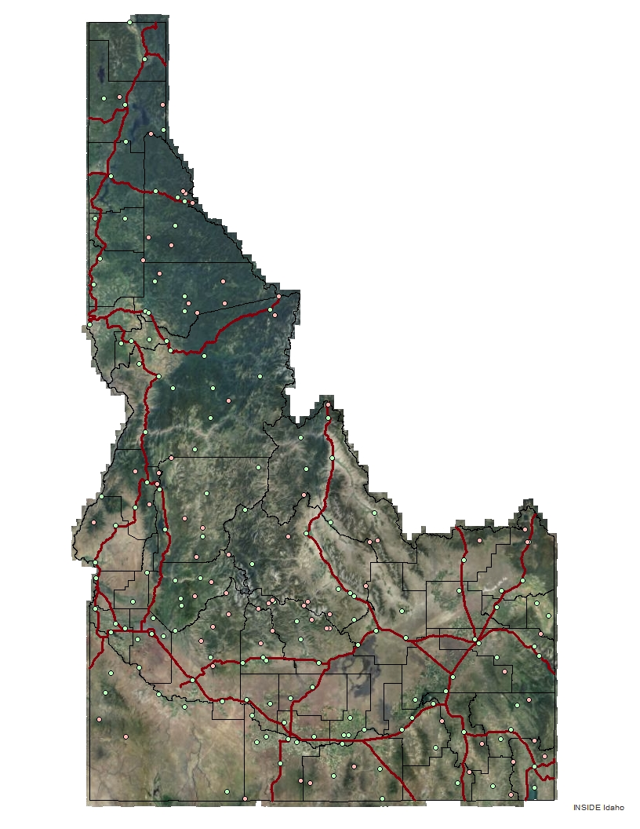
Four Layers Combined
Notes:
So here, we have combined the first four layers into one map. It doesn’t look much like the maps we’re used to. There aren’t any labels, for example. But if your question is ‘How many weather stations are there in Boundary County (Boundary is the one at the top), and can I visit them all in one day?’ then this map will help you out. There are two weather stations in Boundary County, one of which is right on the highway, and the other not too far away from the highway. So, yes, we can probably visit them all in one day. We can ask the same question of Owyhee County, the one in the southwest corner. We can see that there are eight weather stations, none of which is all that close to the highway, and that Owyhee County is quite a bit larger than Boundary, so we might say no, we cannot visit all of these weather stations in one day.
In GIS, most of the maps we make are not for publication. They are for solving a specific problem or answering a specific question. This is an example of such a map. Not much good for general use, but it gets the job done for our specific question.

Slide 55
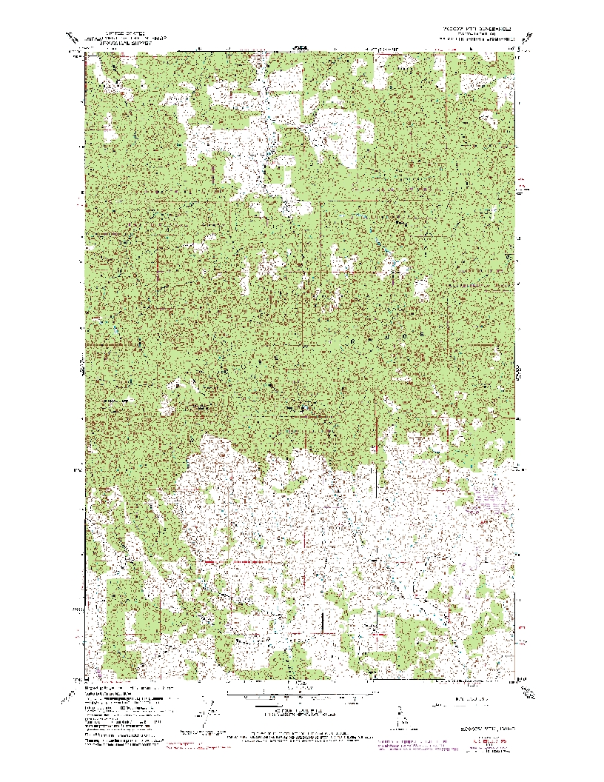
USGS Topo Map
Notes:
Hard to tell from this picture, but this is a USGS Topographic Map. It is the 7.5 minute map of the Moscow Mountain quadrangle. The purpose of this is to introduce another kind of map, this one a little more general purpose. Probably some students have experience with these maps from hunting/fishing, etc. I like to show the students a paper copy of this map, as well, so they can get a close look. One can be had from the USGS for $8.00 today.
Ordering: (this link doesn’t look like it will last forever, but the item is the Moscow Mountain, ID 1:24,000 scale map)
http://store.usgs.gov/b2c_usgs/catalog/setCurrentItem/(xcm=r3standardpitrex_prd&layout=6_1_61_50_2&uiarea=2&ctype=areaDetails&next=seeItem&carea=0000000620&citem=00000006200000000374)/.do
The USGS has a page that describes the historic process of creating these maps: http://pubs.usgs.gov/gip/topomapping/topo.html
The key here is that the features of different colors can be thought of as different layers on this map. The cartographers at USGS used to do this by hand, by tracing features off of air photos. Most of our current USGS topo maps originated from that method, though they have been revised over time.

Slide 56
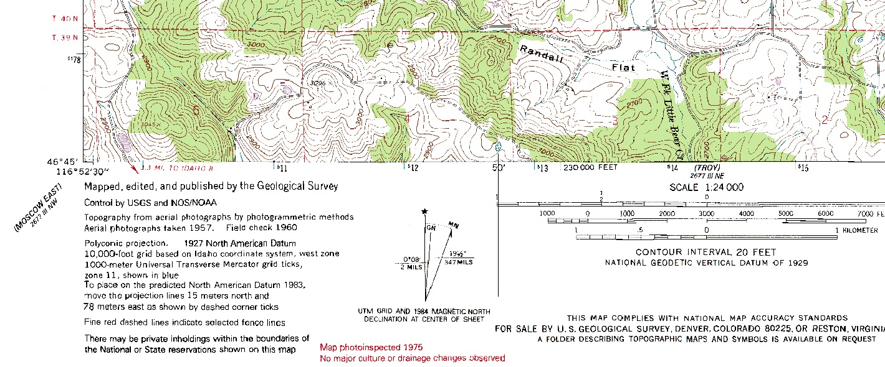
USGS Topo Map
Notes:
In the lower left corner of the map, you can see some text that says this map was made from aerial photgraphs taken in 1957. It was field checked in 1960, which means that someone went and verified some of the information that they couldn’t know from the photographs, alone. There’s also some red text at the bottom that says the map was photoinspected in 1975. This means that they compared the original map to new photos about 20 years later. There was another comparison in 1984, and they added, among other things, the boundary of the UI Experimental Forest (shown on the next slide).

Slide 57
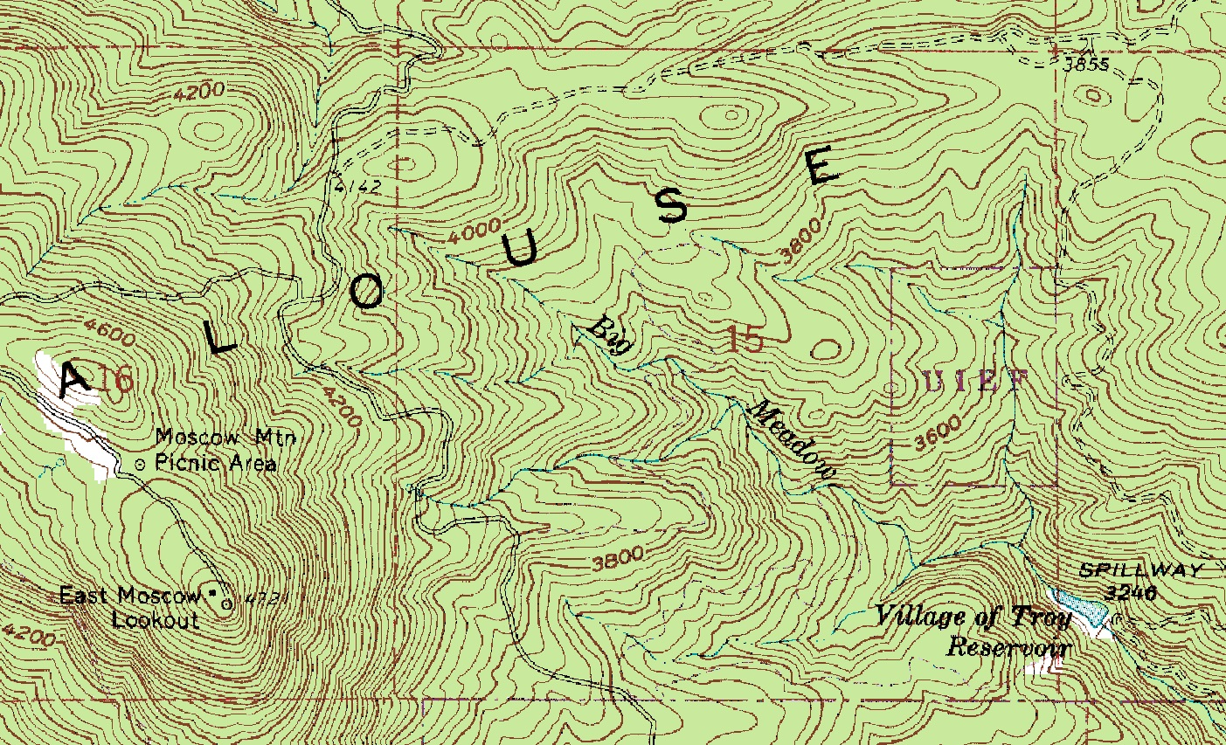
USGS Topo Map
Notes:
Here, we’ve zoomed in on the map from the previous slide. You can see, now, some of the different layers that go in to making this map:
There is a roads layer, which is made of black solid and dashed lines. The solid or dashed symbology tells us how good a road it is.
There is a water layer, which has blue lines for streams and blue polygons for lakes.
There is a topography layer, which has brown lines (called isolines) that show elevation. For a particular line, the elevation is the same everywhere along that line. Elevation contours that are very close together indicate a steep slope (because elevation is changing over a small space), while contours that are farther apart indicate relatively level ground. Look at the East Moscow Mountain lookout, for example, and compare the steep southeastern slope with the relatively flat northwestern area.
There’s also a layer in purple that show changes to the map since it was originally made. In this area, you can see a purple box labeled ‘UIEF’. This is the University of Idaho Experimental Forest.

Slide 58
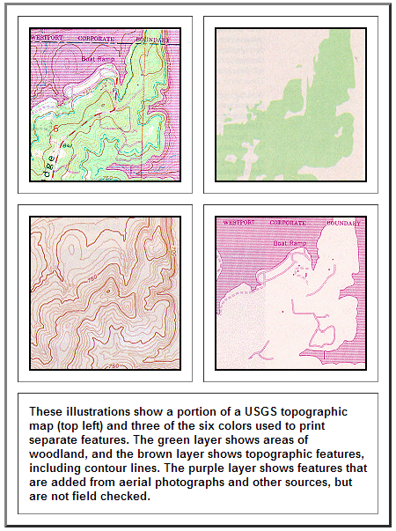
USGS Topo Map
http://pubs.usgs.gov/gip/topomapping/topo.html
Notes:
This picture shows three of the layers from a USGS topo map alone, and in the upper-left, what they look like when combined (with several layers that make up the map not shown).
The key concept here is that the USGS has been making these maps since 1879, and although the technology has changed, we are generally following the same process on the computer with GIS and digital photos that we used to follow with pen and paper.

Slide 59
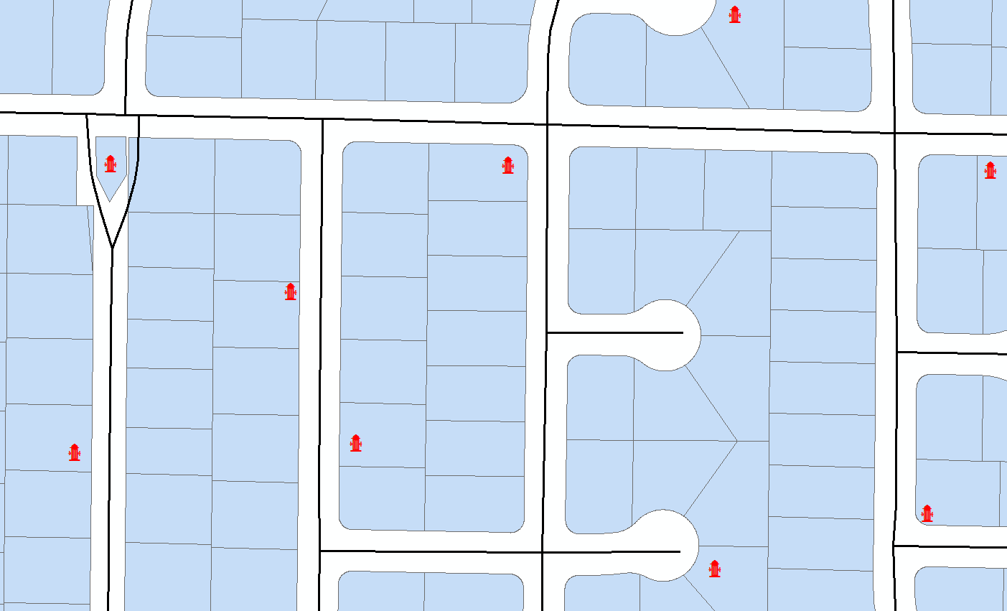
Fire Hydrant Placement
Notes:
This is an example of what is called a ‘placement problem’ or a ‘location problem’ in GIS. In this case, we have a residential neighborhood plan, and we want to check the fire hydrant coverage to make sure it’s okay. Of course, we’ll see it’s not, because there is a big area in the middle without coverage. In this case, we’ll pick a location for a new hydrant just by eyeballing it and trying out the new location, but in quantitative GIS, we can use complex multivariate formulas to compute the best locations for things. We can also do this process in reverse; figure out if we have too many hydrants in one area, for example.
The layers we see here are a point layer for fire hydrants, symbolized with a red hydrant; a line layer of roads, symbolized by black lines; and a polygon layer of residential lots, symbolized by light blue areas with gray borders.

Slide 60
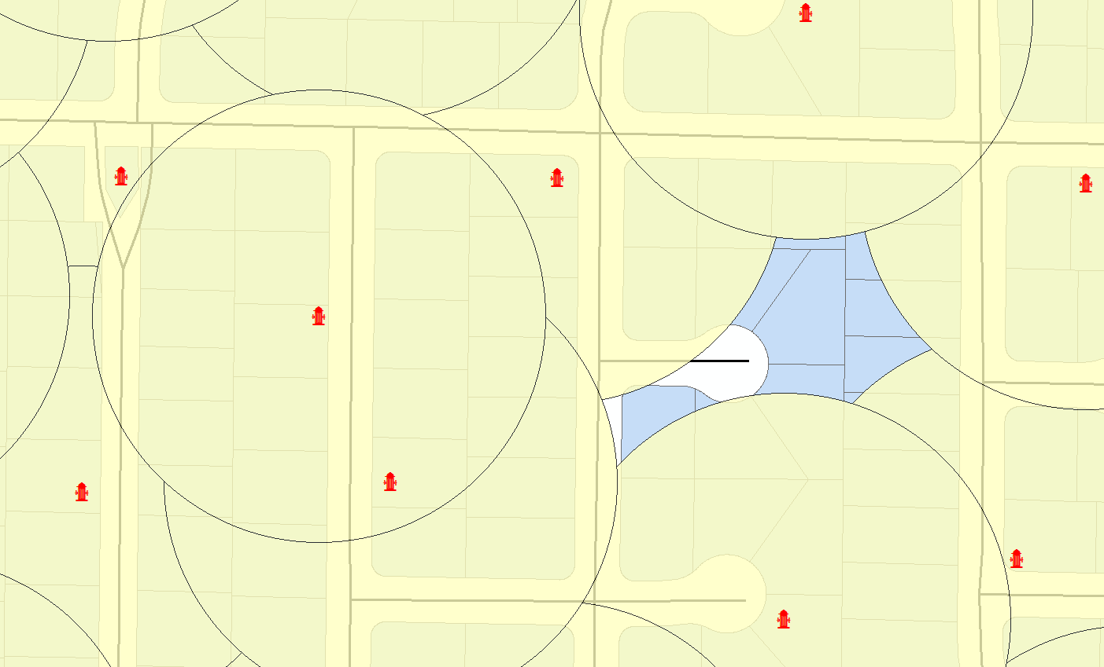
Fire Hydrant Placement
Notes:
The fire hydrants in this town have an effective radius of 300 feet. How can we tell whether we have adequate coverage? We use a simple GIS tool called a buffer. We can use the buffer to draw a 300 foot circle around every fire hydrant, and then look to see how complete our coverage is, by effective areas of hydrants. Here is the result of buffering our fire hydrants layer. The yellow circles are a new polygon layer that represent 300 foot buffers around the hydrants. We can see that there is a conspicuous lack of coverage in one area.
Note that the buffer layer is a little bit transparent. Transparency can be an important tool in GIS for combining layers and still being able to see features that overlap each other.

Slide 61
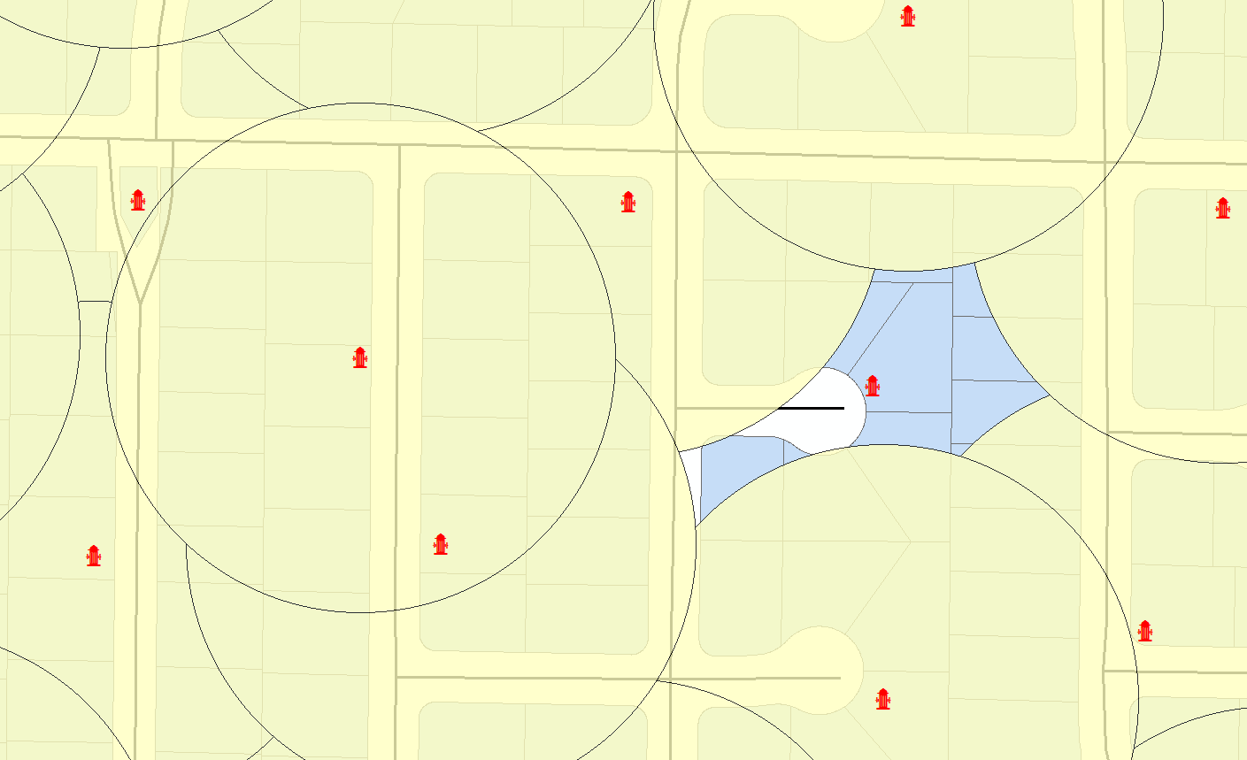
Fire Hydrant Placement
Notes:
Often, we would use some more advanced technical means of finding where to put the hydrant. We may need, for example, to know the location of the water main, where the city right-of-way is, how tall the buildings are in the area, what the water pressure is, and so on. But in this example, we’re just going to fix the coverage area by eyeballing it and adding a hydrant where we think it will be most effective. We’ll put it at the end of the cul-de-sac.

Slide 62
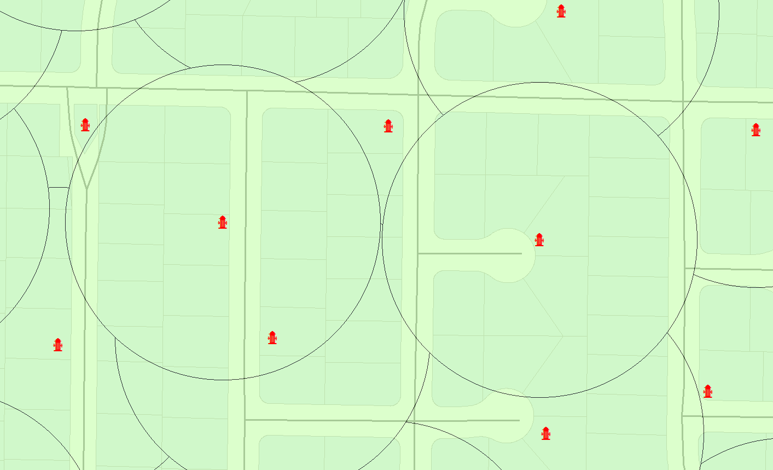
Fire Hydrant Placement
Notes:
After adding the new hydrant, we create an updated buffer layer. We can see now that we have 100% coverage of our area.
This basic technique is used in all sorts of location problems.

Slide 63
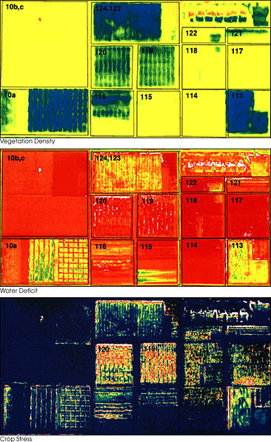
Remote Sensing for Agriculture
http://www.gislounge.com/geospatial-technologies-in-precision-agriculture/
Notes:
We see here three images taken by a NASA aircraft. These are false-color rasters, which means that they are showing reflectance of wavelengths of light that are outside the visible range. The top image shows vegetation density, with darker blue being more dense and yellow being less dense. In the middle image, we see water deficit, with red areas having less water and yellow areas having more water. In the bottom image, we can see crop stress, with blue being low stress and yellow and red being higher stress. The grower can use information like this to make decisions about where to apply water.
This page has a nice description of using sensors on the tractor to make precision ag decisions: http://www.lincoln.ac.nz/conversation/gis/2013/03/19/gis-and-precision-agriculture/
This page goes over the example above in more detail: http://www.gislounge.com/geospatial-technologies-in-precision-agriculture/

Slide 64
More GIS Resources
http://www.gislounge.com/
http://qgis.org/en/site/about/case_studies/index.html
Notes:
GISLounge is a blog-type site with a lot of user-generated content
The QGIS case studies page has descriptions of GIS projects that people have done using the QGIS software. It may serve as a source for ideas about projects that students could do using other tools like ArcGIS Online.

Slide 65
More ArcGIS Online Resources
Importing Excel spreadsheets
  http://blogs.esri.com/esri/arcgis/2011/10/07/getting-started-with-arcgis-online-part-i-working-with-a-spreadsheet-of-addresses/
  http://blogs.esri.com/esri/arcgis/2012/10/08/excel-tips-for-arcgis-online/
  http://help.arcgis.com/en/arcgisexplorer/videos/AGEO_Importing_16/AGEO_Importing_16.html
Notes:
ArcGIS Online supports uploading spreadsheets that have latitude and longitude information in them. It can create point layers from spreadsheets of spatial data, which may be a good way to record field observations and then upload them for display on a map.

Slide 66
More ArcGIS Online Resources
  ArcGIS Online Tutorial Videos
    http://resources.arcgis.com/en/tutorials/
  ArcGIS Online Blog
    http://blogs.esri.com/esri/arcgis/category/arcgis-online/
Notes:
The video tutorials walk through simple processes like adding data to create a map.
The blog has content generated primarily by ESRI employees who cover their examples and ideas.

Slide 67
Exercises
How-to for teachers to see how to get logged in to ArcGIS Online and get their students logged in
Exercise 1: Intro
Exercise 2: Climate Change
Notes:
The login information is still somewhat in flux.
The purpose of exercise 1 is to get the student going with a simple GIS, start working with layers, and answer a few qualitative questions about what’s going on.
The purpose of exercise 2 is to use the GIS to visualize and analyze some agricultural data in conjunction with some climate projections.

Slide 68
Section 3 Activities & Work sheets
Double Click on image to open MS Word Doc

