Slide 1
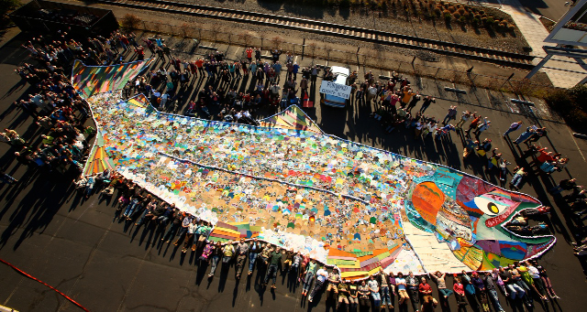
Climate Science and Society
Notes:
This is a way of entering into the discussion of “Ok, now you know about the ways in which climate change affects agriculture—how should we address it?”
The Goal is not to put a lot of pressure on students to take on this world problem, but to understand the complexity of facing any process.
This picture is from the 350.org social movement to address climate change event in Medford OR. Residents took an emblem from the PNW to represent their concern about climate change to their cultures, communities, and environment. You could also return to this image to discuss what would be the emblem of your climate action. With respect to 350, the name comes from 350 ppm of CO2 in the atmosphere, which at the time was a goal for avoiding catastrophic climate change. It is currently at 400ppm.
You could also have them develop their own survey questions using clickers (Activity) or the class. For that I recommend creating linear questions to help people identify the continuum. You could also do clustering questions where students identify themselves in specific groups. Otherwise, having them write clicker questions could be fun and improve their methods of inquiry.

Slide 2
Standards
Unit Objectives:
Students will use researching, writing, rhetoric and argumentation skills to create a visual aid related to climate science education.
Students will compare and contrast views related to climate change on the class, regional, and national levels.
Students will conduct a climate change survey utilizing social science methodology.
Students will explore media (social, news, etc.) to locate and evaluate the credibility of claims made related to climate change.

Slide 3
Warm up:
Brainstorm:
Why does it matter what the public thinks about climate change?
Notes:
Climate change is different from other political topics because of its severity and polarization, but in many ways it is not new. It’s a decision making process by governments and publics about how to address the scientific, economic and social relationships. In this way you can help your students understand about science and society’s relationships through the climate case study.

Slide 4
Warm up: How important is the public in addressing climate change?
Not important
Somewhat important—mostly because of personal action
Somewhat important—mostly because of political influence
Very important

Slide 5
What is Climate Change?
Climate:
Long term pattern of weather in a particular area (30 years)
Weather:
Short term state of the atmosphere (wet/dry, hot/cold, calm/stormy, clear/cloudy)
(minute by minute)
Climate Change:
Change in the distribution of weather patterns. (decades to millions of years)
“Climate is what you expect, weather is what you get”—PNW Farmer
Notes:
A basic review of the definition of climate change and climate. Should be review if you are using other parts of the REACCH curriculum.

Slide 6
Relationships between climate and society
Climate affects human life
Humans affect the earth’s climate
Composition of the atmosphere
Capacity of the oceans and forests to store greenhouse gasses
The reflectivity of the earth’s surface
Where we live
What crops can grow where
What we can do for our livelihoods
The animals around us
Notes:
1. Climate affects where we live—This is a good opportunity to discuss how crops are affected by climate
Because a lot of human life depends on natural resources in certain areas, you can expand from crops to other livelihoods, like timber or transporting on rivers. This unit should be taught after the climate unit.
2. Humans affect the earths climate by changing the composition of the atmosphere through primarily the burning of fossil fuels and land cover change (which includes agriculture and forestry)
This also gets at how melting the ice through increasing global temperatures will decrease the reflectivity (aka albedo).

Slide 7
In this class
Discuss public opinions on climate change at the following scales (in class, regional, national, global):
Weather
Climate
Cultures
Understanding of science
Identify communication barriers and opportunities about climate change
Discuss impacts of and actions to address climate change
Notes:
This unit uses the classes input as one survey.
The PNW public survey is of people surveyed by telephone by the REACCH project in 2012.
The third survey brings in your reading on Climate change in the American Mind. From the Yale Climate Change Communication Group.

Slide 8
What are sources we can use to describe public opinion?
Voting records
Media
Polls
Surveys
Interviews
Management plans
Government documents
Economic spending (e.g. rational choice models)
Notes:
Brainstorm with the class how we can gage public opinions.

Slide 9
How Social Polls/Surveys are Used
Understanding Values and Relationships
In 2009, globally 40% of people are “unaware” of climate change US similar to other countries: Environment is not a “top 10” issue.
1/3 US public say climate influence voting
Social Capacity to Adapt and Respond
How do we want to address this problem?
Do we agree there is a problem to be addressed?
What do we want to do to be fair about addressing this problem?
Notes:
How could these numbers change? Where does the class believe they are today?
Use the search Terms: “Climate Change in the American Mind” to locate and download the latest national climate change survey results. Typically these are conducted every six months, so a set link won’t work. This link should get you close:
http://climatecommunication.yale.edu

Slide 10
Sociology of Climate Change
Climate change can be studied as:
Belief: do you believe in climate change?
Concern: are you concerned about climate change?
Responsibility: who is responsible for addressing climate change?
Response: what should be done about climate change?

Slide 11
What other factors influence climate perceptions?
Belief
Concern
Responsibility
Response
Religion
Where you live
Economic status
Political party
Ideology
Independent-minded
Community-minded
Notes:
The same things that affect all of our beliefs. Climate is really not different. I would scroll through each one and ask for examples
Religion: Stewardship of creation vs. God created the whole world and man can’t affect it.
Where you live: If you live on the coast of Florida, then you might be more concerned about sea level rise. Or if you live where there are more forest fires, you might be more concerned about drought in your area.
Wealth may be a factor
Political parties have formed some solidarity among groups

Slide 12
We’re going to look at three studies:
LOCAL
Class (collected NOW)
REGIONAL
Pacific Northwest General Public
Surveyed 1300 people in 2012 on climate, agriculture and risk; conducted by the University of Idaho
NATIONAL
Conducted annually, surveys across the country on climate perceptions and experiences
Called 6 Americas due to the clustering results.
Notes:
Over the next series of slides students are asked questions on slides labeled class. You will need to count and record results to have students compare their thoughts to those of other groups.
Introduce this as a mini-social science research project on their class. Have them think about questions they might ask to gage their community opinions on climate change.

Slide 13
Class: Based on your understanding of the Earth’s climate, which of the following categories describes how the climate has changed over the past 100 years?
Temperatures have increased a great deal
Temperatures have increased slightly
Temperatures have changed but not significantly
Temperatures have not changed
Temperatures have decreased
Notes:
Record results on paper, or on the board.
If technology permits, you may consider using clickers, Kahoot, or poll anywhere as options for collecting student responses.

Slide 14
PNW Public: Global temperatures over past 100 years have…
Notes:
Discuss differences with the class. This may be a place to discuss the applicability of the differences. How large are they and do they really matter that much?

Slide 15
CLASS: What do you think is the main cause of change in the earths temperature?
Natural Causes
Human Causes
Other
Unsure
Notes:
This is not a time for debate, but a collection of information. Have them save debate for a class debate/discussion in a future class.

Slide 16
PNW Public: What do you think is the MAIN cause of change in temperature?
Notes:
Leiserowitz calls the didn’t know, don’t answer, missing group unaware
We had some please specify of the other category
Many of these comments I have hear in conversation.

Slide 17
What do you think is the MAIN cause of change in temperature?
God’s intervention, scriptural, biblical.
Activity of the sun; A long ice age we’re still withdrawing from.
It’s cyclic, historical, evolutionary, normal part of earth’s process.
Natural disasters. Fires.
Population increase.
BOTH! 17.7% response.
Notes:
Leiserwitz calls the didn’t know, don’t answer, missing group unaware
We had some please specify of the other category. These were many of the expressed reasons for other. Qualitative information (such as a narrative) is helpful in addressing

Slide 18
National Study
Source: Leiserowitz, A., Maibach, E., Roser-Renouf, C., Feinberg, G., & Rosenthal, S. (2016). Climate change in the American mind: March, 2016. Yale University and George Mason University. New Haven, CT: Yale Program on Climate Change Communication.
Notes:
Most recent tables can be found from: http://climatecommunication.yale.edu
Leiserowitz, A., Maibach, E., Roser-Renouf, C., Feinberg, G., & Rosenthal, S. (2016). Climate change in the American mind: March, 2016. Yale University and George Mason University. New Haven, CT: Yale Program on Climate Change Communication.

Slide 19
Class: In general would you describe your political view as…
Very conservative
Somewhat conservative
Moderate
Somewhat liberal
Very liberal

Slide 20
Political Profile of PNW
Chi-square statistic = 319.4, df =12, pvalue =<0.0001
Notes:
This is a cross tab which gives similar information but doesn’t necessarily exactly comparison.

Slide 21
How the climate has changed over the past 100 years: Temperatures have…
The more liberal you are… the more likely you are to perceive increases in temperature over the past century.
And few people have observed decreases.
Chi-square statistic = 47, df =4, pvalue =<0.0001
Notes:
This slide shows the response by political perspective of the change in global temperatures. You won’t be able to compare this because it is a statistical test but it shows clear differences.
Based on your understanding of the earth’s climate, which of the following categories describes how the climate has changed over the past 100 years? Would you say…
Temperatures have increased a great deal
Temperatures have increased slightly
Climate change is an ideological issue as much as a political & scientific issue.

Slide 22
Class: How concerned are you about this (climate) change?
Greatly concerned
Somewhat concerned
A little concerned
Not concerned

Slide 23
What are you concerned about?
Brainstorm the ways in which climate change is affecting you, your community or your country.
Notes:
If you’re in a computer lab, you could have students do one of the three activities at the end of the pptx. Google docs/forms is a great way for students to add their answers in a real-time environment.

Slide 24
National Concern:
Notes:
http://Climatecommunication.yale.edu

Slide 25
PNW Public: Level of Concern

Slide 26
PNW Public: How concerned are you about this change * Cause of temp. changes.
Chi-square statistic = 78.8, df =20, p value =0.0001
The more you perceive humans as the cause of climate change…the more concerned you are.
Notes:
This is another statistical test. Concern is greater if you think climate change is primarily caused by humans.

Slide 27
Gender and Concern
Men are less concerned than women in the PNW.
Chi-square statistic = 18.5, df =3, pvalue =0.0003
Notes:
This is likely due to some connection with the political party of women and men being very differen
Significance of .0001 for political party (women are more liberal and more republican, but not less Independent) and political view is not significant. Often women will over state an emotion, are more likely to do greatly than somewhat.

Slide 28
How much do you think climate change will harm your family?
Not at all
Only a little
A moderate amount
A great deal
Notes:
Q: Q6Family
T:3 5 1
How much do you think climate change will harm your family?
T:7 10 1
1. Not at all
2. Only a little
3. A moderate amount
4. A great deal
8. Don't know (don't read)
9. Refused (don't read)

Slide 29
How much do you think climate change will harm your community?
Not at all
Only a little
A moderate amount
A great deal
Notes:
Q: Q6Family
T:3 5 1
How much do you think climate change will harm your family?
T:7 10 1
1. Not at all
2. Only a little
3. A moderate amount
4. A great deal
8. Don't know (don't read)
9. Refused (don't read)

Slide 30
Scale of Concern: How much do you think climate change will harm…
The public is aware of risks to their family and community.
Notes:
It doesn’t appear to be a measure of access to financial resources at this time.
And only 42 percent of people believe climate change is human caused. Way more believe it is a risk to their family and community.

Slide 31
Why might people deny climate change is occurring?
Stand to lose something?
Implies responsibility or culpability
Requires response
Ideological challenge
Cognitive dissonance
Shifting baselines/short-term memories
Status quo

Slide 32
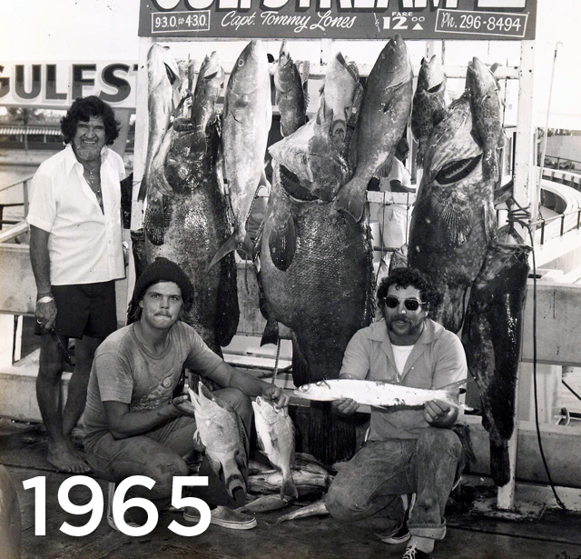
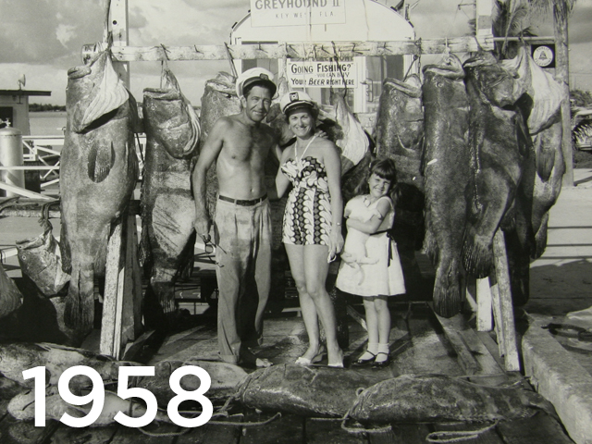
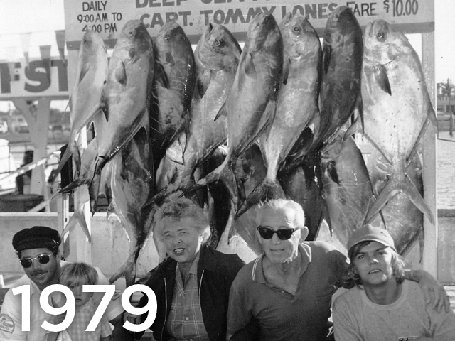
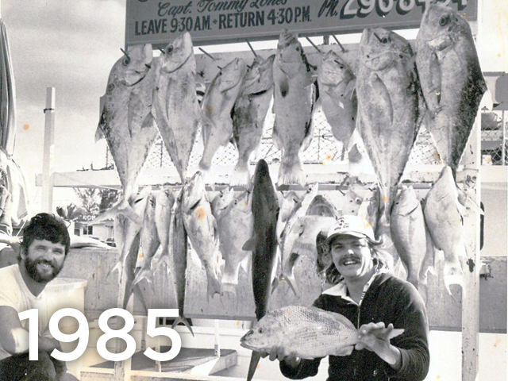
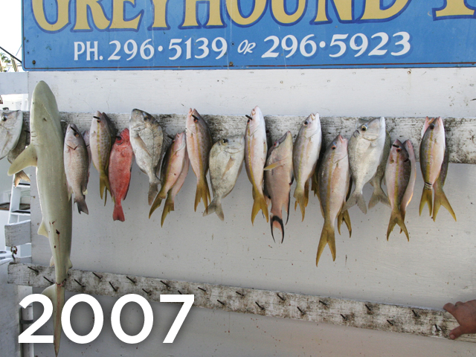
Shifting Baselines
Source: Ocean portal.
Jeremy Jackson
Notes:
What possibilities are their for the decrease in size of fish?
This can go anywhere. Students who are interested should be encouraged to pursue this as a research project. Students may also focus on more regionally applicable wildlife species being impacted by local climate change. Encourage students to start searching using scholar.google.com or their school library website search engine.

Slide 33
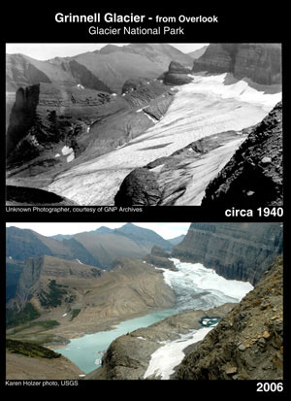
VISUALIZING CLIMATE CHANGE
USGS Repeat Photography Project & Climate Change in Mountain Ecosystems
Notes:
There’s not really a cropping system alternative to help us visualize. Why might the glaciers be receding? What alternative theories are there? How do we evaluate their credibility.
This should lead to a good discussion, and once again, getting interested students to pursue this will add to future class discussion.

Slide 34
In the areas of science and technology, would you say you are…
Very uninformed
Somewhat uninformed
Somewhat informed
Very informed
Notes:
Don’t let these guys self-grade

Slide 35
In the area of climate science, would you say you are..
Very uninformed
Somewhat uninformed
Somewhat informed
Very informed

Slide 36
PNW Public On Science and Technology, Climate Change
Notes:
These two are the same graphs, but I think it’s important to note that more people feel confident about science and technology than climate science.

Slide 37
PNW Public understanding of science and technology; and climate science

Slide 38
I have observed changes in weather patterns over the course of my lifetime.
Strongly disagree
Somewhat disagree
Neither agree nor disagree
Somewhat agree
Strongly agree
Notes:
This might depend on how long you’ve been alive!
But also this is a factor of where you live. If you live on a mountain you’re more likely to notice the shifting gradients of temperatures because there is more diversity within a smaller area. But if you live in a vast valley like the Great Basin, the changes are less likely to be noticed. You really have to look at records.

Slide 39
PNW Public: I have observed changes in weather patterns over the course of my lifetime…

Slide 40
Do you recall any unusual weather events in your local area that occurred in the past twelve months?
Yes
No
Notes:
This could be good to do with an extreme weather event in your area or in the news--just this section.
It’s also interesting how little information you get out of this kind of question. Training your students to ask the right questions will help them pursue more in-depth answers.

Slide 41
Do you recall any unusual weather events that occurred elsewhere in the US in the past twelve months
Yes
No
Notes:
Similar to the US, but greater recognition of events elsewhere and fewer personally experienced.

Slide 42
Yale Extreme Weather Survey
Notes:
One note, the connections between extreme weather and climate change as with all climate change issues are not simple. Consider having students search the following website and then have a class discussion: https://health2016.globalchange.gov/extreme-events
An executive summary (Impacts of CC on Human Health) is included with the readings file.

Slide 43
Extreme Weather
“In 2011, Americans experienced a record-breaking 14 weather and climate disasters that each caused $1 billion or more in damages, in total costing approximately $53 billion, along with incalculable loss of human life. These disasters included severe drought in Texas and the Great Plains, Hurricane Irene along the eastern seaboard, tornadoes in the Midwest, and massive floods in the Mississippi River Valley. In the period of January through March 2012, Americans also experienced record warm temperatures, with temperatures across the contiguous United States 6.0 degrees F above the long-term average. In March alone, 15,292 warm temperature records were broken across the United States.”—Extreme weather report from Yale Project on Climate Change Communication
Find out extreme weather in your area: http://www.environmentamerica.org/page/ame/map-recent-weather-related-disasters-idaho
Notes:
http://www.environmentamerica.org/page/ame/map-recent-weather-related-disasters-idaho

Slide 44
Adaptation and Mitigation
Adaptation is the adjustments that society or ecosystems make to limit negative effects of climate change. It can also include taking advantage of opportunities that a changing climate provides. (US EPA 2014)
Mitigation
Refers to efforts to reduce or prevent emission of greenhouse gases. Mitigation can mean using new technologies and renewable energies, making older equipment more energy efficient, or changing management practices or consumer behavior. (UN Environmental Programme 2015)
Notes:
http://www.epa.gov/climatechange/impacts-adaptation/
There are basically two ways to address this:
Adaptation and mitigation
Have students define what these words mean to them.
There’s also a host of words that go with mitigation: sequestration, geoengineering (see reading), enhanced oil recovery, carbon cap and trade, carbon cap and store.
For cool word roots, I use etymonline.com
We didn’t ask about what we should be doing because that’s a really long survey, but we did get to ask whether groups of people should be doing more.
Adaptation is more about dealing with what we are already experiencing and anticipate, whereas mitigation is about trying to reduce the problems by changing the way we emit greenhouse gases and how we can remove them from the atmosphere.

Slide 45
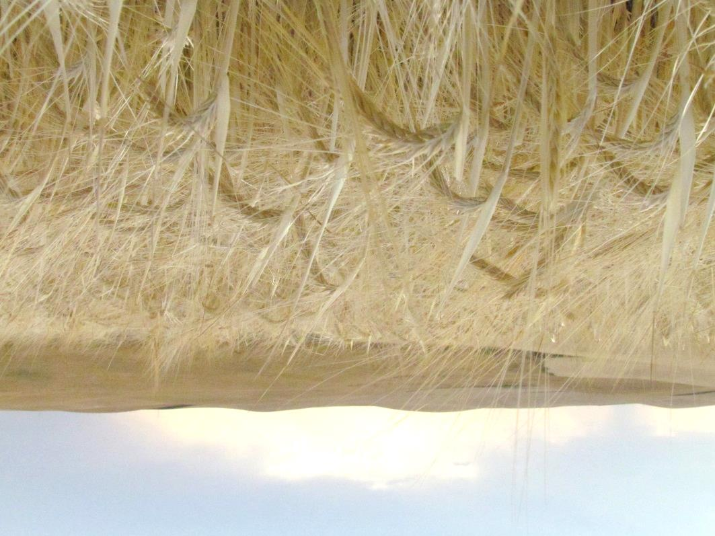
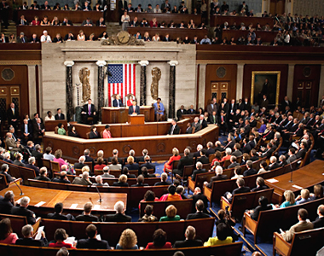
Do you think each of the following groups should be doing more or less to address climate change?
State legislators
U.S. Congress
The agricultural sector
US citizens
Notes:
Discussion of the scope of the various groups, or a joint class with the school’s government teacher could be beneficial with this topic.

Slide 46
CLASS: Do you think the State Government should be doing more or less to address climate change:
Much less
Less
Currently doing the right amount
More
Much More

Slide 47
CLASS: Do you think the US Congress should be doing more or less to address climate change:
Much less
Less
Currently doing the right amount
More
Much More

Slide 48
CLASS: Do you think Agriculture should be doing more or less to address climate change:
Much less
Less
Currently doing the right amount
More
Much More

Slide 49
CLASS: Do you think US Citizens should be doing more or less to address climate change:
Much less
Less
Currently doing the right amount
More
Much More

Slide 51
PNW Public: How much more should each group be doing?
State Congress Agriculture Citizens
Notes:
The class thinks we should be doing more

Slide 52
How much more should each group be doing?
66%
Notes:
We should be doing much more is an indicator that we most people would actually fit well into the alarmed category.
Though asking a different question, it seems that this is counter to what we know from an international survey:
“One reason for the relatively low ranking of climate change is that people often believed it did not directly affect them. Climate change is seen more as a country-level problem than as a personal problem,” Smith said. “While 14.6 percent cited it as the most important environmental issue for their country, only 9 percent rated it first for themselves.” - See more at: http://news.uchicago.edu/article/2013/02/25/global-surveys-show-environment-ranks-low-public-concerns#sthash.rYncKz0H.dpuf
“Have you punished a company by not buying something from them because of their climate perceptions?” several times in the past year?

Slide 53
CLASS: What Percentage of Scientists have concluded that human caused global warming is occurring?
0-10%
11-20%
21-30%
31-40%
41-50%
51-60%
61-70%
71-80%
81-90%
91-100%
Don’t know

Slide 54
How do we communicate climate science when this is the public perception of climate scientists?

Slide 56
Conclusions from PNW Public study
Our region is politically diverse, and climate perceptions are connected to political views.
“Believers” and women are more likely to be concerned. Public is aware of risks to family, community.
People who think globally, think locally.
The PNW public wants to do more about climate change.

Slide 57
Computer lab EXERCISE 1
Climate and climate change.
Search the internet using images.google.com
2. Find two examples in five minutes:
a. One example of climate
b. One example of climate change
3. Be prepared to describe this to the person next to you and then the class.
Notes:
See last slide for worksheet accompanying this activity

Slide 58
Computer lab EXERCISE 2a
How do we know what we know about climate change?
Google (scholar) search: http://scholar.google.com
Scholar search on google for climate change methods.
Get ready to describe how we know this information.
Notes:
See last slide for worksheet accompanying this activity

Slide 59
Computer lab EXERCISE 2b
What is the news reporting about climate change?
Google news search:
News search on google for climate change in your region, your tribe.
Save an image
Get ready to tell the story. And what it means to you.

Slide 60
Activity 3
Social Scientists collect public opinion from interviews and surveys.
Many of the questions discussed in class the last few days are directly from national and regional studies.
Your turn:
Create a survey to gather climate opinions in your area.
What questions will you ask?
Who will you poll?
How will you communicate your results?
Notes:
See last slide for worksheet accompanying this activity

Slide 61
Discourse Alternatives to “CC”—Speaking to the values of the audience
Food systems
Water availability
Human health
Forest fires
Wildlife
Finances
Risk in investments—e.g. Sierra club destabilization of investing in coal-fired power plants
Notes:
All these value items hold great potential to be impacted by changing climates.

Slide 62
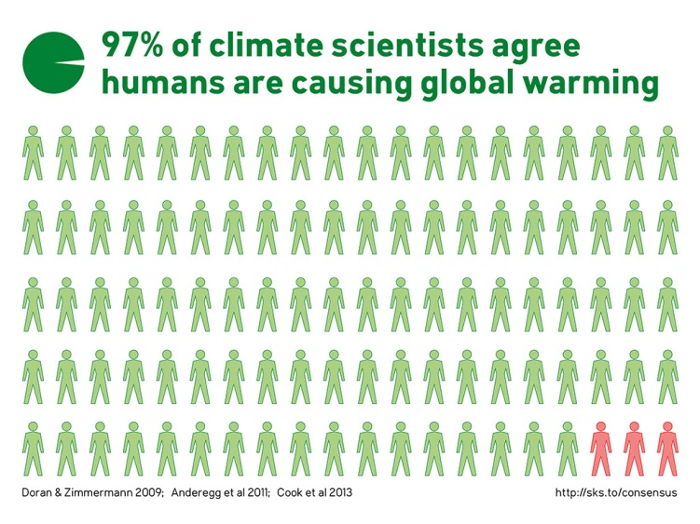
Visualizing climate change perceptions
7 out of 10 Pacific Northwest citizens think citizens should be doing more about climate change.
Notes:
Your students could create an iconographic or advertisement about the implications of climate change and what it means to their community and their family and them. For examples see Step It Up.org and 350.org.

Slide 63
Implications:
This ad is:
Specific, Shocking, Clear
But there’s no action connected to it other than getting more Information.
What would your infographic include to make the implications clear?
Notes:
http://img-9gag-fun.9cache.com/photo/6020139_700b.jpg
https://frogmatters.wordpress.com/2008/05/06/if-frogs-go-extinct-youll-notice/
This is a good time to talk about advertising and take what they have learned about climate change attitudes in the class, region, and country to create a graphic. This could take several days of class time or be a longer homework type assignment.

Slide 64
TALK ABOUT THINGS PEOPLE CARE ABOUT
Notes:
Here is a semi-related issue, but the way it is presented provides great foundations for dialogue.
But let’s talk about something truly delicious and important: Chocolate.
Seventy percent of the world’s cocoa is produced in the Ivory Cost and Ghana. But disease, drought and farmers opting to grow more productive crops such as corn and rubber have made growing conditions less than ideal.
Bloomberg: Chocolate lovers rarely pause to consider that cocoa might be an exhaustible resource. Those who do generally assume that the biggest threat is climate change, which is indeed expected to have severe negative consequences. According to a report prepared by the International Center for Tropical Agriculture for the Bill & Melinda Gates Foundation, in Ghana and Ivory Coast -- which together produce 53 percent of the world’s cocoa -- temperatures will increase by up to 2 degrees Celsius (3.6 degrees Fahrenheit) by 2050, intensifying the dry season and causing water shortages. The result, the report states, is that “cocoa-growing areas will decrease seriously.”
How might this be applied to your region? What crops may suffer under a changing climate? What new crops might flourish? What impacts could this have on the economy in your area?

Slide 65
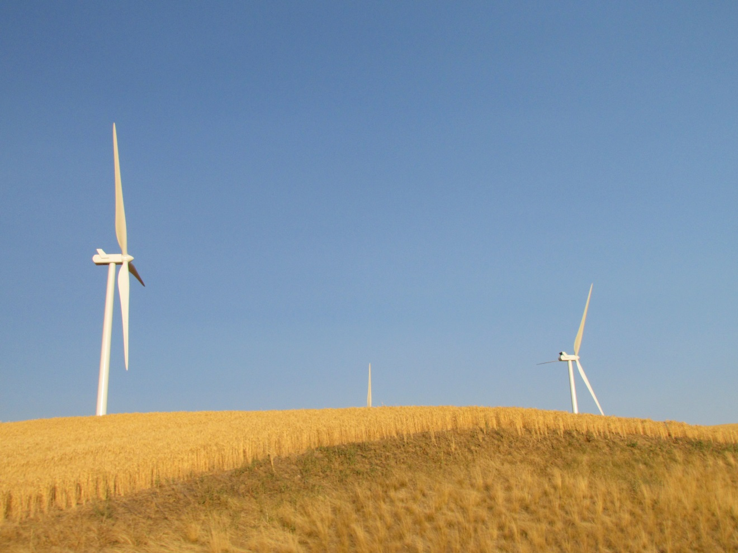
Alternative images: Communicating Climate Change
Girl at Moscow Community Garden growing local, organic food.
Wind power in wheat field near Hwy 195 between Spokane and Pullman, Washington—alternative sources of income and energy.

Slide 66
Activities:
Double click image to open MS Word Doc

