Slide 1
The Nitrogen Cycle
How are my farming practices affecting the environment & long term stability?
Notes:
Teacher notes: Nitrogen atoms participate in a continuous cycle, changing from organic, inorganic and gaseous forms. Nitrogen cycling is especially important to understand because N is essential for plant growth, is the most common nutrient that limits plant growth in agricultural systems, can move from the soil to the atmosphere and can take the form of a potent greenhouse gas, is considered to be a ground water contaminant and is expensive for farmers to purchase. Since each form of N differs in its availability to plants and environmental fate, it is very important to understand all of the potential reactions that take place within the N cycle.

Slide 2
Standards:
Double click on image to open MS Word Doc.
Lesson Goal(s):
Students will diagram the flow of nitrogen through an ecosystem.
Following the nitrogen cycle game students create diagram of the nitrogen cycle.
Students will use their nitrogen cycle diagrams and in class readings to recommend ways to reduce ground water contamination.

Slide 3
Objectives
Describe nitrogen cycling in agricultural soils
Identify the major processes of the nitrogen cycle
Describe the relationship between agricultural crop production and nitrogen
Describe the reasons why nitrogen application in excess is harmful to the environment and the farm budget
Identify ways nitrogen moves into and out of the soil

Slide 4
NOTE:
This presentation has multiple choice questions on many slides which are compatible with many clicker software applications. If you are not using clickers these slides can still be used for general polling/formative assessment.

Slide 5
Nitrogen is the most limiting and over-applied nutrient in agricultural soils?
True
False

Slide 6
N is essential for plants because it is part of:
Lignin
Water
Enzymes and proteins

Slide 7
The atmosphere is ~78% N
True
False

Slide 8
Plants generally utilize which form(s) of N?
N in organic form (proteins for example)
Ammonium and nitrate
N₂

Slide 9
What is the largest source of N in agriculture?
Animal waste
Lightning fixation of N₂
Symbiotic Bacteria
Fertilizer

Slide 10
Nitrate is safe to have in drinking water.
True
False

Slide 11
Denitrification can produce greenhouse gases such as:
N₂ (g)
NO₄ (g)
N₂O (g)

Slide 12
Ammonia gas is more likely to be produced when:
Nitrate fertilizers are incorporated into the soil
Ammonium fertilizers are applied to the surface of soils
Soils are acidic

Slide 13
Terms:
Nitrogen fixation: conversion of atmospheric nitrogen (N₂) to organic compounds, especially by certain microorganisms. N₂ can also be fixed through lightening.
Nitrification: biological conversion of ammonia or ammonium to nitrite followed by conversion of nitrite to nitrate
Denitrification: microbial conversion of nitrate that may produce molecular nitrogen (N₂) through a series of intermediate gaseous nitrogen oxide products
Notes:
Teacher notes:
Nitrogen fixation: N often limits plant growth despite the fact that the atmosphere is 78% N. This is because the N₂ (N triple bonded to N) is highly inert and can’t be used by crop plants. Certain bacteria that are predominately living in a symbiotic relationship with plant roots can break the triple bond and convert the N into a more reactive (less inert) form of N. The reaction is catalyzed by the nitrogenase enzyme. The overall reaction looks like: N₂ + 8H⁺ + 6e- → 2NH₃ + H₂ The NH3 produced can be converted to amino acids and proteins within the plant. This reaction requires a large input of energy (consumes ATP). Note that N2 is “artificially” fixed during the production of N-containing fertilizers in the Haber-Bosch process. Fossil fuels are generally used as a source of energy- resulting in the price of N fertilizers fluctuating with the cost of fuel.
Nitrification: The enzymatic oxidation of NH4+ (ammonium) to NO2- (nitrite) and finally NO3- (nitrate). The specific bacteria that carry out this reaction are called autotrophs because they get energy from oxidizing the ammonium ions, instead of from organic matter (as is the case with heterotrophs). This reaction requires 02 and is extremely limited when soils are completely saturated with water (reduces O2 in pores). This reaction is carried out in a 2-step process that looks like:
Step 1: NH4+ + 1.5 O2 → NO2- + 2H+ + H2O + energy
Step 2: NO2- + 0.5 O2 → NO3- + energy
Note that this reaction produces H+, which can reduce the pH (acidify) soils overtime. This reaction can also produce greenhouse gases (NO and N2O). Nitrification produces nitrate (NO3-) that is not retained by soils minerals, which predominately have a negative charge in temperate soils. This means that nitrate can easily leach into groundwater where it is considered a human health hazard.
Denitrification: Denitrification returns soil N (in the form of nitrate) back to the atmosphere as a nitrogen gas. The bacteria that carry out this reaction are generally facultative anerobes (prefer O2, but can use alternative electron acceptors under low O2 conditions). The organisms can be heterotrophs (need organic matter as an energy source) or autotrophs that oxidize sulfide for energy. The reaction, therefore, requires low O2 and organic matter and/or sulfide to occur. The reaction can produce greenhouse gases (NO and N2O) but may go all the way back to N2 (inert). The overall reaction looks like:
2NO3- → 2NO2- → 2NO (g) → N2O (g) N2 (g)
Ammonia volatilization: Ammonia gas is produced when the following equilibrium reaction favors the products.
NH4+ OH- → H2O + NH3 (g) If you add a reactant (NH4+ or OH-) the reaction will be pushed to the right and more H2O and NH3 will be released. NH3 production, therefore, is greatest when NH4-containing fertilizers are applied to the surface of alkaline (high pH) soils.
Mineralization: Nitrogen is most often present in organic (non-plant available forms). The material must be mineralized to become plant available. The reaction relies on enzymes produced by microorganisms in the soil. Typically only about 2-3% of the organic nitrogen in a soil mineralizes each year. This may be adequate to support plant growth in a wildland system, but not in agricultural soils. In agricultural soils, fertilizer N is generally added to maximize plant growth.

Slide 14
Terms:
Ammonia Volatilization: production of NH3 gas through an equilibrium reaction
Mineralization: Conversion of an element from an organic state to an inorganic state as a result of microbial decomposition
Immobilization: Conversion of an inorganic element to an organic form by plant or microbial uptake.
Notes:
Teacher notes:
Nitrogen fixation: N often limits plant growth despite the fact that the atmosphere is 78% N. This is because the N₂ (N triple bonded to N) is highly inert and can’t be used by crop plants. Certain bacteria that are predominately living in a symbiotic relationship with plant roots can break the triple bond and convert the N into a more reactive (less inert) form of N. The reaction is catalyzed by the nitrogenase enzyme. The overall reaction looks like: N₂ + 8H⁺ + 6e- → 2NH₃ + H₂ The NH3 produced can be converted to amino acids and proteins within the plant. This reaction requires a large input of energy (consumes ATP). Note that N2 is “artificially” fixed during the production of N-containing fertilizers in the Haber-Bosch process. Fossil fuels are generally used as a source of energy- resulting in the price of N fertilizers fluctuating with the cost of fuel.
Nitrification: The enzymatic oxidation of NH4+ (ammonium) to NO2- (nitrite) and finally NO3- (nitrate). The specific bacteria that carry out this reaction are called autotrophs because they get energy from oxidizing the ammonium ions, instead of from organic matter (as is the case with heterotrophs). This reaction requires 02 and is extremely limited when soils are completely saturated with water (reduces O2 in pores). This reaction is carried out in a 2-step process that looks like:
Step 1: NH4+ + 1.5 O2 → NO2- + 2H+ + H2O + energy
Step 2: NO2- + 0.5 O2 → NO3- + energy
Note that this reaction produces H+, which can reduce the pH (acidify) soils overtime. This reaction can also produce greenhouse gases (NO and N2O). Nitrification produces nitrate (NO3-) that is not retained by soils minerals, which predominately have a negative charge in temperate soils. This means that nitrate can easily leach into groundwater where it is considered a human health hazard.
Denitrification: Denitrification returns soil N (in the form of nitrate) back to the atmosphere as a nitrogen gas. The bacteria that carry out this reaction are generally facultative anerobes (prefer O2, but can use alternative electron acceptors under low O2 conditions). The organisms can be heterotrophs (need organic matter as an energy source) or autotrophs that oxidize sulfide for energy. The reaction, therefore, requires low O2 and organic matter and/or sulfide to occur. The reaction can produce greenhouse gases (NO and N2O) but may go all the way back to N2 (inert). The overall reaction looks like:
2NO3- → 2NO2- → 2NO (g) → N2O (g) N2 (g)
Ammonia volatilization: Ammonia gas is produced when the following equilibrium reaction favors the products.
NH4+ OH- → H2O + NH3 (g) If you add a reactant (NH4+ or OH-) the reaction will be pushed to the right and more H2O and NH3 will be released. NH3 production, therefore, is greatest when NH4-containing fertilizers are applied to the surface of alkaline (high pH) soils.
Mineralization: Nitrogen is most often present in organic (non-plant available forms). The material must be mineralized to become plant available. The reaction relies on enzymes produced by microorganisms in the soil. Typically only about 2-3% of the organic nitrogen in a soil mineralizes each year. This may be adequate to support plant growth in a wildland system, but not in agricultural soils. In agricultural soils, fertilizer N is generally added to maximize plant growth.

Slide 15
Terms
N forms
NH₄⁺ = ammonium
NO₃⁻ = nitrate
NO₂⁻ = nitrite
N₂ = dinitrogen gas
NH₃ = ammonia gas
N₂O = nitrous oxide gas
R-NH₂ = amino compounds

Slide 16
Ecological cycles
“Biogeochemical Cycles
“self-regulating processes that recycle the earth's limited resources that are necessary for life”
Nitrogen is one of the major plant essential macronutrients that participates in an ecological cycle
Nitrogen is often most limiting
Carbon, phosphorus and sulfur are also critical to understand in crop production and climate change

Slide 17
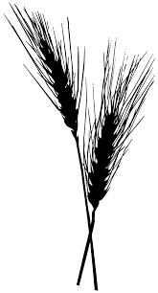
Nutrient Cycle diagrams: Nitrogen
N₂ (g)
NH₃ (g)
Ammonia
N₂ fixation
Plant material
harvest
Soil organic matter
ammonia
volatilization
immobilization
mineralization
denitrification
NO₃⁻
Nitrate
NH₄⁺
Ammonium
nitrification
leaching
Notes:
Teacher notes: Scientists often diagram ecological cycles to help us better understand the types or pools of N (boxes), the flows between them. Diagrams of cycles can be relatively simple like this one, or extremely detailed and complex.

Slide 18
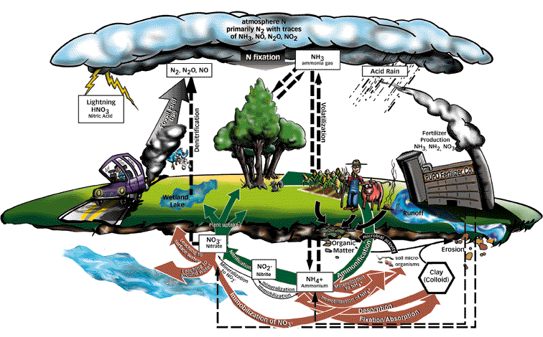
The Nitrogen Cycle
Notes:
http://ltpwww.gsfc.nasa.gov/globe/NFTG/nitrocyc.htm

Slide 19
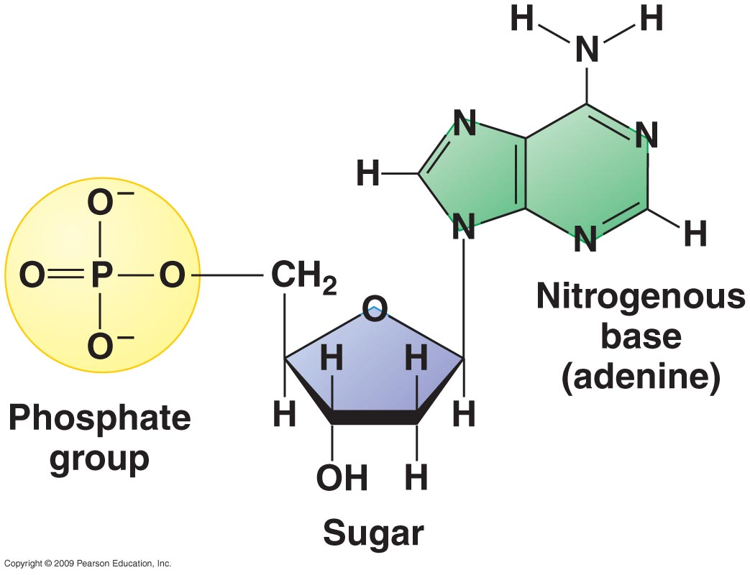
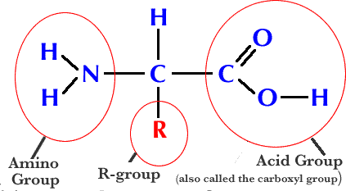
Nitrogen Cycle
Nitrogen is an important plant essential macronutrient
A key component of:
Proteins
DNA, RNA
Enzymes
N₂ in the atmosphere is the most common form
Plants primarily use nitrate (NO₃⁻) or ammonium (NH₄⁺)
Bacteria are able to convert N₂ to more reactive forms (NH₃ and NH₄⁺)
Notes:
http://www.sciencemuseum.org.uk/ClimateChanging/ClimateScienceInfoZone/ExploringEarthsclimate/1point6/1point6point2.aspx/ .

Slide 20
N is essential for plants because it is part of:
Lignin
Water
Enzymes and proteins

Slide 21
Plants generally utilize which form(s) of N?
N in organic form (proteins for example)
Ammonium and nitrate
N₂

Slide 22
N-cycle activities
“Be the N atom”
Role dice to determine the form of N you are/become
Record the different forms you take
Draw a N cycle that reflects your journey and share it with the larger group

Slide 23
Post activity questions
What N forms did you take?
Did you experience each possible form?
What processes (mineralization, immobilization, etc.) describe each arrow on your N cycle?

Slide 24
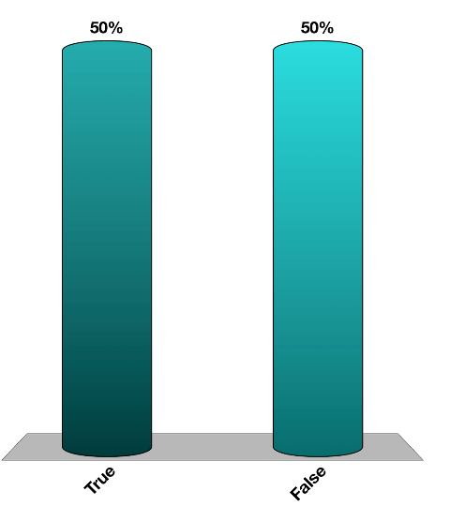
Nitrate is safe to have in drinking water.
True
False

Slide 25
Atmosphere 78% N₂
N₂ON₂
N₂
Fertilizer
NH₃
Harvest
N-fixation
erosion
De-nitrification
NO₃⁻ leaches to ground and surface water
NO₃⁻ & NH₄⁺
Nitrogen in Agriculture
Soil
organic
matter
Bacteria
Notes:
Teacher notes: A simple representation of the nitrogen cycle focusing on plant agriculture. Emphasize that there is only one arrow that takes N2 out of the atmosphere (small amount is also fixed by lightning) and production of chemical N requires fossil fuels. Nitrogen harvest in food, leaves the system and isn’t available for future growth. N also leaves the system by erosion, erosion, leaching into groundwater or by denitrification (carried out by microorganisms). N₂O is noted since it is a powerful greenhouse gas. This is not a closed cycle. Chemical reactions are included in the notes section of slide 3.

Slide 26
The atmosphere is ~78% N
True
False

Slide 27
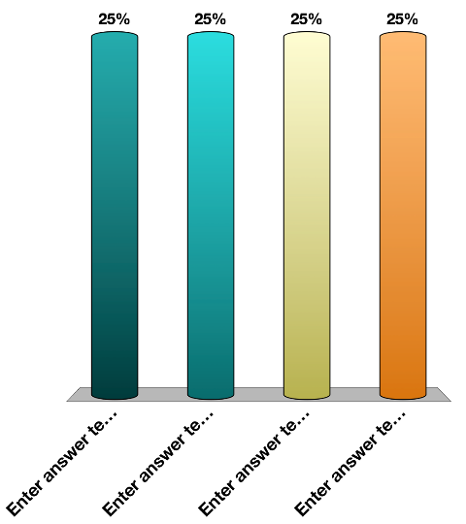
Ammonia gas is more likely to be produced when:
Nitrate fertilizers are incorporated into the soil
Ammonium fertilizers are applied to the surface of soils
Soils are acidic

Slide 28
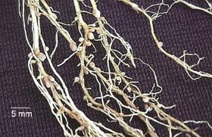
Nitrogen Fertilization
Most soils do not have enough N to allow maximum crop production (only about 2-3% of organic N is mineralized each year).
N is added to crop fields as nitrate or ammonia
Legume crops are able to fix their own N
Symbiotic bacteria take N₂ from the air and convert it to a form the legumes can use (N fixation)
Image from soils4teachers.org
Notes:
Teacher notes: Normal mineralization of N from organic matter is not sufficient to support the high yielding crop cultivars that we plant. Soils, therefore, are enriched with natural (manure and compost) or synthetic fertilizers. Legumes are plants that host N fixing bacteria in a symbiotic relationship. The bacteria receive carbohydrates from the plant for energy, while the plant benefits from greater levels of reactive N. Biological N2 fixation occurs within nodules which are formed on the roots of legumes.

Slide 29
What is the largest source of N in agriculture?
Animal waste
Lightning fixation of N₂
Symbiotic Bacteria
Fertilizer

Slide 30
How much N?
N tends to be the most expensive component of fertilizer.
Over-application can pollute the environment, harm plants and is expensive
Under-application of nitrogen reduces crop yields.
Precision agriculture focuses on applying only just what the plants can use
Notes:
Later units discuss precision ag in more detail

Slide 31
Nitrogen Use Efficiency
Can be defined as:
-N harvested divided by N applied
-World-wide average for cereal crops ~ 33%
-Loss of N occurs through volatilization, denitrification, leaching and erosion
-Economic loss
-Scientists are looking for ways to improve NUE through better soil management and crop breeding

Slide 32
Nitrogen is the most limiting and over-applied nutrient in agricultural soils?
True
False

Slide 33
Nitrogen GHG
Nitrogen can take the form of several greenhouse gases that are of concern
Nitrous oxide (N₂O) accounts for about 5% of all US GHG emissions
The impact of 1 pound of N₂O on warming in the atmosphere is almost 300 times that of 1 pound of CO₂
Agricultural soil management and manure management together are estimated to contribute about 79% of N₂O emissions (EPA, 2013).
Notes:
http://www.epa.gov/climatechange/ghgemissions/gases/n2o.html

Slide 34
Denitrification can produce greenhouse gases such as:
N₂ (g)
NO₄ (g)
N₂O (g)

Slide 35
Economics of Nitrogen Application
Nitrogen is one of the most costly inputs in production agriculture (all the way down to small garden plots too!)
Over application does not benefit the plants, in extreme cases it can kill them
Farming by the foot (Precision agriculture) is now within the economic grasp of nearly every farmer
Variable rate application is a WIN-WIN process. It will save farmers money, and it will reduce run-off and leaching

Slide 36
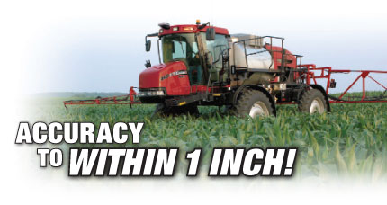
Components of Variable Rate Fertilizer Equipment
Satellite based auto-guidance system
Yield monitoring and mapping
On the go, vehicle based sensors
Additional resources:
www.precisionag.com
Notes:
Move to precision ag

Slide 37
Variable Rate Applications
See Extension Publications:
Overview of Variable Rate Technology.pdf
Implementing Site Specific Management Map Versus Sensor Based Variable Rate Application.pdf
Notes:
Move to precision ag

Slide 38
Activities:
Double Click on Image to open MS Word Doc.
Notes:
This Word Document contains all the lab activities.

