Slide 1
Ecological Cycles: Carbon, Photosynthesis, & Respiration
How are my farming practices affecting the environment & long term stability?

Slide 2
Standards

Slide 3
Objectives
Describe carbon cycling in agricultural applications
Identify the major phases of the carbon cycle
Explain the term carbon dioxide fertilization
List major carbon sinks in production agriculture

Slide 4
Terms:
Carbon fixation: conversion of inorganic carbon (carbon dioxide) to organic compounds by living organisms
Carbon sequestration: long-term storage of carbon dioxide or other forms of carbon to either mitigate or defer global warming and avoid dangerous climate change
Nitrogen fixation: conversion of atmospheric inorganic nitrogen to organic compounds, especially by certain microorganisms as part of the nitrogen cycle
Nitrification: biological conversion of ammonia or ammonium to nitrite followed by conversion of nitrite to nitrate
Denitrification: microbial conversion of nitrate that may produce molecular nitrogen (N₂) through a series of intermediate gaseous nitrogen oxide products
Photosynthesis: the process by which green plants and some other organisms use sunlight to synthesize foods from carbon dioxide and water
Respiration: metabolic process by which an organism reacts oxygen with glucose to produce water, carbon dioxide and energy
Notes:
Added more terms, modified a couple removed carbon sink

Slide 5
Ecological cycles
“Self-regulating processes that recycle the earth's limited resources that are necessary for life”
Many types of ecological cycles
  Hydrological, carbon, nitrogen, phosphorus, sulfur, etc.
The carbon cycle and nitrogen (N) cycle are especially important in agriculture
Notes:
Nitrogen is the focus of another unit in the REACCH curriculum.

Slide 6
The Carbon Cycle
“Although it is critical to more accurately predict the impacts of shifting climate conditions on carbon cycling and biosequestration in ecosystems, most carbon cycle processes are either minimally represented or altogether absent from current climate models. Different models supplied with nearly identical human emissions scenarios have produced dramatically different projections for carbon uptake, storage, or release by land and ocean ecosystems.” http://genomicscience.energy.gov/carboncycle/ (retrieved Oct. 2014)

Slide 7
The Carbon Cycle
Source: U.S. Department of Energy Genomic Science program http://genomicscience.energy.gov
Notes:
“Components of the Global Carbon Cycle. A simplified representation of the contemporary global carbon cycle is shown in the center of this figure. Values in parentheses are estimates of the main carbon reservoirs in gigatons (GT) as reported in Houghton (2007). The natural flux between the terrestrial biosphere and the atmosphere is about 120 GT of carbon per year, and that between the oceans and atmosphere is about 90 GT per year (IPCC 2007). In the terrestrial biosphere, photosynthesis removes about 120 GT of carbon from the atmosphere; decomposition of biological material and respiration from plants and soil microbes return 120 GT of carbon.
In the oceans, the marine biosphere does not take up CO₂ directly from the atmosphere. Each year the oceans absorb and release about 90 GT of carbon largely via diffusion across the air-ocean interface. The physical processes controlling the sinking of CO₂ into colder, deeper waters (where CO₂ is more soluble) and the mixing of ocean water at intermediate depths are known collectively as the “solubility pump.” Phytoplankton photosynthesis converts CO2 into organic carbon that is largely returned to ocean water as CO₂ via microbial respiration and decomposition. The “biological pump” refers to the small fraction of organic carbon that forms into degradation-resistant clumps and sinks to the ocean floor. Together the solubility and biological pumps control the amount of carbon transported to ocean depths and the exchange of CO₂ between ocean and atmosphere. Human activities (primarily fossil fuel use) emit about 9 GT of carbon each year. About 4 GT of this human-contributed carbon remain in the atmosphere; 3 GT are taken up by natural terrestrial processes, and another 2 GT are removed by the ocean (Canadell et al. 2007). Peripheral boxes describe some of the biological processes (photosynthesis, partitioning, respiration, and organic matter formation) discussed in this report that play key roles in regulating the flow of carbon in and out of terrestrial and ocean ecosystems. (pg. 11)”

Slide 8
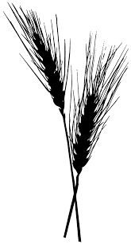
CO₂
CO₂
CO₂
Respiration
Photosynthesis
Respiration
Combustion
Food &
Residue
Decomposition
Soil organic matter
Carbon Cycle
Fossil
fuels
Notes:
Simplified version of prior slide. Teachers may want to use either or both.
Most simple representation carbon cycle focusing on plant agriculture. Emphasize that there is only one arrow that takes CO2 out of the atmosphere and that plants, animals, dead organic matter, fossil fuels and soil organic matter are pools of carbon. Fossil fuels and soil organic matter are the only long lasting pools shown (carbonates in the soil and rocks and the ocean are others). Fossil fuels are only long lasting if we don’t burn them. Residue is the organic matter left behind after harvest.

Slide 9
The Earth’s carbon sinks
Carbon sinks: forms in which carbon stored other than the atmosphere
Carbon sources: sources of carbon moving into the atmosphere
Carbon fixation through photosynthesis is the most important mechanism for taking CO₂ out of the atmosphere
  Source of carbon for all life.
Notes:
Carbon sinks are important in that fossil fuels are the result of long-term carbon storage, and we are reintroducing them as active in the carbon cycle at historic rates. Agriculture has the potential to recapture and store some of this carbon.
Resource: http://www.sciencemuseum.org.uk/ClimateChanging/ClimateScienceInfoZone/ExploringEarthsclimate/1point6/1point6point2.aspx

Slide 10
Carbon Sinks
Short lived:
  Living organisms
  Dead organisms
  Organic matter in soil
Long lived:
  Organic matter in soil
  CO₂ dissolved in the oceans
  Carbonates in rocks
  Fossil fuels (if not burned)
Notes:
There are different types of soil organic matter, some are long lasting, others quickly decompose.
Suggested Reading: Carbon credits from tilled and no-tilled winter wheat available at https://www.reacchpna.org/sites/default/files/AR3_6.6.pdf

Slide 11
Fossil Fuels
Coal, oil, natural gas
Result of organic material being buried for millions of years and removed from the carbon cycle.
When burned they release CO₂ into the atmosphere
Photosynthesis and the ocean sinks have been able to incorporate roughly half these emissions each year
  Ocean acidification is one result
The rest remains in the atmosphere
Notes:
Resource: http://www.sciencemuseum.org.uk/ClimateChanging/ClimateScienceInfoZone/ExploringEarthsclimate/1point6/1point6point2.aspx

Slide 12
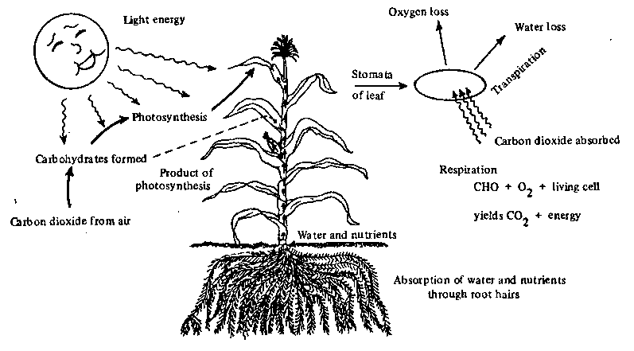
Photosynthesis
Notes:
One of several graphical representations presented in the next few slides. Students may benefit from drawing our several different diagrams, or by seeing several different ones and then constructing their own (triggering more recovery and building better long-term memory).
Transparency from:
http://www.uidaho.edu/~/media/Files/orgs/CALS/Department/AEE/Curriculum/Curriculum%20guides/400%20and%20above/510/Ag%20510-E.ashx

Slide 13
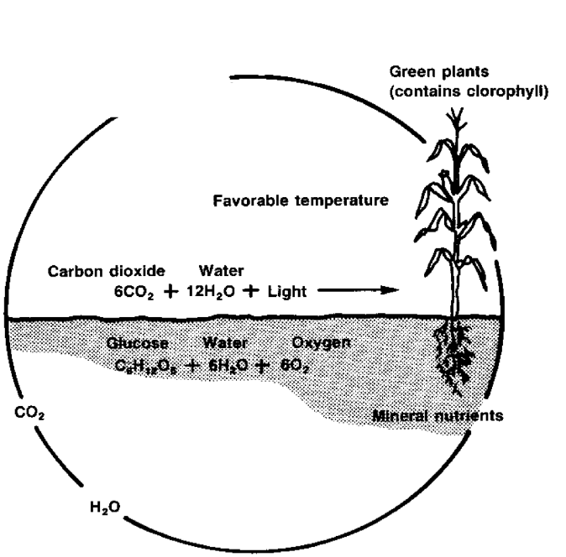
Photosynthesis
Photosynthesis only occurs in the presence of light
Source: Idaho PTE Ag Curriculum Guides 510-E
Notes:
Transparency from:
http://www.uidaho.edu/~/media/Files/orgs/CALS/Department/AEE/Curriculum/Curriculum%20guides/400%20and%20above/510/Ag%20510-E.ashx
Several representation of photosynthesis are presented over the next few slides. They can be hidden or used to show students differing ways to represent the same process.

Slide 14
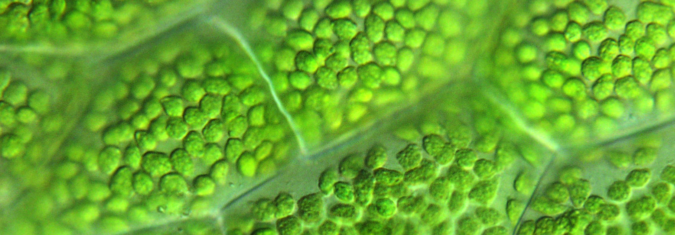
Photosynthesis

Slide 15
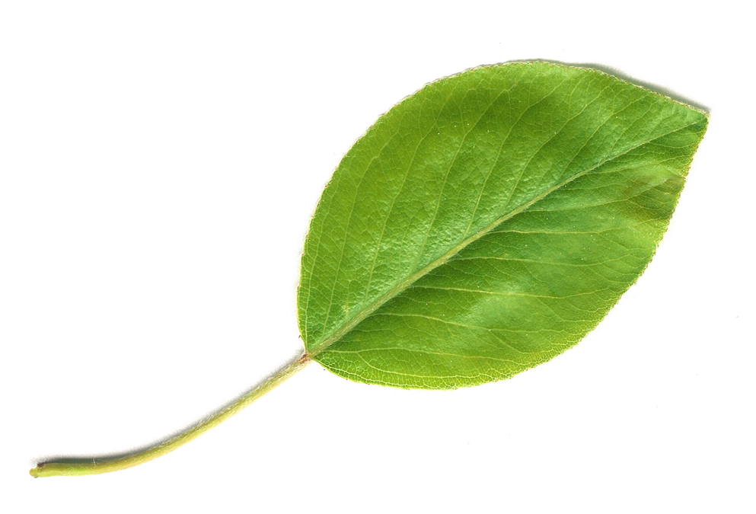
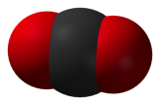
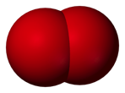
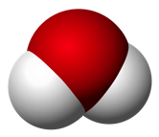
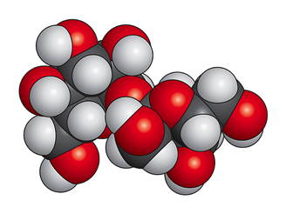
Photosynthesis
Light
CO₂
O₂
H₂O
Carbohydrates
Notes:
May need to explain that sugars are carbohydrates

Slide 16
Photosynthesis
Notes:
http://www.johnkyrk.com/photosynthesis.html
Another representation of the photosynthesis process

Slide 17
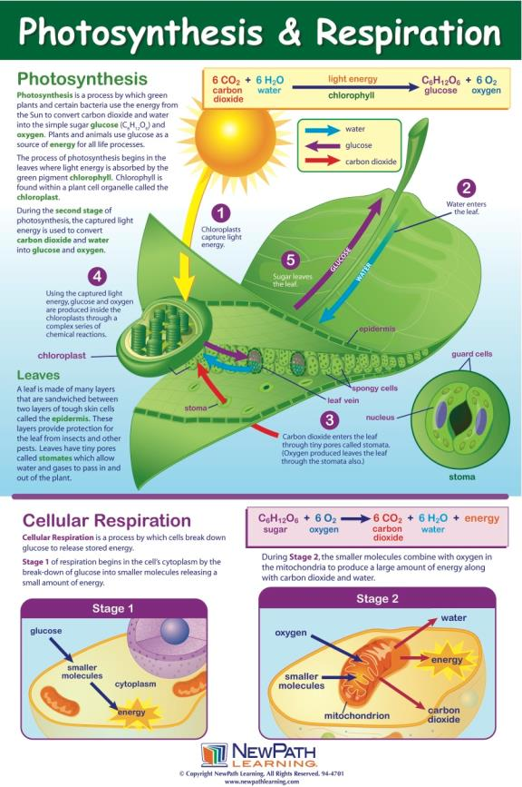
Respiration
Respiration is always occurring.
CO₂ is constantly being produced as the plant grows.
Two stage process
  Starting in the cytoplasm glucose is broken down to smaller energy molecules (glucose → pyruvic acid → NADH & FADH₂)
  In the mitochondria these molecules are converted to energy (Adenosine Tri-Phosphate) yielding CO₂ and water as the byproducts
Notes:
The poster on the side of this slide is available from http://www.connecticutvalleybiological.com/photosynthesis-and-respiration-p-15495.html for about $20

Slide 18
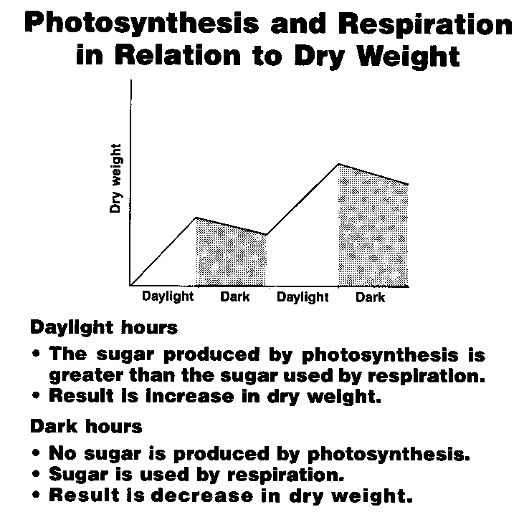
Plant Growth
Daylight hours
  The sugar produced by photosynthesis is greater than the sugar used by respiration.
  Result is increase in dry weight.
Dark Hours
  No sugar is produced by
  photosynthesis.
  Sugar is used by respiration.
  Result is decrease in dry weight.
Notes:
Focus on the cyclical process and that the end result in healthy plants is an increase in organic matter (growth) which may or may not be in above ground parts of the plant.

Slide 19
Organic Matter Formation (Growth)
Growth in plants occurs as a net increase in dry weight when photosynthetic process produces more energy than the respiratory process consumes.
Photosynthesis – Respiration = Net Plant Growth
Notes:
The idea of plants producing CO2 is often overlooked. Plants take CO2 and produce O2 is what is stressed to the point that CO2 being produced as well may not even register for many students. Use the attached labs to help students see this connection.
Suggested Reading: Catching carbon on the Palouse available at https://www.reacchpna.org/sites/default/files/AR3_6.2.pdf

Slide 20
Mauna Loa Observatory
Atmospheric CO₂ measured in Hawaii
Nearly 50 years of continuous recording of CO₂ levels
Increase of nearly100 PPM (25% increase) in the last 50 years
Man-made (anthropogenic) processes contribute to the net increase in atmospheric CO₂
Notes:
One of the longer continuous records of atmospheric CO2 levels scientists have.

Slide 21
Photosynthesis & Respiration
Photosynthesis
Respiration
Animals & microbes
Plants
&
microbes
CO₂
CO₂
Notes:
A reoccurring model for students to consider and manipulate. Encourage expansion and reflection on what appears simple, but is increasingly complex as students explore the components.
Ask how photosynthesis and respiration balance each other and under what conditions they get out of balance.

Slide 22
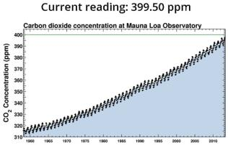
Keeling Curve
Measured in Hawaii
Nearly 50 years of continuous recording of CO₂ levels
Net change of nearly 100 PPM (25% increase)
Graph shows the net product of the carbon cycle
Many natural and man-made processes create this net increase in atmospheric CO₂

Slide 23
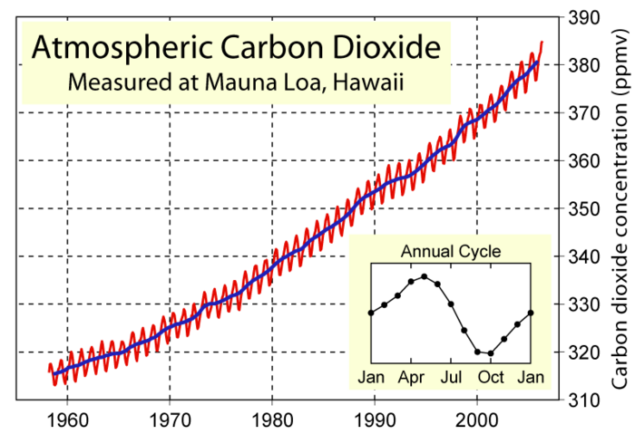
Keeling Curve

Slide 24
Photosynthesis & Respiration
Photosynthesis
Respiration
Burning/fuel use
Animals & microbes
Plants &
microbes
CO₂
CO₂
Notes:
Discuss how the model shows a lack of balance. Have students propose and evaluate possible ways to bring the model back to equilibrium. Use the labs to help evaluate possibilities and encourage students to create their own experiments related to the Carbon Cycle. Use the readings to both increase understanding and add to the complexity of the model.
Suggested Reading: N2O and CO2 production in wheat-based cropping systems available at https://www.reacchpna.org/sites/default/files/AR3_6.1.pdf

Slide 25
Carbon Dioxide Fertilization
As CO₂ levels increase, plants are able to utilize some of it to increase growth rates.
Exact benefits vary by species and are also dependent upon no other nutrients or water being limiting factors.
Growth from increased CO₂ may not exhibit itself in above ground plant structures

Slide 26
Activities:
Double click to open documents

Slide 27
Other Resources:
Earths Energy Budget http://gpm.nasa.gov/education/videos/real-world-monitoring-earths-energy-budget-ceres
NASA Weather & Climate http://gpm.nasa.gov/education/weather-climate

