Slide 1
Water
Water availability is one of the most limiting factors in crop production across the Western US. Changes in when water is available have impacts on every aspect of crop production.

Slide 2
Standards

Slide 3
Resources
Print materials to supplement unit, or create PDF catalog on student digital devises.
  Suggested Reading Resources:
    Service, R. F. (2004). As the west goes dry. Science, 303(5661), 1124-1127. doi: 10.1126/science.303.5661.1124
    Columbia Basin Fact Sheet. http://www.usbr.gov/climate/SECURE/docs/columbiabasinfactsheet.pdf
    Western Water Assessment (http://wwa.colorado.edu/)
    Palouse Basin: Community water information system (http://wr.civil.uidaho.edu/cwis/palouse/)
    Water Resources, Washington State Department of Ecology (http://www.ecy.wa.gov/programs/wr/wrhome.html)
    Climate Impacts Group (http://cses.washington.edu/cig/pnwc/pnwc.shtml)
    Project WET

Slide 4
Objectives
1. Define terms related to water and erosion
2. Describe the traditional distribution of precipitation for your area
3. Contrast future precipitation predictions and historical allocations
4. Describe the relationship between snow pack and seasonal reservoir water levels
5. Discuss the impacts of changing precipitation patterns on dry-land farming practices
6. List and describe three farming practices designed to reduce erosion
7. Describe the relationship between fertilizer application and rainfall
8. List three practices that farmers can adapt to account for changes in water allocations on dry-land farms
9. Match soil water holding capacity to cropping systems

Slide 5
Terms
Soil—The mineral and organic matter that supports plant growth on the earth's surface; it is a mixture of particles of rock, organic materials, living organisms, air and water
Aggregate—Mass or cluster of soil particles such as a clod, crumb or granule
Leaching—Removal of water soluble soil components from the soil by the downward action of water
Erosion—Process in which soil particles undergo detachment, transport, and deposition.
Hydrologic cycle—The continuous movement of water on, above and below the surface of the Earth
Notes:
Teaching Idea: Use handout As the West Goes Dry. This isn’t so much a climate change discussion as a look at trends and discuss what we do. The why isn’t really important anymore; it’s how do we deal with the reality that water availability has changed over the past several decades. Farmers and all water users need to understand how it’s changing and find ways to adapt.
Hydrology: a science dealing with the properties, distribution, and circulation of water on and below the earth's surface and in the atmosphere

Slide 6
Terms
Runoff—The water flow that occurs when the soil is infiltrated to full capacity (saturated) and excess water from rain, snowmelt, or other sources flows over the land.
Watershed—A geographically defined area where all of the water that comes into or under it drains into one body of water. The size of which is defined by the body of water into which it collects.
Hydrology—Branch of science concerned with the study of the properties and movement of water.
Conservation tillage—Farming practices reducing the amount of soil disturbance compared to conventional or traditional practices.
No-till—Farming practice that does not require seedbed disturbance or preparation prior to planting. Machinery deposits seeds through existing ground cover.
Notes:
Teaching Idea: Use handout As the West Goes Dry. This isn’t so much a climate change discussion as a look at trends and discuss what we do. The why isn’t really important anymore; it’s how do we deal with the reality that water availability has changed over the past several decades. Farmers and all water users need to understand how it’s changing and find ways to adapt.
Hydrology: a science dealing with the properties, distribution, and circulation of water on and below the earth's surface and in the atmosphere

Slide 7
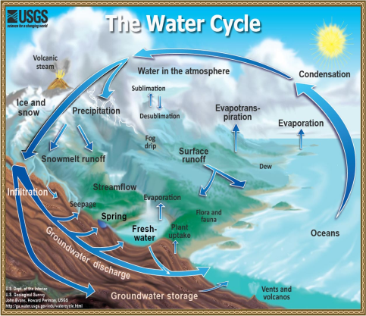
Hydrologic cycle
There are five main processes that control the movement and distribution of water in a watershed that are main components of the hydrologic cycle:
      Precipitation
      Evaporation
      Condensation
      Runoff
      Transpiration
Notes:
Teaching Idea: Students know the cycle. This is a discussion place for how do these stages relate to our area? What does the precipitation fall as, where is it stored, how does that affect me as a student. Hand out the Basin Report for the Columbia basin. Discuss its implications.

Slide 8
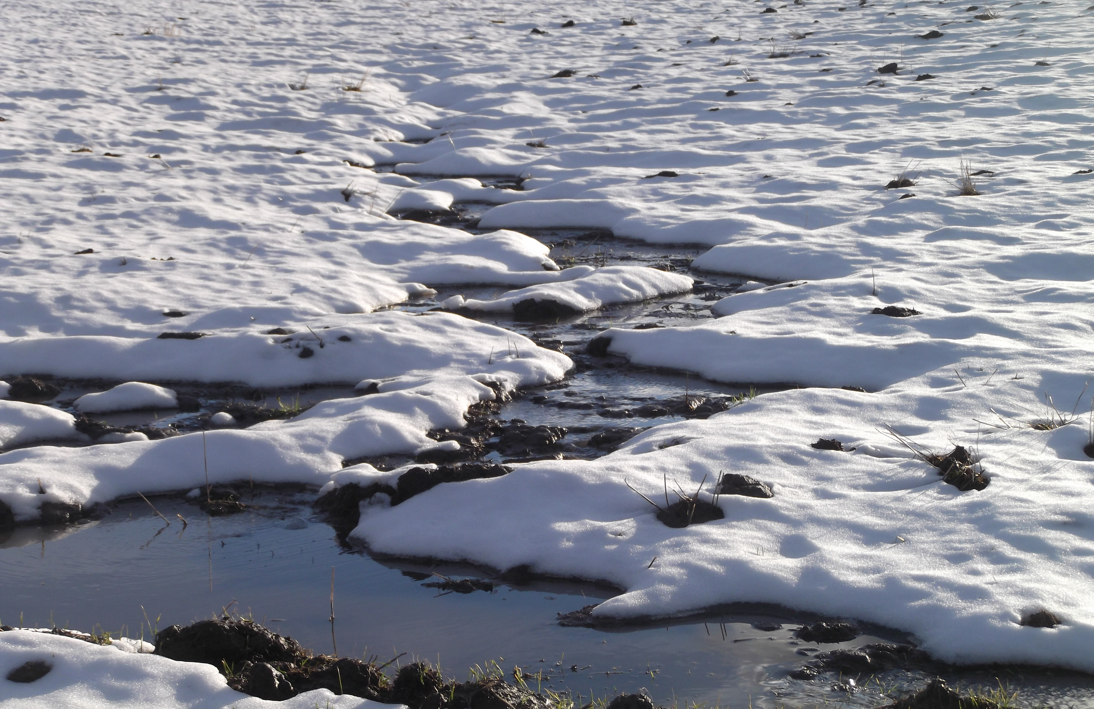
Runoff Defined
Surface Runoff: is the water flow that occurs when the soil is infiltrated to full capacity (saturated) and excess water from rain, snowmelt, or other sources flows over the land.

Slide 9
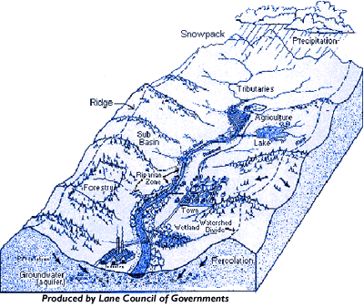
Watershed defined:
A watershed is the area of land where all of the water that is under it or drains from it goes into the same place. They come in all shapes and sizes.
Notes:
Teaching Idea: Review the larger range of the Columbia watershed, and discuss the local watershed, its storage capacity, and who uses the water locally.

Slide 10
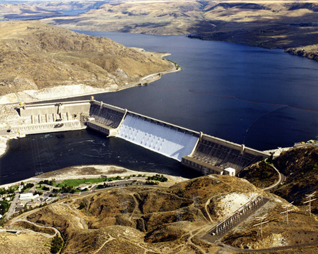
Local storehouses for water
Reservoirs:
http://www.usbr.gov/pn/grandcoulee/photogallery/aerials/pic4.html
Notes:
Teaching Idea: Find local photos or articles to increase the relevance for students

Slide 11
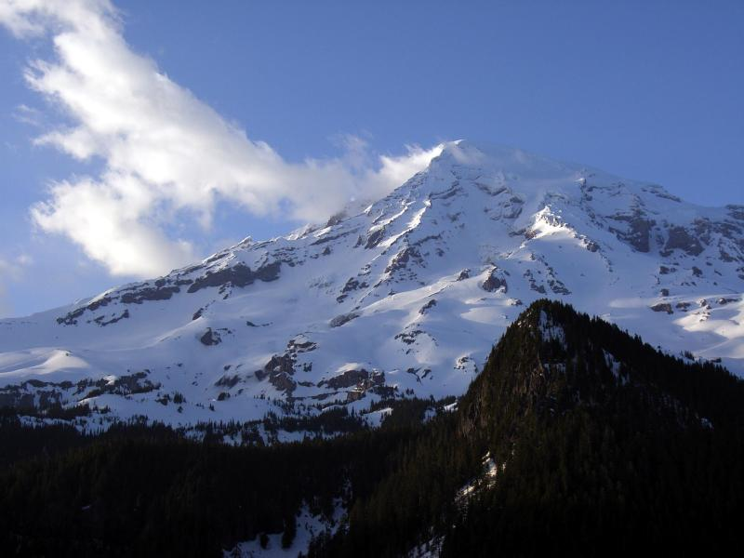
Local storehouses for water
Snow pack:
http://www.nps.gov/pwr/photosmultimedia/photogallery.htm?id=CA4C9908-155D-4519-3E19303DAEADE22C

Slide 12
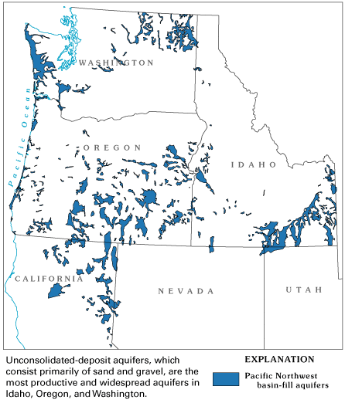
Local storehouses for water
Aquifers:
http://water.usgs.gov/ogw/aquiferbasics/ext_pacnorbf.html

Slide 13
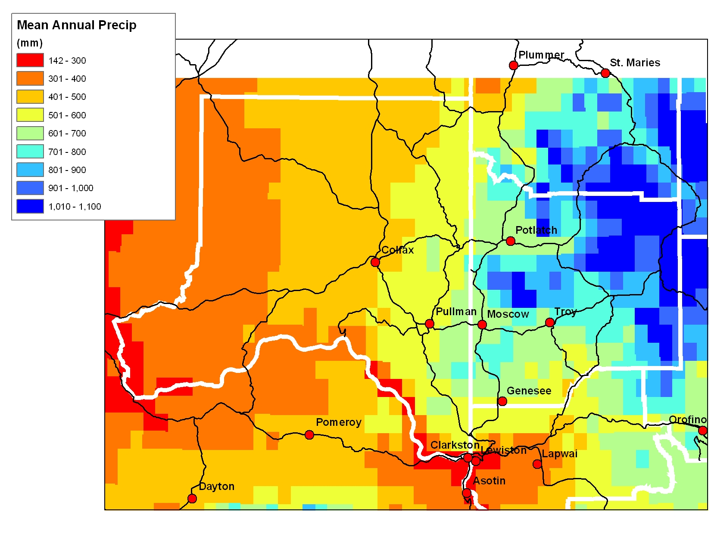
Average Historical Precipitation distribution for the Inland PNW
Average annual precipitation ranges from 6 inches in South Central WA to 24 inches near Moscow ID.
Notes:
Teaching Idea: http://cses.washington.edu/cig/maps/index.shtml has maps of historical rainfall by time of year. They could be used to look at the entire region.

Slide 14
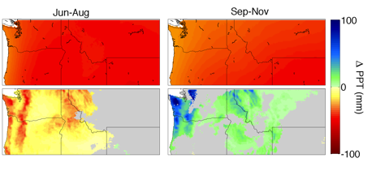
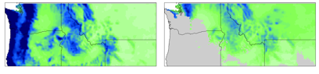
Projected Annual Precipitation for the Inland PNW
Climate Change is expected to change annual rainfall distribution and amounts
  Models predict a 1-2% annual increase in precipitation for the region
Dec- Feb
Mar-May
Jun-Aug
Sept-Nov
Notes:
Taken from Chad Kruger presentation “Othello Sandhill Crane” on REACCH CD website. And modified
(image of projected rainfall distribution)

Slide 15
How Rainfall Distribution Impacts Farming -Why does it matter when it rains?
Dryland farming relies on stored soil water and precipitation that falls during crop growth
Soils are limited in the amount of water that can be stored
Less precipitation in summers when plants are actively growing can reduce the amount of water available to plants
Increase in Fall and Spring rains can lead to muddy conditions when farmers need to be in the field planting

Slide 16
How much soil water do dry-land crops need?
Crop yield is directly related to the amount of water stored in soil at planting and related to precipitation during plant growth
Notes:
From, “How Wheat Responds to Water” by USDA ARS Scientist, 2005
Teaching Idea: Use Available-water-and-wheat-yield-EM049E.pdf and discuss how the changes in water directly impact the economics of the farmer and the region.

Slide 17
The Bottom Line
Dryland farming uses moisture in the soil profile
More stored water the more production per acre
It is estimated for every additional inch of water available to wheat in a winter wheat – summer fallow system will produce 7 bushels/acre¹
Finding ways to prevent water from running off or evaporating increases the profits for farmers
1 - Schillinger W., Schofstoll S., Alldredge J. Washington State University Extension and USDA. Predicting Wheat Grain Yields Based on Available Water.
Bulletin EM049E. Pullman, WA. April 2012
Notes:
Teaching Idea: This is a good place to tie back into the farm case studies from the last chapter. Discuss the disturbance of the soil and its impact on evaporation of soil water.

Slide 18
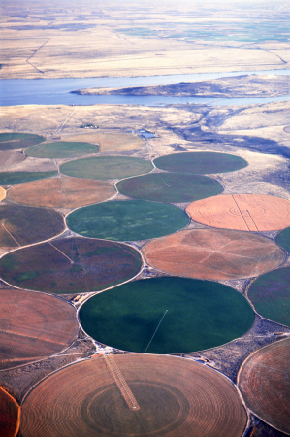
Why does precipitation matter to irrigated Farms?
Irrigation practices rely on stored precipitation in reservoirs.
Changes in precipitation distribution will have potential impacts on water available for irrigation.
Warmer wetter winters = less water stored in snowpack
Hermiston, OR. Photo courtesy of USDA-ARS
Notes:
Teaching Idea: Discussion should go back to reservoirs, when the water will collect, and when it is drawn out the fastest. Pose the question, if the reservoir is going dry who gets the water, cities, or farmers and why? This would be a great class debate if you have the flexibility and time. Its deeper thinking requirement is what the common core is focused upon.

Slide 19
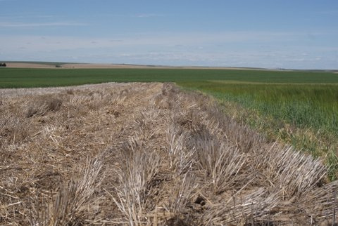
Cultivation practices to increase soil moisture:
In drier areas many farmers will have a fallow season as part of their crop rotation to have additional stored water
Fallow land has nothing grown on it for a season

Slide 20
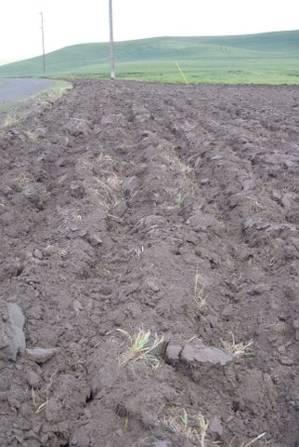
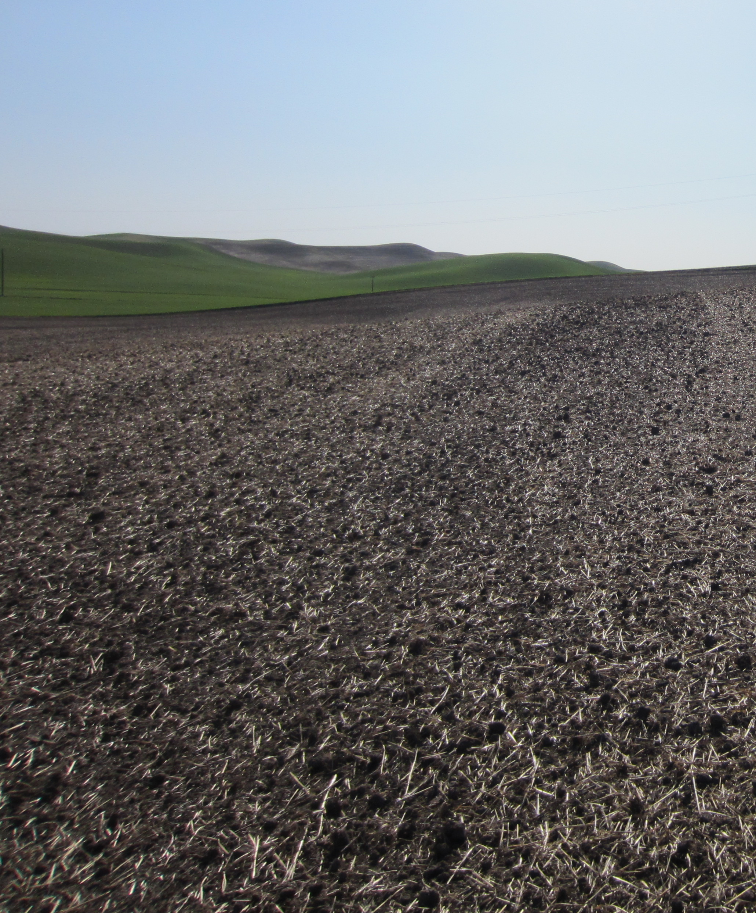
Cultivation practices to increase soil moisture
Reduced Tillage: tilling with the intent on leave 30% or more of the field covered crop residues.
Reducing tillage increases soil organic matter which increases the soils ability to store water
Conventional Tillage
Reduced Tillage

Slide 21
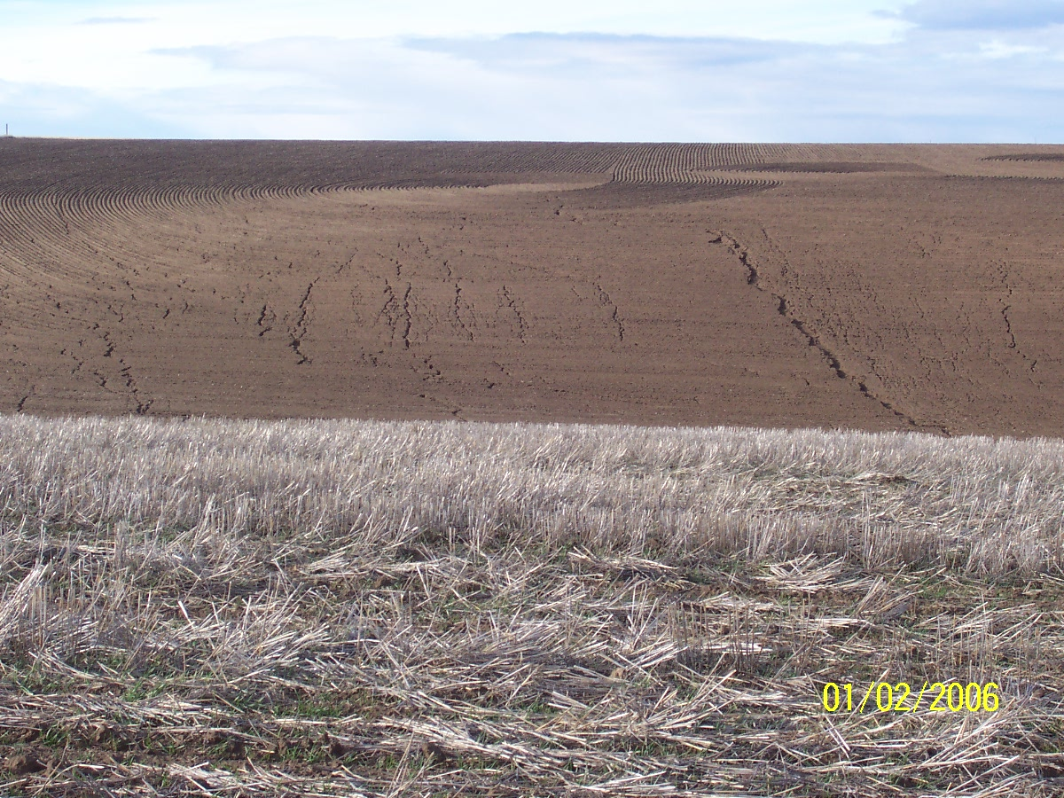
Cultivation practices to increase soil moisture
No-Till: Is a practice the minimizes soils disturbance and results in increased residue retention.
This practice optimizes soil organic matter content which increases the soil’s water holding capacity
Conventional Till
No-Till (picture)
No-Till

Slide 22
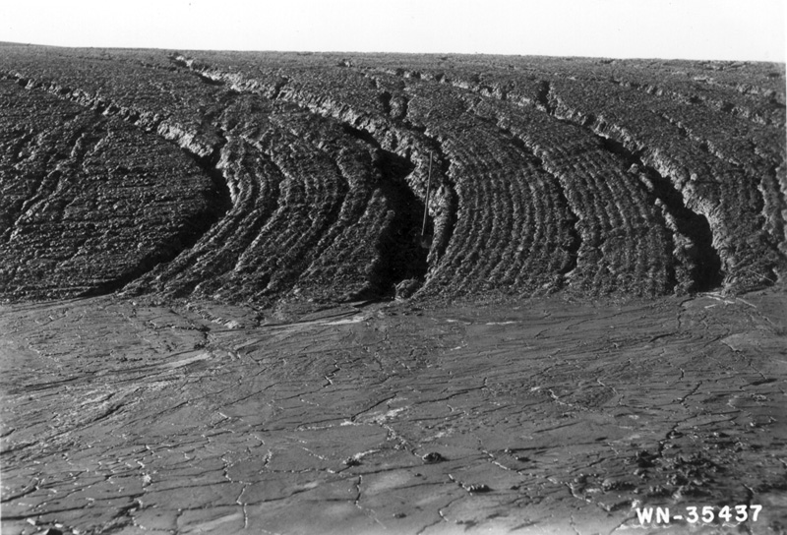
Erosion
Erosion:
Shovel
Erosion: is the detachment transport and deposition of soil particles due to the impact from rain drops, movement of water, and wind.

Slide 23
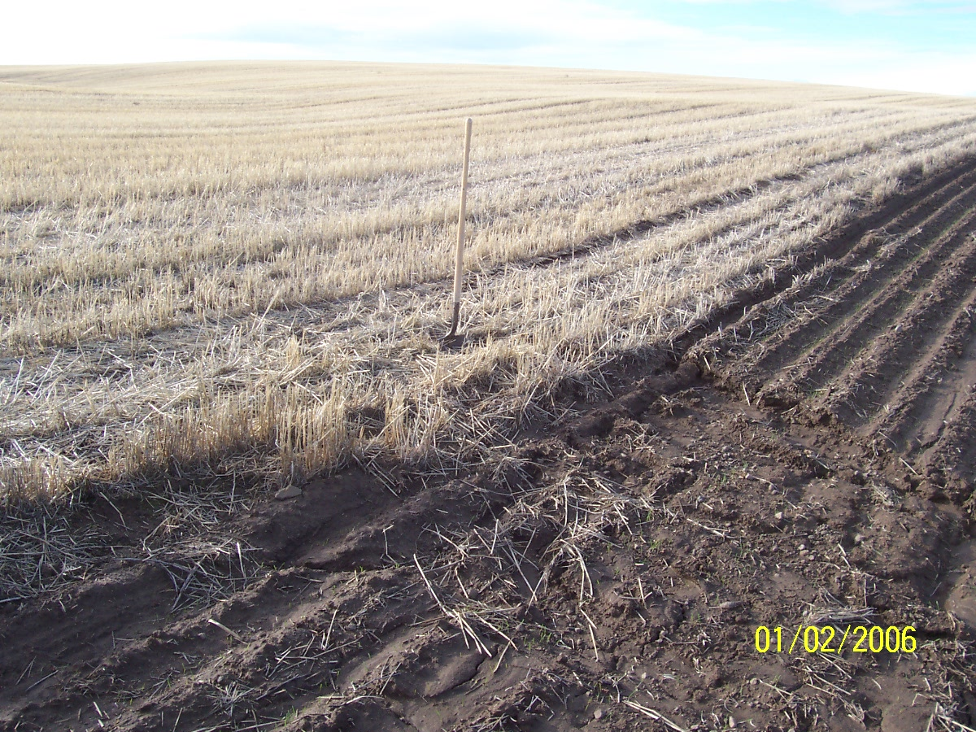
Cultivation practices to reduce runoff and erosion
No-Till
Conventional till
Photo courtesy of Bill Jepsen, OR

Slide 24
How does precipitation and soil moisture affect fertilizer application?
Fertilizer application rates are determined by an anticipated crop yield.
In a wet year potential crop yield is greater than in a dry year. This would mean more fertilizer would have to be applied to a crop in a wet year to fulfill their nutrient requirements.
In wetter years there is greater potential for fertilizer loss due to runoff and erosion. It’s a double edge sword.

Slide 25
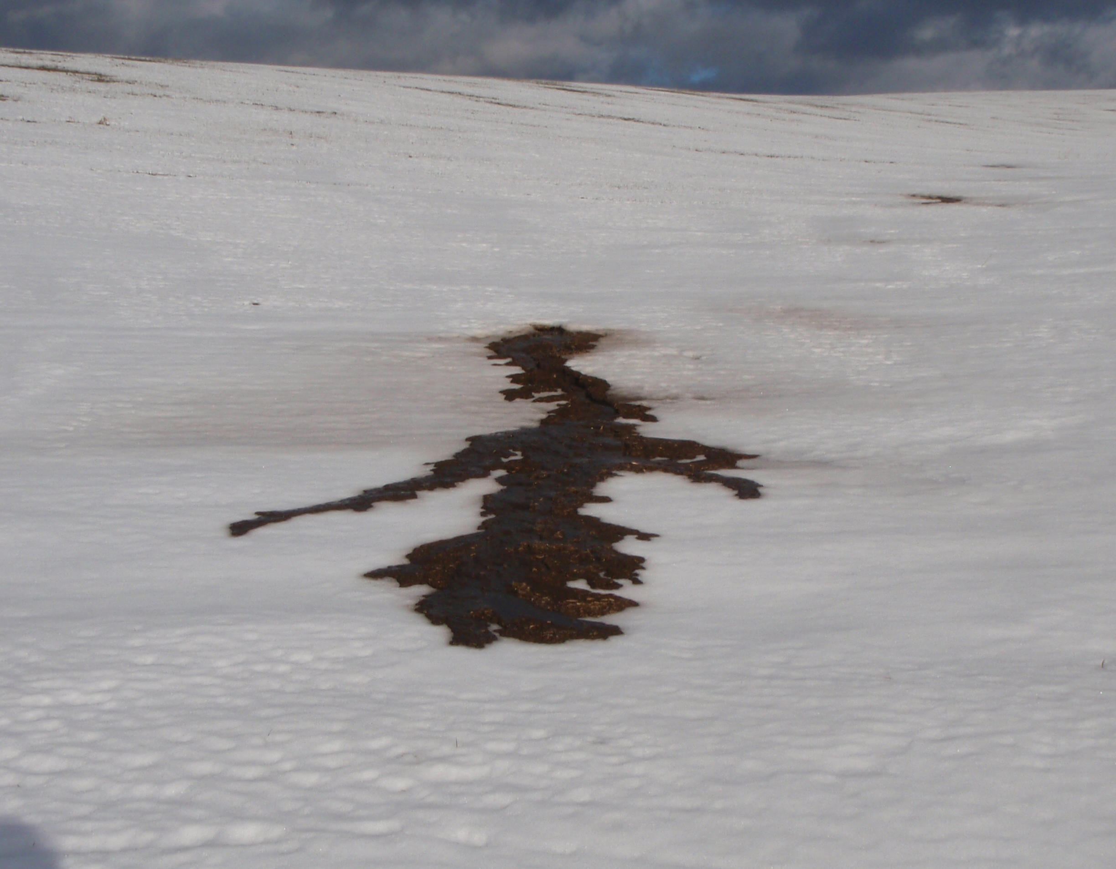
Rain on Frozen Soil
When rain falls on frozen soils water is unable to infiltrate the soil. It is similar to rain falling on pavement, excessive runoff happens when this occurs
If soil is bare, it is easy for this water to erode soils

Slide 26
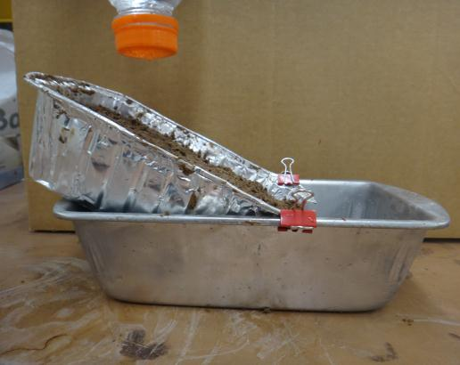
Activity/Lab
Soil infiltration and Runoff
Notes:
Word Doc located on last slide in this PPT.
Teaching Idea: Run as many different simulations through the lab as you have time for. The dollar store is where the pans were purchased so having multiples shouldn’t cost much. Make students do a complete lab report and present their findings on the scenario they were assigned.

Slide 27
Review Questions
What are the 5 parts of the hydrologic cycle?
Name the three locations where water can be stored?
In your own words define runoff and erosion.
How does soil moisture effect crop yield?
What cultivation practices can increase infiltration and decrease runoff and erosion?

Slide 28
Handouts & Activities
Double click on Word Doc Image to Open

