Slide 1
Climate and
Agriculture
How will changing weather patterns and long-term climate changes impact agriculture in our area?
Notes:
This is the foundational unit for the REACCH curriculum. The slides presented here are intended to create interest in our changing climate. While there are some very polarized views about the causes of climate change/global warming in America, agriculturalists cannot ignore the reality of changes in the growing practices they have utilized for decades. Several publications exist relating to climate change impacts and agriculture both in the US and specifically related to the Pacific Northwest.
Recommended Readings / Background Information:
Hatfield, J., G. Takle, R. Grotjahn, P. Holden, R. C. Izaurralde, T. Mader, E. Marshall, and D. Liverman, 2014: Ch. 6: Agriculture. Climate Change Impacts in the United States: The Third National Climate Assessment, J. M. Melillo, Terese (T.C.) Richmond, and G. W. Yohe, Eds., U.S. Global Change Research Program, 150-174. doi:10.7930/J02Z13FR.
Mote, P., A. K. Snover, S. Capalbo, S. D. Eigenbrode, P. Glick, J. Littell, R. Raymondi, and S. Reeder, 2014: Ch. 21: Northwest. Climate Change Impacts in the United States: The Third National Climate Assessment, J. M. Melillo, Terese (T.C.) Richmond, and G. W. Yohe, Eds., U.S. Global Change Research Program, 487-513. doi:10.7930/J04Q7RWX.
Walthall, C.L., J. Hatfield, P. Backlund, L. Lengnick, E. Marshall, M. Walsh, S. Adkins, M. Aillery, E.A. Ainsworth,C. Ammann, C.J. Anderson, I. Bartomeus, L.H. Baumgard, F. Booker, B. Bradley, D.M. Blumenthal, J. Bunce, K. Burkey, S.M. Dabney, J.A. Delgado, J. Dukes, A. Funk, K. Garrett, M. Glenn, D.A. Grantz, D. Goodrich, S. Hu, R.C. Izaurralde, R.A.C. Jones, S-H. Kim, A.D.B. Leaky, K. Lewers, T.L. Mader, A. McClung, J. Morgan, D.J. Muth, M. Nearing, D.M. Oosterhuis, D. Ort, C. Parmesan, W.T. Pettigrew, W. Polley, R. Rader, C. Rice, M. Rivington, E. Rosskopf, W.A. Salas, L.E. Sollenberger, R. Srygley, C. Stöckle, E.S. Takle, D. Timlin, J.W. White, R. Winfree, L. Wright-Morton, L.H. Ziska. 2012. Climate Change and Agriculture in the United States: Effects and Adaptation. USDA Technical Bulletin 1935. Washington, DC.

Slide 2
Objectives
Objectives
Analyze geoscience data to make the claim that one change to Earth’s surface can create feedbacks that cause changes to other Earth’s systems. NGSS-HS-ESS2-2.
Use a model to describe how variations in the flow of energy into and out of Earth’s systems result in changes in climate. NGSS-HS-ESS2-4.
Construct an explanation based on evidence for how the availability of natural resources, occurrence of natural hazards, and changes in climate have influenced human activity. NGSS-HS-ESS3-1.
Analyze geoscience data and the results from global climate models to make an evidence-based forecast of the current rate of global or regional climate change and associated future impacts to Earth systems. NGSS-HS-ESS3-5.
Research climate change and summarize evidence that climate change is occurring. AFNR-ESS.03.01.03.a.
Assess the environmental, economic and social consequences of climate change. AFNR-ESS.03.01.03.b.
Evaluate the predicted impacts of global climate change on environmental service systems. AFNR-ESS.03.01.03.c.
Technical Reading Resources
Ch. 6: Agriculture. Climate Change Impacts in the United States: The Third National Climate Assessment. doi:10.7930/J02Z13FR LINK
Ch. 21: Northwest. Climate Change Impacts in the United States: The Third National Climate Assessment. doi:10.7930/J04Q7RWX LINK
Climate Change and Agriculture in the United States: Effects and Adaptation. USDA Technical Bulletin 1935. Washington, DC. LINK
Lambert, J. (2014). Global Climate Change: The Science Needed to Understand the Problem. LINK
Climate Literacy Handbook. NOAA LINK

Slide 3
The REACCH Agronomy Curriculum supports the following AFNR Standards, NGSS, & CCSS, however additional resources and time may be required to completely meet the intent of these standards.
The image to the left is an embedded MS Word Document. For many users you can simply double click on it to open it in a MS Word Editing window. If this does not work on your computer then right click on the image and go to “Document Object” and click “Open”
This is a “Hidden Slide.” Hidden slides will not show when the presentation is played.

Slide 4
What IS Climate Change?
Climate:
Long term pattern of weather in a particular area
(30 years)
Weather:
Short term state of the atmosphere (wet/dry, hot/cold, calm/stormy, clear/cloudy)
(minute by minute)
Climate Change:
Change in the distribution of weather patterns. (decades to millions of years)
“Climate is what you expect, weather is what you get”_{—PNW Farmer}
Notes:
Climate and Weather are two terms often confused by students and the American public at large. Discussion on the differences should focus on duration of observations (30+ yrs. for climate) and that it takes many changes in daily weather over an extended period of time to change climate, not just single observable weather events.
Recommended reading: As the West Goes Dry

Slide 5
Seasons

Slide 6
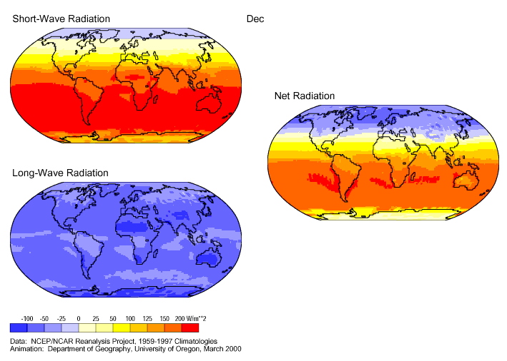
Tilting Of The Earth Causes Seasons
Notes:
Recommended Resources: Globe, thermometer, and Light bulb
Seasons are sometimes not fully understood by high school students due to limited Earth Science courses in many of the PNW rural schools. This slide can be changed into an active learning opportunity if you have a globe, light bulb and a thermometer. Vernier published a lab that you can use as a guide to a classroom demonstration (http://www2.vernier.com/sample_labs/ESI-01-seasons_and_angle_of_insolation.pdf). It is a part of their Agriculture Laboratory Manual. The keys are to show students changes in temperature and if a light meter is available light intensities as the earth orbits the sun. Emphasis on the orbit creating the seasons will help in understanding the Milankovitch cycles presented on the next slide.

Slide 7
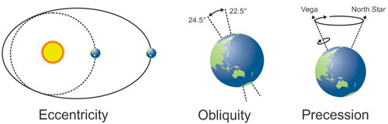
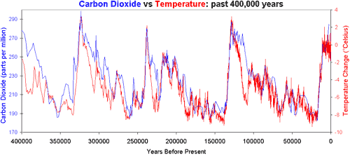
The Strange Relationship between the Earth and the Sun
Milankovitch Cycles ~41,000 yr. cycle
Vostok Antarctic ice core records for carbon dioxide concentration (Petit 2000) and temperature change (Barnola 2003).
Notes:
Milankovich cycles: http://www.skepticalscience.com/co2-lags-temperature-intermediate.htm --” Inter-glacials come along approximately every 100,000 years. This is called the Milankovitch cycle, brought on by changes in the Earth's orbit. There are three main changes to the earth's orbit. The shape of the Earth's orbit around the sun (eccentricity) varies between an ellipse to a more circular shape. The earth's axis is tilted relative to the sun at around 23°. This tilt oscillates between 22.5° and 24.5° (obliquity). As the earth spins around it's axis, the axis wobbles from pointing towards the North Star to pointing at the star Vega (precession).”

Slide 8
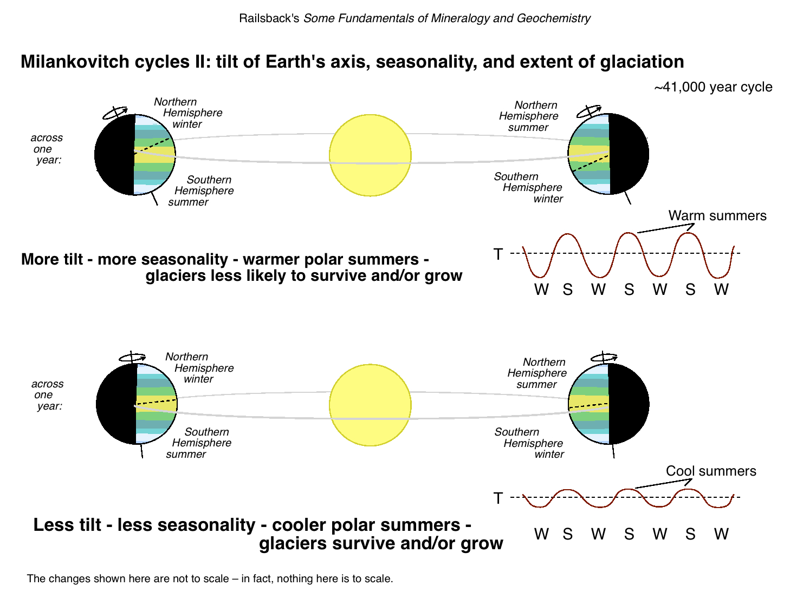
Notes:
Current tilt of the earth.

Slide 9
The Atmosphere

Slide 10
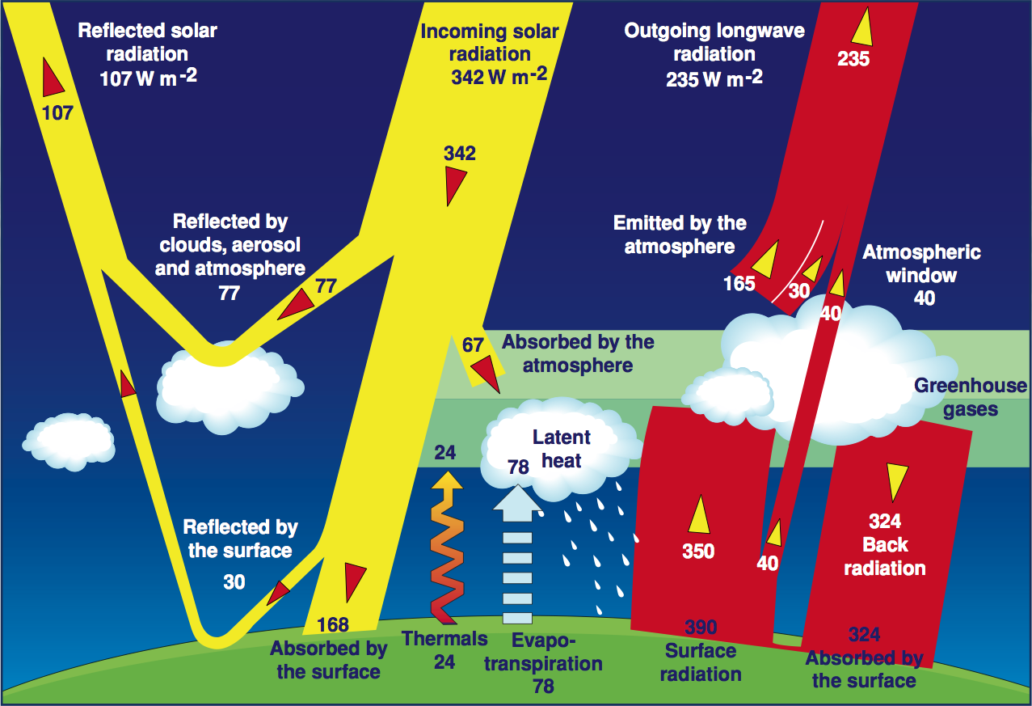
The Atmosphere Stores Heat
Notes:
The greenhouse effect is an often misrepresented process. Even textbook diagrams of the process are misleading and incorrect. Simplifying the process without misrepresenting it is key.
The sun heats the earth and to a lesser extent the air,
The earth heats the air and heat not absorbed by the air radiates into space,
Greenhouse gasses aka GHG’s (CO₂, Nitrous Oxide, Water Vapor, etc) store heat radiating from the earth,
GHG’s radiate the heat they absorbed out in all directions, some coming back to earth and some being lost to space,
The higher the levels of GHG the more heat is stored and the less heat is lost into space,
The more heat is stored the hotter the system gets
GHG’s are produced naturally & anthropogenically (by man)
Anthropogenic production has been on the rise since the Industrial Revolution
Current CO₂ levels in the atmosphere exceed those recorded in the past 10,000 yrs.
Different GHG’s store different amounts of heat
CO₂ and water vapor are two of the largest heat reservoirs in the atmosphere

Slide 11
Greenhouse Gas Warming Potential
Greenhouse Gas | Formula | 100-year GWP (AR4)
Carbon dioxide | CO₂ | 1
Methane | CH₄ | 25
Nitrous oxide | N₂O | 298
Sulphur hexafluoride | SF₆ | 22,800
Hydrofluorocarbon-23 | CHF₃ | 14,800
Hydrofluorocarbon-32 | CH₂F₂ | 675
Perfluoromethane | CF₄ | 7,390
Perfluoroethane | C₂F₆ | 12,200
Perfluoropropane | C₃F₈ | 8,830
Perfluorobutane | C₄F₁₀ | 8,860
Perfluorocyclobutane | c-C₄F₈ | 10,300
Perfluoropentane | C₅F₁₂ | 13,300
Perfluorohexane | C₆F₁₄ | 9,300
Notes:
Map shows current approximate atmospheric gas concentrations.
GHG Warming Potential (From http://climatechangeconnection.org/emissions/co2-equivalents/)
Image source: https://commons.wikimedia.org/wiki/File:The_green_house_effect.svg
Not all gases are equal: Nitrous oxide traps 298 x more heat than an equal amount of CO2. Agriculture is a major producer of Methane.
REACCH is interested in this because a major component of fertilizer is nitrogen, extra fertilizer leads to extra gases.
What if we could figure out a way to grow wheat and other crops with less fertilizer?

Slide 12
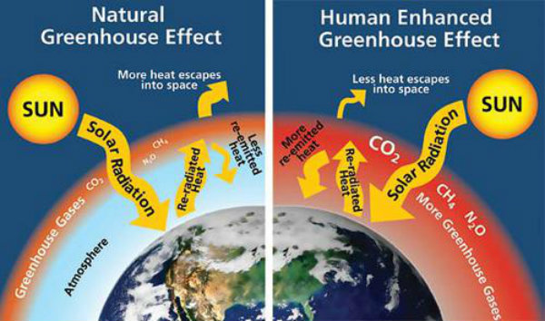
Natural vs. Enhanced CO₂
Notes:
Without an atmosphere, the earth ‘s temperature would be less than 0 degrees F. All water on earth would freeze and life as we know it would not exist. GHG’s are necessary to sustain life on earth. The reason Venus is hotter than Mercury is due to the concentration of GHG. The earth’s GHG levels are on the rise.

Slide 13
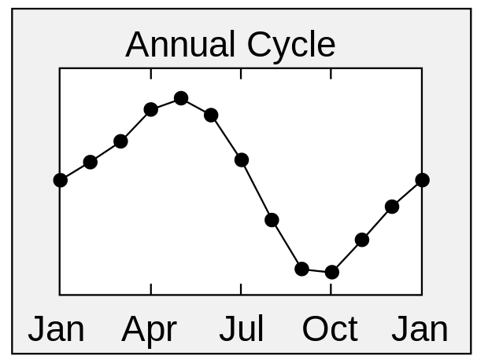

Global CO₂ Concentrations are at Historic Levels
Notes:
CO₂ measurements in Hawaii are at historic levels (+400 ppm).
Images: http://www.esrl.noaa.gov/gmd/webdata/ccgg/trends/co2_data_mlo.png

Slide 14
What are the sources of greenhouse gasses?

Slide 15
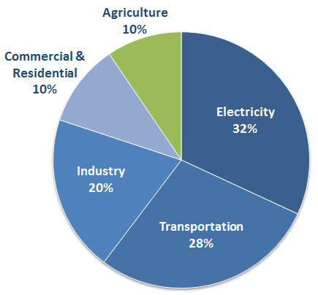
Total U.S. Greenhouse Gas Emissions
Source: EPA.gov
Notes:
¾ of the N₂0 emissions are from Agriculture. Even though N₂0 only makes up about 6% of the GHG budget.
Land Use, Land-Use Change, and Forestry in the United States is a net carbon sink and offsets approximately 15% of these greenhouse gas emissions.
Various management practices for agricultural soils can lead to production and emission of nitrous oxide (N₂O). The large number of different activities that can contribute to N₂O emissions from agricultural lands range from fertilizer application to methods of irrigation and tillage. Management of agricultural soils accounts for over half of the emissions from the Agriculture sector.*
Livestock, especially cattle, produce methane (CH₄) as part of their digestion. This process is called enteric fermentation, and it represents almost one third of the emissions from the Agriculture sector.

Slide 16
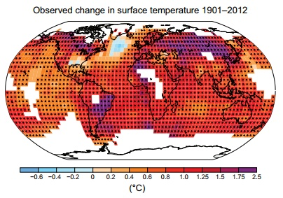
Observed Temperature Changes
Intergovernmental panel on climate change (IPCC)
  World Meteorological Organization and UN Environment Program
  195 members
  Reports are authored by hundreds of leading scientists
“Warming of the climate system is unequivocal, and since the 1950s, many of the observed changes are unprecedented over decades to millennia. The atmosphere and ocean have warmed, the amounts of snow and ice have diminished, sea level has risen, and the concentrations of greenhouse gases have increased.”
.85 deg. C
IPCC Assessment Report (2014)
Notes:
How much is that in degrees F? 2 degrees F approximately.
“Warming of the climate system is unequivocal, and since the 1950s, many of the observed changes are unprecedented over decades to millennia. The atmosphere and ocean have warmed, the amounts of snow and ice have diminished, sea level has risen, and the concentrations of greenhouse gases have increased” (IPCC Assessment Report 2014).

Slide 17
How is the Weather Changing?
What do the following images tell us?

Slide 18
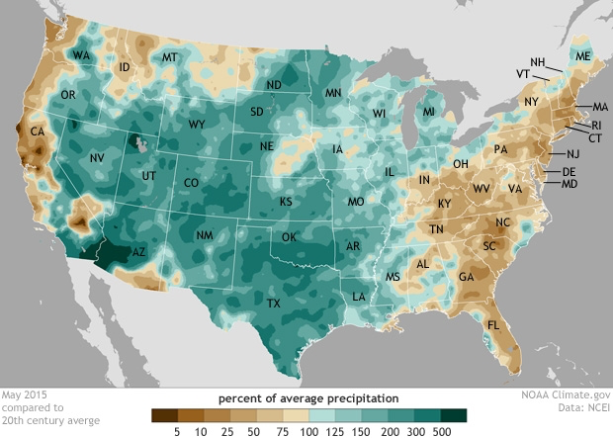
May 2015 was wettest month ever recorded in U.S.
Notes:
Weather makes the news more often than climate, however keeping them separate is important.

Slide 19
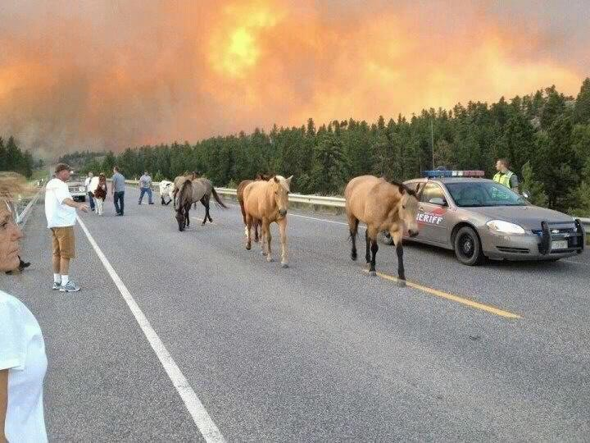
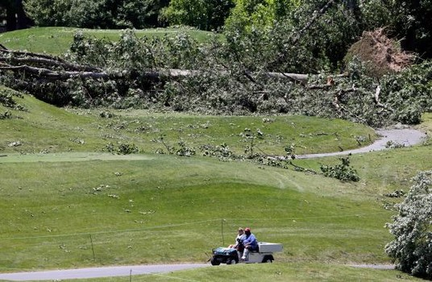
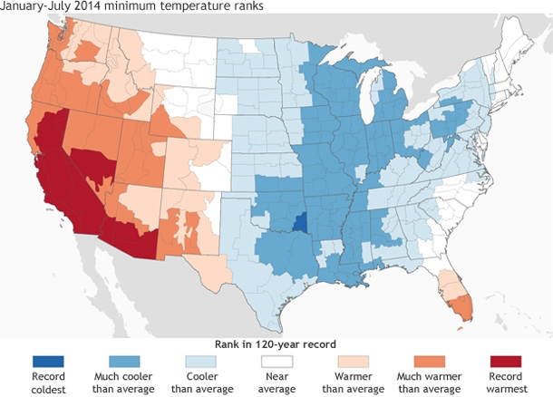
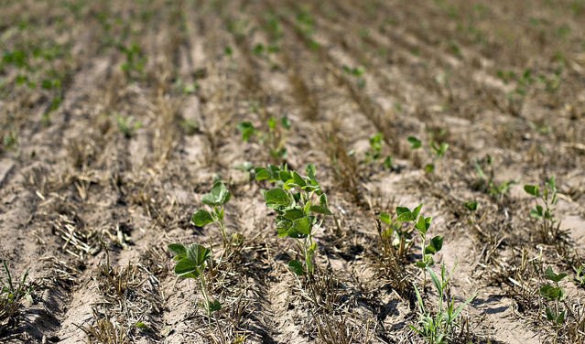
Notes:
Source: http://www.climate.gov/news-features/event-tracker/2014-temperature-extremes-us-runs-hot-and-cold

Slide 20
How is the Climate Changing?
What do the following images tell us?

Slide 21
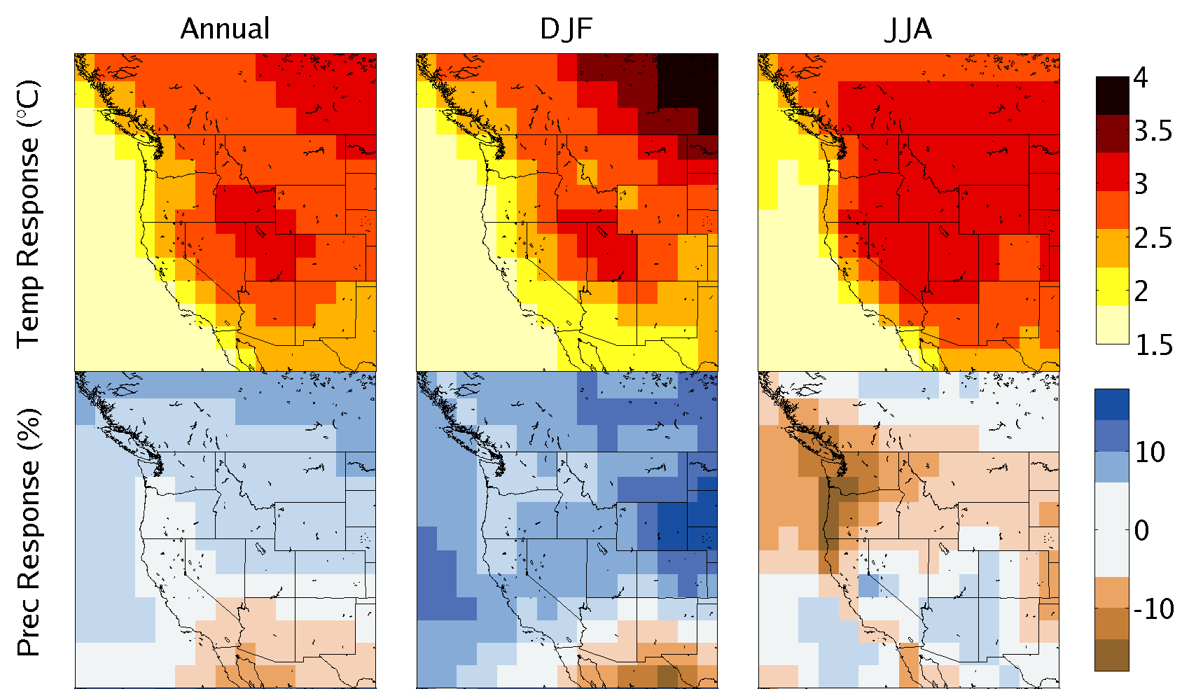
Projected Changes 2031-2060 vs. 1950-1999
CMIP5, RCP85, 28 model average
Notes:
Climatic change models combined give us an average anticipated change in our climate. The Pacific Northwest can expect warmer drier summers and wetter warmer winters, meaning less snow pack and more rainfall.
Projected changes in key climate variables
Comparison to CMIP3
Projections in derived variables
Integrated Scenarios

Slide 22
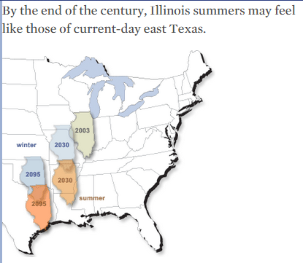
Union of Concerned Scientists
Notes:
Using Illinois summers as an example we see that summer in Illinois is likely to resemble current summers in Texas.

Slide 23
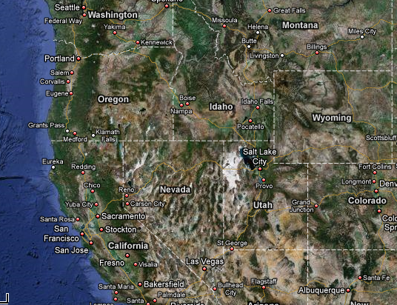
Moscow Summer Temperatures
Current Climate: July TMAX in Moscow ~ 83.5F
Notes:
If we look at the Pacific Northwest & Moscow in particular, we see Moscow summers looking more like …

Slide 24
Moscow Summer Temperatures
2090s: July TMAX in Moscow ~ 91 F
Where do we currently find average high temperatures for July today around 91F?
Notes:
Boise or Reno summers

Slide 25
How will this impact Agriculture?

Slide 26
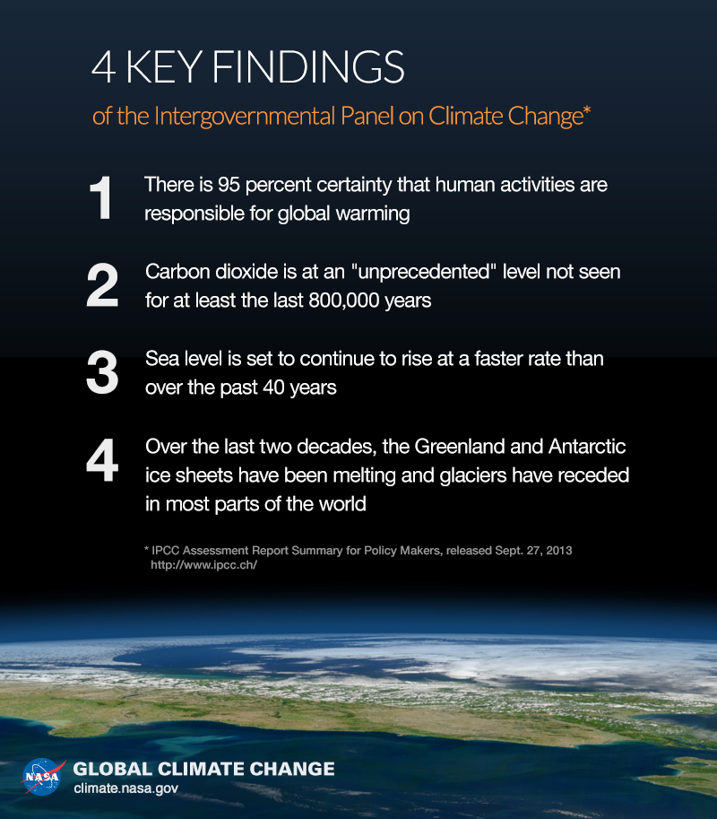
Notes:
What does all this mean, the IPCC has four key findings to ponder.

Slide 27
How will these changes affect Agriculture?
Yields?
Availability of Irrigation Water?
Changes in Pests and Diseases?
Profitability?
What else?
Notes:
Good place to have a class discussion, or in a one to one school to do a quick 10 minute “Webquest and Share” activity where students spend 6-7 minutes searching for possible answers and then share the results with the class.

Slide 28
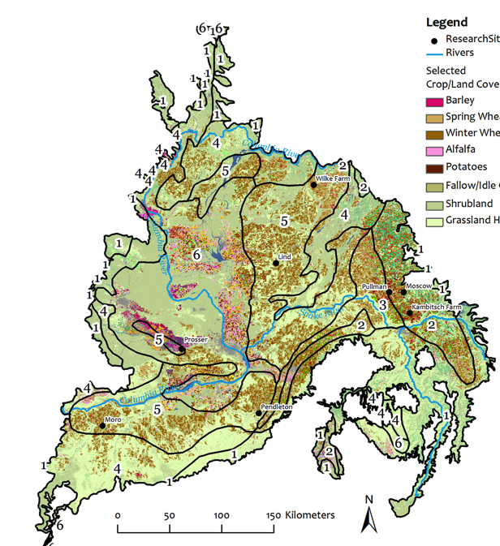
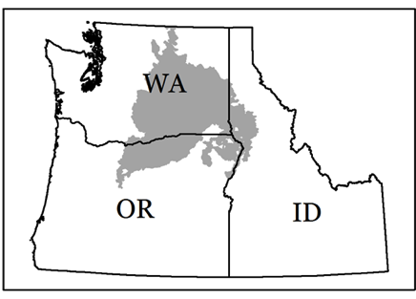





Why should we care about
Agriculture?
www.REACCHPNA.org
Project Director: Sanford Eigenbrode, University of Idaho
Notes:
From Chad Kruger, REACCH Extension Team Lead & Director of WSU Center for Sustaining Agriculture and Natural Resources:
“Snowmelt waters crops in the dry interior, helping the region produce tree fruit (number one in the world) and almost $17 billion worth of agricultural commodities, including 55% of potato, 15% of wheat, and 11% of milk production in the United States.,
Assuming adequate nutrients and excluding effects of pests, weeds, and diseases, projected increases in average temperature and hot weather episodes and decreases in summer soil moisture would reduce yields of spring and winter wheat in rain-fed production zones of Washington State by the end of this century by as much as 25% relative to 1975 to 2005. However, carbon dioxide fertilization should offset these effects, producing net yield increases as great as 33% by 2080.
Agriculture is perhaps best positioned to adapt to climate trends without explicit planning and policy, because it already responds to annual climate variations and exploits a wide range of existing climates across the landscape. Some projected changes in climate, including warmer winters, longer annual frost-free periods, and relatively unchanged or increased winter precipitation, could be beneficial to some agriculture systems. Nonetheless, rapid climate change could present difficulties. Adaptation could occur slowly if substantial investments or significant changes in farm operations and equipment are required. Shifts to new varieties of wine grapes and tree fruit, if indicated, and even if ultimately more profitable, are necessarily slow and expensive. Breeding for drought- and heat-resistance requires long-term effort. Irrigation water shortages that necessitate shifts away from more profitable commodities could exact economic penalties.”

Slide 29
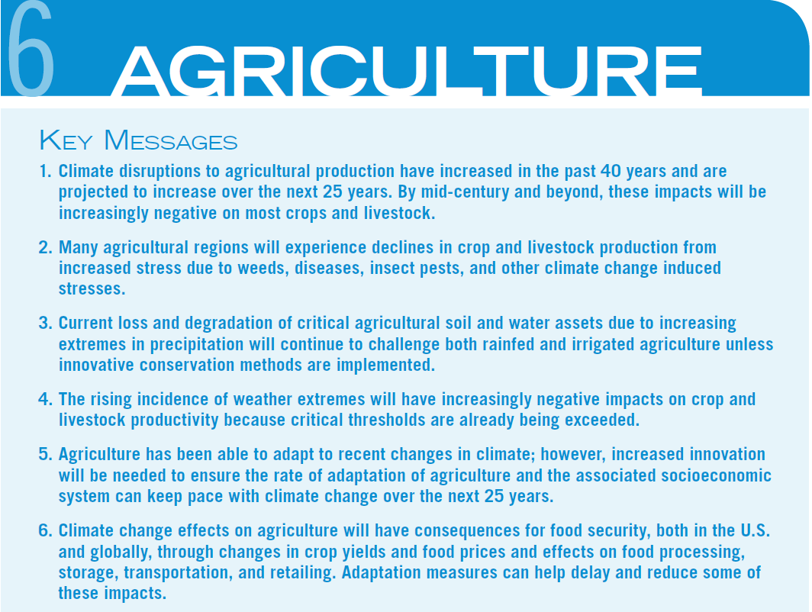
Hatfield et.al. 2014. National Climate Assessment: Agriculture.
Notes:
Six key messages for agriculture are presented on this slide. It is recommended that you print this slide for your classes.

Slide 30
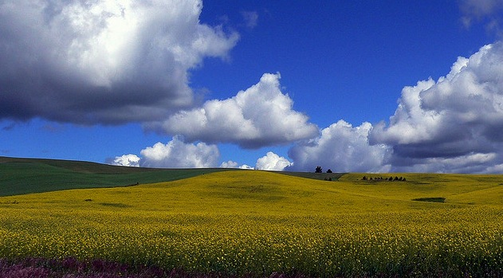
Impacts: Agriculture
Pros (for some crops)
Increased growing season length (3-months in Moscow!)
Potential Increase in yields
Novel crops (vineyards)
Higher CO₂ stimulate plant growth/water efficiency
Cons
Increased irrigation demands*
Increased summer temperatures impact dairy industry and quality of grain proteins
Potential changes in pests and weeds
Stöckle et al. 2009
Notes:
Specific impacts to agriculture are listed to spur discussion, the list is not exhaustive, nor was it intended to be.

Slide 31
Projected Effect on Production by Commodity Group
Eigenbrode et.al., 2013
Notes:
Projected impacts. Additional detail is found in the readings for this unit.

Slide 32
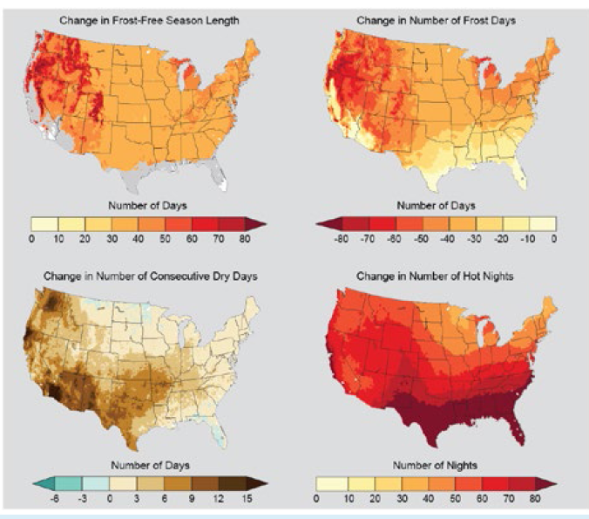
Projected Changes In Key Climate Variables Affecting Agricultural Productivity
Hatfield et.al. 2014. National Climate Assessment: Agriculture.
Notes:
Maps showing projected changes to four key variables are shown. This graphic is directly from the recommended readings.

Slide 33
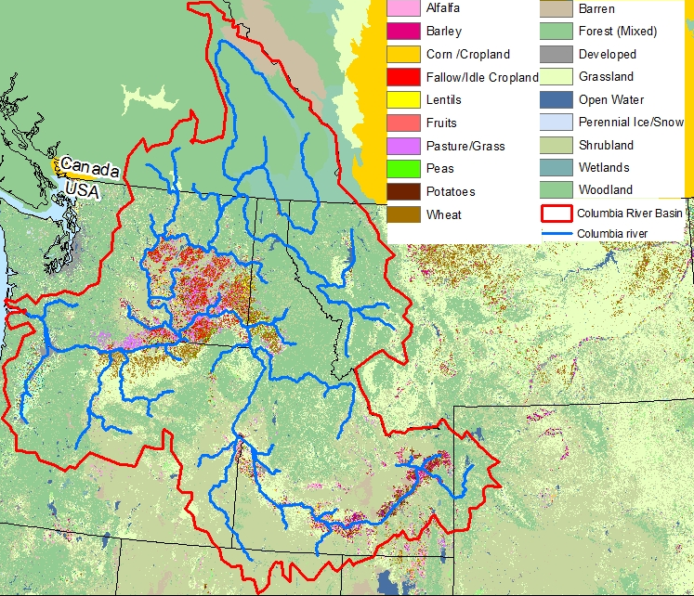
Geographic focus for most REACCH results:
Notes:
REACCH is an USDA-NIFA sponsored research group focused on cereal grain production in the inland Pacific Northwest. Annual reports (reacchpna.org) are filled with short readings students can utilize to explore the impacts of climate change on agriculture. These reports contain short articles intended for agricultural producers and other stakeholders across the region.
Pacific Northwest agricultural systems are highly diverse, ranging from extensive rain-fed livestock grazing to intensive horticultural production systems dependent on irrigation. Major production systems include: extensive livestock grazing; confined animal feeding operations (dairy and feedlot); irrigated field / row crop systems (processed vegetable, forages, grains, etc.); perennial fruits (tree-fruit, vineyards, berries); diversified horticultural farms; and rain-fed cereal grain systems. The evolution of each of these systems is based on a combination of existing agri-climatic conditions, infrastructural investments and continually improving agricultural management systems. A changing climate will likely impact each of these production systems.

Slide 34
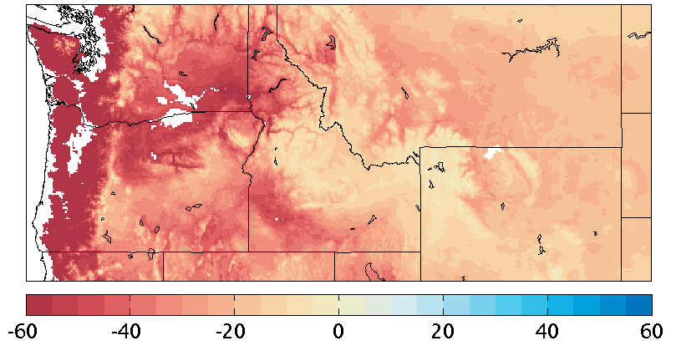
Changes in Snowfall Accumulation
2031-2060 vs. 1950-2005 (14 model mean, RCP45)
Phase transformation of Dai, 2008
Regions with < 25mm SFE accumulation masked out
Notes:
Snowfall accumulation maps show decreasing accumulation over the next several decades. What does less snowpack mean to your school, county, and region?

Slide 35
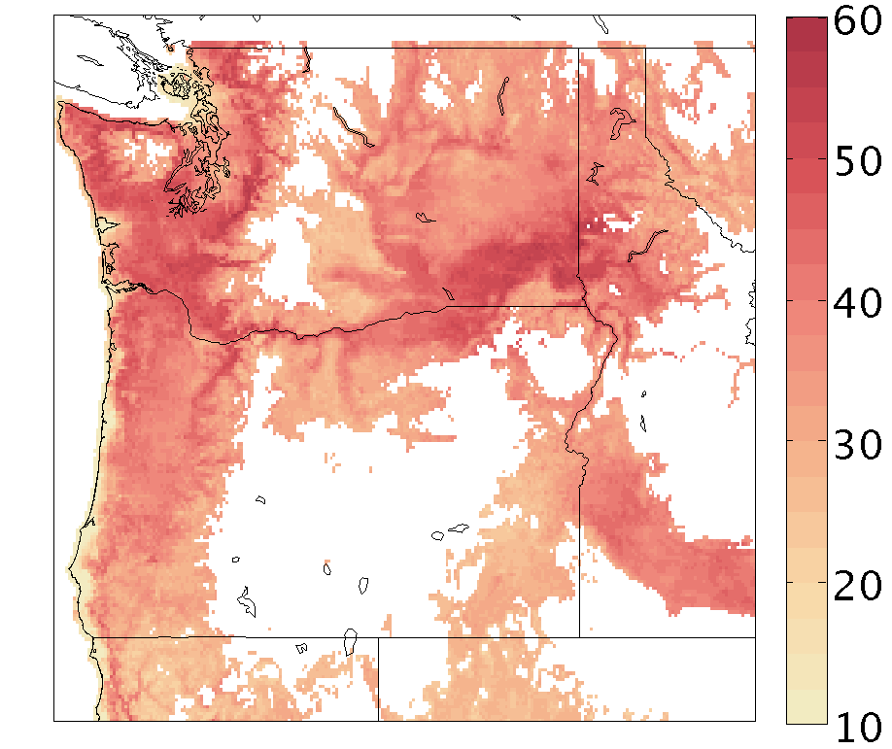
Changes in Growing Season Length
2031-2060 vs. 1950-2005 (14 model mean, RCP45)
Regions with < 60d season length masked out
Notes:
Growing seasons are expected to increase in a large portion of the northwest. What opportunities des a longer growing season provide? How does less snowfall impact those opportunities?

Slide 36
Hardiness Zones vs. Agro-Ecozones
Hardiness zones
  Average annual minimum temperature divided into 10-degree zones
  Used by gardeners and homeowners
Agro-Ecological Classifications
  Classification system which utilizes current climatic data and USDA cropland data imagery, in conjunction with downscaled future climatic scenarios (CMIP-5) to predict both future cultivation frequencies (annual, wheat-fallow, etc) and most prevalent type of agricultural commodity (barley, alfalfa, potatoes, wheat, beans, peas, etc) growing in a region.
Notes:
Hardiness zones have been used for decades to help landowners pick plants that will grow successfully in their region. These maps have been updated by the USDA and the Arbor Day Foundation. The REACCH group has been tracking and forecasting where agronomically important crops are and will be growing in the region. Similar to hardiness zone maps, these classification regions represent the shifting production changes occurring as a result of climate change.

Slide 37
Then and Now
“Maps courtesy The Arbor Day Foundation”
1990
2006
Notes:
Updated maps based on the most recent 15 & 30 year climate data show a northward migration of warmer zones.

Slide 38
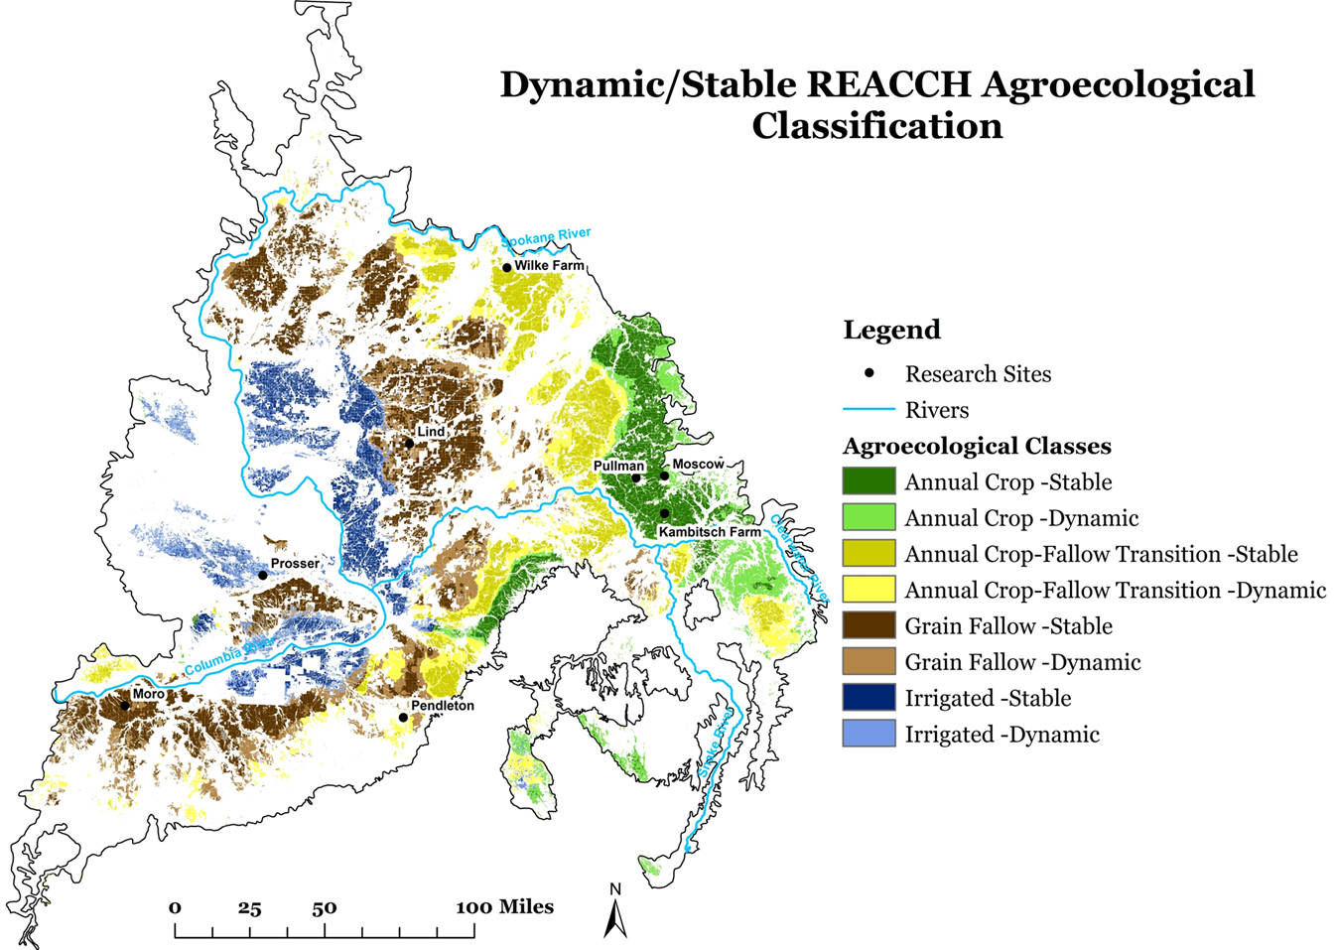
Dynamic vs. Stable Growing Agro-ecological Classes
Stable zones are those areas which are most likely to maintain their current crop rotations in the future
Dynamic zones are those areas whose classifications are most likely to be impacted by future climatic changes
Notes:
Agro-ecological classes which are dynamic represent areas which are likely to change under future climatic conditions. Stable classes are likely to maintain current practices

Slide 39
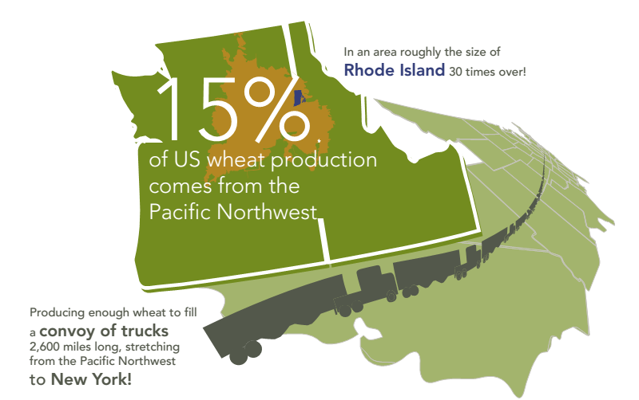
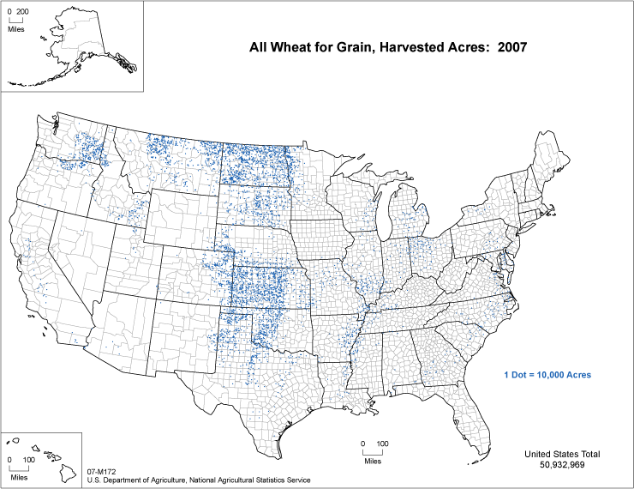
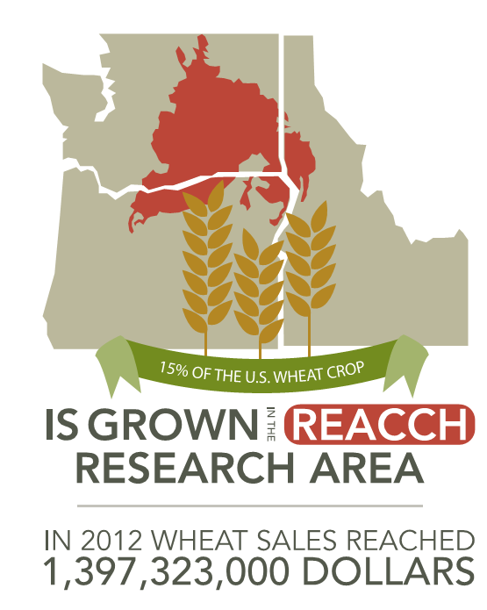
REACCH Domain

Slide 40
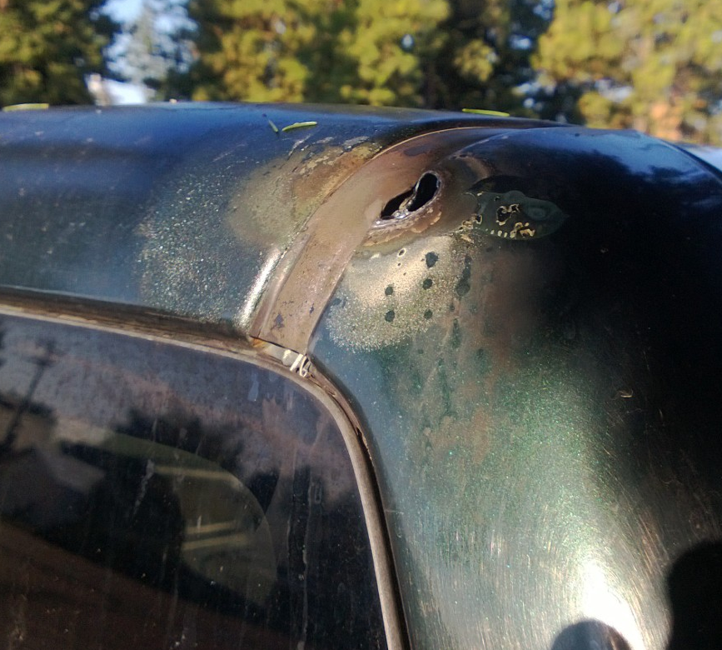
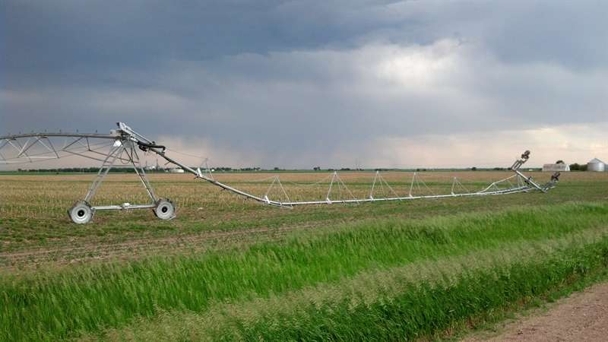
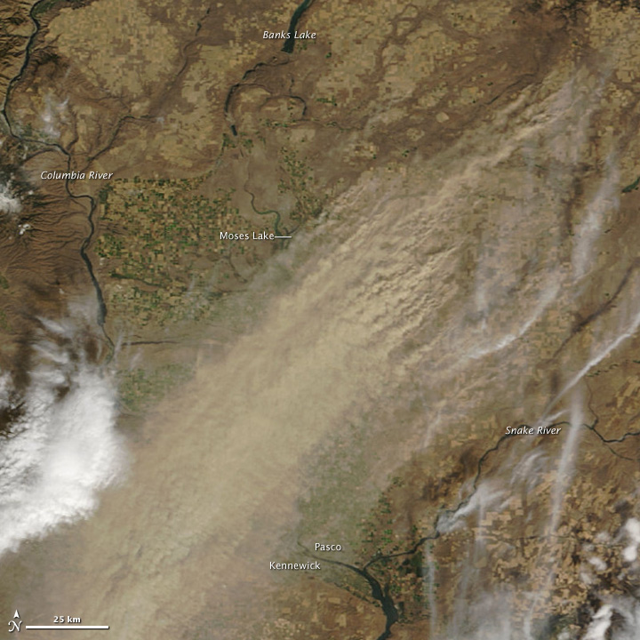
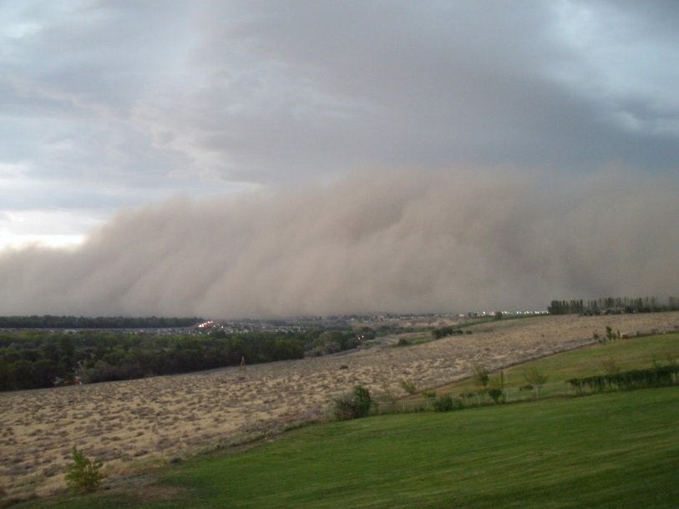
talk.newagtalk.com
Extremes and Meteorological Events Are More Critical Than Average Climate Trends
Dennis L. Homan
Scablander.blogspot.com
NASA Earth Observatory
Notes:
Crops are sensitive to extreme weather events. In addition, false spring conditions can spur crop growth and lead to loss when temperatures drop below freezing.

Slide 41
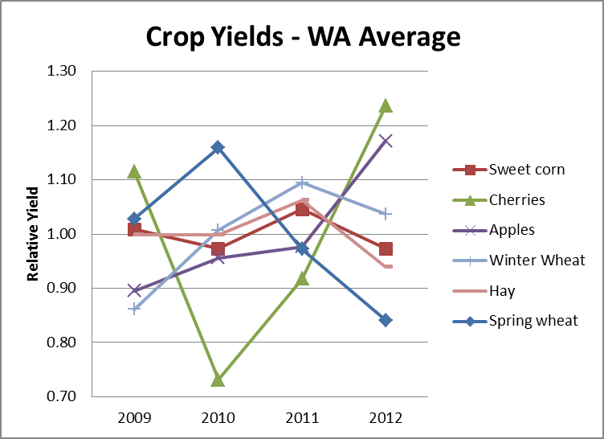
Seasonal variability affects crop yields NOW!
NASS Yield Surveys
Notes:
From Chad Kruger, REACCH Extension Team Lead & Director of WSU Center for Sustaining Agriculture and Natural Resources:
“Use this data simply to show that PNW farmers already deal with a tremendous amount of inter-annual variability when it comes to crop yields – with yield variability ranging from +-5% to +-25%. It’s SUPER IMPORTANT TO NOT CONVEY THE IDEA THAT THIS YIELD VARIABILITY IS EXCLUSIVELY DRIVEN BY CLIMATE VARIABILITY OR ENSO. Some of this effect is definitely climate, but there are a lot of artifacts in NASS data – particularly for the perennials (average age of plantings, whether the full crop was harvested or not, technology, etc.). Even the climatic effects are often not generalizable to ENSO (e.g. random late freeze / frost, etc.). It’s nearly impossible to compare NASS data with ENSO cycles and produce a statistically meaningful correlation – Scott Yates just wrote an article on this in Wheat Life. The biggest message in showing this data is to bound the later yield forecasts. People tend to get excited when they see projected yields +-10% in a future forecast, but that’s really “noise” compared to what we already manage for most crops. That’s the point. Anything we forecast that’s less than 10% relative yield I think can largely be ignored as meaningless. Beyond 10%, then you need to start asking the question of what’s going on here and is there a minor management manipulation (planting date) that can be made that reduces the difference to <10%. This is why I’ve been saying for a long time that I think for PNW ag production, climate variability is more important than change for at least the first half of the century – because the change signal is dwarfed by the variability signal at least that far into the future.”

Slide 42
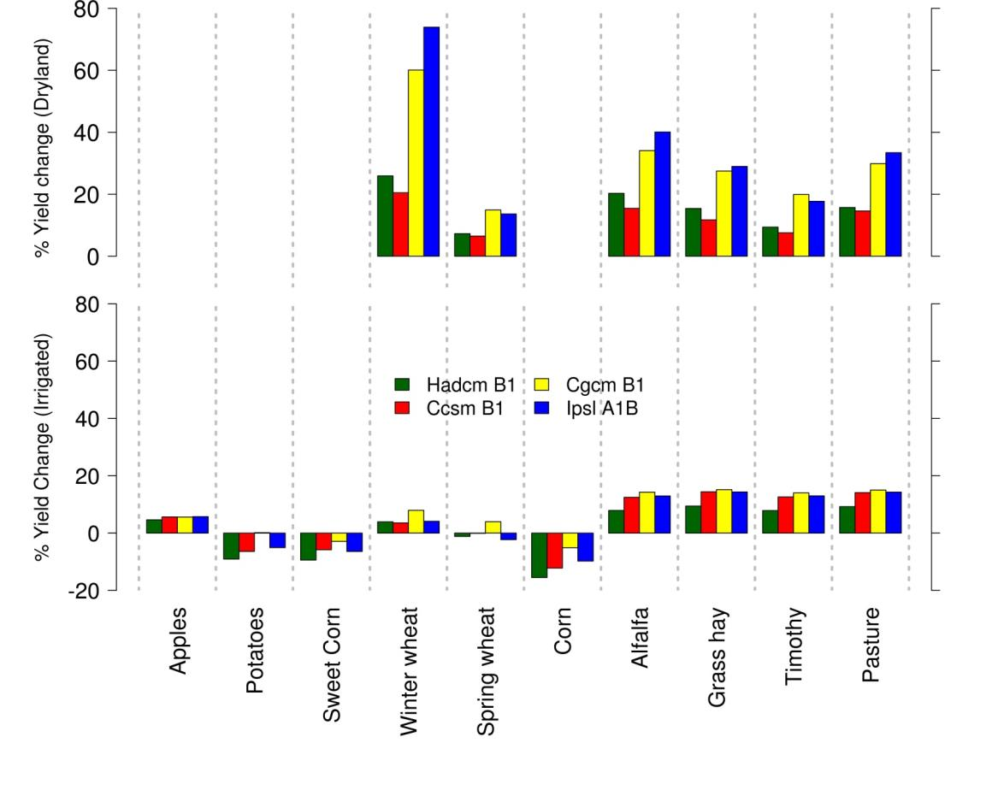

Year 2030 Projected Impacts on WA Crop Yield: GCM Ensemble
Rajagopalan et.al. in prep.
Notes:
Mixed forecasts depending upon the crop and the availability of water.

Slide 43


What have we learned?
Climate defines the western US
Climate models provide best guidance on future climates
Most models reasonably simulate climate of the region
Regional warming by 2-7F by mid-21st century
Slight increase in precipitation, far less precipitation as snow
Where can I find current regional information?
Dr. Abatzoglou, jabatzoglou@uidaho.edu
http://climateinw.wordpress.com
Notes:
John is the REACCH Geography Team Member (climatology, mapping, etc) and maintains the climate site listed. He welcomes any questions you may have.

Slide 44
Scientific Consensus?

Slide 45
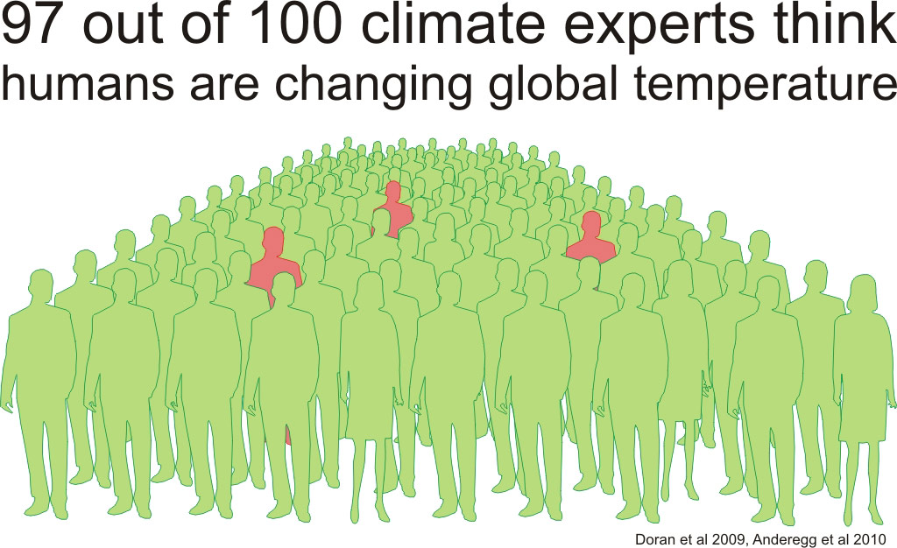
Notes:
Consensus by the majority of the scientific community (97%) is that climate change is occurring.

Slide 46
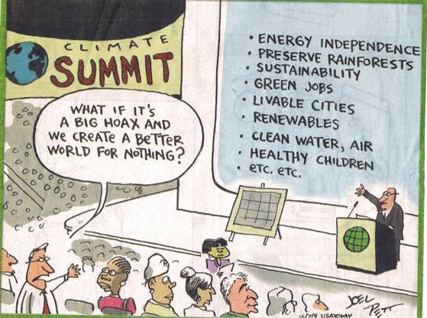
Notes:
For a similar argument consider: What's the Worst That Could Happen?: A Rational Response to the Climate Change Debate By Greg Craven who also has several YouTube videos of his analysis.

Slide 47
Still Skeptical?
Even if you are a skeptic of long term forecasts:
  Seasonal changes in the short term greatly impact the bottom line
  Knowing what to expect over the next 5 years could make/break your farm/ranch.
  Planning properly could improve yields and add more money to your bank accounts.
Understanding (regardless of belief) directly impacts the farmers’ bottom line!

Slide 48
Conclusion
The image below is an embedded MS Word Document. For many users you can simply double click on it to open it in a MS Word Editing window. If this does not work on your computer then right click on the image and go to “Document Object” and click “Open”
Review
All four of the references included at the beginning of this plan are excellent. Choosing one or two to have the students read during the time spent teaching the unit could greatly improve student participation.
Invite a scientist into your classroom. Given current Skype technology, any scientist can easily be in your classroom with little effort. If you need a suggestion, or would like to use a REACCH scientist, contact Dr. Kattlyn Wolf, kwolf@uidaho.edu or Dr. Jodi Johnson-Maynard, jmaynard@uidaho.edu to help arrange an expert Skype or possibly an in-person presenter.
Evaluation
Several lab activities are available to enhance student understanding:
  Climate Change Greenhouse Effect Lab
Opinion Papers before and after, “What do you think?”
  Before teaching the unit: 1-page essay outlining students beliefs relating to climate change
  After teaching the unit, 2-page essay: “How have your opinions been impacted by this information?”
  To increase student autonomy, it is recommended that you don’t give any suggestions about your own beliefs, what you think they should include, or explaining what is climate change.
Double click to open Lab activity

